Slide 1
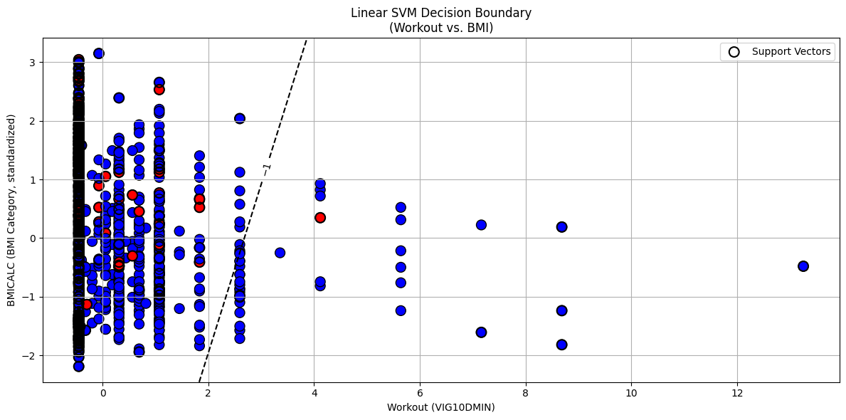
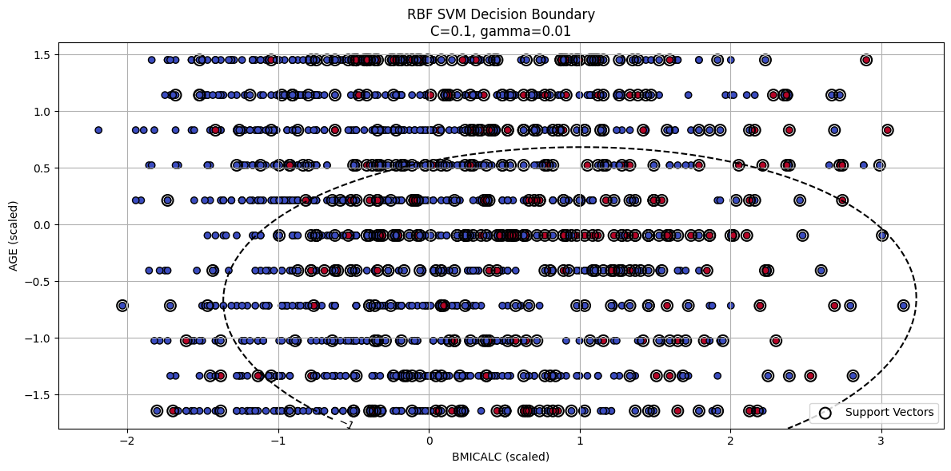
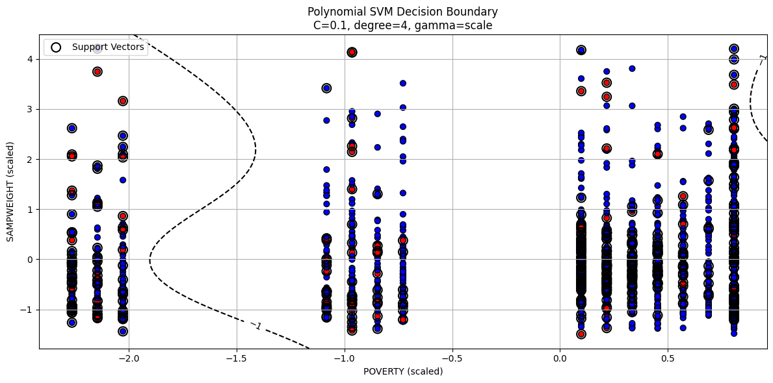
Predicting Diabetes Outcomes Using Support Vector Machines (SVMs) Evidence from NHIS 2022 Health Survey
By Surya Kailash Ramesh
Abstract
This project investigates the relationship between health behaviors and the diagnosis of diabetes among U.S. adults using the 2022 National Health Interview Survey (NHIS) dataset. I have applied Support Vector Machine (SVM) classifiers with linear, radial basis function (RBF), and polynomial kernels to predict diabetes presence based on demographic, sleep, diet, and physical activity variables. Feature selection, hyperparameter tuning, and decision boundary visualizations are presented to highlight key predictors of health outcomes.
Methodology
Data Preparation:
Variables selected: AGE, SEX, BMICALC, CIGDAYMO, HRSLEEP, VIG10DMIN, PIZZANO, FRIESPNO, SODAPNO.
Target variable: DIABETICEV (diagnosed with diabetes or not).
Categorical values cleaned (unknowns 7-9, 97-999 treated as NA).
Feature Selection:
Linear SVM: L1-penalized SVC + RFE.
RBF/Poly: Top 5 features via Random Forest.
Modeling: Kernels: Linear, RBF, Polynomial.Tuned using GridSearchCV (5-fold CV).
Introduction
Goal: Predict diabetes diagnosis using demographic and behavioral data.
Data: NHIS 2022, ~9 health behavior variables selected based on codebook.
Research Question: Which daily habits and characteristics are predictive of diabetes risk?
Models Used: SVMs (Linear, RBF, Polynomial).
Discussion
Using SVM models, we explored how demographics and lifestyle behaviors predict diabetes in adults aged 50–60.
Linear SVM revealed BMI, sleep hours, and pizza consumption as key predictors.
RBF SVM captured non-linear relationships, especially involving vigorous physical activity and BMI, achieving the best accuracy.
Polynomial SVM showed moderate performance but required careful tuning to avoid overfitting.
Overall, physical activity, diet habits, and basic demographics emerged as strong predictors of diabetes, with non-linear models offering improved classification over linear methods.
Advantages
Effective in high-dimensional spaces
Can model complex, non-linear relationships using kernel tricks
Disadvantages
Computationally expensive on large datasets
Kernel and parameter tuning can be non-trivial
Future Scope
Extend to broader age groups and other chronic diseases
Apply deep learning or ensemble models for performance gains
Technical Background
Support Vector Machines (SVMs) are supervised learning models mainly used for classification. SVM finds the optimal hyperplane that separates classes with the largest possible margin, improving the model’s ability to generalize.
Key Concepts:
Hyperplane: A boundary that separates classes, defined by \( w^T x + b = 0 \).
Support Vectors: The closest data points to the hyperplane, critical in shaping it.
Margin: The distance between support vectors and the hyperplane; larger margins are better.
Kernel: A function that maps data to higher dimensions to handle non-linear separation.
Hard Margin vs. Soft Margin: Hard margins require perfect separation; soft margins allow some misclassification to better handle real-world data.
C Parameter: Controls the trade-off between maximizing margin and minimizing errors.
Conclusion
Support vector machines effectively predicted diabetes risk from lifestyle and demographic factors. The RBF kernel SVM achieved the highest accuracy, highlighting the importance of non-linear patterns. Findings suggest promoting physical activity, healthy eating, and regular screening to reduce diabetes risk in middle-aged adults.
Computational Results
Model | Best Params | Accuracy
Linear SVM | C=0.01 | 0.8559
RBF SVM | C=0.1, gamma=0.01 | 0.8559
Poly SVM | C=0.1, degree=4, gamma: scale | 0.8579
References
"sklearn.svm.LinearSVC." scikit-learn: Machine Learning in Python, version 1.6.1, 2025, https://scikit-learn.org/stable/modules/generated/sklearn.svm.LinearSVC.html.
GeeksforGeeks. "Feature Selection Using Random Forest." GeeksforGeeks, 2025, https://www.geeksforgeeks.org/feature-selection-using-random-forest/.
Lynn A. Blewett, Julia A. Rivera Drew, Miriam L. King, Kari C.W. Williams, Daniel Backman, Annie Chen, and Stephanie Richards. IPUMS Health Surveys: National Health Interview Survey, Version 7.4 [dataset]. Minneapolis, MN: IPUMS, 2024. https://doi.org/10.18128/D070.V7.4. Links to an external site.http://www.nhis.ipums.orgLinks to an external site..

