Slide 1
Exploring Youth Drug Use with Decision Trees
By
Suryakailash Ramesh

Slide 2

Research Questions
Can peer/school/family factors predict alcohol use? (Binary Classification: ALCFLAG)
Can we classify cigarette use into low/medium/high levels? (Multi-Class: IRCIGFM)
How many days per month does a youth smoke? (Regression: CIGMDAYS)

Slide 3
Dataset Overview
Source: 2020 NSDUH (National Survey on Drug Use and Health)
Target Population: Youth under 18
Selected Features: Demographics, peer/parent influence, drug education, and youth experiences
Preprocessing:
Used imputed variables (e.g. IRCIGFM)
Handled missing values

Slide 4
Modeling Approach
Models Used:
Decision Tree
Random Forest
Bagging (Bootstrap Aggregating)
Boosting (Gradient Boosting / AdaBoost)
Key Steps:
Train-test split
Hyperparameter tuning with GridSearchCV
Evaluation: Accuracy, Precision, Recall, RMSE (for regression)

Slide 5
Important variables
Variable | Description
FRDMJMON | Number of close friends who use marijuana at least once a month
FRDPCIG2 | Number of close friends who smoke cigarettes at least once a month
PRMJEVR2 | Parent(s) talk to youth about dangers of marijuana (Yes/No)
STNDSMJ | Perceived risk of smoking marijuana once or twice a week
PRMJMO | Number of days youth used marijuana in the past 30 days
PARCHKHW | Parent(s) check if youth has done their homework
FRDMEVR2 | Number of close friends who ever used marijuana
PRLMTTV2 | Parent(s) limit amount of time youth can watch TV
PRGDJOB2 | Parent(s) praise youth for doing a good job (e.g., verbal encouragement)

Slide 6
Binary Classification (ALCFLAG)

Slide 7
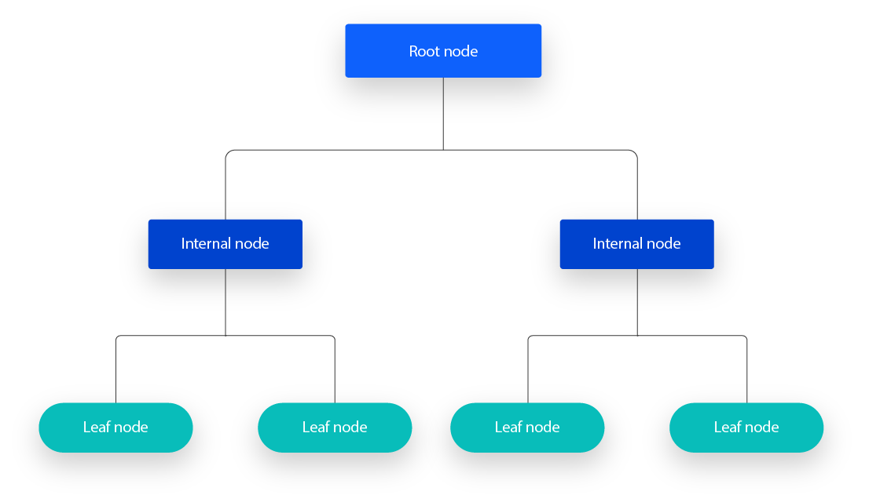
Decision Tree Classifier
A decision tree is a flowchart that helps you visualize and compare different options,
It is supervised learning algorithm, which is utilized for both classification and regression tasks.
Advantages
Easy to interpret
More flexible
Disadvantages
overfitting
greedy search
"What Are Decision Trees?" IBM, www.ibm.com/think/topics/decision-trees. Accessed 14 Apr. 2025.

Slide 8
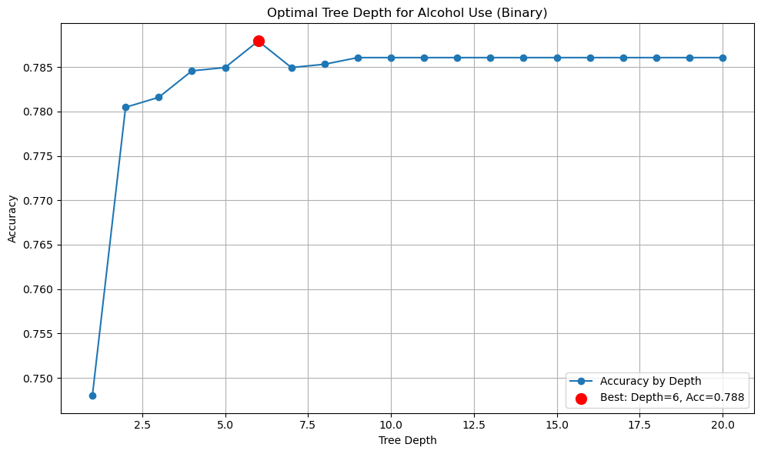

Slide 9
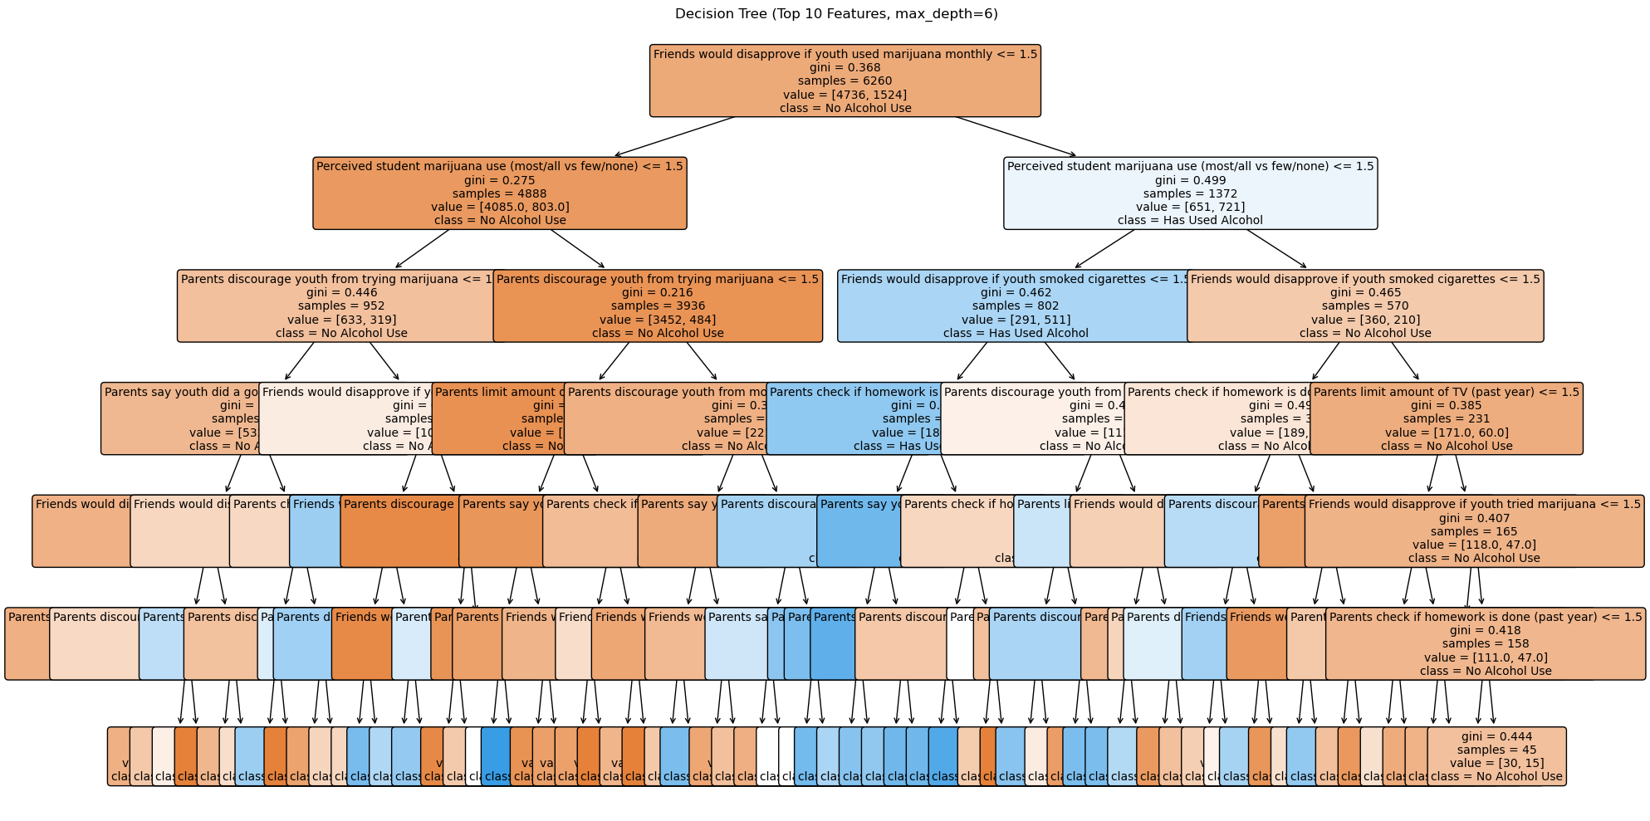
Decision Tree Classifier
Goal: Predict if youth has tried cigarettes
Top Features: Peer disapproval, parental checks, marijuana usage
Accuracy:
Train = 80%,
Test = 78%
Interpretation: Strong influence of peer and parental behavior

Slide 10
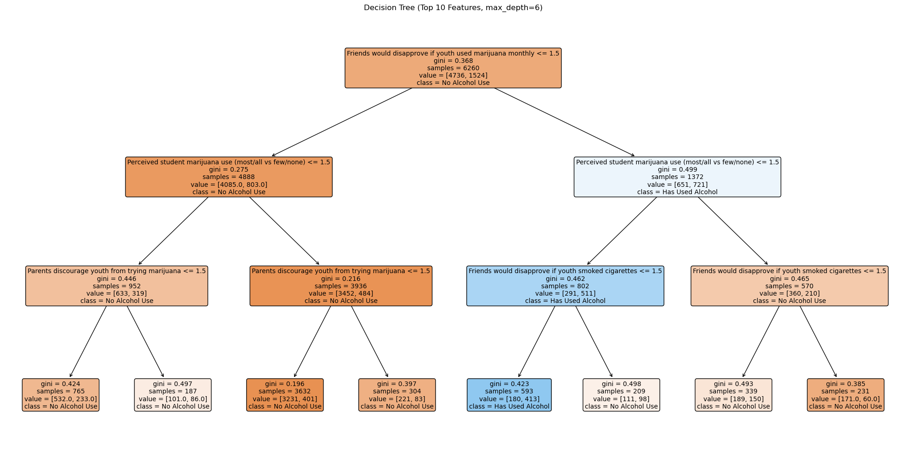
Understandable Tree

Slide 11
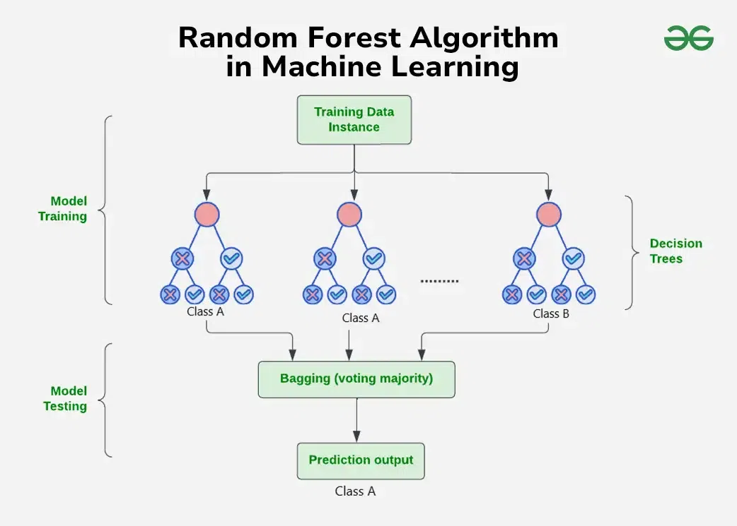
Random Forest Classifier
Random Forest builds multiple decision trees and combines their outputs to improve accuracy and control overfitting.
Advantages
High Accuracy
Reduces Overfitting
Disadvantages
Hard to Interpret
Slower Predictions
Accuracy:
Train = 80%,
Test = 78%
"Random Forest Algorithm in Machine Learning." GeeksforGeeks, 2 Jan. 2023, www.geeksforgeeks.org/random-forest-algorithm-in-machine-learning/. Accessed 14 Apr. 2025.

Slide 12
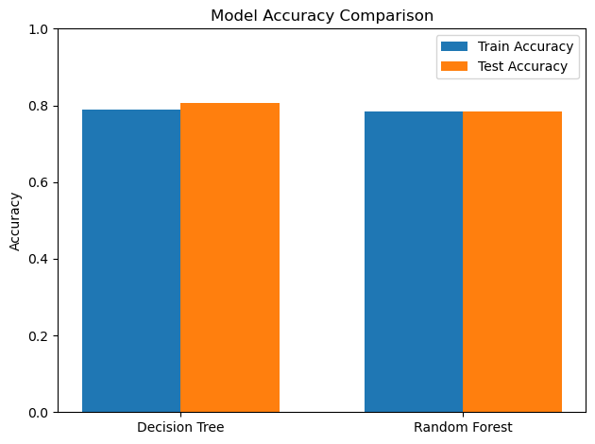
Compare the RF and DT

Slide 13
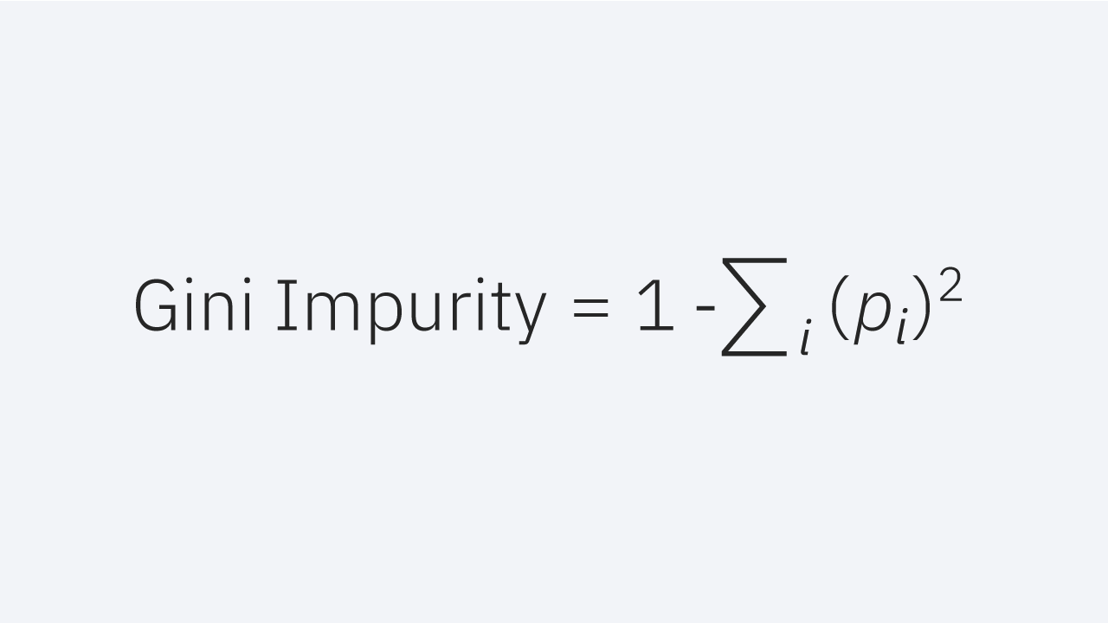
Gini Impurity
The Gini Index measures how “pure” or “impure” a node is in a decision tree.
Interpretation:
Gini = 0: Perfectly pure
Higher Gini: More mixed
Maximum Gini : evenly distributed
pi​ = proportion of samples belonging to class i

Slide 14
Multi-class Classification: IRCIGFM

Slide 15
Multi-class classification
Multi-class classification is a type of supervised learning problem where the goal is to classify inputs into one of three or more discrete classes.
Classifying types of cigarette use as Low, Medium, or High.
Target variable with more than 2 classes
Evaluation Metrics:
Accuracy
Precision / Recall / F1-score

Slide 16
Gradient Boosting
Gradient Boosting is an ensemble learning technique that builds a strong predictive model by combining many weak learners in a sequential manner.
It Measures errors (residuals) from predictions.
It minimizes the loss function by gradient descent, where each new learner takes a step in the direction that reduces the error.
Advantages
High predictive accuracy
Works well with non-linear data
Disadvantages
Slower
Can overfit
"What Are Decision Trees?" IBM, www.ibm.com/think/topics/decision-trees. Accessed 14 Apr. 2025.

Slide 17
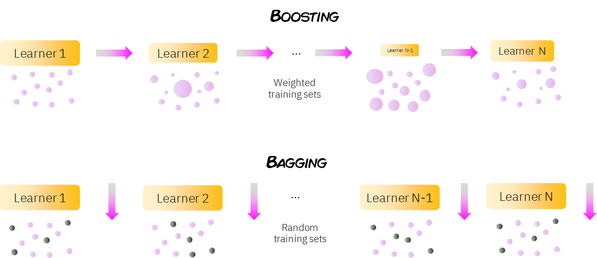
Difference Between
"Boosting in Machine Learning: A Simple Explanation." How to Learn Machine Learning, www.howtolearnmachinelearning.com/articles/boosting-in-machine-learning/. Accessed 14 Apr. 2025.

Slide 18
Grid Search-CV
It searches exhaustively over a grid of hyperparameter combinations, training and evaluating the model on multiple folds of the data to find the best settings.
How it Works:
You define:
A model (e.g., DecisionTreeClassifier)
A parameter grid (e.g., max_depth, min_samples_split)
A scoring metric (e.g., accuracy, R²)
It performs:
A cross-validation loop for each combination
Evaluates model performance using the scoring metric
It returns:
The best combination of parameters
The best score achieved
"GridSearchCV for Beginners." Towards Data Science, 28 Nov. 2020, towardsdatascience.com/gridsearchcv-for-beginners-db48a90114ee. Accessed 14 Apr. 2025.

Slide 19
Steps and models
"sklearn.feature_selection.SelectKBest." scikit-learn: Machine Learning in Python, scikit-learn.org/stable/modules/generated/sklearn.feature_selection.SelectKBest.html. Accessed 14 Apr. 2025.
Filters the dataset to include only predictor variables and the target IRCIGFM
Keeps only classes of IRCIGFM that have at least 2 samples to ensure model stability
Selects the top 10 most important features
A grid of hyperparameters to tune with GridSearchCV
Decision Tree, Random Forest, Gradient Boosting

Slide 20
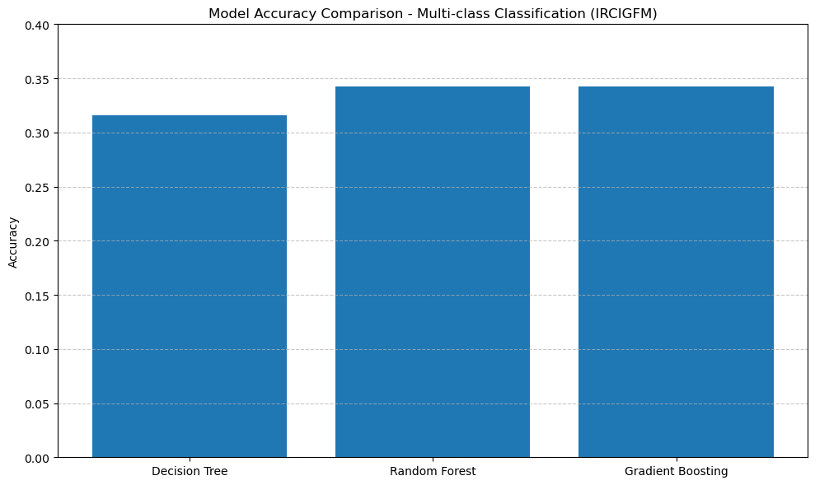
GridSearchCV
Tuning Decision Tree...
✅ Best Params for Decision Tree: {'max_depth': 3}
🎯 Accuracy: 0.3158
Tuning Random Forest...
✅ Best Params for Random Forest: {'max_depth': 5, 'n_estimators': 100}
🎯 Accuracy: 0.3421
Tuning Gradient Boosting...
✅ Best Params for Gradient Boosting: {'learning_rate': 0.01, 'max_depth': 1, 'n_estimators': 20}
🎯 Accuracy: 0.3421

Slide 21
Regression: CIGMDAYS

Slide 22
Regression
Regression is a type of supervised learning used when the target variable is continuous.
How many days per month does a youth smoke cigarettes?
Evaluation Metrics:
Accuracy
Precision / Recall / F1-score
MSE/MAE and R2

Slide 23
Steps and models
Goal: Clean the dataset by handling special codes and missing values.
Number of days youth smoked in the past month.
A grid of hyperparameters to tune with GridSearchCV
Decision Tree, Random Forest, Gradient Boosting

Slide 24
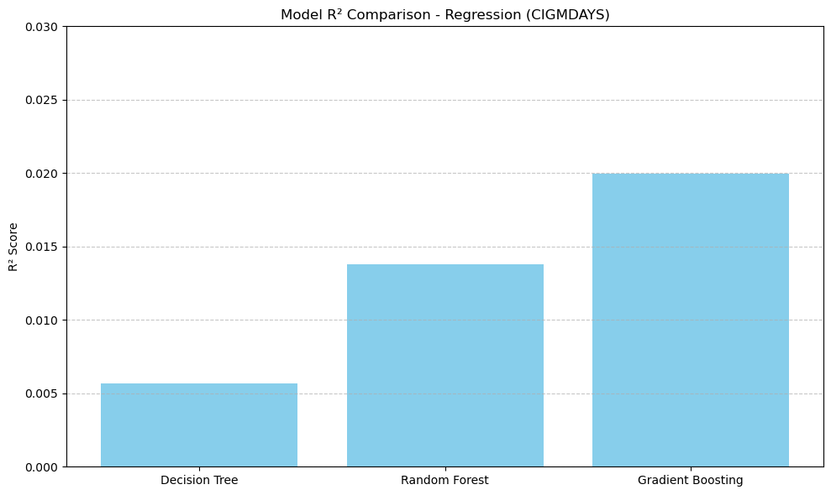
GridSearchCV
Regression Model Evaluation:
Decision Tree
R² Score: 0.0057
MAE: 0.1116
RMSE: 0.5079
Random Forest
R² Score: 0.0138
MAE: 0.1110
RMSE: 0.5058
Gradient Boosting
R² Score: 0.0200
MAE: 0.1141
RMSE: 0.5042

Slide 25
Summary
Model | Accuracy | Interpretability | Speed | Overfitting Risk | Tuning Needed
Decision Tree | 🟡 Medium | 🟢 High | 🟢 Fast | 🔴 High | 🟢 Low
Random Forest | 🟢 High | 🟡 Medium | 🟡 Medium | 🟢 Low | 🟡 Medium
Gradient Boosting | 🟢 Very High | 🔴 Low | 🔴 Slow | 🟡 Medium | 🔴 High

Slide 26
Thank you

