Slide 1


IET CLN SMART CITY CHALLENGE 2019
I-CAR
Idea Proposed By
ATCHAYA.S - SRMIST (VDP)
SRIPRIYADHARSHINI.L - SRMIST (VDP)
SURYA KAILASH R - SRMIST (VDP)
Category: Smart Transport

Slide 2

Objective
TO REDUCE THE EFFECT ON HUMAN
EFFICIENT IN ALL CLIMATE
REDUCE IN COST
NO PENETRATION
2

Slide 3
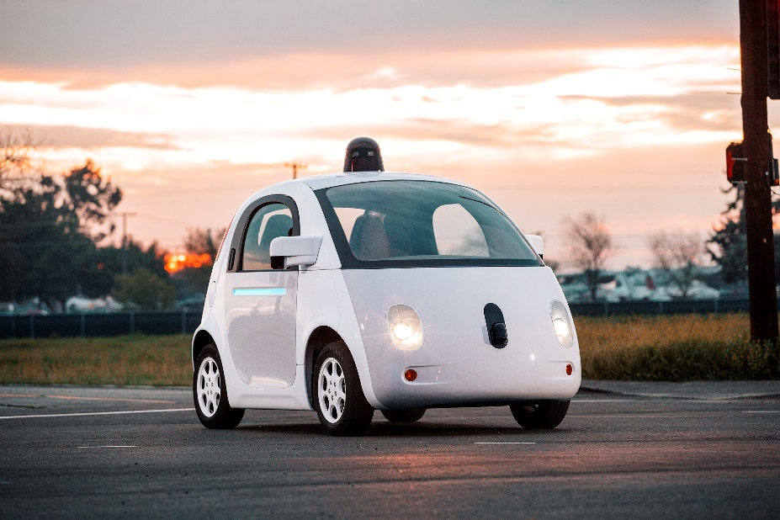
Motivation
Most major manufacturers like Tesla, GM, Ford, BMW, and Waymo/Google are working on building and testing different types of autonomous vehicles.
Things that are the reason drawback of existing system :-
Potential For Technology To Go Wrong
Expensive
Affect the human health

Slide 4
Problem Definition
01
AFFECTS HUMAN EYE IN CASES THE BEAM IS POWERFUL
02
ELEVATION ERRORS DUE TO INABILITY TO PENETRATE VERY DENSE FORESTS
03
INEFFECTIVE LOW HANGING CLOUDS
04
DEGRADED AT REFLECTIONS
05
INABILITY TO PENETRATE THICK VEGETATION

Slide 5

Proposed Solution
I-CAR
A
B
C
D
E
CAMERA
IMAGE PROCESSING
NEURAL NETWORK
ALGORITHM
I-CAR

Slide 6
Proposed Solution
IMAGE PROCESSING
1. COMPUTER VISION
1. COMPUTER VISION
2. THE PERCEPTRON
2. THE PERCEPTRON
3. KERAS
1
Add your description here. This is a placeholder for the text.
2
Add your description here. This is a placeholder for the text.
3

Slide 7




Proposed Solution
SMOOTH MAX
MNIST
Deep Learning
CROSS ENTROPY
Le NET

Slide 8
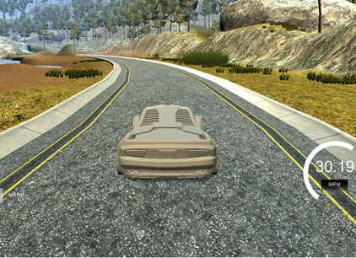
Proposed Solution
PREDICTED OUTPUT

Slide 9
Problem in Implementation
HIGHLY EFFICIENT CONTROL UNIT
HIGH DEFINITION CAMERA

Slide 10
THANK YOU

