Slide 1
<JavaScript>

Slide 2
What is JavaScript?
JavaScript is a scripting language most often used for client-side web development.
Create interactive user interface in a web page (e.g., menu, pop-up alert, windows, etc.)
JavaScript (JS) is a programming language mostly used client-side to dynamically script web-pages, but often also server-side, using packages such as Node.js
Its various framework are Angular,React Native.

Slide 3
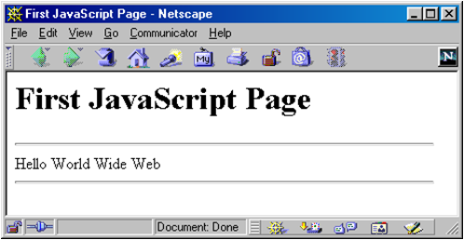
<script> Tag
<script> Tag
<html>
<head><title>First JavaScript Page</title></head>
<body>
<h1>First JavaScript Page</h1>
<script type="text/javascript">
document.write("<hr>");
document.write("Hello World Wide Web");
document.write("<hr>");
</script>
</body>
</html>

Slide 4
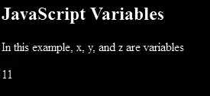
Variables and Variable Declaration
<p>In this example, x, y, and z are variables</p>
<p id="sum"></p>
<script>
var x = 5;
var y = 6;
var z = x + y;
document.getElementById("sum").innerHTML = z;
</script>

Slide 5
What are Identifiers?
# All JavaScript variables must be identified with unique names.
# These unique names are called identifiers.
# Contains only 'A' – 'Z', 'a' – 'z', '0' – '9', '_', '$'
# Case-sensitive

Slide 6
JavaScript Data Types
DATA TYPES
Primitive Data Types
Non-Primitive
Data Types
Number
String
Array
Object
Boolean

Slide 7
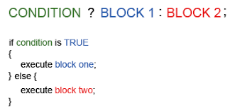
Conditional Statements
# "? :" ternary conditional statement
# “if” statement
# “if … else” statement
# “switch” statement

Slide 8
Operators
<Assignment>
<Arithmetic>
Operators are : +, -, *, /, %
Operators are : =, += ,-= ,*= ,/=
<Comparison>
Operators are : ==, !=, >, >=, <, <=, ===
<Logical>
Operators are: &&,||, !

Slide 9

Loop Statements and Control-Flow Statements
# “for” Loops
# “for/in” Loops
# “while” Loops
# “do … while” Loops
# “break” statement
# “continue” statement
# “return” statement

Slide 10
Functions
# Definition
Function is a block of code designed to perform a particular task.It is executed only when someone “invokes” the function(calls it).
# Example
var x = myFunction(4, 3);
function myFunction(a, b) {
return a * b; // Function returns the product of a and b
}
Output : 12

Slide 11
Events
# An event occurs as a result of some activity.
#Example
A user clicks on a link in a page.
Page finished loaded.
Mouse cursor enter an area.
A preset amount of time elapses.
A form is being submitted.

Slide 12
EventHandlers
# Event Handler – a segment of codes (usually a function) to be executed when an event occurs
# We can specify event handlers as attributes in the HTML tags
#Example
<a href="…" onClick="alert('Bye')">Other Website</a>

Slide 13
Events and their description
Events | Description
onchange | An HTML element has been changed
onclick | The user clicks an HTML element
onmouseover | The user moves the mouse over an HTML element
onmouseout | The user moves the mouse away from an HTML element
onkeydown | The user pushes a keyboard key
onload | When the window is loaded

Slide 14
# EventListener

Slide 15
addEventListener() method
# element.addEventListener(event, function, useCapture);
# The first parameter is the type of the event (like "click" or "mousedown").
# The second parameter is the function we want to call when the event occurs.
# The third parameter is a boolean value specifying whether to use event bubbling or event capturing. This parameter is optional.
element.addEventListener("click", function(){ alert("Hello World!"); });

Slide 16
addEventListener() method continued..
window.addEventListener("resize",function(){ document.getElementById("demo").innerHTML = sometext; });
# Add an Event Handler to the Window Object
element.addEventListener("click", function(){ myFunction(p1, p2); });
# Passing Parameters
element.removeEventListener("mousemove", myFunction);
#The removeEventListener() method

Slide 17
#Animation

Slide 18
setInterval()
# The setInterval() method calls a function or evaluates an expression at specified intervals (in milliseconds).
# The setInterval() method will continue calling the function until clearInterval() is called, or the window is closed.
# The ID value returned by setInterval() is used as the parameter for the clearInterval() method.
Syntax :
setInterval(function, milliseconds,param1,param2....)

Slide 19
setInterval() in live
function myMove() {
var elem = document.getElementById("animate");
var pos = 0;
var id = setInterval(frame, 5);
function frame() {
if (pos == 350) {
clearInterval(id);
} else {
pos++;
elem.style.top = pos + 'px';
elem.style.left = pos + 'px';
}
}
}

Slide 20
requestAnimationFrame()
# The window.requestAnimationFrame() method tells the browser that you wish to perform an animation.
# The browser call a specified function to update an animation before the next repaint.

Slide 21
contd...
# Syntax:
window.requestAnimationFrame(callback);
# Parameters
Callback - A parameter specifying a function to call when it's time to update your animation for the next repaint.
# Return value
A long integer value, the request id, that uniquely identifies the entry in the callback list.

Slide 22
#Canvas

Slide 23
Canvas
#The canvas element is used to draw graphics, on the fly, via JavaScript.
#The canvas element is only a container for graphics. You must use JavaScript to actually draw the graphics.
#Canvas has several methods for drawing paths, boxes, circles, text, and adding images.
<canvas id="myCanvas" width="200" height="100"></canvas>
WILL GIVE

Slide 24
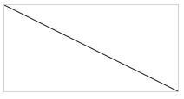
Things you can do in canvas
# Draw a Line
var c = document.getElementById("myCanvas");
var ctx = c.getContext("2d");
ctx.moveTo(0,0);
ctx.lineTo(200,100);
ctx.stroke();
WILL GIVE

Slide 25
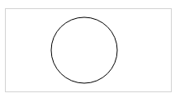
Draw
# Draw a Circle
var c = document.getElementById("myCanvas");
var ctx = c.getContext("2d");
ctx.beginPath();
ctx.arc(95,50,40,0,2*Math.PI);
ctx.stroke();
WILL GIVE

Slide 26
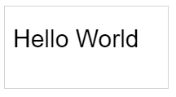
Draw
# Draw a Text
var c = document.getElementById("myCanvas");
var ctx = c.getContext("2d");
ctx.font = "30px Arial";
ctx.fillText("Hello World",10,50);
WILL GIVE

Slide 27
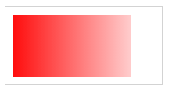
Gradient
# Draw Linear Gradient
var c = document.getElementById("myCanvas");
var ctx = c.getContext("2d");
// Create gradient
var grd = ctx.createLinearGradient(0,0,200,0);
grd.addColorStop(0,"red");
grd.addColorStop(1,"white");
// Fill with gradient
ctx.fillStyle = grd;
ctx.fillRect(10,10,150,80);
WILL GIVE

Slide 28
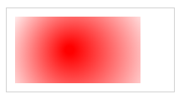
Gradient
# Draw Circular Gradient
var c = document.getElementById("myCanvas");
var ctx = c.getContext("2d");
// Create gradient
var grd = ctx.createLinearGradient(0,0,200,0);
grd.addColorStop(0,"red");
grd.addColorStop(1,"white");
// Fill with gradient
ctx.fillStyle = grd;
ctx.fillRect(10,10,150,80);
WILL GIVE
var grd = ctx.createRadialGradient(75,50,5,90,60,100);

