Slide 1
Bluestock fintech mutual fund analysis

Slide 2
objectives
The objective of this project was to develop an end-to-end Mutual Fund Analytics Platform using Python, SQL, SQLite, and Power BI. The project aimed to analyze mutual fund performance, evaluate risk metrics, study investor behavior, assess portfolio concentration, build a recommendation system, and create interactive dashboards that transform raw financial data into meaningful insights for informed investment and business decision-making.
problems
Investors and analysts lack a unified, programmatic view of mutual fund performance, risk, and investor behavior across the Indian market. Manual analysis is slow, error-prone, and non-scalable.

Slide 3
Data sources
AMFI NAV Data
Daily Net Asset Value records across all registered mutual fund schemes, enabling return calculations and performance tracking over time.
Fund Master Data
Static reference data including scheme names, categories, AMCs, inception dates, and benchmark mappings for all funds.
Investor Transactions
Individual purchase, redemption, and SIP transaction records enabling investor-level analytics and SIP continuity analysis.
Portfolio Holdings
Quarterly fund-level holdings data including sector, asset class, and security-level allocations for concentration analysis.
Benchmark Index Data
Daily index values for Nifty 50, Sensex, and category-specific benchmarks used for Alpha, Beta, and relative performance calculations.

Slide 4
architecture
The project follows a structured data analytics architecture where raw mutual fund datasets are collected, cleaned, transformed, and stored in a SQLite database. Python is used for ETL processing, performance analytics, and advanced risk analysis. The processed data supports Power BI dashboards, reports, and a recommendation system, enabling interactive visualization and data-driven investment insights.
Raw Data Sources
↓
Data Cleaning & Transformation
↓
SQLite Database
↓
Analytics & Risk Metrics
↓
Power BI Dashboard
↓
Reports & Recommendations

Slide 5
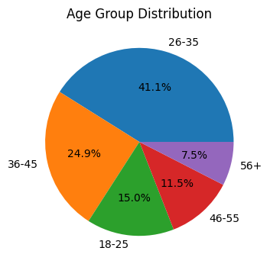
Data Quality & Investor Demographics
Key Insights
• The 26–35 age group represents the largest investor segment, contributing 41.1% of total investors.
• Investors aged 36–45 years account for 24.9%, indicating strong participation from working professionals.
• Participation declines in older age groups, with investors aged 56+ contributing only 7.5%, suggesting lower mutual fund adoption among senior investors.

Slide 6
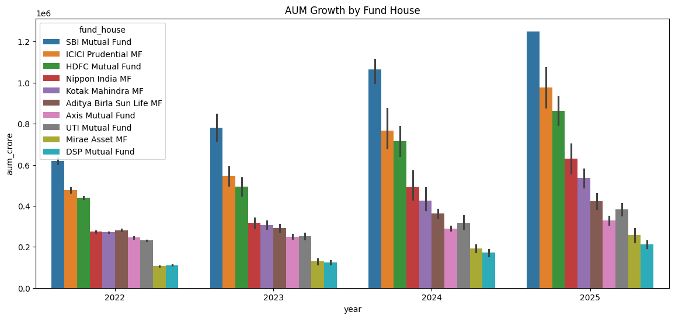
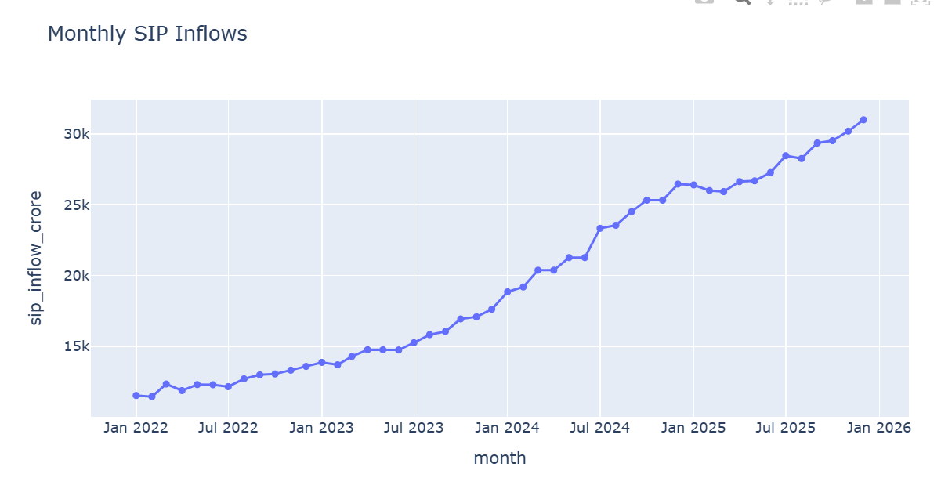
AUM & SIP Trends
• Assets Under Management (AUM) increased steadily across all major fund houses from 2022 to 2025, indicating sustained growth in the mutual fund industry.
• SBI Mutual Fund, ICICI Prudential MF, and HDFC Mutual Fund consistently maintained the highest AUM levels among fund houses.
• Monthly SIP inflows showed a strong upward trend, rising from approximately ₹11K Cr to ₹31K Cr, reflecting increasing retail investor participation.
• The continuous growth in SIP investments suggests strong investor confidence and a preference for disciplined long-term wealth creation.

Slide 7
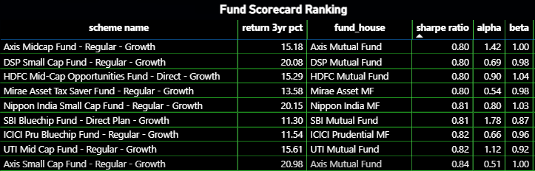
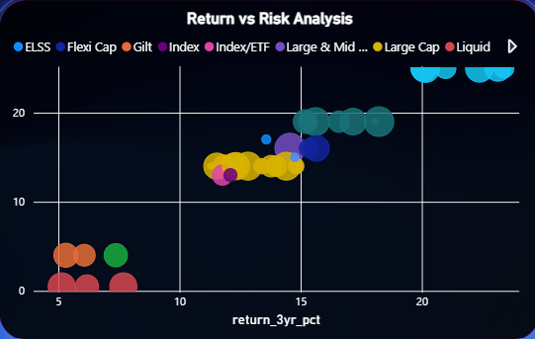
Risk-Adjusted Performance Analysis
Key Points
• Sharpe Ratio was used to evaluate return generated per unit of risk.
• Sortino Ratio measured performance considering downside risk only.
• Alpha identified funds that outperformed benchmark expectations.
• Beta measured fund sensitivity to overall market movements.
Conclusion
Risk-adjusted metrics help identify funds that generate superior returns while maintaining acceptable levels of risk.

Slide 8
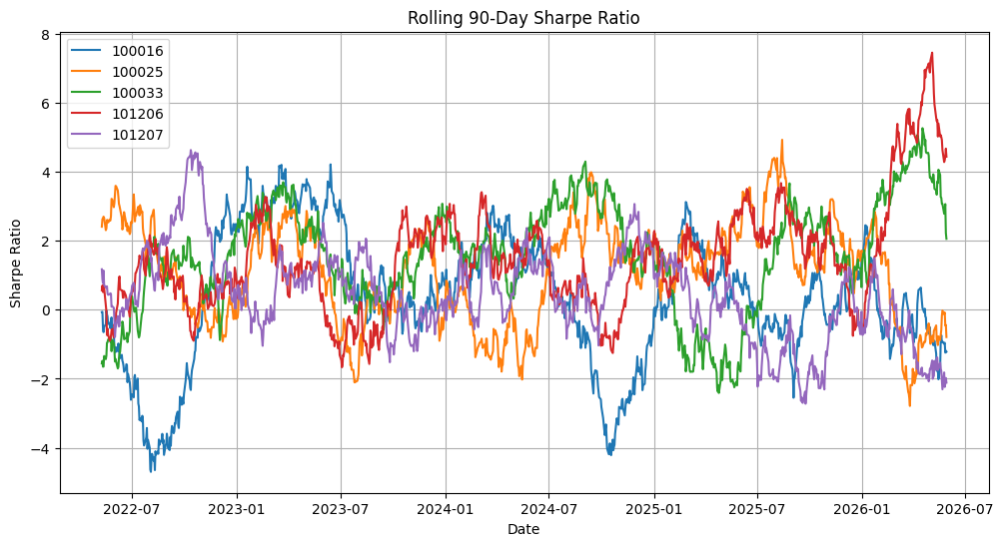
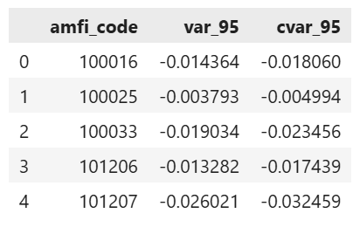
Advanced Risk & Return Metrics
Key Points
• CAGR measured long-term annualized growth of mutual fund investments.
• Volatility quantified fluctuations in fund returns and overall risk exposure.
• VaR and CVaR estimated potential downside losses under adverse market conditions.
Conclusion
Advanced risk metrics provide deeper insights into portfolio stability, downside protection, and long-term investment performance.

Slide 9
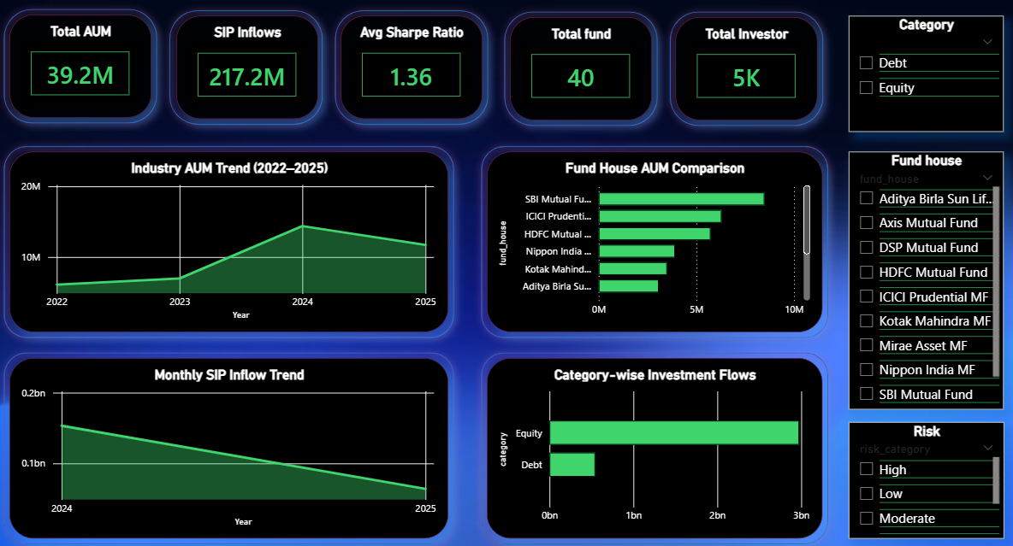
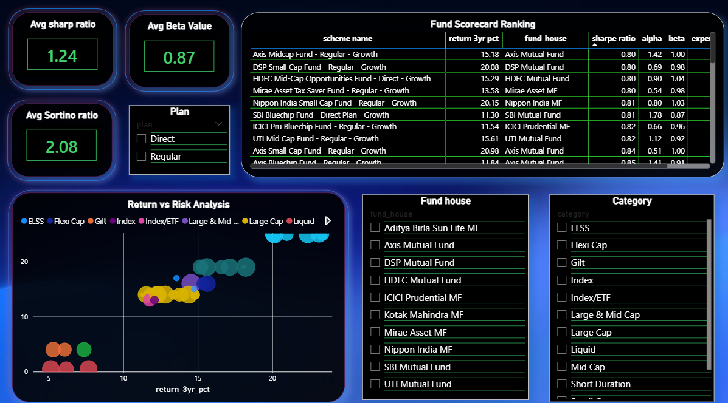
Dashboard

Slide 10
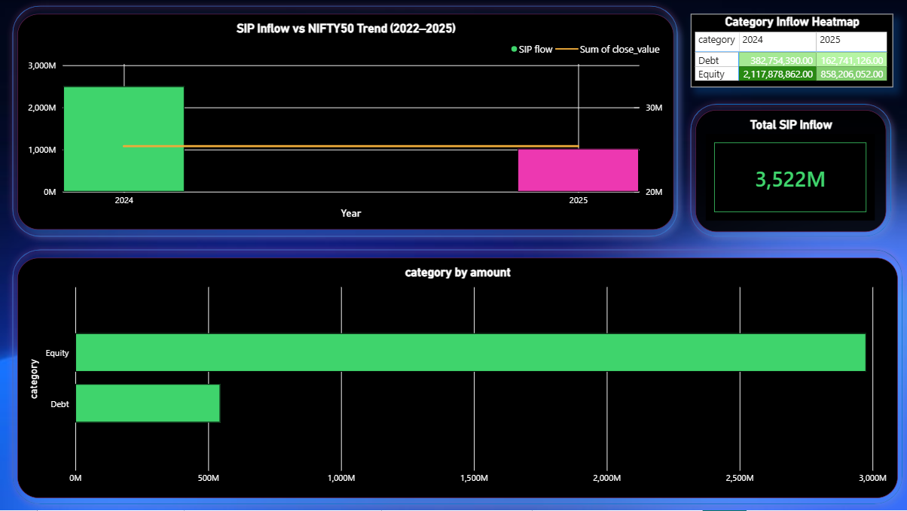
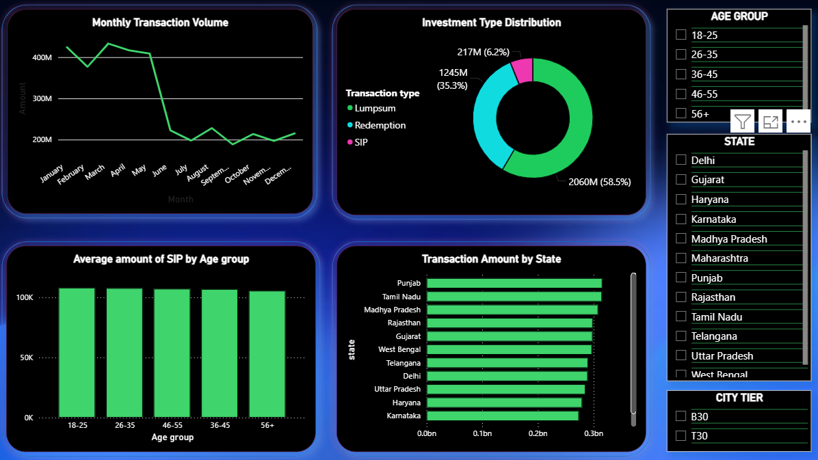
dashboard

Slide 11
Key findings
1. Strong Industry Growth
Total AUM reached ₹39.2M Cr while SIP inflows exceeded ₹217.2M, indicating continued expansion of the mutual fund industry.
Industry AUM peaked during 2024–2025, reflecting growing investor participation.
2. Market Leadership Concentration
SBI Mutual Fund, ICICI Prudential MF, and HDFC Mutual Fund consistently maintained the highest Assets Under Management (AUM).
A significant share of industry assets is concentrated among a few leading fund houses.
3. Equity Funds Dominate Investments
Equity-oriented schemes attracted substantially higher investment flows than debt schemes.
Category-wise inflow analysis shows investors preferred growth-oriented investments over conservative debt products.
4. Risk-Adjusted Performance Varies Across Funds
Sharpe Ratio, Sortino Ratio, Alpha, and Beta metrics revealed notable differences in fund performance.
Several schemes delivered strong returns while maintaining acceptable risk levels, making them attractive investment options.
5. SIPs Drive Long-Term Participation
SIP inflows remained a major contributor to mutual fund investments.
Consistent SIP activity indicates strong investor confidence in long-term wealth creation through systematic investing.
6. Investor Participation Is Broadly Distributed
Transaction analysis shows participation across multiple states and age groups.
The 26–45 age segment represents the most active investor base, highlighting strong engagement from working professionals.

Slide 12
Thank you
This project demonstrated the application of Python, SQL, SQLite, and Power BI for mutual fund analytics, risk assessment, investor behavior analysis, and business intelligence reporting.
Presented By: Suryakant Sharma

