Slide 1





Car Rental System Group 1 Suryakaran Tiwari Ujjwal Mandloi

Slide 2
Introduction
It helps the users to search for available cars view profile and book the cars for the time period.
It has a user-friendly interface which helps the user to check for cars and rent them for the period specified.
car rental company to enable renting of cars through an online system.

Slide 3
Proposed System
This tool will enable the user to rent a vehicle.
The user shall login to the system and check for availability of cars.
The user specifies a type of car and the journey date and time.
The system shall check for the availability of the car and rent the car to the customer.

Slide 4
Technology Stack
React.js
Node.js
Express.js
Mongodb

Slide 5
Modules
Axios
React-router-dom
React-redux
Antd
Bcryptjs

Slide 6
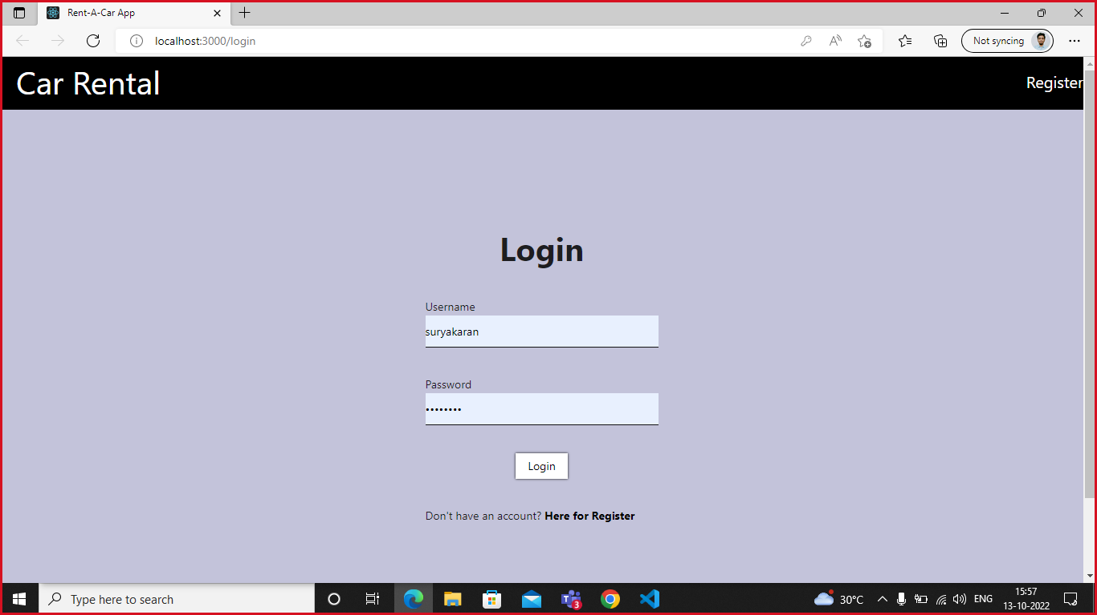
Screen Shots

Slide 7
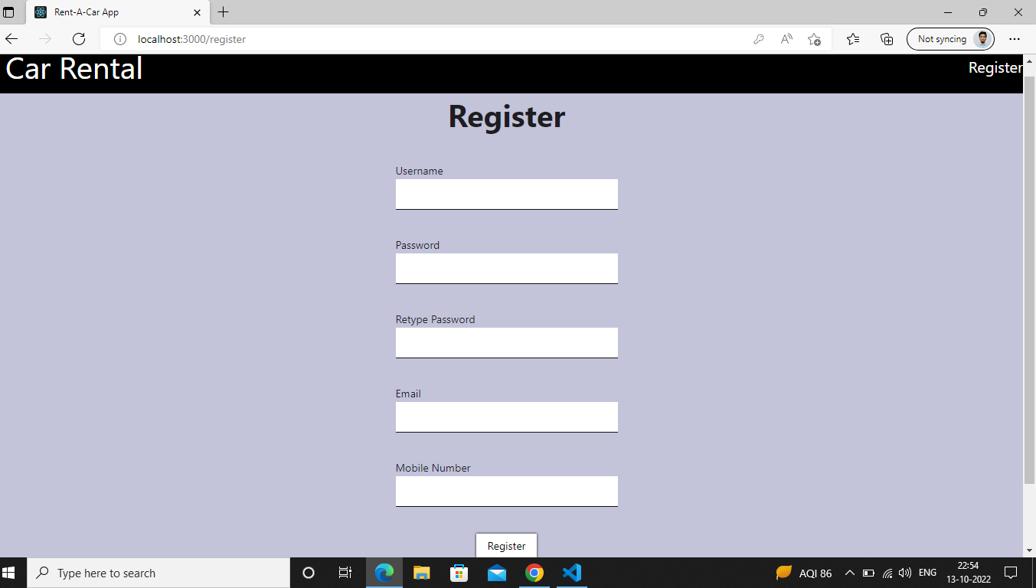
Screen Shot:- Registration Page

Slide 8
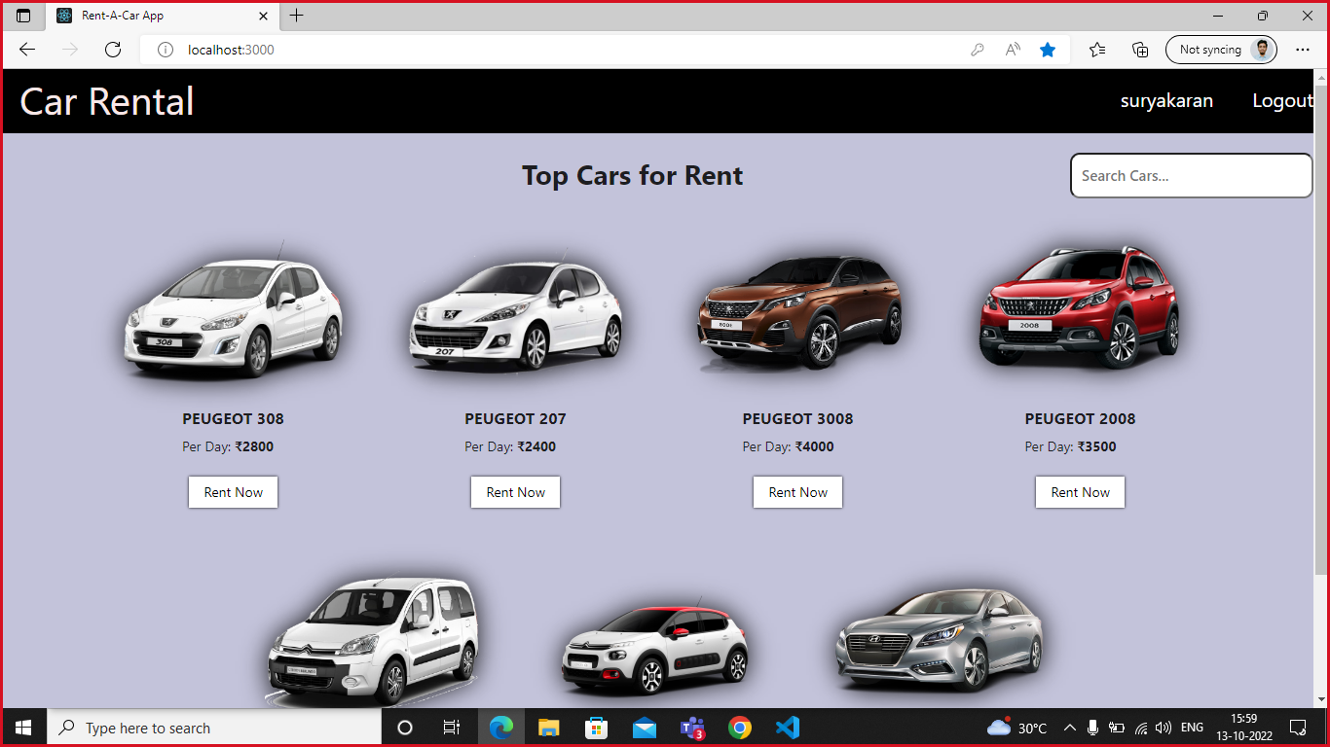
Screen Shot:- Homepage

Slide 9
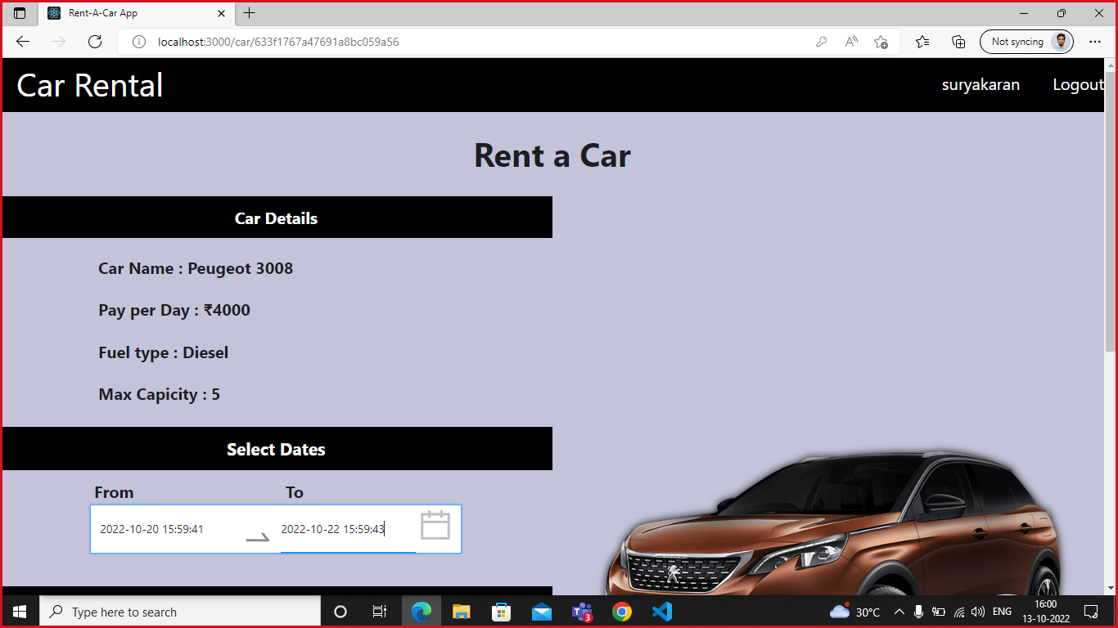
Screen Shot :- Rent Car

Slide 10
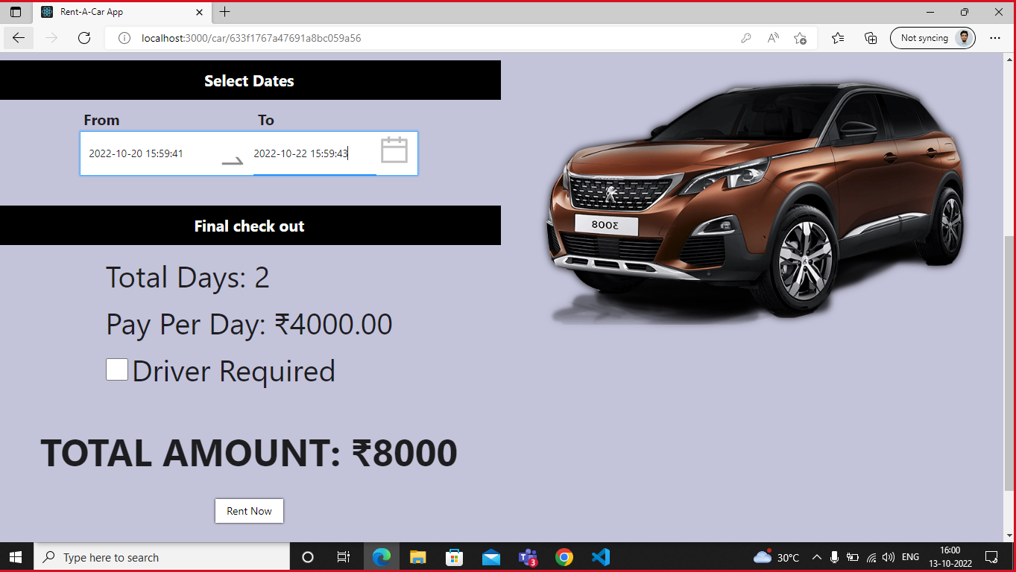
Screen Shot:- Rent Car

Slide 11
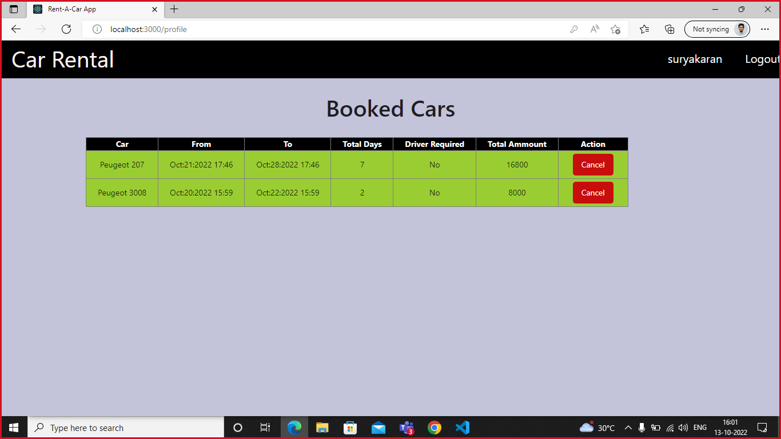
Screen Shot:- Booking Details

Slide 12

Demo

