Slide 1
CAPSTONE PROJECT
YouTube Data Harvesting and Warehousing using SQL and Streamlit
Skills take away From This Project:
Python scripting
Data Collection
Streamlit
API integration
Data Management using SQL
MongoDB as Data Lake
Domain: Social Media

Slide 2
Problem Statement
The problem statement is to create a Streamlit application that allows users to access and analyze data from multiple YouTube channels. The application should have the following features:
Ability to input a YouTube channel ID and retrieve all the relevant data (Channel name, subscribers, total video count, playlist ID, video ID, likes, dislikes, comments of each video) using Google API.
Ability to collect data for up to 10 different YouTube channels and store them in the data lake by clicking a button.
Option to store the data in a MYSQL or PostgreSQL.
Ability to search and retrieve data from the SQL database using different search options, including joining tables to get channel details.

Slide 3
Approach
Set up a Streamlit app:
Streamlit is a great UI for building data visualization and analysis tools quickly and easily. We can use Streamlit to create a simple UI where we can enter a YouTube channel ID, view the channel details, and select channels to migrate to the data warehouse.
Connect to the YouTube API:
We'll need to use the YouTube API to retrieve channel and video data. We can use the Google API client library for Python to make requests to the API.
Store and Clean data:
Once we retrieve the data from the YouTube API, store it in a MongoDb Document format for temporary storage before migrating to the data warehouse.
Migrate data to a PostgreSQL data warehouse:
After we've collected data for multiple channels, we can migrate it to a PostgreSQL data warehouse to store a data into table format.

Slide 4
Approach
Query the SQL data warehouse:
We can use SQL queries to join the tables in the SQL data warehouse and retrieve data for specific channels based on our input. We can use a psycopg2 library to interact with the SQL database.
Display data in the Streamlit app:
Finally, we can display the retrieved data in the Streamlit app. We can use Streamlit's data visualization and ploty features to create charts and graphs to help users analyze the data.
Overall, this approach involves building a simple UI with Streamlit, retrieving data from the YouTube API, storing the data PostgreSQL as a warehouse, querying the data warehouse with SQL, and displaying the data in the Streamlit app.

Slide 5
SQL Query Output need to displayed as table in Streamlit Application:
What are the names of all the videos and their corresponding channels?
Which channels have the most number of videos, and how many videos do they have?
What are the top 10 most viewed videos and their respective channels?
How many comments were made on each video, and what are their corresponding video names?
Which videos have the highest number of likes, and what are their corresponding channel names?
What is the total number of likes and dislikes for each video, and what are their corresponding video names?
What is the total number of views for each channel, and what are their corresponding channel names?
What are the names of all the channels that have published videos in the year2022?
What is the average duration of all videos in each channel, and what are their corresponding channel names?
Which videos have the highest number of comments, and what are their corresponding channel names?

Slide 6
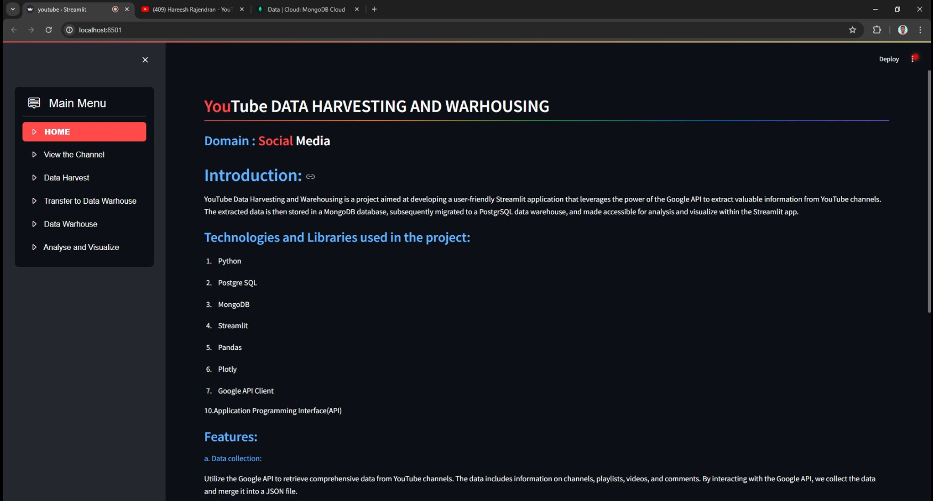
Home Screen

Slide 7
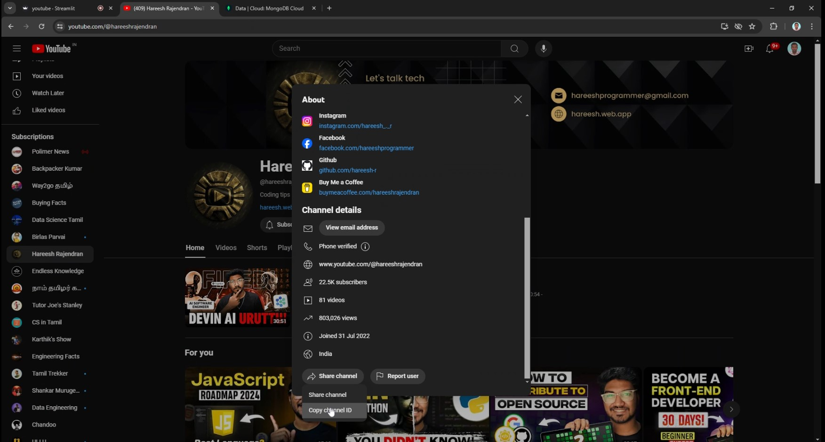
Copy the Channel ID

Slide 8
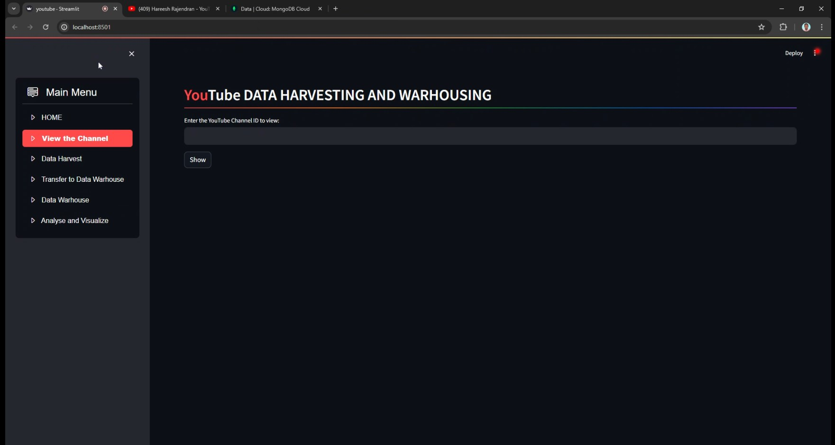
Enter the Channel ID to view the Channel

Slide 9
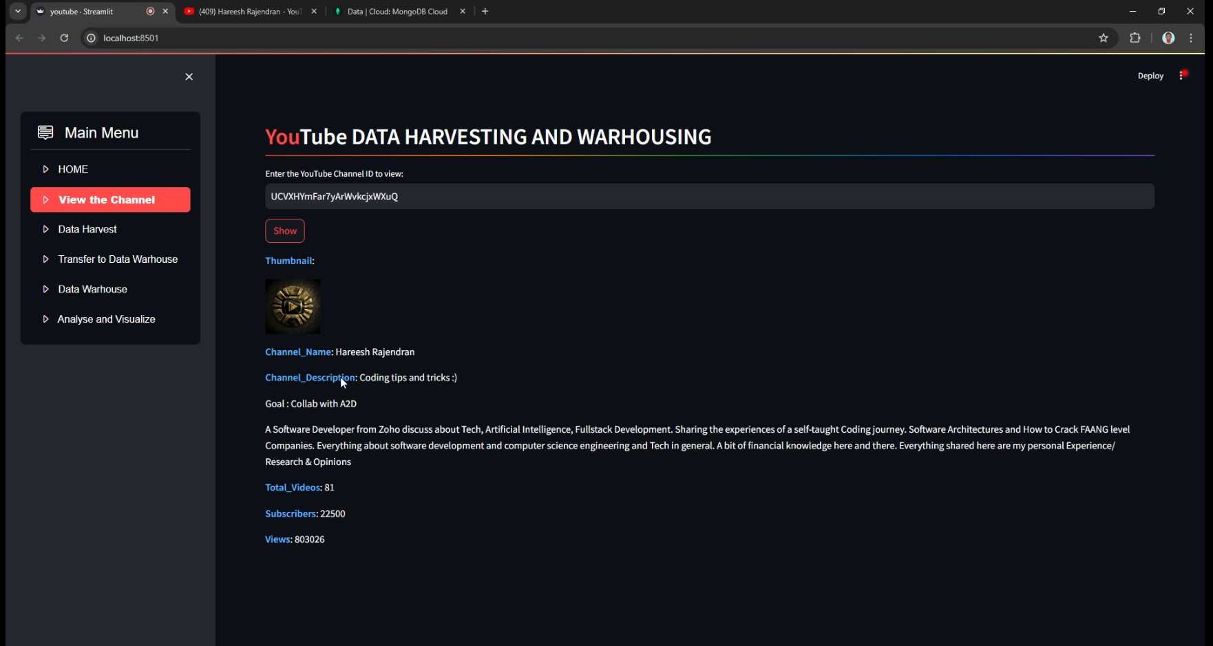
Channel Information

Slide 10
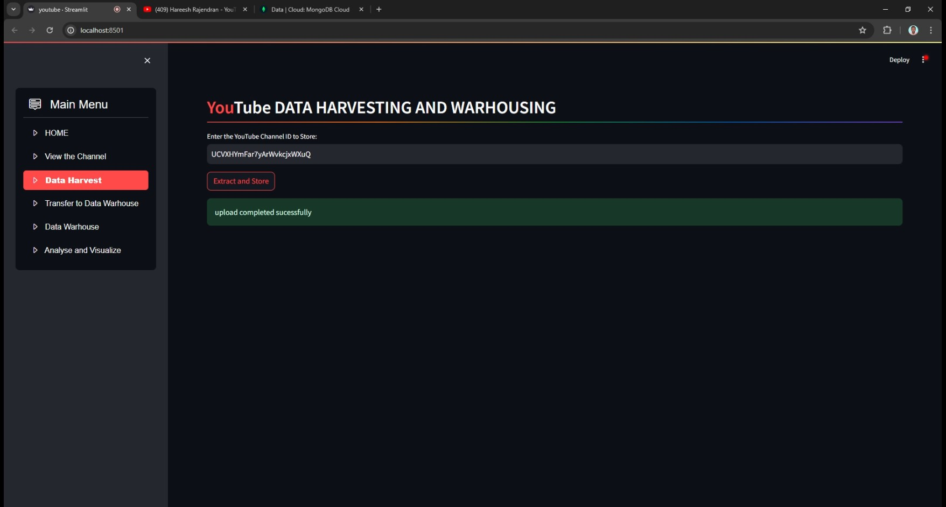
Data Harvest: Extract and Upload the Channel Details to Data Lake(MongoDB)

Slide 11
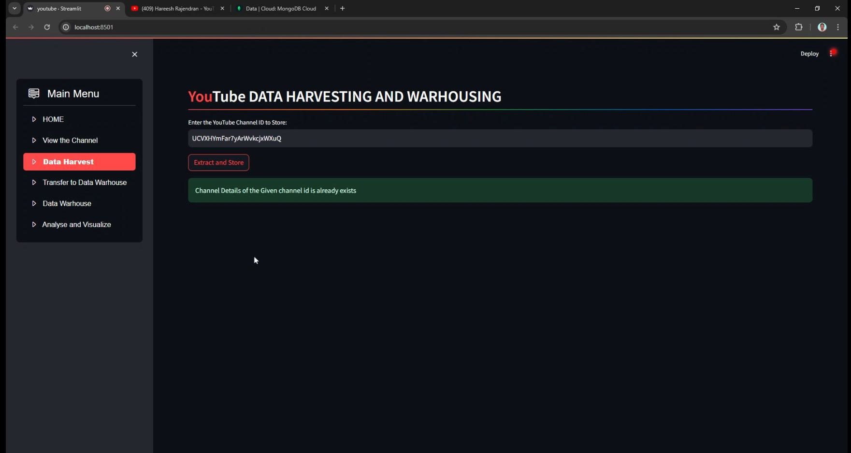
Re-Entering the same Channel ID that gives message as already exists

Slide 12
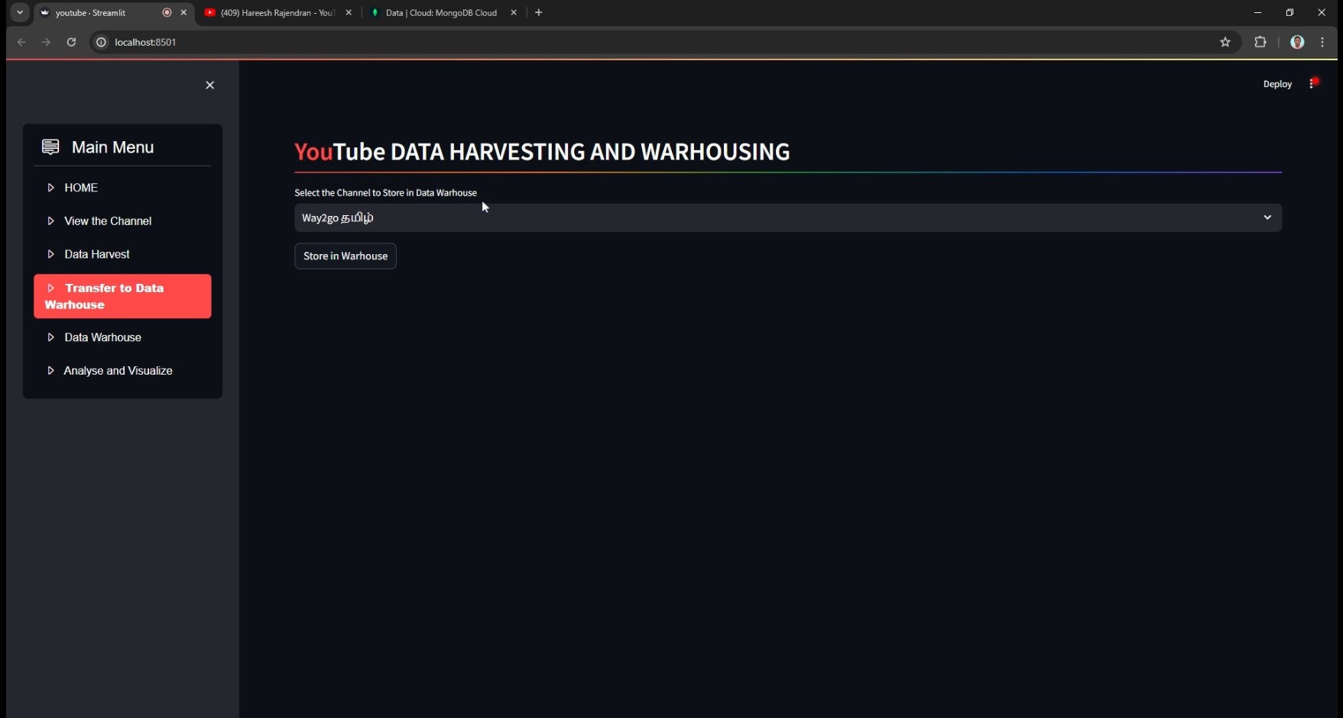
Transfer Screen to Transfer the details to Data Warhouse

Slide 13
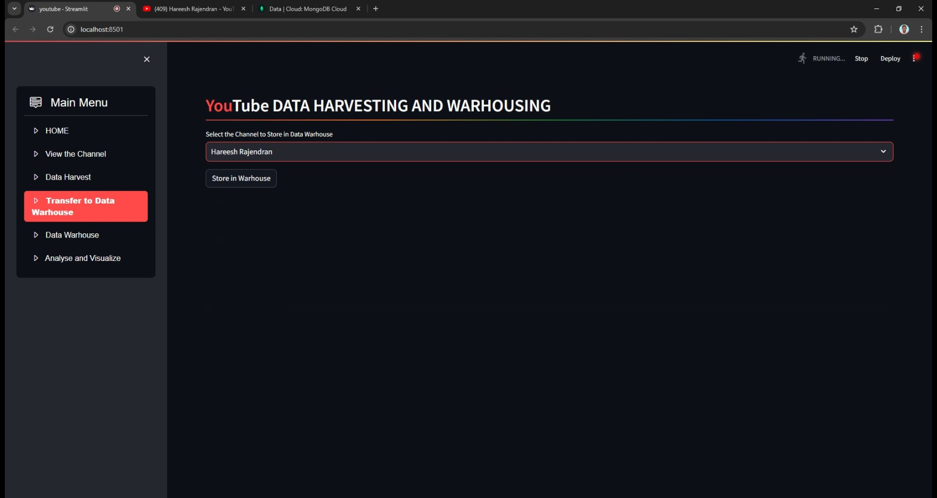
Choose the Channel to transfer the details to Data Warhouse

Slide 14
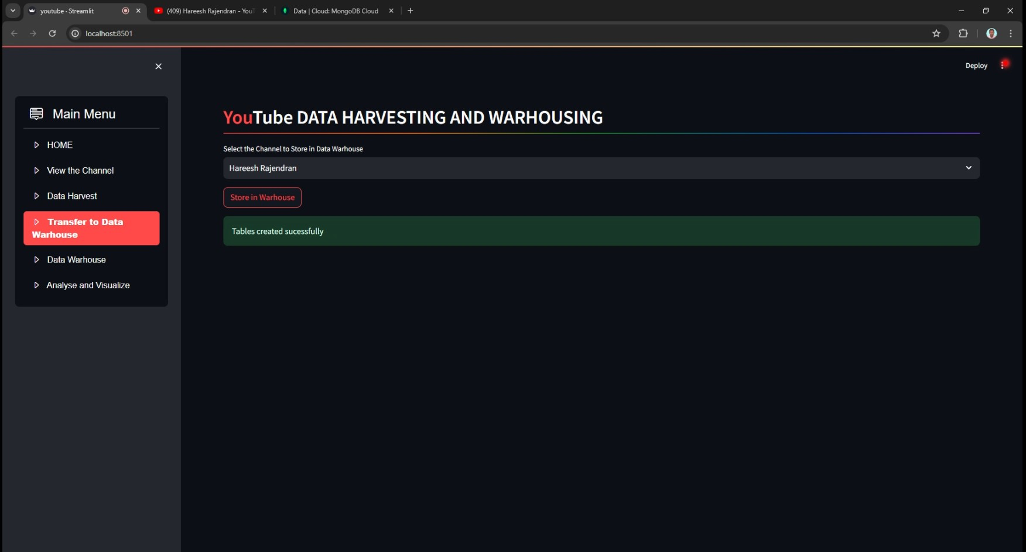
Table created successfully for transferred channel

Slide 15
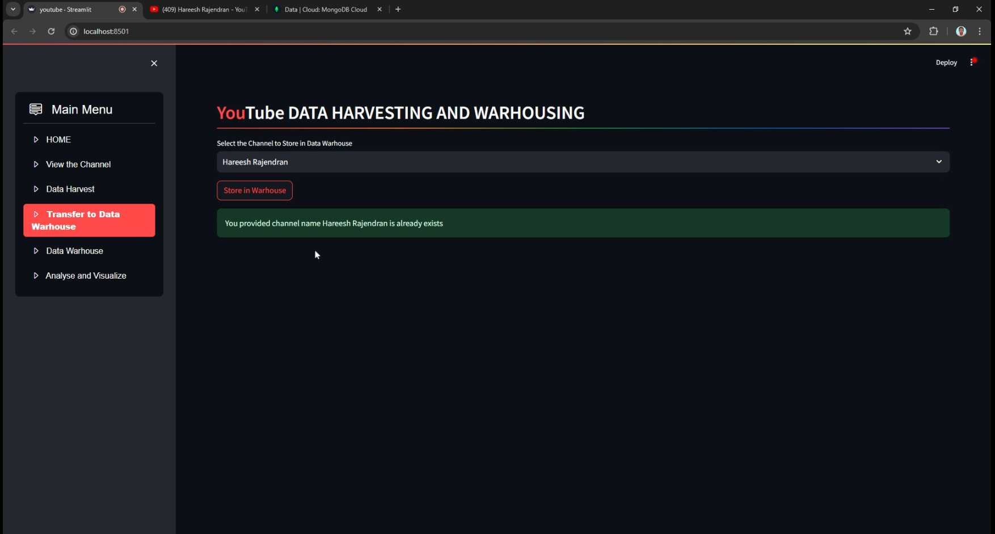
Channel Name exists to store the details in Data Warhouse

Slide 16
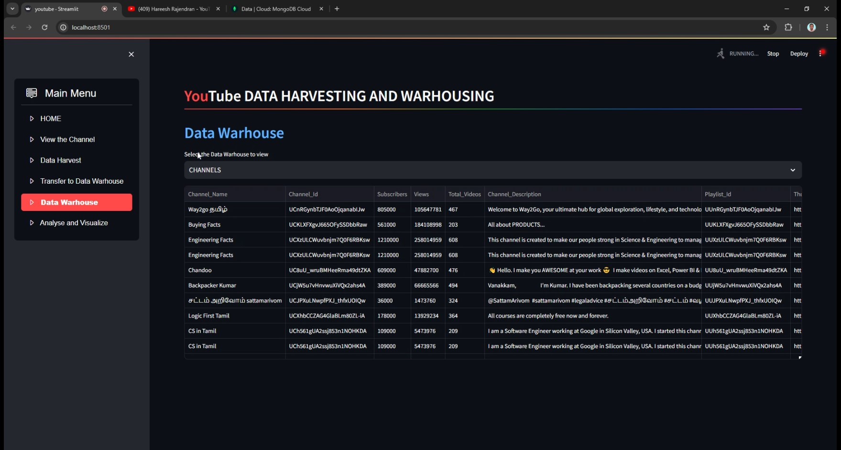
Channel Data Warhouse

Slide 17
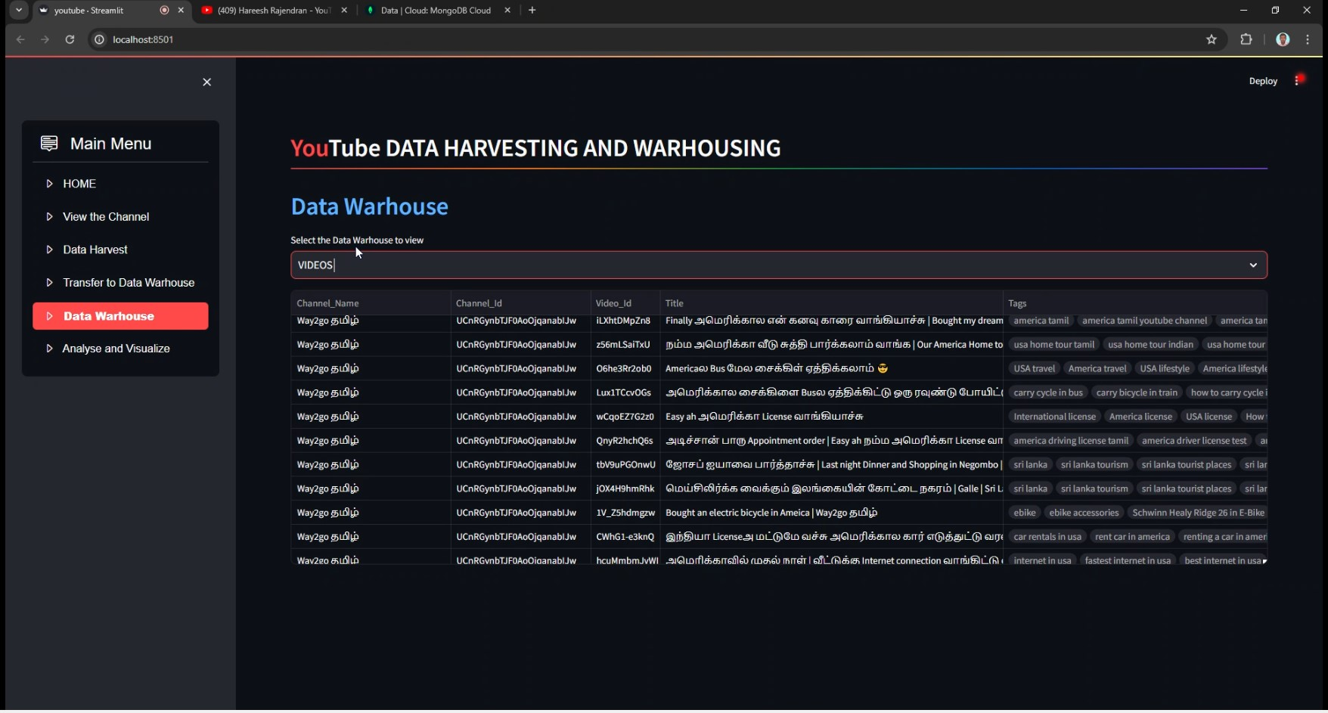
Videos Data Warhouse

Slide 18
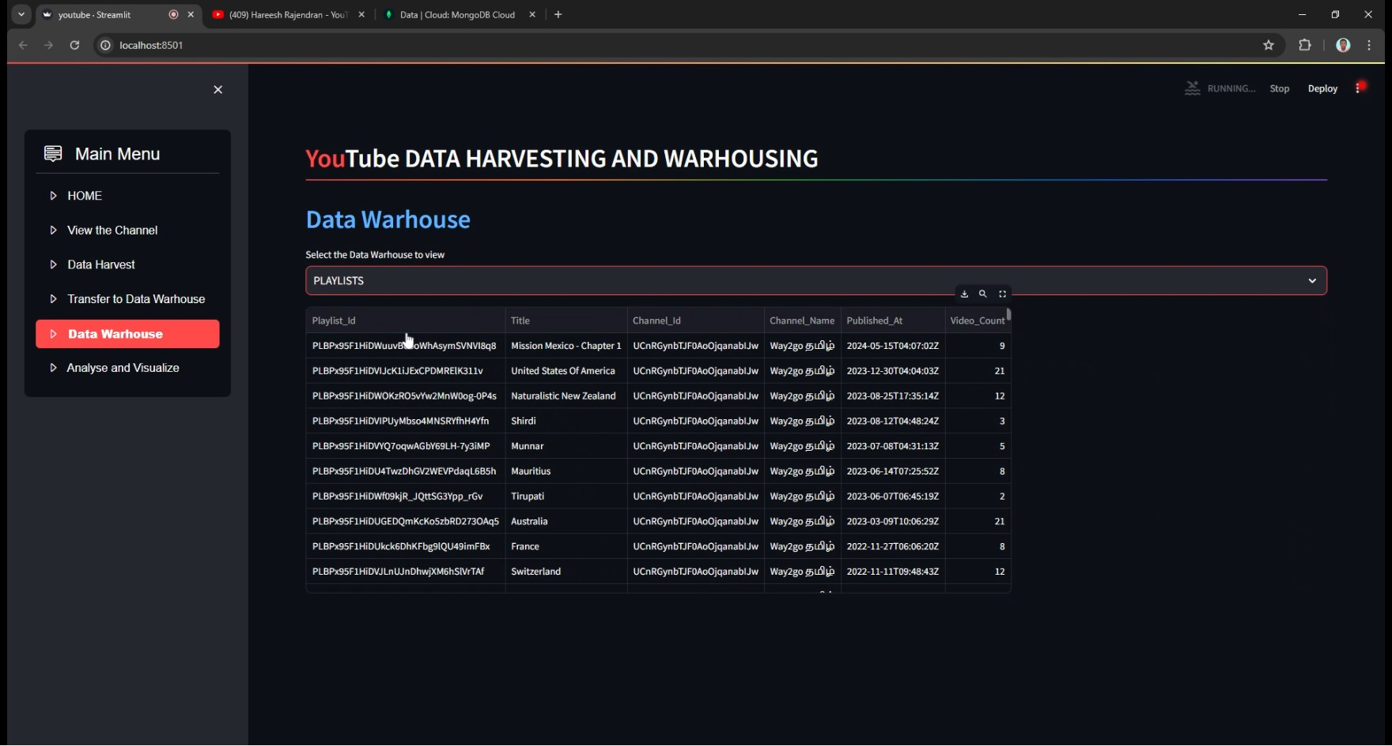
Playlist Data Warhouse

Slide 19
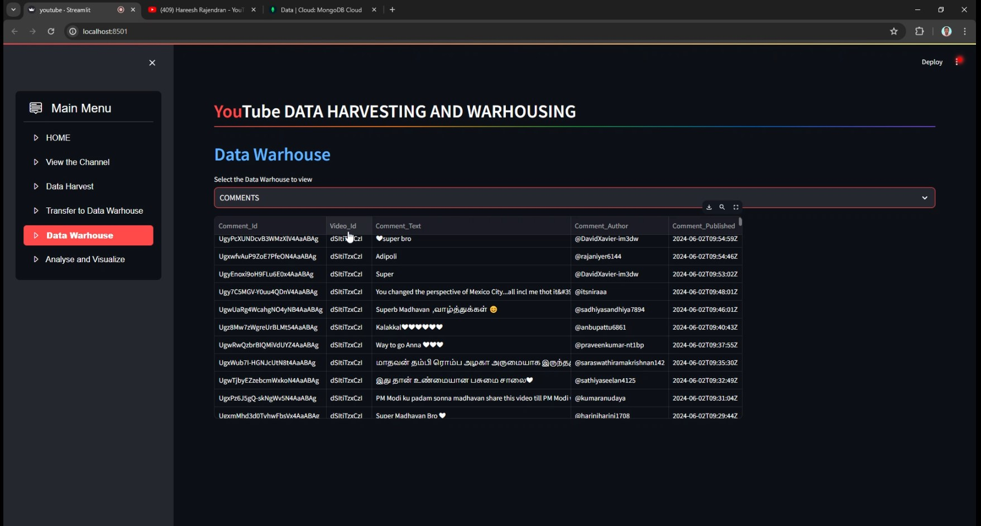
Comments Data Warhouse

Slide 20
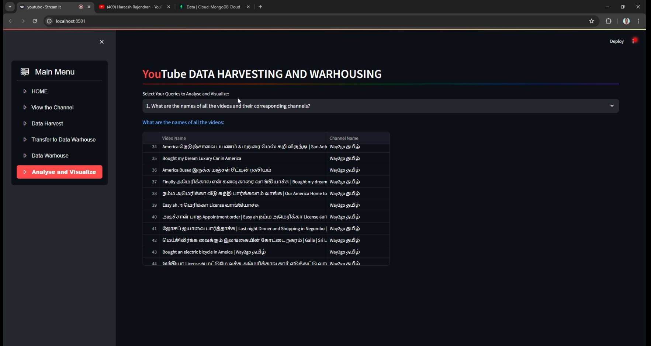
Queries Screen for Analyse and Visualize

Slide 21
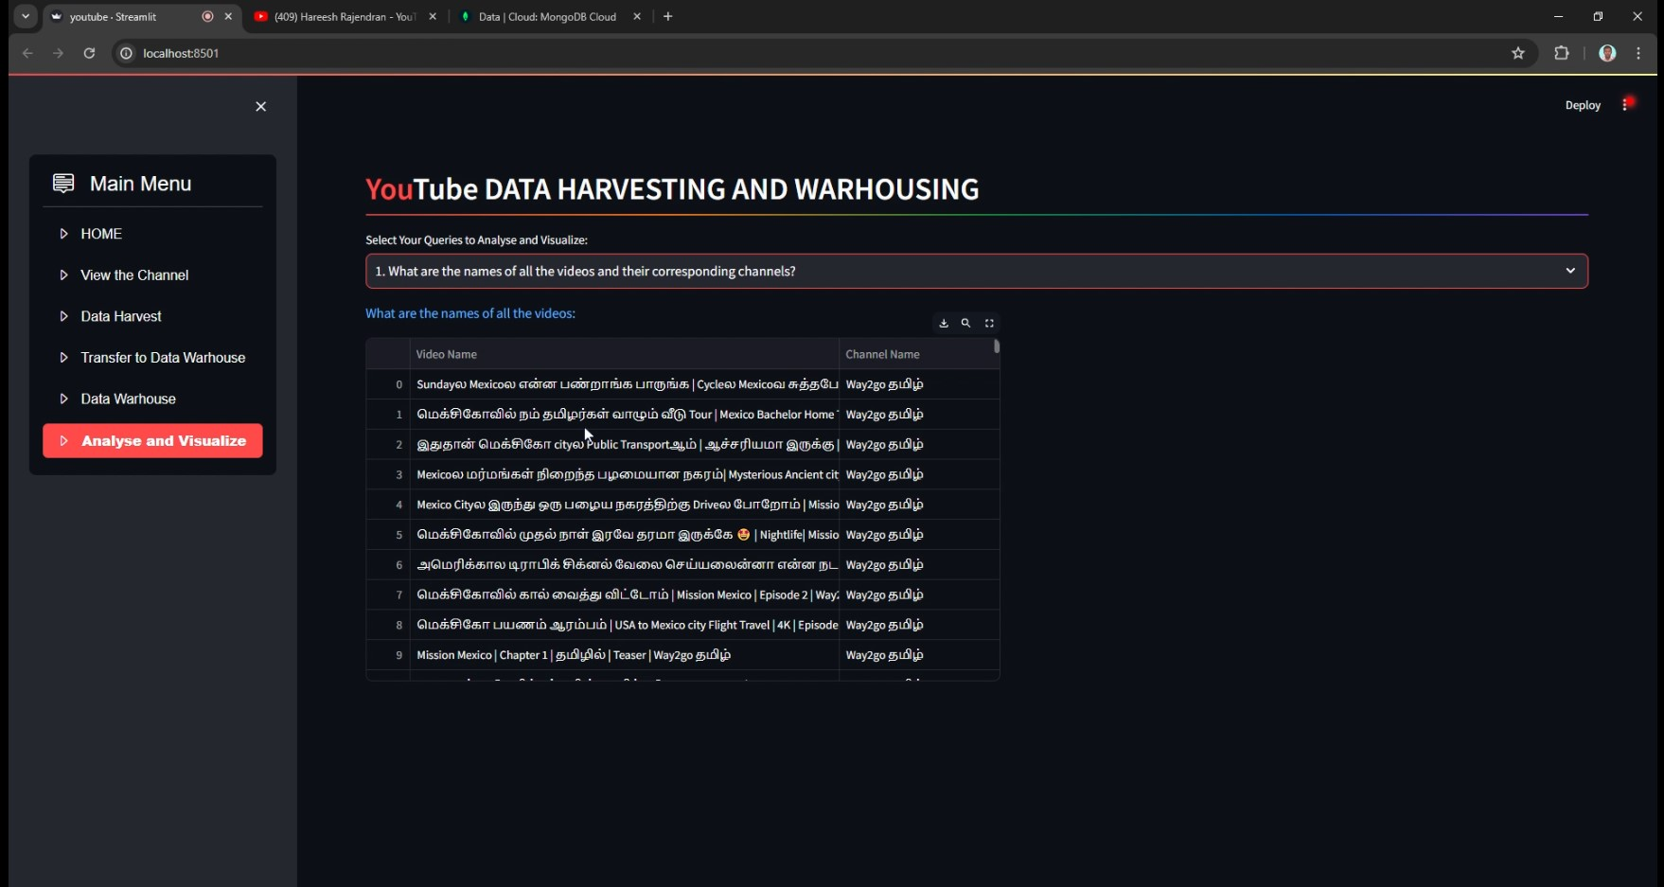
1. What are the names of all the videos and their corresponding channels?

Slide 22
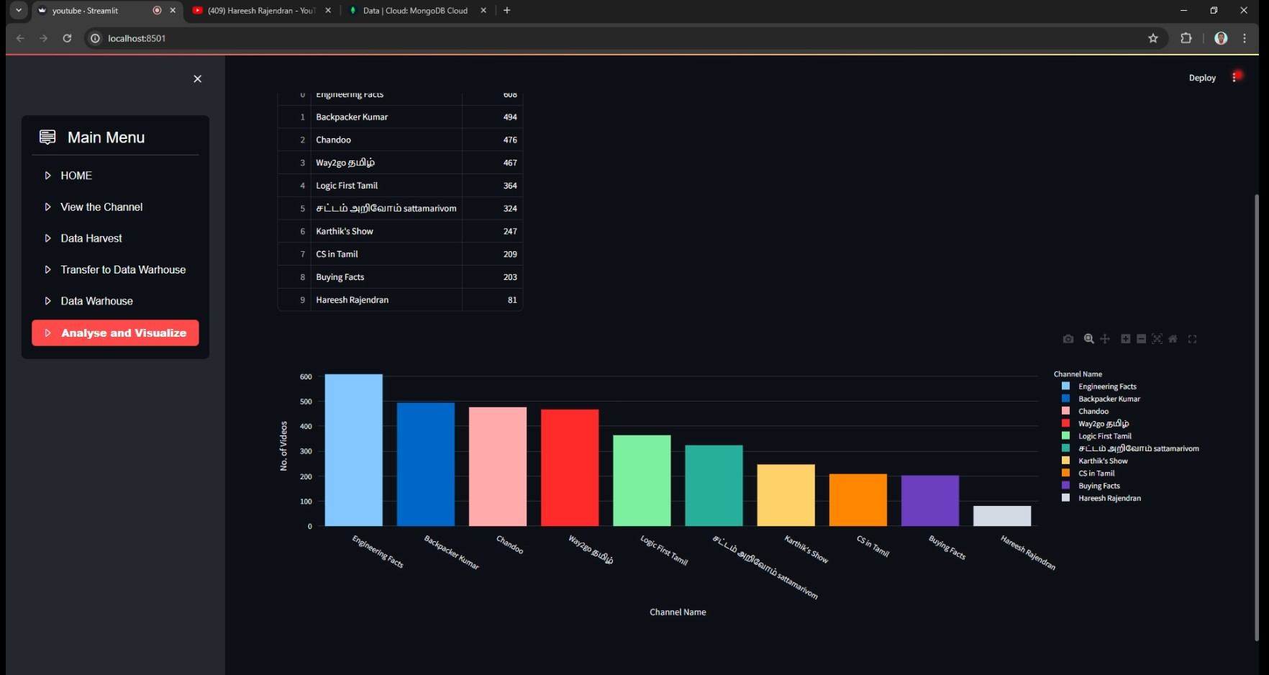
2. Which channels have the most number of videos, and how many videos do they have?"

Slide 23
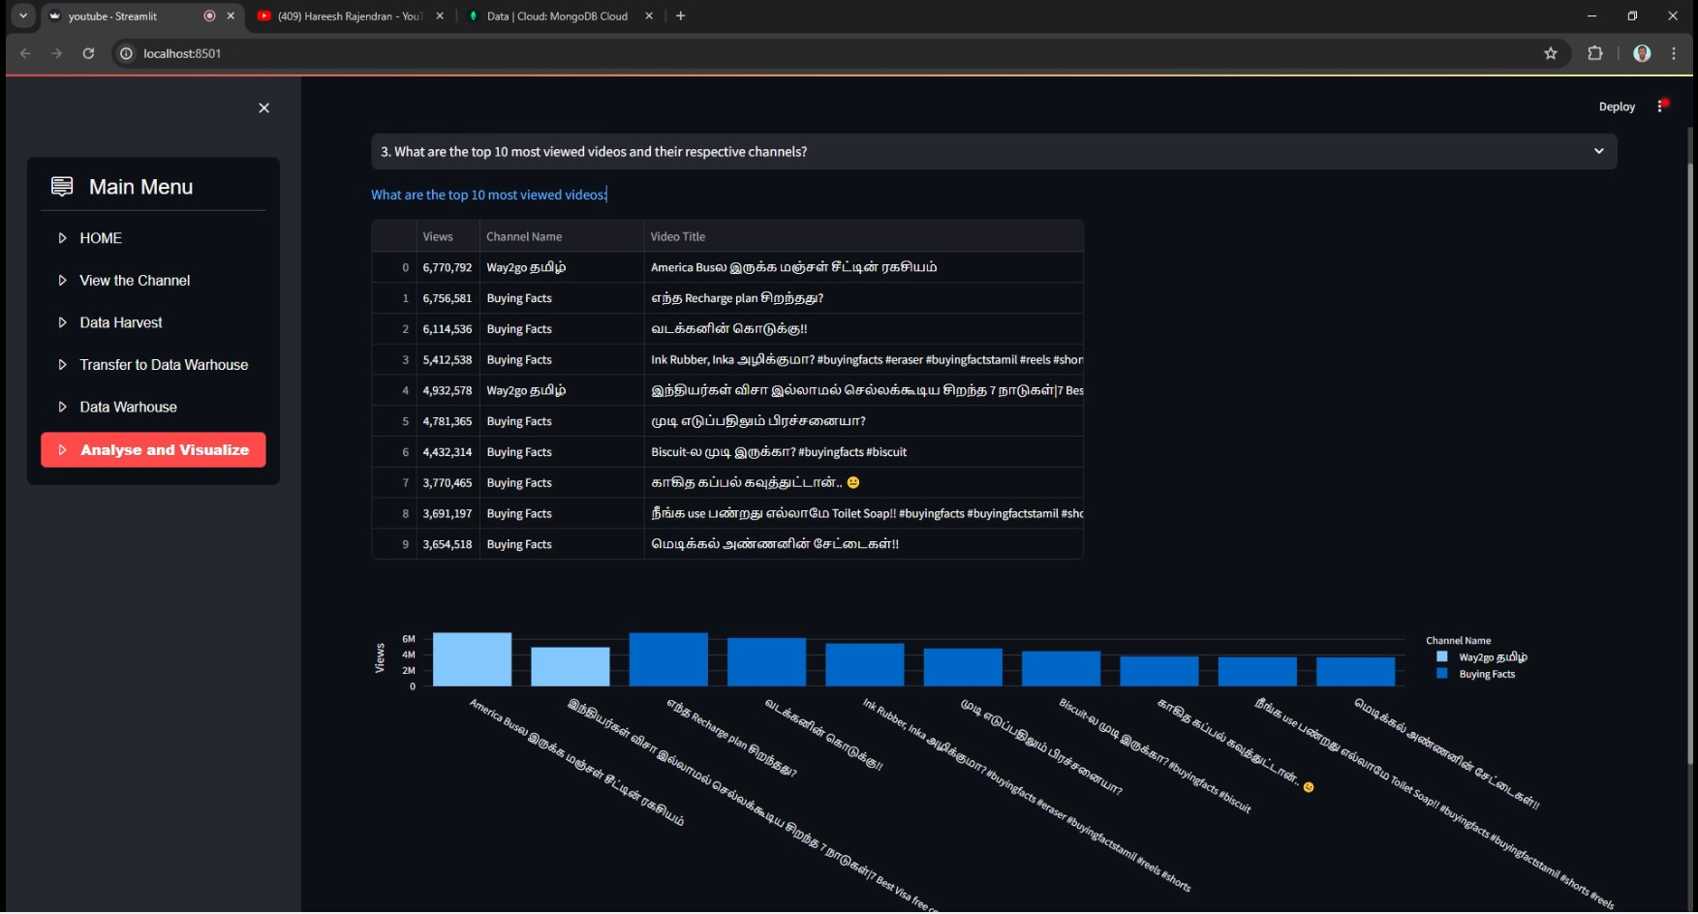
3. What are the top 10 most viewed videos and their respective channels?"

Slide 24
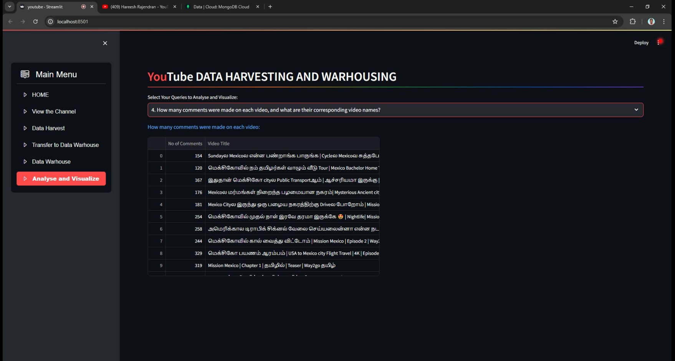
4. How many comments were made on each video, and what are their corresponding video names?

Slide 25
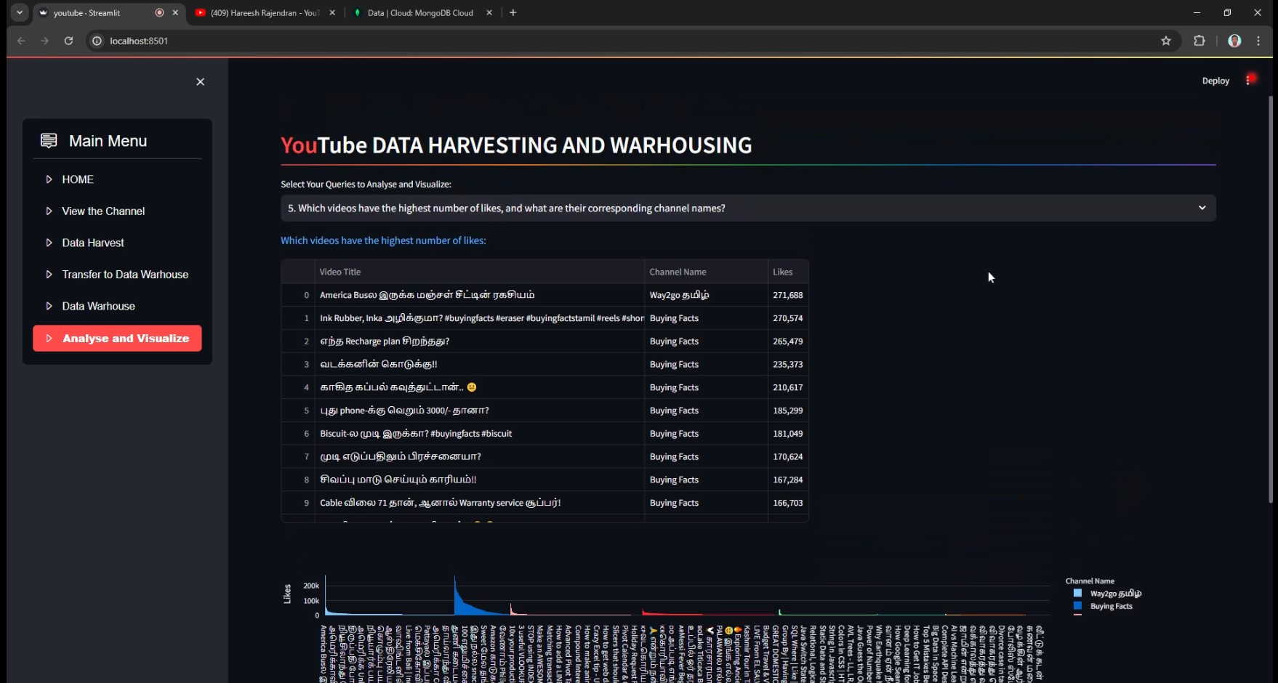
5. Which videos have the highest number of likes, and what are their corresponding channel names?

Slide 26
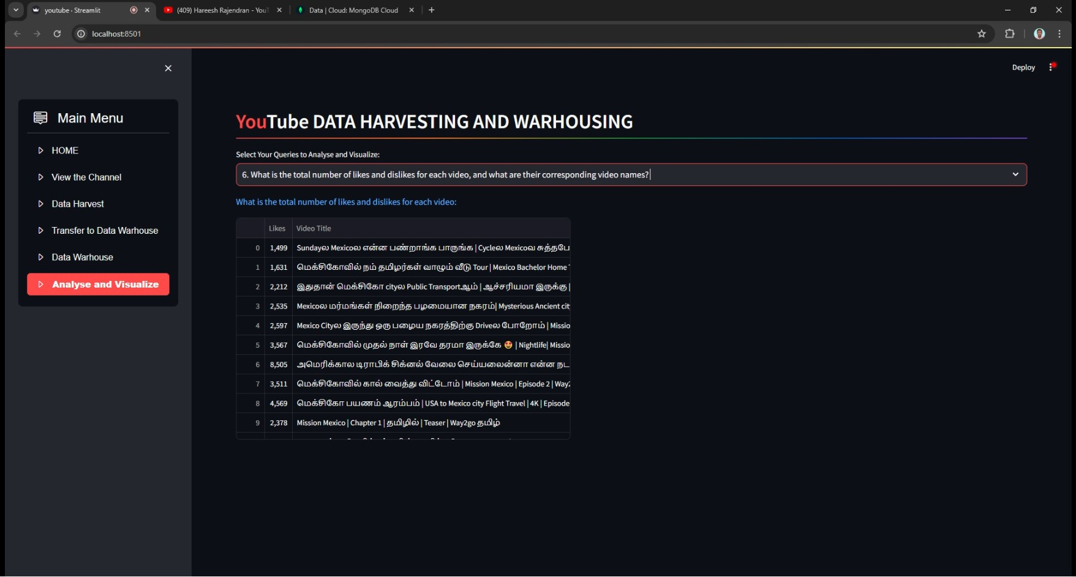
6. What is the total number of likes and dislikes for each video, and what are their corresponding video names?

Slide 27
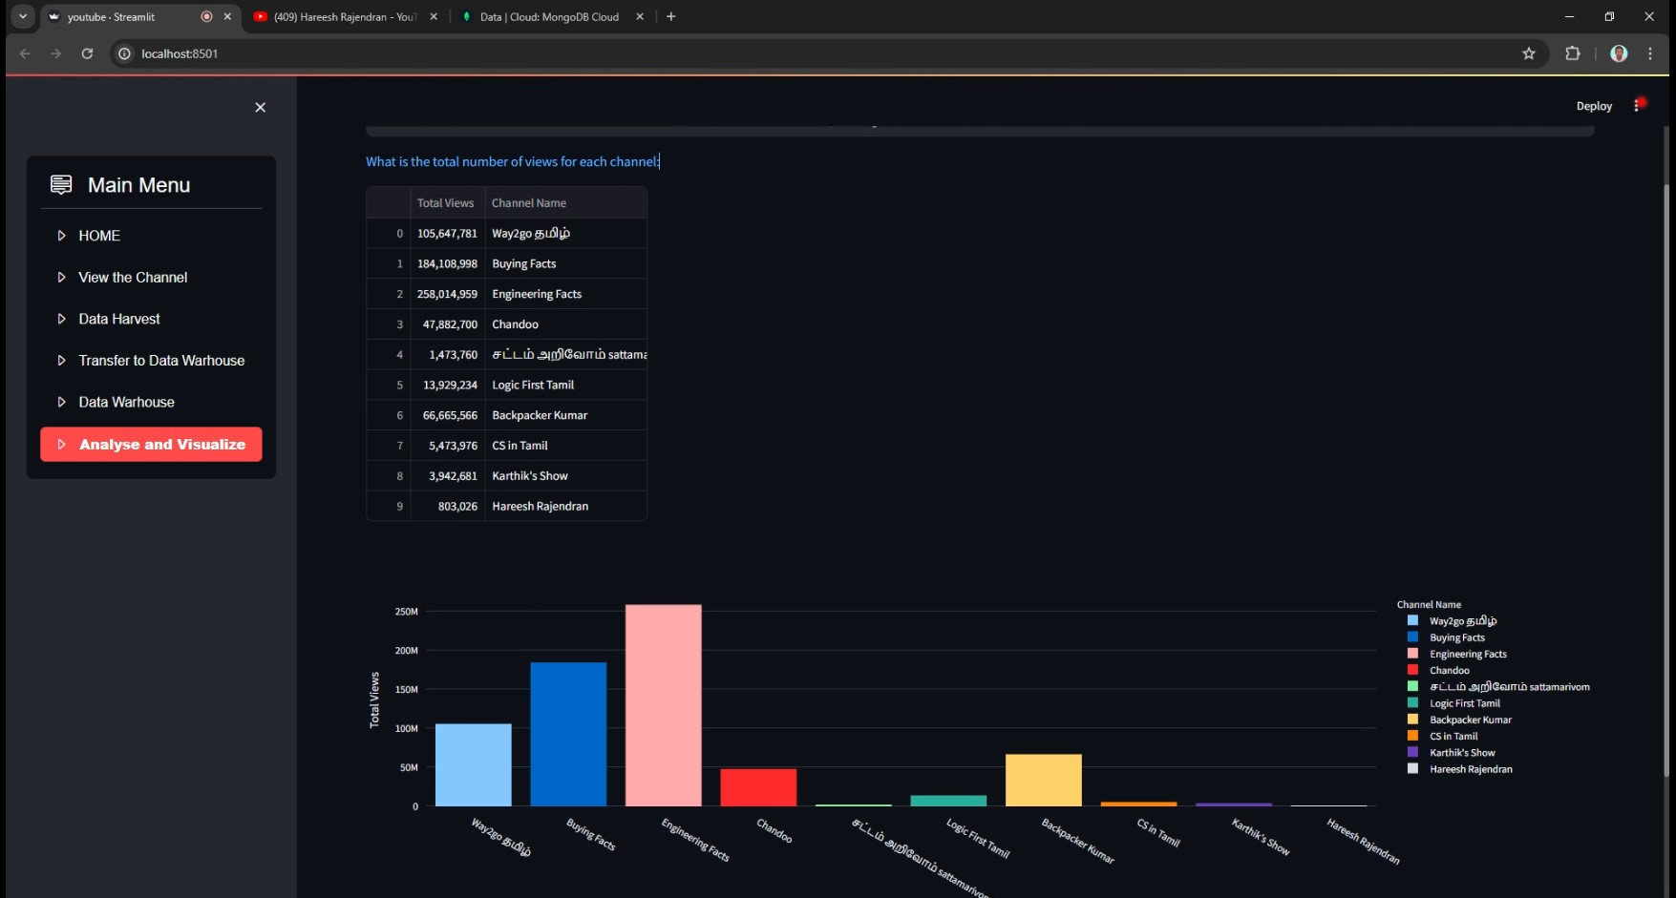
7. What is the total number of views for each channel, and what are their corresponding channel names?

Slide 28
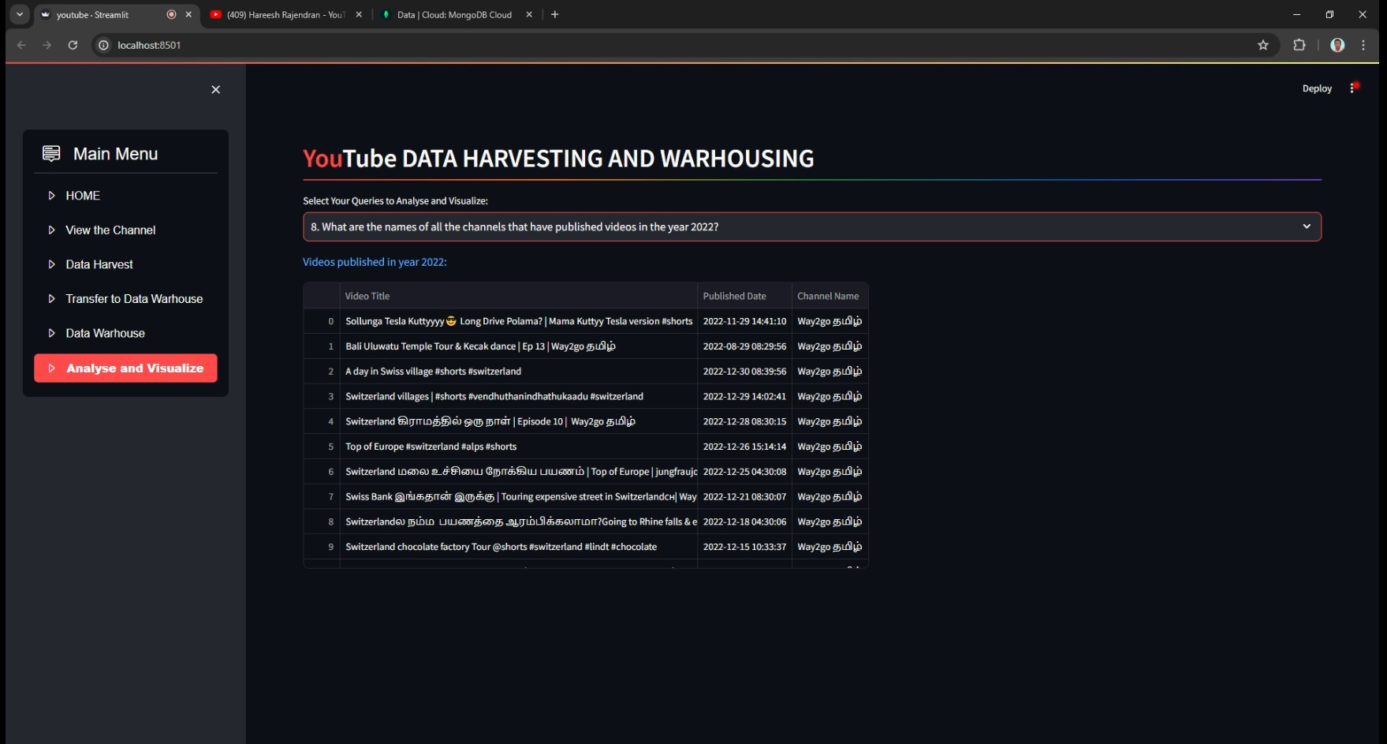
8. What are the names of all the channels that have published videos in the year 2022?

Slide 29
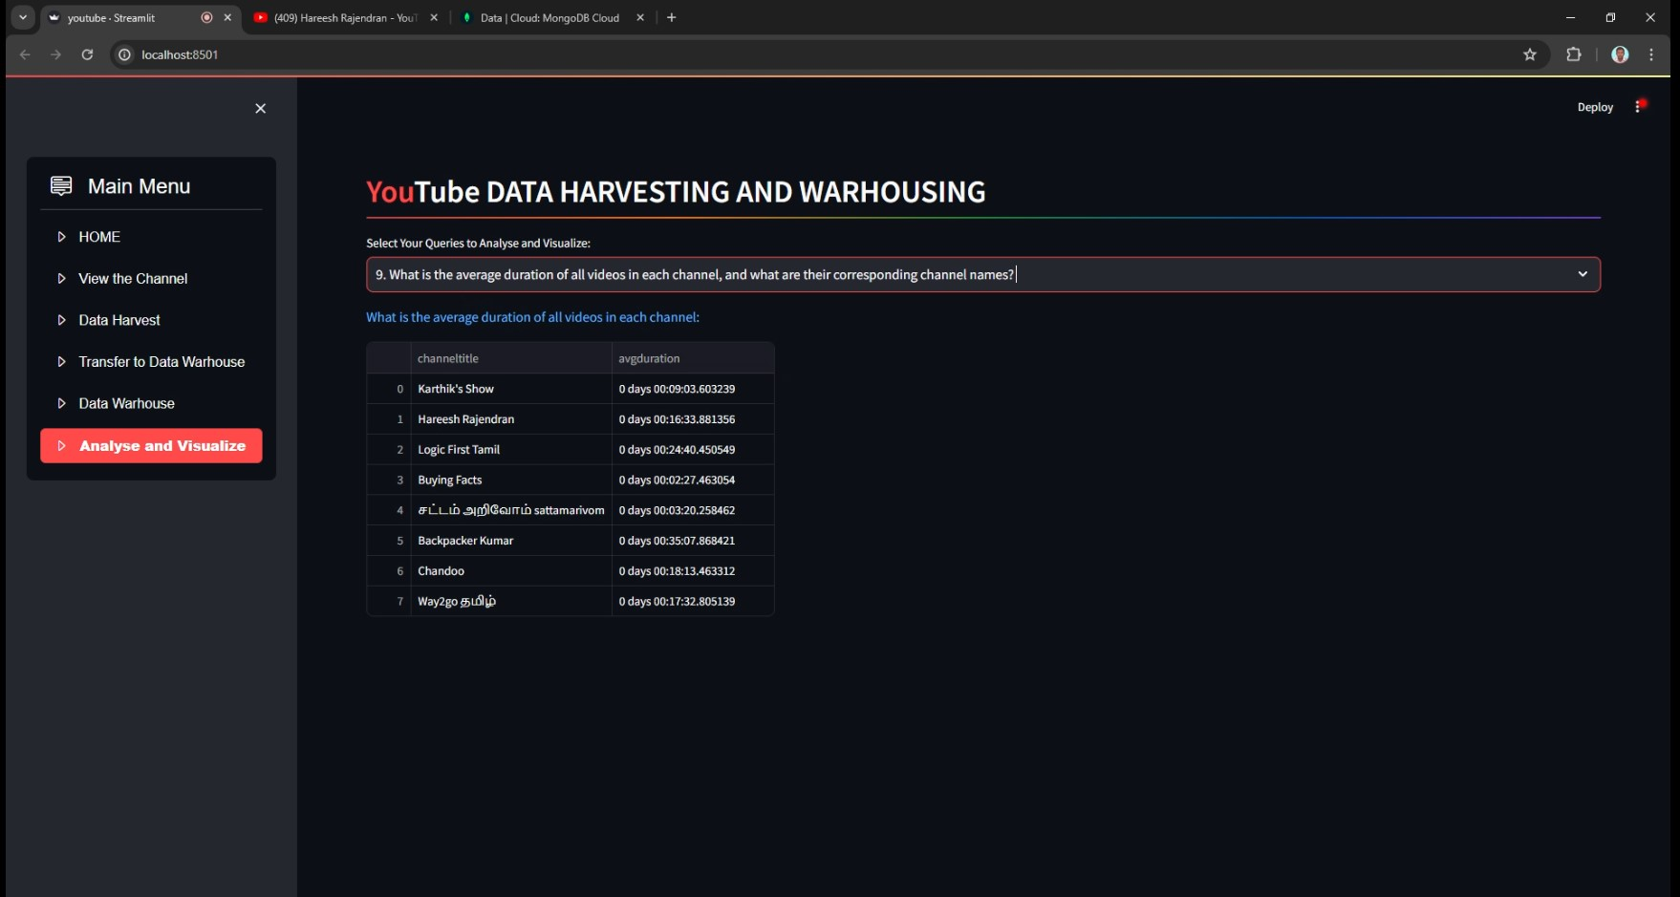
9. What is the average duration of all videos in each channel, and what are their corresponding channel names?

Slide 30
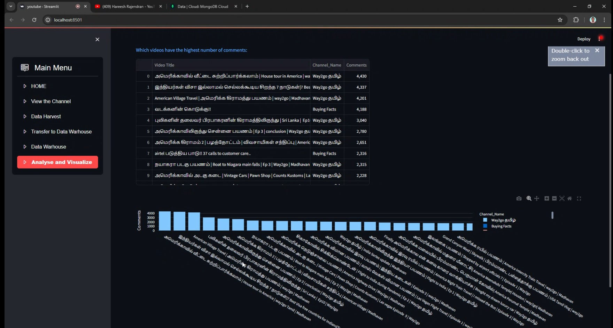
10. Which videos have the highest number of comments, and what are their corresponding channel names?

Slide 31
Results
This project aims to develop a user-friendly Streamlit application that utilizes the Google API to extract information on a YouTube channel, stores it in a SQL database, and enables users to search for channel details and join tables to view data in the Streamlit app.

