Slide 1


ME6650 – Advanced Battery Materials Realizing High-capacity All-Solid-State Li-S Batteries using Low Density Inorganic Solid State Electrolyte Winter 2025
Literature Review
Presented By: Suryakiran M. George
Original Authors: Daiwei Wang, Li Ji Jhang, Rong Kou, Meng Liao, Shiyao Zheng, Heng Jiang, Pei Shi, Guo Xing Li, Kui Meng & Donghai Wang

Slide 2
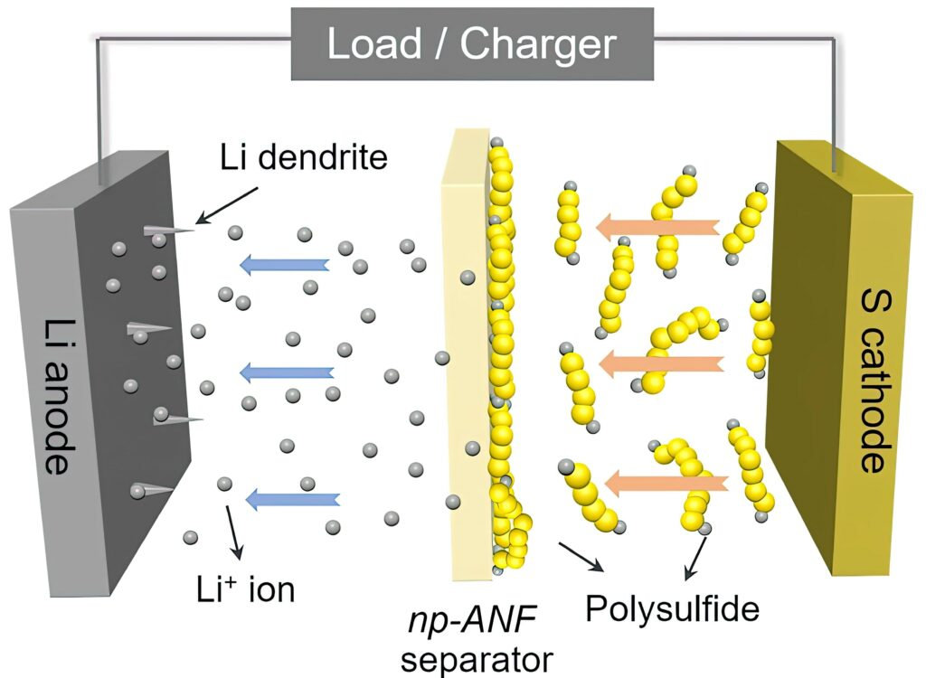
Background: Liquid Electrolyte Li-S Battery
High theoretical capacity of S
(~2,600 Wh/kg vs Li-ion’s ~250-300 Wh/kg)
Low cost – abundant, non-toxic
High Energy Density (3-5x of Li-ion)
Light Weight – for Aerospace, EVs
Fast Charging potential
Li Anode Dendrite growth(Safety!) → Solid State Li-S
Severe Polysulfide Shuttling Effect (reduce cycle life) → Solid State Li-S
Insulating nature of Sulfide → Conductive additives
Cathode Volumetric Expansion (~80%)→ Advanced cathode materials
Notes:
Breakthroughs from 2000’s
Innovations - sulfur-graphene composites, electrolyte additives, and protective anode coatings
Challenges – Cycle Life, Efficiency (stabilizing sulfur), Electrolyte compatibility

Slide 3
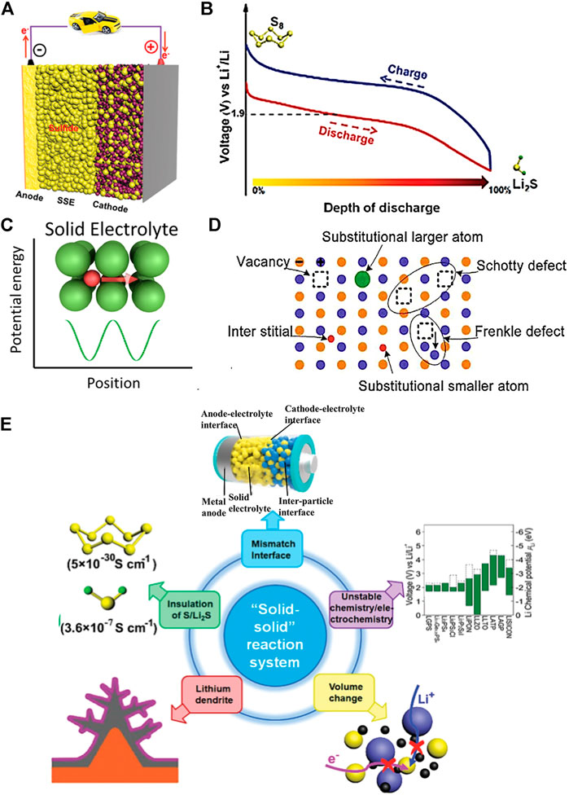
Background: All Solid State Li-S Battery
Higher Safety
High specific energy
Durable, Low cost
Higher cycle life - less polysulfide dissolution
Engineered to prevent volume expansion
Beyond Li-ion & Liquid Li-S → ASSB Li-S:
High S utilization(>1000mAh/g) with >50 wt% S

Slide 4
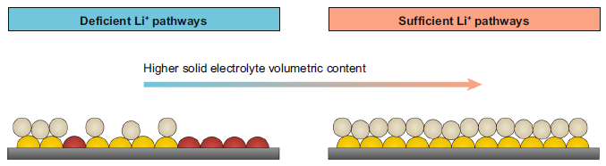
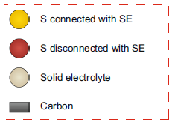
Our Context: All Solid State Li-S Battery
Challenges:
Practical Realization of High Specific Energy
S-Cathode:
Need High S utilization >1000 mAh/g with >50wt%S
General Strategies Used:
Improve cathode content uniformity
Improve interfacial contact
Enhance interfacial ionic transport
Hybrid cathodes with high ionic transport
Problems: → Improved S Utilization at low S content – Unable to replicate results with high S contents above 50 wt%
Root Cause: Poor ionic transport within S Cathode → low S utilization
Solution: Use Low density Solid Electrolyte with small particle size (Lithium Phosphorus Boron (LPB))
Notes:
illustration showing that the sufficiency of Li+ pathways increases upon increasing SE volume content (from left to right) in the sulfur cathode.
High sulfur content – critical for achieving the full potential and to compensate for all the losses.

Slide 5
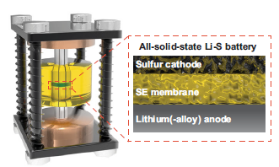
In Pursuit of All Solid State Li-S Battery
Challenges:
Developing Positive Electrode with High sulfur content
Adequate sulfur utilization
High mass loading
Proposed Solution: Liquid-phase-synthesized Li3PS4-2LiBH4 glass-ceramic solid electrolyte with low density(1.491g/cm3), small primary particle size(~500nm) & bulk ionic conductivity of 6mS/cm → LPB
Test: Swagelok cell configuration with Li-In anode & 60wt%S cathode, avg stack pressure of ~55MPa
Results: High discharge capacity ~1144.6 mAh/g at 167.5mA/g & 60degC
For context : Li-ion batteries typically offer a discharge capacity of around 150-250 mAh/g for graphite anodes
Demonstrated Benefits: Increased Electrolyte volume ratio in cathode, Reduced Inactive bulky sulfur, Improved content uniformity of the sulfur based positive electrode → Sufficient ion conduction pathways
Notes:
Developing Positive Electrode with High sulfur content
- Sulfur is an insulator (hampers cathode performance – need conductive additives)
Volume expansion – more sulfur means more expansion
Polysulfides (During discharge, sulfur is reduced to lithium polysulfides – loss of active material, capacity fade, poor cycle life)
Adequate sulfur utilization
Formation of insulating polysulfides – reduce effective active material
Sluggish reaction kinetics
High mass loading (of S- need this for high energy density)
large volumetric expansion during cycling – fractures, poor cycle stability
~1144.6 mAh/g is an impressive value, particularly at a moderate current density (167.5 mA/g) and relatively high temperature (60°C)

Slide 6
Demonstration – LPB Solid Electrolyte
Argyrodite glass-ceramic SE (Li3PS4-2LiBH4 – LPB)
Used High ionic conductive SE with small particle size to enable efficient ion transport in high-sulfur-content Cathode
High Performance Li-S ASSB - Observations:
High discharge capacity ~1144.6 mAh/g at 167.5mA/g & 60degC
Stable cycling with high initial discharge capacity
Low fading rate(~0.028% per cycle) for over 800 cycles with 77.5% capacity retention.
Other Findings: Excessive High S volume ratio & meager SE volume ratio in S-Cathode → Compromise uniformity → Inactive bulky S-particles → Low ion transport → Low S-Utilization.

Slide 7
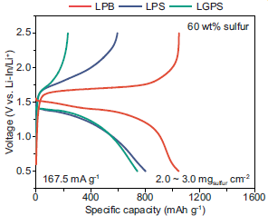
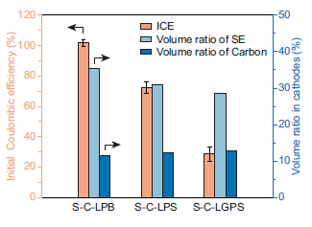
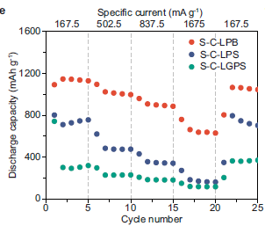
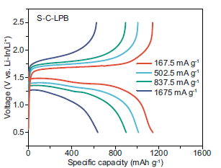
RESULTS – LPB vs LPS & LGPS
Lithium Phosphorus Boron (LPB)
Lithium Phosphorus Sulfide (LPS)
Lithium Germanium Phosphorus Sulfide (LGPS)
Notes:
The comparison of LPB with LPS and LGPS electrolytes highlights LPB’s superiority in capacity, Coulombic efficiency, and rate performance
Key Insight:
- LPB’s smaller nanoparticle size (~500 nm) and mixed-phase structure improve Li⁺ pathway connectivity in high-sulfur cathodes.
- LPB enables higher sulfur utilization and lower polarization due to optimized percolation pathways, even with lower SE content.
- Compatible with Li-In alloy anodes (prevents Li penetration). Also it’s less reactive with LPB compared to Li metal
- In high-sulfur cathodes (60 wt% S), ionic percolation (governed by SE particle size and volumetric content) is more critical than intrinsic SE conductivity.
- Smaller nanoparticles (~500 nm) and glass-ceramic structure create sufficient Li⁺ pathways at low SE content (24 wt%), whereas LGPS/LPS require 40 wt% SE for comparable performance.

Slide 8
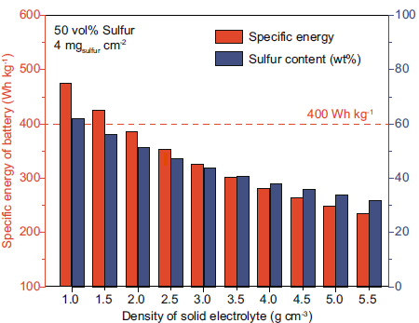
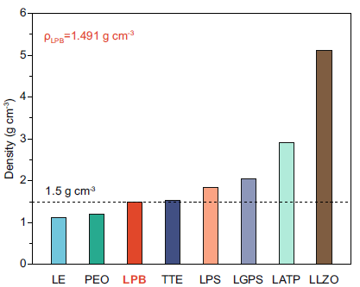
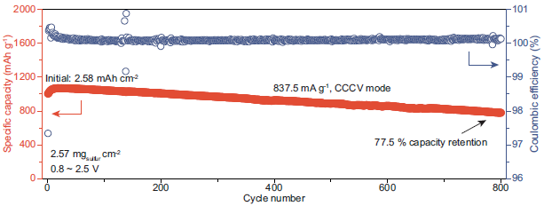
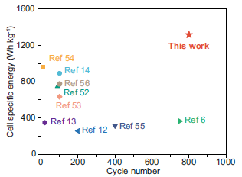
Results
Notes:
Dependence of specific energy at battery level and sulfur content at cathode level on the density of SE. The estimation was performed by assuming fixed volume ratios of cathode (or battery) components. The weight of the sulfur cathode, SE membrane, Li anode, and current collectors was considered for calculating the specific energy of Li-S ASSBs.
Comparison of density among LPB, non-aqueous liquid electrolyte solutions, polymer electrolytes, and inorganic SEs.
LE: nonaqueous liquid electrolyte solutions; PEO: poly(ethylene oxide); LPB: Li3PS4-2LiBH4;TTE: 1,1,2,2-tetrafluoroethyl-2,2,3,3-tetrafluoropropyl ether; LPS: β-Li3PS4; LGPS:Li10GeP2S12; LATP: Li1.3Al0.3Ti1.7(PO4)3; LLZO: Li7La3Zr2O12

Slide 9
Conclusion
Demo’ed of SE with low density & high ionic conductivity can achieve High specific capacity.
Unlike conventional inorganic SEs (LPS and LGPS) with high density – low density LPB SE enables S-cathode with a higher SE volume ratio, low bulky S-particles & good content uniformity -- in addition to good ionic transport due to the high ionic conductivity of LPB SE.
LPB’s nanostructured glass-ceramic design optimizes Li⁺ percolation in high-S cathodes, outperforming even high-conductivity LGPS
Highlight: Ionic conductivity(LGPS - highest) alone is insufficient—morphology & interfacial design (LPB has edge) are equally critical for solid-state Li-S batteries.
Critique:
Clear Explanation of methods used for synthesis, fabrication, measurement & testing.
Datasets are available on request – Establishes -- LPB superior to LPS & LGPS
Long sentences – need better readability & clarity.
Many references to supplementary figures – difficult to follow if no access to these.
No statistical analysis – can’t establish reliability of performance findings.
Lacks clear conclusion/summary & future research direction.
Notes:
Overall, this paper provides valuable insights into LPB solid electrolytes and their performance in solid-state Li-S batteries.
Goal : design principles for high-sulfur-loading cathodes – provides connection between SE volumetric content (vs. ionic conductivity) and cathode performance

Slide 10
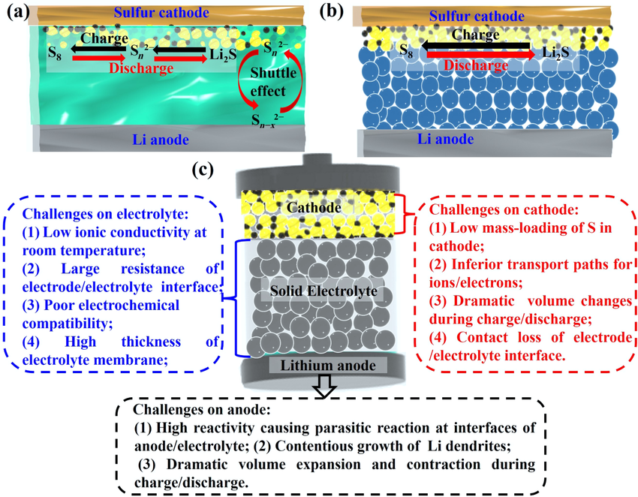
Thank you! Questions?

