Slide 1
Model Based Design – Matlab/Simulink
- Suryakiran

Slide 2
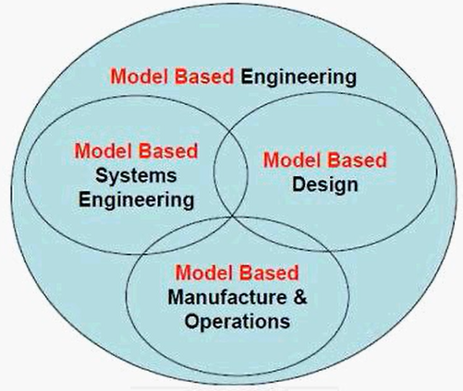
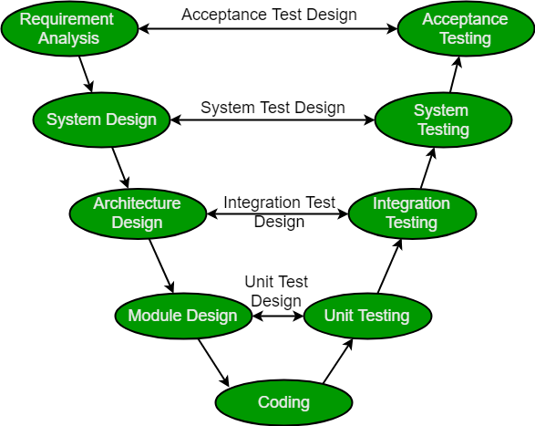
SDLC –- V Model
Product Engineering
Based on V-Model
Implementation using model instead of hard coding; code is generated automatically when model is already simulated and approved.
Why MBD? Growing complexity & functionality of systems & software.
Advantages:
Lowering barrier to entry
Parameterization : key properties are parameters
Reusability

Slide 3
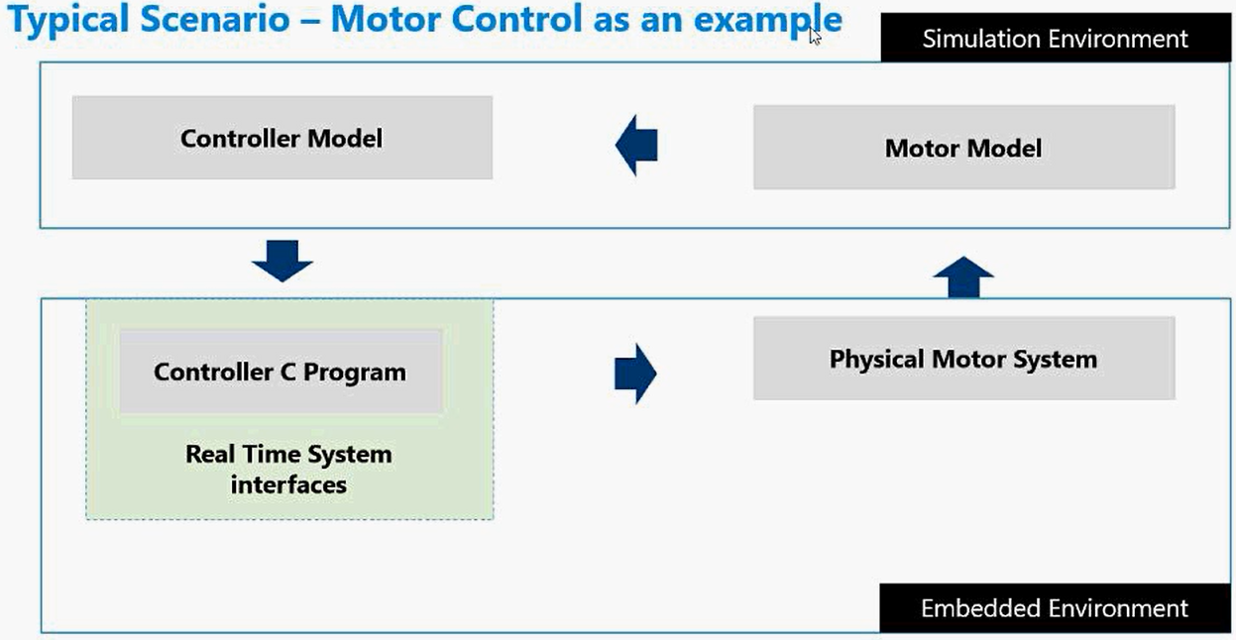

Slide 4
Model Based Engineering
An approach to engineering that uses models as an integral part of the technical baseline that includes the requirements, analysis, design, implementation, and verification of the product throughout the acquisition life cycle.
MIL Simulation : Plant, Controller & Input are modelled & simulated (Build's confidence)
SIL Simulation : The code generated from Algorithm is run in the host computer to drive the plant model. Used to test code coverage, execution time metrics etc.
PIL Simulation : code generated from a Simulink® model runs directly on the target hardware, which means you can test models on the hardware using the same test cases as on the host. PIL tests are designed to expose problems with execution in the embedded environment. For instance, does your control loop fit within the execution time available on the embedded processor?
HIL Simulation : Plant simulated in HW; Code generated is ported to the Embedded HW

Slide 5
Solving the Model
The process of computing the states of a model at successive time steps over a specified time span.
Solver selection based on time & accuracy
Step Size: Size of each successive time interval
Solver : A solver is a program that applies a numerical method to solve the set of ODEs that represent the continuous states of dynamic system/model.
Sequence of Operation: Left to Right, Top to Bottom; solves sequentially (See sorted execution order)
Fixed Step/Variable Step : With a fixed-step solver, the step size remains constant throughout the simulation. With a variable-step solver, the step size can vary from step to step, depending on the model dynamics. In particular, a variable-step solver increases or reduces the step size to meet the error tolerances that you specify.
Fixed-step solvers solve the model at regular time intervals from the beginning to the end of the simulation. You can specify the step size or let the solver choose the step size. Generally, decreasing the step size increases the accuracy of the results while increasing the time required to simulate the system.
Variable-step solvers vary the step size during the simulation. They reduce the step size to increase accuracy when a model's states are changing rapidly and increase the step size to avoid taking unnecessary steps when the model's states are changing slowly. Computing the step size adds to the computational overhead at each step but can reduce the total number of steps, and hence the simulation time required to maintain a specified level of accuracy for models with rapidly changing or piecewise continuous states.
Continuous /Discrete
Continuous solvers use numerical integration to compute a model's continuous states at the current time step based on the states at previous time steps and the state derivatives. Continuous solvers rely on the individual blocks to compute the values of the model's discrete states at each time step.
Discrete solvers exist primarily to solve purely discrete models. They compute the next simulation time step for a model and nothing else. In performing these computations, they rely on each block in the model to update its individual discrete states.

Slide 6
Resources
Simulink on Ramp
Matlab on Ramp
‘sldemo’ in command window
MATLAB help
For help on matlab commands type, help ‘your command’ in command window

Slide 7
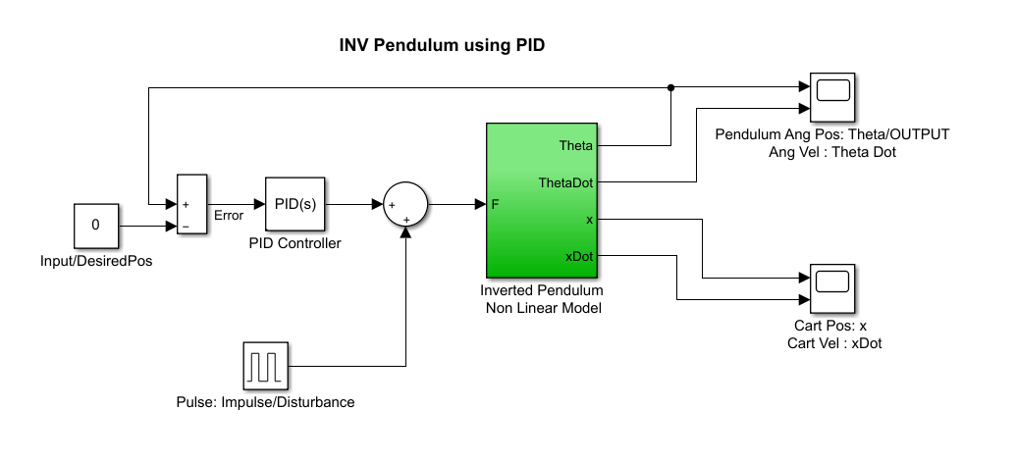
eXAMPLES

Slide 8
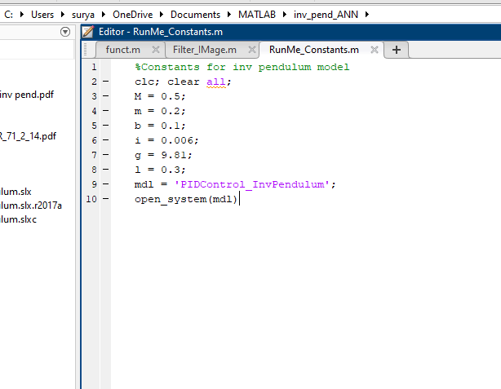
eXAMPLES

Slide 9
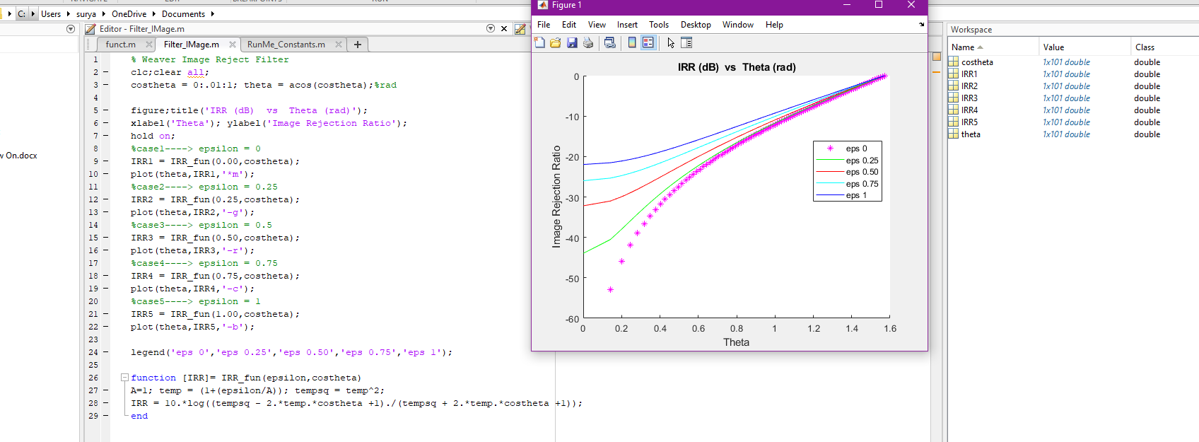
eXAMPLES

Slide 10
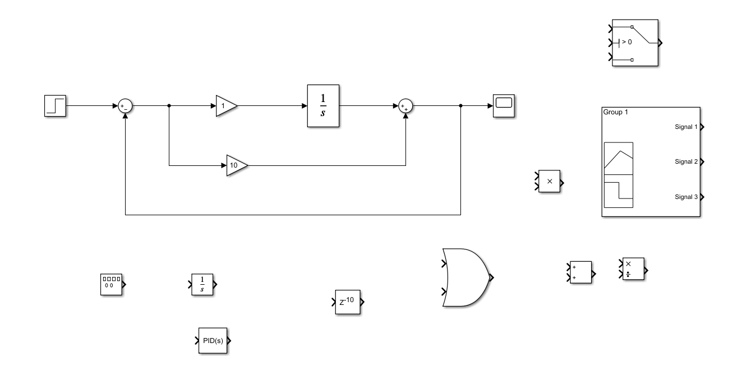
eXAMPLES

