Slide 1
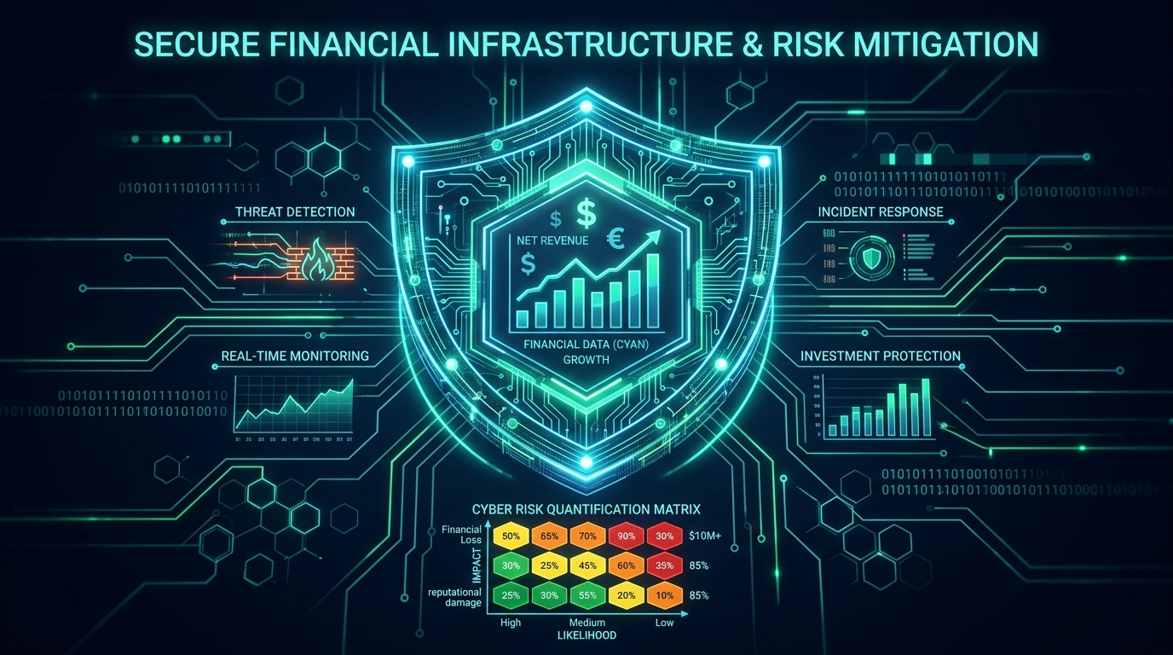
RESEARCH & PROTOTYPE DEFENSE
Cyber Risk Quantification &
Budget Optimization Platform
Solving the CISO-CFO Chasm through Empirical Financial Modeling (FAIR), 0/1 Knapsack Resource Allocation & Active Layer 7 Defense.
• The Core Problem: CISO-CFO communication gap & subjective 5x5 color heatmaps.
• The Solution: Converting CVE vulnerabilities into Annualized Loss (ALE in ₹).
• The Methods: FAIR Framework, 0/1 Knapsack DP, Web Scanner & Layer 7 WAF.
• Proven Results: ₹26.64L Net Savings, +337.3% to +739.3% Security ROI.

Slide 2
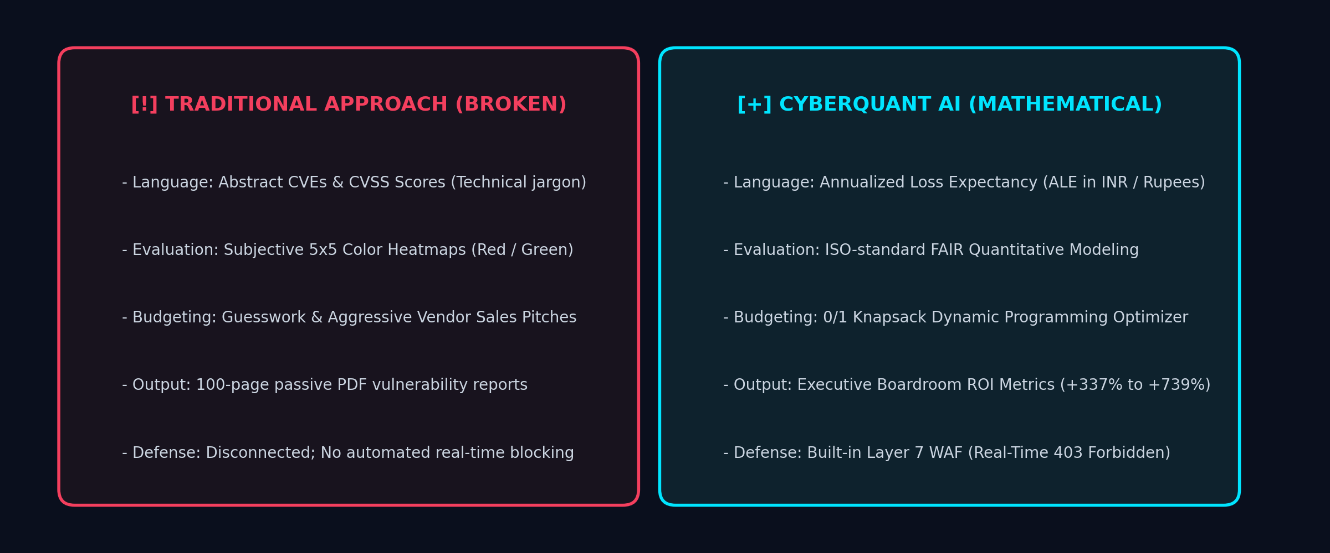
1. PROBLEM IDENTIFICATION
What is the Problem? The Industry Cybersecurity Dilemma
Traditional enterprise cybersecurity is paralyzed by subjective metrics and misallocated investments.
FOUR CRITICAL INDUSTRY FAILURE POINTS
❌ 1. CISO vs CFO Language Gap:
Security engineers speak in CVEs and CVSS scores; CFOs and Boardrooms speak in currency (₹) and ROI. CFOs cannot evaluate the value of security tools.
❌ 2. Subjective 5x5 Color Heatmaps:
Traffic-light grids (Red/Yellow/Green) guess severity arbitrarily. A minor slow page and a massive customer database leak are both labeled 'High'.
❌ 3. Blind Spending & Redundancy:
Companies have limited budgets (e.g. ₹3L-₹15L) but face 100+ vendor tools. Without math, they waste budget on redundant, low-impact software.
❌ 4. 'Scan & Abandon' Inaction:
Legacy scanners (Nessus, Qualys) generate static 100-page PDF reports. They provide zero budget optimization and zero active attack mitigation.
💡 THE BOTTOM LINE:
Companies are spending millions on security tools, yet still suffering devastating breaches because investments are made on vendor hype rather than empirical risk reduction.
Our solution transforms cybersecurity from an emotional guessing game into an exact, solvable optimization equation.

Slide 3
2. STRATEGIC SOLUTION
How to Solve It? Transforming Cyber Risk into Solvable Math
A 3-pillar blueprint: Financial Risk Quantification + Algorithmic Optimization + Active Defense.
1. Monetize Cyber Risk (FAIR)
Translate Technical Flaws into Currency (₹)
✔ Compute Annualized Loss Expectancy (ALE in ₹) for every digital asset.
✔ Equation: ALE = Loss Event Frequency (LEF) × Loss Magnitude (LM).
✔ CFOs instantly see: 'Our baseline exposure is ₹39.70 Lakhs/year across ₹1.50 Cr of assets'.
✔ Grounds cyber security directly in corporate balance sheet risk management.
2. Algorithmic Optimization (0/1 Knapsack)
Maximize Risk Reduction per Rupee Spent
✔ Treat corporate security budget as Knapsack Capacity (W) and controls as value-cost items.
✔ Dynamic Programming algorithm mathematically selects the optimal control set.
✔ Eliminates trial-and-error: guarantees maximum protection within budget limits.
✔ Proves +337.3% to +739.3% Security ROI for both lean and enterprise budgets.
3. Active Defense Enforcement (Layer 7 WAF)
Close the Gap Between Audit and Protection
✔ Don't just inspect and report vulnerabilities—actively terminate malicious traffic.
✔ Inspects live HTTP requests for SQL Injection, XSS, and Path Traversal payloads.
✔ Immediate real-time mitigation with HTTP 403 Forbidden enforcement.
✔ Provides an end-to-end cycle: Assess → Quantify → Optimize → Defend.

Slide 4
3. SELECTED METHODOLOGY
What Methods Did I Select to Use & Why?
A rigorous combination of empirical frameworks, algorithmic theory, and defense engineering.
Method 1: FAIR Framework (Factor Analysis of Information Risk)
• Mathematical Formula: ALE = Loss Event Frequency (LEF) × Loss Magnitude (LM).
• Why Selected: Globally recognized Open Group / ISO-compatible standard for empirical financial cyber risk quantification.
• Technical Impact: Translates 5 portfolio assets worth ₹1.50 Cr into an exact baseline risk of ₹39,70,260/yr.
Method 2: 0/1 Knapsack Dynamic Programming Optimizer
• Mathematical Formula: Maximize ∑ (ΔRisk_i) subject to ∑ (Cost_i) ≤ Budget, where x_i ∈ {0, 1}.
• Why Selected: Guarantees global mathematical optimum; cannot be swayed by vendor sales pitches or guesswork.
• Technical Impact: Solves combinatorial control allocation in O(N × W) time, delivering +739% ROI on lean budgets.
Method 3: Automated Asset Reconnaissance & Vulnerability Scanner
• Technical Mechanics: Multi-threaded HTTP/TLS header auditing, port mapping, and vulnerability correlation.
• Why Selected: Provides empirical real-world inputs to feed the FAIR engine rather than manual subjective assumptions.
• Technical Impact: Instantly audits missing HSTS, CSP, X-Frame-Options, SSL expiry, and exposed endpoints.
Method 4: Layer 7 Active Web Application Firewall (WAF)
• Technical Mechanics: High-performance regular expression inspection on query params, headers, and body payloads.
• Why Selected: Bridges the critical gap between passive assessment and active threat mitigation.
• Technical Impact: Real-time neutralization of OWASP Top 10 exploits (SQLi, XSS, Path Traversal) with HTTP 403.

Slide 5
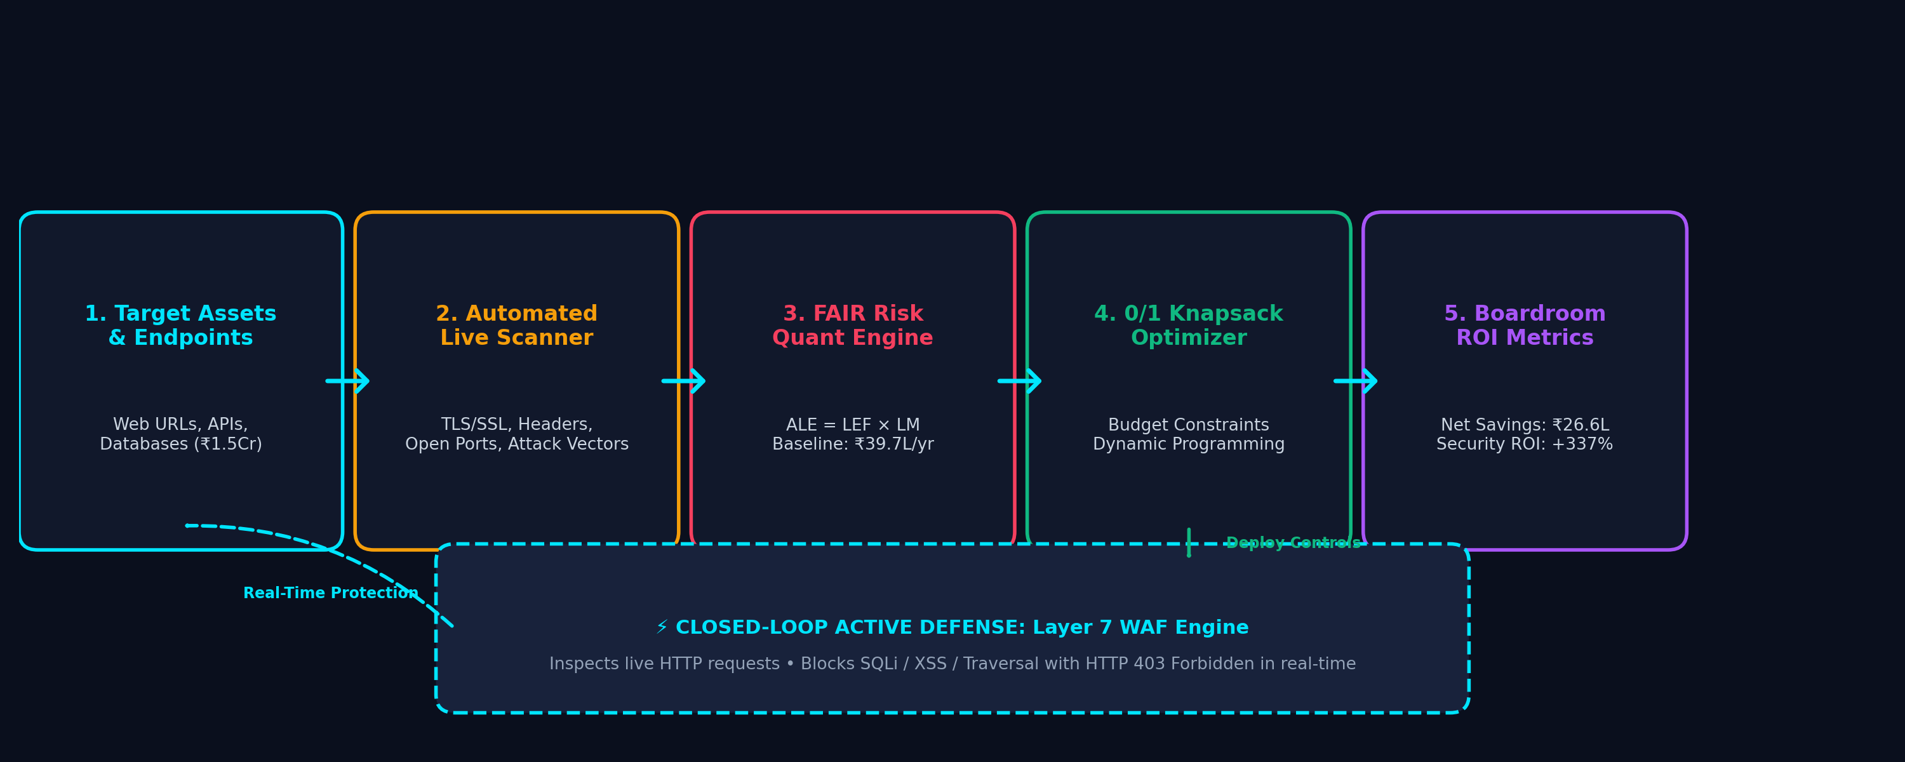
4. ARCHITECTURE & WORKFLOW
System Architecture: End-to-End Autonomous Pipeline
How data flows seamlessly from asset discovery through financial quantification to real-time defense.
PIPELINE SUMMARY: Discovery ➔ FAIR Risk Quantification (ALE ₹) ➔ 0/1 Knapsack AI ➔ Boardroom Metrics ➔ Real-Time WAF Defense

Slide 6
5. ADVANTAGES & STRENGTHS
Pros of My Solution: Proven Value Proposition
Quantifiable advantages over both traditional scanners and expensive enterprise platforms.
✔ C-Suite & Boardroom Alignment
• Eliminates technical jargon. Converts abstract CVEs into clear financial liabilities in Indian Rupees (₹).
• CFOs can approve security budgets with full confidence in expected savings.
• Transforms cybersecurity from an unavoidable operational expense into a measurable investment.
✔ Mathematically Optimal Budget Allocation
• 0/1 Knapsack Dynamic Programming guarantees that not a single rupee is wasted.
• Proven results: ₹2.90L spend yields ₹24.33L in loss avoidance (+739.3% ROI).
• Protects resource-constrained startups and SMEs from predatory vendor upselling.
✔ Closed-Loop Active Defense
• Unlike Nessus or Qualys which only generate passive PDF reports, CyberQuant actively defends.
• Integrated Layer 7 WAF intercepts live malicious traffic (SQLi, XSS, Path Traversal).
• Provides an end-to-end cycle: Assess → Quantify → Optimize → Defend.
✔ High Speed & Lightweight Architecture
• Sub-second mathematical optimization calculations using dynamic programming.
• Lightweight Python/FastAPI architecture with zero external enterprise cloud dependencies.
• Cost-effective deployment accessible to any organization regardless of size.

Slide 7
6. CRITICAL EVALUATION
Cons & Limitations of My Solution (+ How We Mitigate Them)
An honest, rigorous engineering evaluation of system boundaries and planned architectural mitigations.
1. Asset Valuation Dependency
⚠️ Limitation: FAIR model requires initial asset financial value inputs.
🛡️ Mitigation: Pre-configured industry-standard valuation templates for e-commerce, healthcare, and finance SMEs to eliminate manual estimation effort.
2. Threat Frequency Probabilities
⚠️ Limitation: Loss Event Frequency (LEF) relies on historical threat statistics.
🛡️ Mitigation: Automated threat telemetry integration (CISA KEV, MITRE ATT&CK, AlienVault OTX) to continuously refine probability weights dynamically.
3. WAF False Positive Potential
⚠️ Limitation: Aggressive regex inspection could mistakenly flag complex legitimate user queries.
🛡️ Mitigation: Implemented whitelisting rules, contextual sanitization pipelines, and anomaly score thresholds instead of blunt string matching.
4. Discrete Knapsack Boundary
⚠️ Limitation: 0/1 Knapsack treats controls as binary (all or nothing), ignoring partial deployments.
🛡️ Mitigation: Future evolution to Fractional Knapsack / Multi-choice Knapsack for phased rollouts and hybrid licensing models.

Slide 8
7. STRATEGIC CONCLUSION
Conclusion: A Paradigm Shift in Cyber Defense & Next Steps
Transforming cybersecurity from an opaque cost sink into an automated, profitable business enabler.
Proven Problem-Solving Impact
✔ Directly resolves the #1 friction in corporate security: CISO-CFO communication gap.
✔ Validates real ROI: ₹26.64L net profit on full deployment; +739% ROI on lean budget.
✔ Bridges the divide between theoretical risk assessment and real-time defense.
Commercial & Research Viability
✔ Democratizes Cyber Risk Quantification (CRQ)—making $50K enterprise features accessible.
✔ Zero cloud vendor lock-in: standalone, lightweight, fast, and highly customizable.
✔ Immediate real-world applicability for Indian SMEs, startups, and regulated sectors.
Future Technological Roadmap
✔ Phase 1: Real-time CISA KEV threat intelligence stream ingestion.
✔ Phase 2: Reinforcement Learning (RL) for dynamic budget optimization across multi-cloud.
✔ Phase 3: Automated regulatory compliance mapping (DPDP Act 2023, ISO 27001, SOC 2).
EXECUTIVE TAKEAWAY: Security is no longer an expense. With CyberQuant AI, it is a mathematically optimized investment with +337.3% net ROI.

