Slide 1
Credit Card Fraud Detection Using Logistic Regression and Isolation Forest Anomaly Detection
Machine Learning Case Study | B.Tech | A.Y. 2026-27
V. Bhardwaj (2520090182) P. Uday (2520090089) A. Sri Chaitanya (2520090094)
Guide: Dr. Y. Lakshmi Prasanna, Asst. Professor
Department of CS&IT

Slide 2
Introduction
Background
Domain
Why needed
Card payments are the default way to pay
Fraud causes loss, chargebacks and lost trust
Fraud detection is core to every card issuer
Machine learning on transaction data
Only 492 of 284,807 transactions are fraud (0.17%)
Needs imbalance-aware methods
Stop stolen cards before money is lost
Catch known and new fraud types
Keep false alarms manageable
2

Slide 3
Problem Statement
Existing problem
Challenges
Who is affected
Fraud is rare: predicting 'legitimate' always gives 99.8% accuracy but catches nothing
Accuracy is misleading
Extreme class imbalance
New fraud looks unlike past fraud
False alarms annoy genuine customers
Banks (direct losses)
Cardholders (blocked or stolen cards)
Merchants (chargebacks)
3

Slide 4
Motivation
Why this project: fraud detection differs from ordinary classification and tests real ML skills
Real-world need: a bank must approve purchases instantly yet block misuse
Industry need: combine a supervised model (known fraud) with an unsupervised detector (unusual behaviour)
Evaluate with metrics suited to imbalanced data: Precision, Recall, F1, ROC-AUC, PR-AUC
4

Slide 5
Objectives
Main objective: build a two-layer fraud detection system that catches maximum fraud (high recall) with manageable false alarms.
Data preprocessing and EDA
Logistic Regression with class weights
1
2
Isolation Forest anomaly detection
Combined High / Medium / Low risk strategy
3
4
5

Slide 6
Existing vs Proposed System
Existing approach
Proposed system
Single classifier judged mainly by accuracy
Cannot see new, unseen fraud types
Ignores class imbalance
Flat 'fraud / not fraud' label
Layer 1: Logistic Regression (balanced weights) for known fraud
Layer 2: Isolation Forest for unusual transactions
OR rule plus High / Medium / Low risk levels
Judged by Recall, Precision, F1, ROC-AUC, PR-AUC
6

Slide 7
System Architecture
INPUT
PREPROCESS
MODELS
COMBINE
OUTPUT
Transaction data
Time, V1-V28, Amount
Remove duplicates
RobustScaler
80/20 split
Logistic Regression
Isolation Forest
LR OR IF
Risk level
High: block
Medium: verify
Low: approve
Layer 1 learns known fraud from labels; Layer 2 flags unusual behaviour without labels.
7

Slide 8
Methodology / Workflow
1. Load data
2. Clean: nulls, duplicates
3. Scale Time, Amount
4. Stratified split
5. Train LR
6. Train IF
7. Combine
8. Evaluate
Row 1: data preparation | Row 2: modelling and evaluation
8

Slide 9
Technology Stack and Modules
Technology stack
System modules
Language: Python
Libraries: pandas, NumPy, scikit-learn
Visualization: matplotlib, seaborn
Data: creditcard.csv (CSV file)
Hardware: standard PC, no GPU
Data collection and loading
Preprocessing (clean, scale, split)
Core ML: Logistic Regression, Isolation Forest
Prediction: combined rule and risk levels
Reporting: metrics, confusion matrix, ROC / PR
9

Slide 10
Dataset and Preprocessing
Item | Detail
Dataset | Credit Card Fraud Detection (ULB / Kaggle)
Records | 284,807 (283,726 after cleaning)
Features | Time, V1-V28 (PCA), Amount; target Class
Fraud cases | 492 (0.173%), about 1 in 577
Train / Test | 226,980 (394 fraud) / 56,746 (98 fraud)
Preprocessing
No missing values
1,081 duplicates removed; all 492 frauds kept
RobustScaler on Time and Amount (skewed outliers)
Stratified 80/20 split
10

Slide 11
Algorithms / Models
Logistic Regression
Isolation Forest
Supervised; outputs fraud probability
class_weight = balanced, max_iter = 1000
Threshold = 0.5
Why: simple, fast; PCA features are uncorrelated
Unsupervised; trained without labels
n_estimators = 200
contamination = 0.00174 (train fraud rate)
Why: isolates rare points and can catch unseen fraud
11

Slide 12
Results
Model | Acc. | Prec. | Recall | F1 | ROC-AUC | PR-AUC
Logistic Regression | 0.9815 | 0.0823 | 0.9592 | 0.1516 | 0.9972 | 0.8401
Isolation Forest | 0.9965 | 0.0894 | 0.1122 | 0.0995 | 0.8725 | 0.0373
Combined (LR OR IF) | 0.9796 | 0.0754 | 0.9592 | 0.1399 | - | -
Logistic Regression caught 94 of 98 frauds
Isolation Forest caught only 11
Low precision at the 0.5 threshold; tune the threshold using the PR curve
12

Slide 13
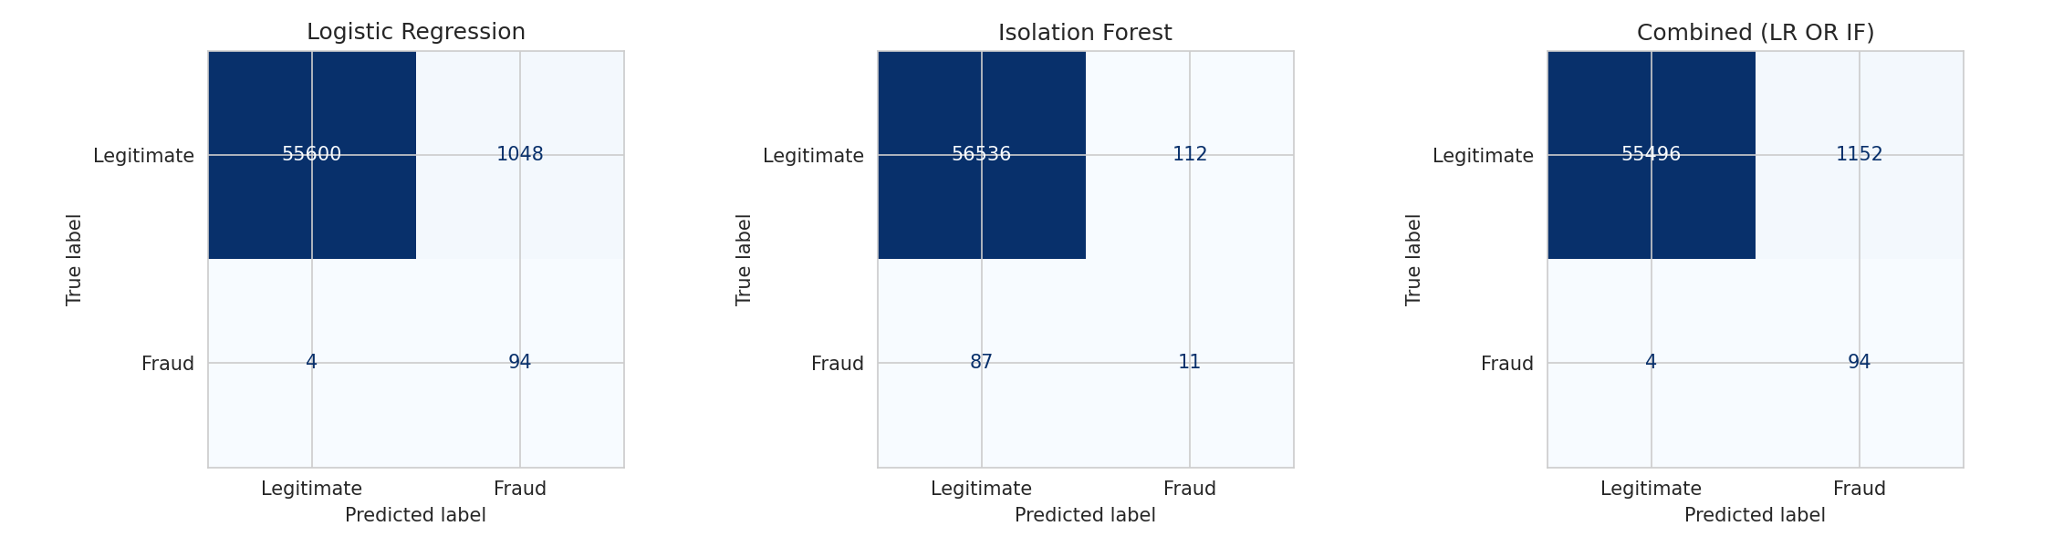
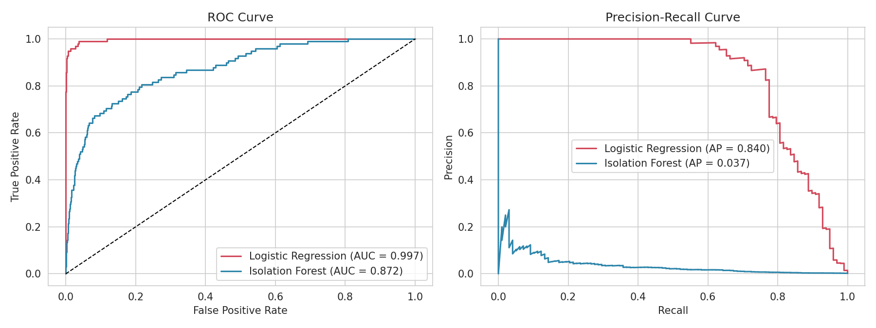
Graphs and Risk Strategy
Risk levels (test set)
High (both alert): 11 fraud, 8 genuine. Block or verify
Medium (one alerts): 83 fraud, 1,144 genuine. OTP or review
Low (none): 4 fraud, 55,496 genuine. Approve
Confusion matrices: LR (TP 94, FP 1,048, FN 4), IF (TP 11, FP 112, FN 87)
ROC and PR curves
13

Slide 14
Advantages and Applications
Advantages
Applications
Very high recall (0.959) for fraud
Two layers cover known and unusual fraud
Risk levels guide action, not a flat label
Fair evaluation beyond accuracy
Banks and card issuers
Payment gateways, e-commerce
Insurance and fintech fraud screening
Users: risk analytics and fraud-review teams
14

Slide 15
Limitations and Future Scope
Limitations
Future scope
Only two days of European data
Anonymised features: not explainable
Low precision; many false alarms at 0.5
Single split, no cross-validation; offline only
Threshold tuning and cost-based evaluation
Cross-validation; try XGBoost or deep models
Real-time deployment with monitoring
Human review loop with OTP verification
15

Slide 16
Conclusion
Built a two-layer fraud detection system using Logistic Regression and Isolation Forest
Logistic Regression was strongest: Recall 0.959, ROC-AUC 0.997, 94 of 98 frauds caught
Isolation Forest gave a complementary anomaly signal (Recall 0.112)
High / Medium / Low risk strategy is practical for real banks
Accuracy alone is misleading on imbalanced data; Recall, PR-AUC and confusion matrices give a fair view
16

