Slide 1


PLAYFAIR CIPHER
A . Rohith 2003A51109
K. Surya Kumari 2003A51123

Slide 2


What we learnt from the course project
We have used concepts of swings , classes, objects, string methods in the process of implementing the course project.
We have been able to differentiate and use the concepts according to the necessity.
We have been able to implement the concepts that we learnt in class.

Slide 3
Where did we faced problems while doing project
We faced difficulties in printing the output on jframe window while using swings

Slide 4
How did we solved it
We have referred through relevant resources and understood the roots of the concepts where we faced issues.
We have gone through different possible solutions to obtain the final output.

Slide 5
Introduction
Generally we use ciphers to maintain security and privacy
Our project playfair cipher is all about converting plaintext to encrypted text and cipher text to decrypted or plaintext
In our project we use a 5X5 matrix in which each cell contain a alphabet
And here we consider a key word which do not have any reputed letters and first cells of the matrix is filled with the key word
Based on the matrix and rules we encrypt and decrypt the text

Slide 6
Objective
Our main objective is to convert plain text to cipher text and improve security
And also to decrypt the cipher

Slide 7
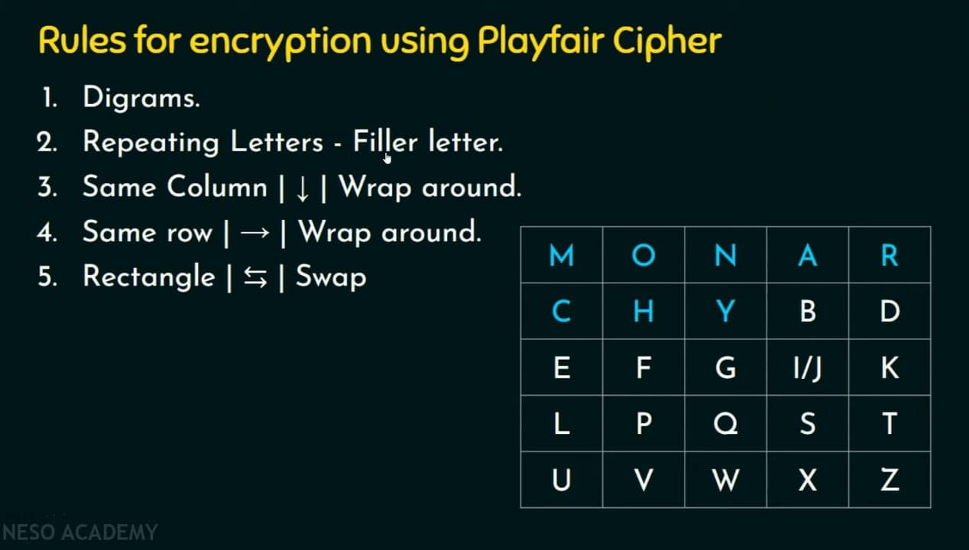
Procedure

Slide 8
Why did we choose the project
To perform encryption and decryption operations which improves security

Slide 9
References
5228924/files/folder/Unit-2?preview=188030769
https://stackoverflow.com/questions/6179101
https://www.javatpoint.com

Slide 10
Conclusion
By end of the project we could get a hold on the various topics of java.
We could understand the concepts better and implement them for real time uses.
We have gained and developed coding skills.

Slide 11
Acknowledgement
We would like acknowledge and give my warmest thanks to my supervior T.Sampath Kumar sir who made this work possible under his guidance through this wonderful opportunity which helped us evolve academically.

