Slide 1

Surya Chandra Raju Kurapati
(x23396920)
Nisarga Holenarasipur Ramesh
(x24101028)
Saranya Munikanniah
(x23434821)

Slide 2
Idea
Pain points after patients’ initial visit to doctor:
Keep a track of end-to-end patient profile
Summarize the visit into key sections such as Issue, Diagnosis/Test, Treatment/Prescription.
Pros:
Handy mobile app – for quick revisit(s)
Response in 5 seconds
Both doctor and patient revisiting the case anytime, anywhere and leave comments if any to each other

Slide 3
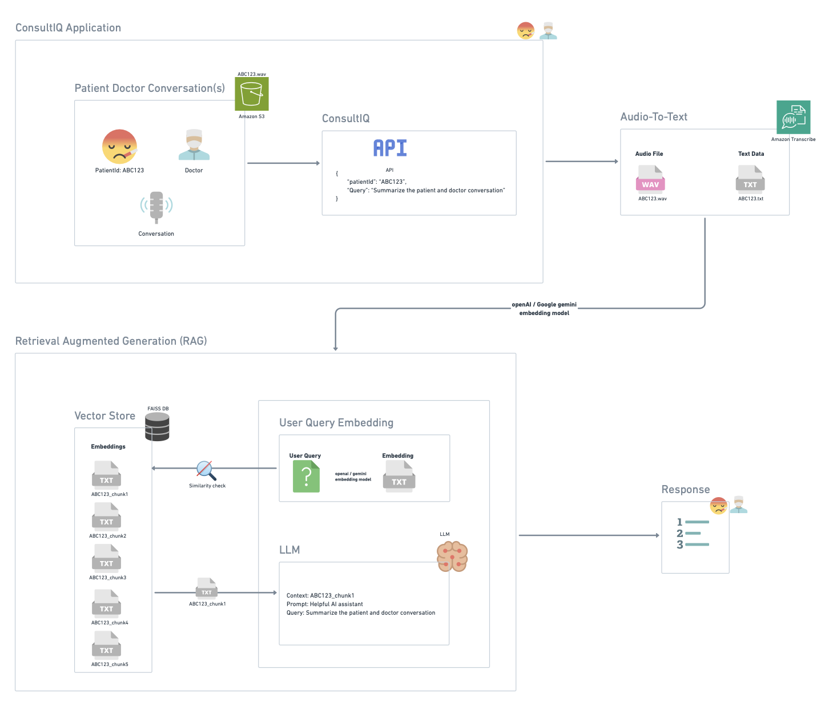
Architecture

Slide 4
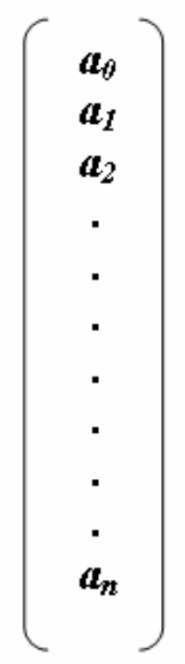
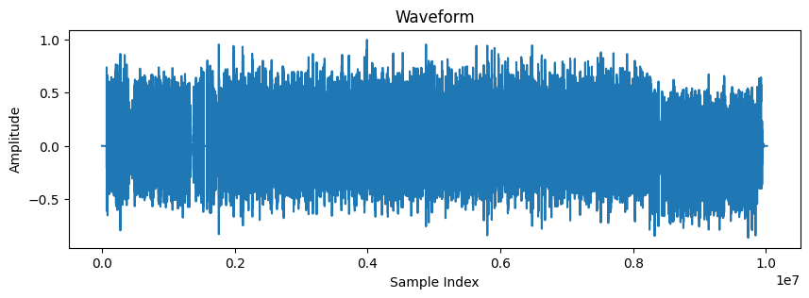
Speech to Text workflow
1D PyTorch tensor (librosa)
CNN - wav2vec2 tokenizer
Wav2vec2 CTC decoder
(Connectionist Temporal Classification)
Logits (1 audio file, 150 frames, 32 vocab)
Source File
Frame/Time Step | 0 | 1 | 2 | 3 | 4 | 5 | . | . | . | 32
1 | 4.5 | 0.9 | 0.3 | 0.7 | 0.2 | 0.8 | . | . | . | 0
2 | 0.7 | 5.1 | 0.3 | 0.5 | 0.4 | 1.1 | . | . | . | 0
. | 0 | 0 | 0 | 0 | 0 | 0 | . | . | . | 0.1
. | 0 | 0 | 0 | 0 | 0 | 0 | . | . | . | 0.1
150 | 0.4 | 0.6 | 0.5 | 0.7 | 3.5 | 0.9 | . | . | . | 0
.wav file
16KHz / sec
Argmax (1, 150)
Decode
[4.5, 5.1,…, 0.1,…3.5]
[“h”, “I”, …..,” “]
“hi “
Say, 3 sec audio file with “hi “
Frame into 20 msec chunk with 320 samples
3 sec * 1000 msec/sec / 20 msec = 150 frames
n = 48000 waveforms / samples
(3 sec * 16000 Hz)
Models:
Speech-to-text: facebook/wav2vec2-base-960h
Embeddings: all-MiniLM-L6-v2
LLM: gemini-2.0-flash

