Slide 1
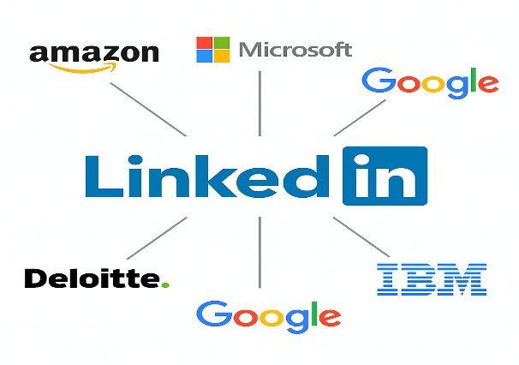
Optimizing B2B Sales Outreach at LinkedIn using Job Activity Signals and Lead Scoring
Surya Chandra Raju Kurapati
x23396920
Saranya Munikannaiah
x23434821
Yathish Juttu Rajkumar
x23389818

Slide 2
Problem Statement
Platform underperforming due to Operational and Financial instabilities due to:
Low Application Conversion Rates
Revenue Leakage (Poor Monetization)
High Employer Churn
Lack of Insights
Manual & Reactive Process
Notes:
LinkedIn's job posting platform is underperforming due to several critical operational and financial challenges:
Low Conversion: Despite job listings receiving views, application rates remain low.
Revenue Leakage: Minimal use of sponsored listings (only ~5%) results in poor monetization.
High Employer Churn: Employers are leaving the platform due to poor ROI and a lack of actionable feedback.
Lack of Insights: There’s no consolidated view of job performance, employer engagement, or candidate behavior.
Manual & Reactive Processes: Outreach to employers is delayed, non-personalized, and lacks automation.
This results in lost revenue, reduced satisfaction, and operational inefficiency, threatening LinkedIn's competitiveness in the recruitment market.

Slide 3
Business Goals & Strategy
Goals
Increase Job Conversion Ratio (Applies / Views)
Maximize ROI for employers
Strategy
CRM Implementation – Centralized Integration
BI Dashboards – Performance & Alerts
Target Employers - Sponsorship
Strategic frameworks – SWOT, Balance Scorecard, PDCA
Platform Engagement & Employer Retention

Slide 4
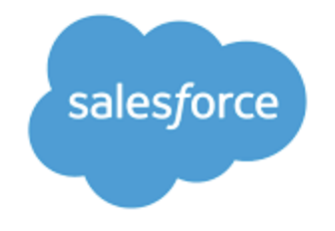
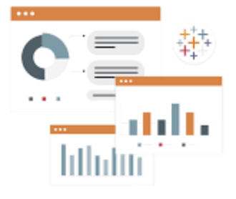


Proposed Business Model
Contacts
User Behavior
Accounts
Job Postings
Job Performance
Alerts Dashboard
LinkedIn Sales Navigator
(CRM Sync)
salesforce
connector
dashboards
LinkedIn
CRM Sales
Opportunities

Slide 5
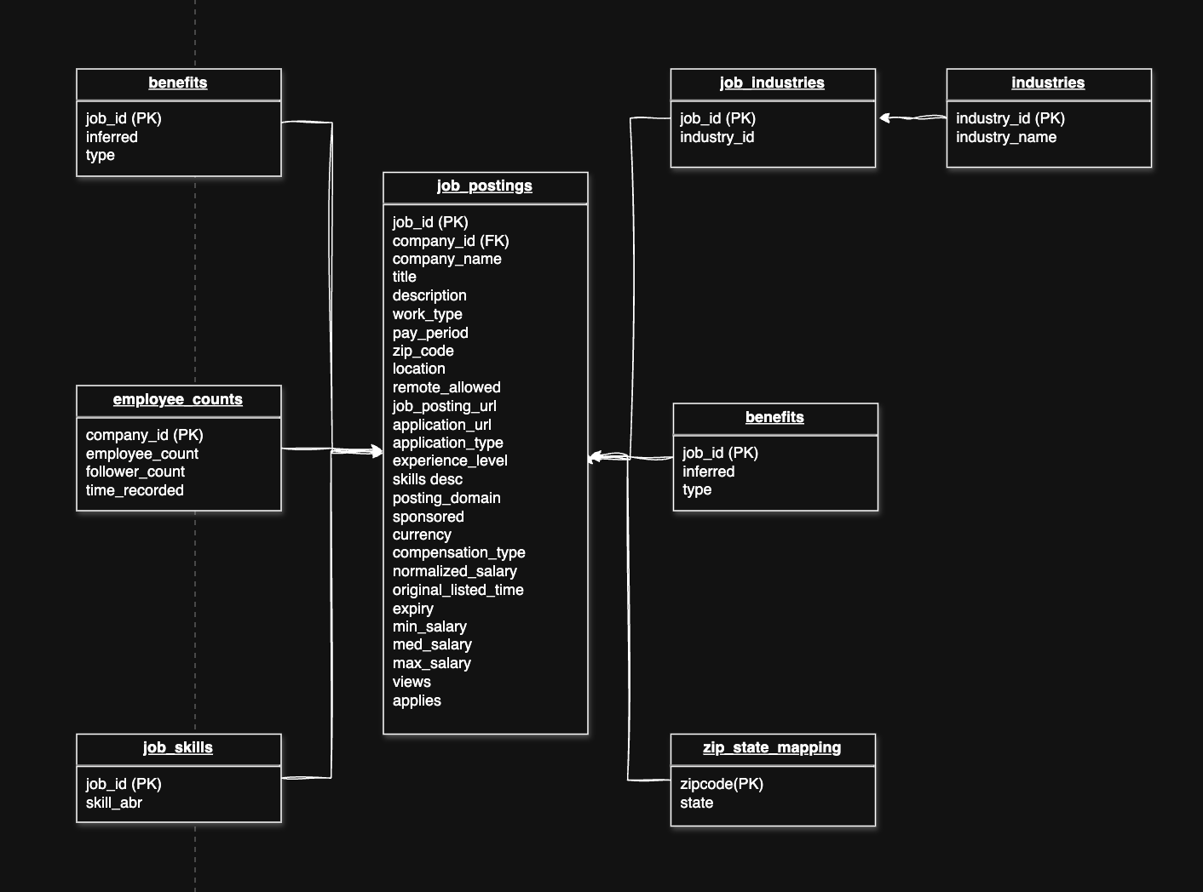
Data Model

Slide 6
SWOT Analysis
STRENGTHS
Large employer base, trusted brand, access to job & engagement data.
OPPORTUNITIES
Integration of sales CRM and BI dashboards
THREATS
Competitors ahead in terms of Analytics, Social-Platform ads, One-Click apply
WEAKNESSES
Poor use of sponsorship, no automation or insights

Slide 7
Continuous Improvement Program - PDCA
Plan
RCA- (SWOT)
Do
Salesforce CRM sales
Check
Monitor Views, Job Conversion Ratio, Employer activity
Act
CRM Objectives
KPIs benchmarking
Tableau BI dashboard
Adjust KPIs
Tweak Sponsorship strategy

Slide 8
Balance Scorecard
Alignment of strategic objectives with measurable KPIs across below 4 dimensions:
Perspective | Strategic Objective | Relevant KPIs (from Dashboards) | Insights / Explanation
Financial | Improve employer ROI on job listings | - Job Conversion Ratio | Evaluate how job views lead to applications and hires. Sponsored posts' ROI can be tracked here.
 |  | - Sponsored vs. Organic Performance
 |  | - Application Rate
 | Control cost of low-performing listings | - Jobs Nearing Expiry Without Results | Identify underperforming posts to optimize promotion budget and listing strategy.
Customer (Employer) | Increase employer satisfaction and platform engagement | - Top Companies by Conversion | Helps identify strategic partners and pain points in conversion effectiveness.
 |  | - Companies with Least Conversion Ratio
 |  | - Target Companies for Sponsorship
 | Improve listing effectiveness | - Top Viewed Job Titles | Match job features with industry/job seeker preferences.
 |  | - Benefits Provided
Internal Process | Optimize job listing and performance cycle | - Min/Max Posting Available Period | Reveals how quickly jobs receive applications and how listing time affects engagement.
 |  | - Jobs Trend (Posting Activity)
 |  | - Application Types
 | Enhance visibility and conversion path | - Posting Domains | Guides decisions on domains and simplified application flows to increase conversion.
 |  | - Experience Level Summary
 |  | - Application Complexity Pie Chart
Learning & Growth | Understand job market trends to support strategic planning | - Top Skills (placeholder in screenshot) | Supports workforce and industry forecasting to adapt platform offerings.
 |  | - Industries with Highest Jobs
 |  | - Work Type Mix
 | Enable regional talent strategy | - Views Distribution by State | Highlights geographic areas to target or improve listing visibility.
 |  | - States with Least Interaction

Slide 9
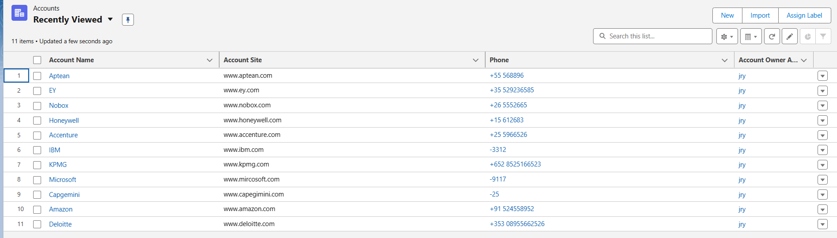
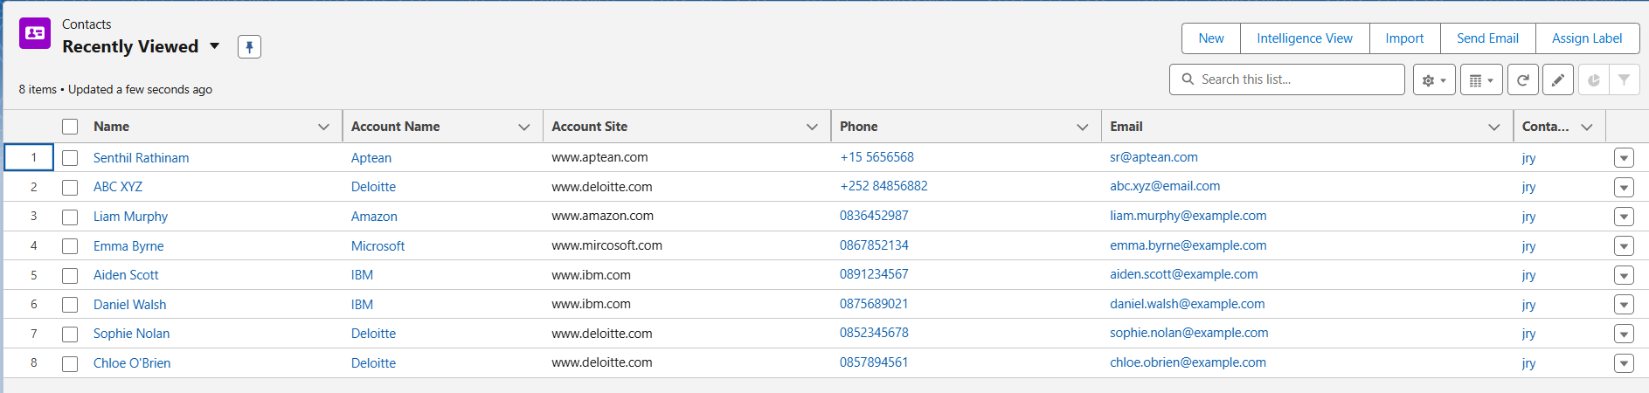
Salesforce CRM sales Integration
Accounts
Contacts

Slide 10
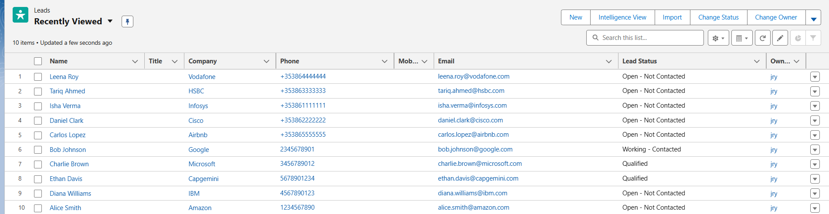
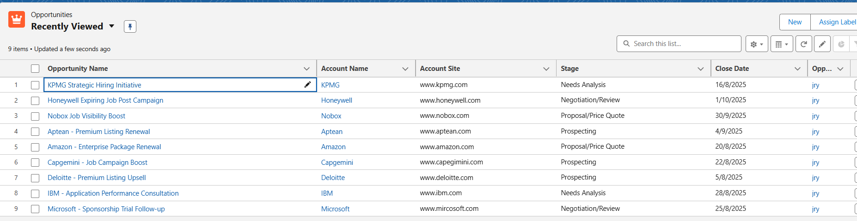
Salesforce CRM sales Integration
Leads
Opportunities

Slide 11
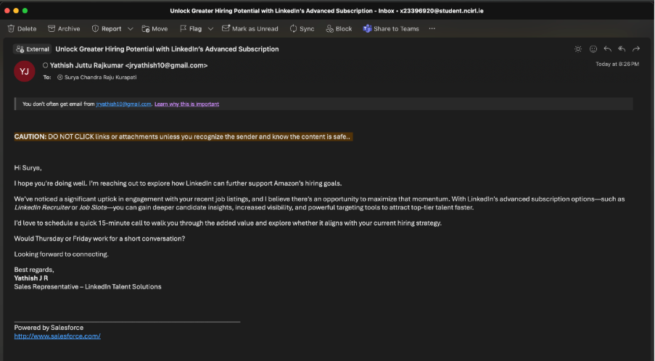
Salesforce CRM sales Integration
Email

Slide 12
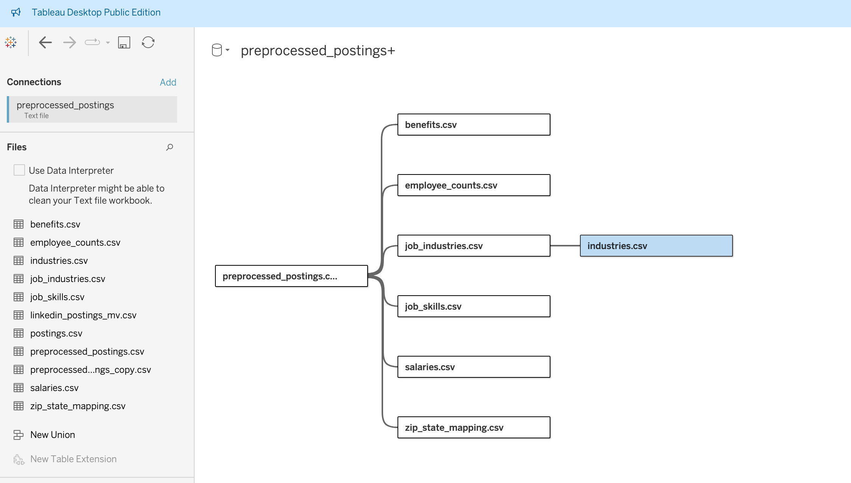
Tableau Data Source

Slide 13
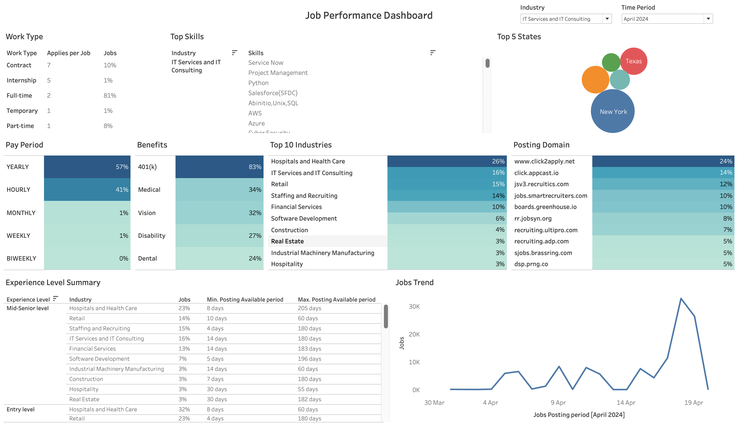
Dashboard 1

Slide 14
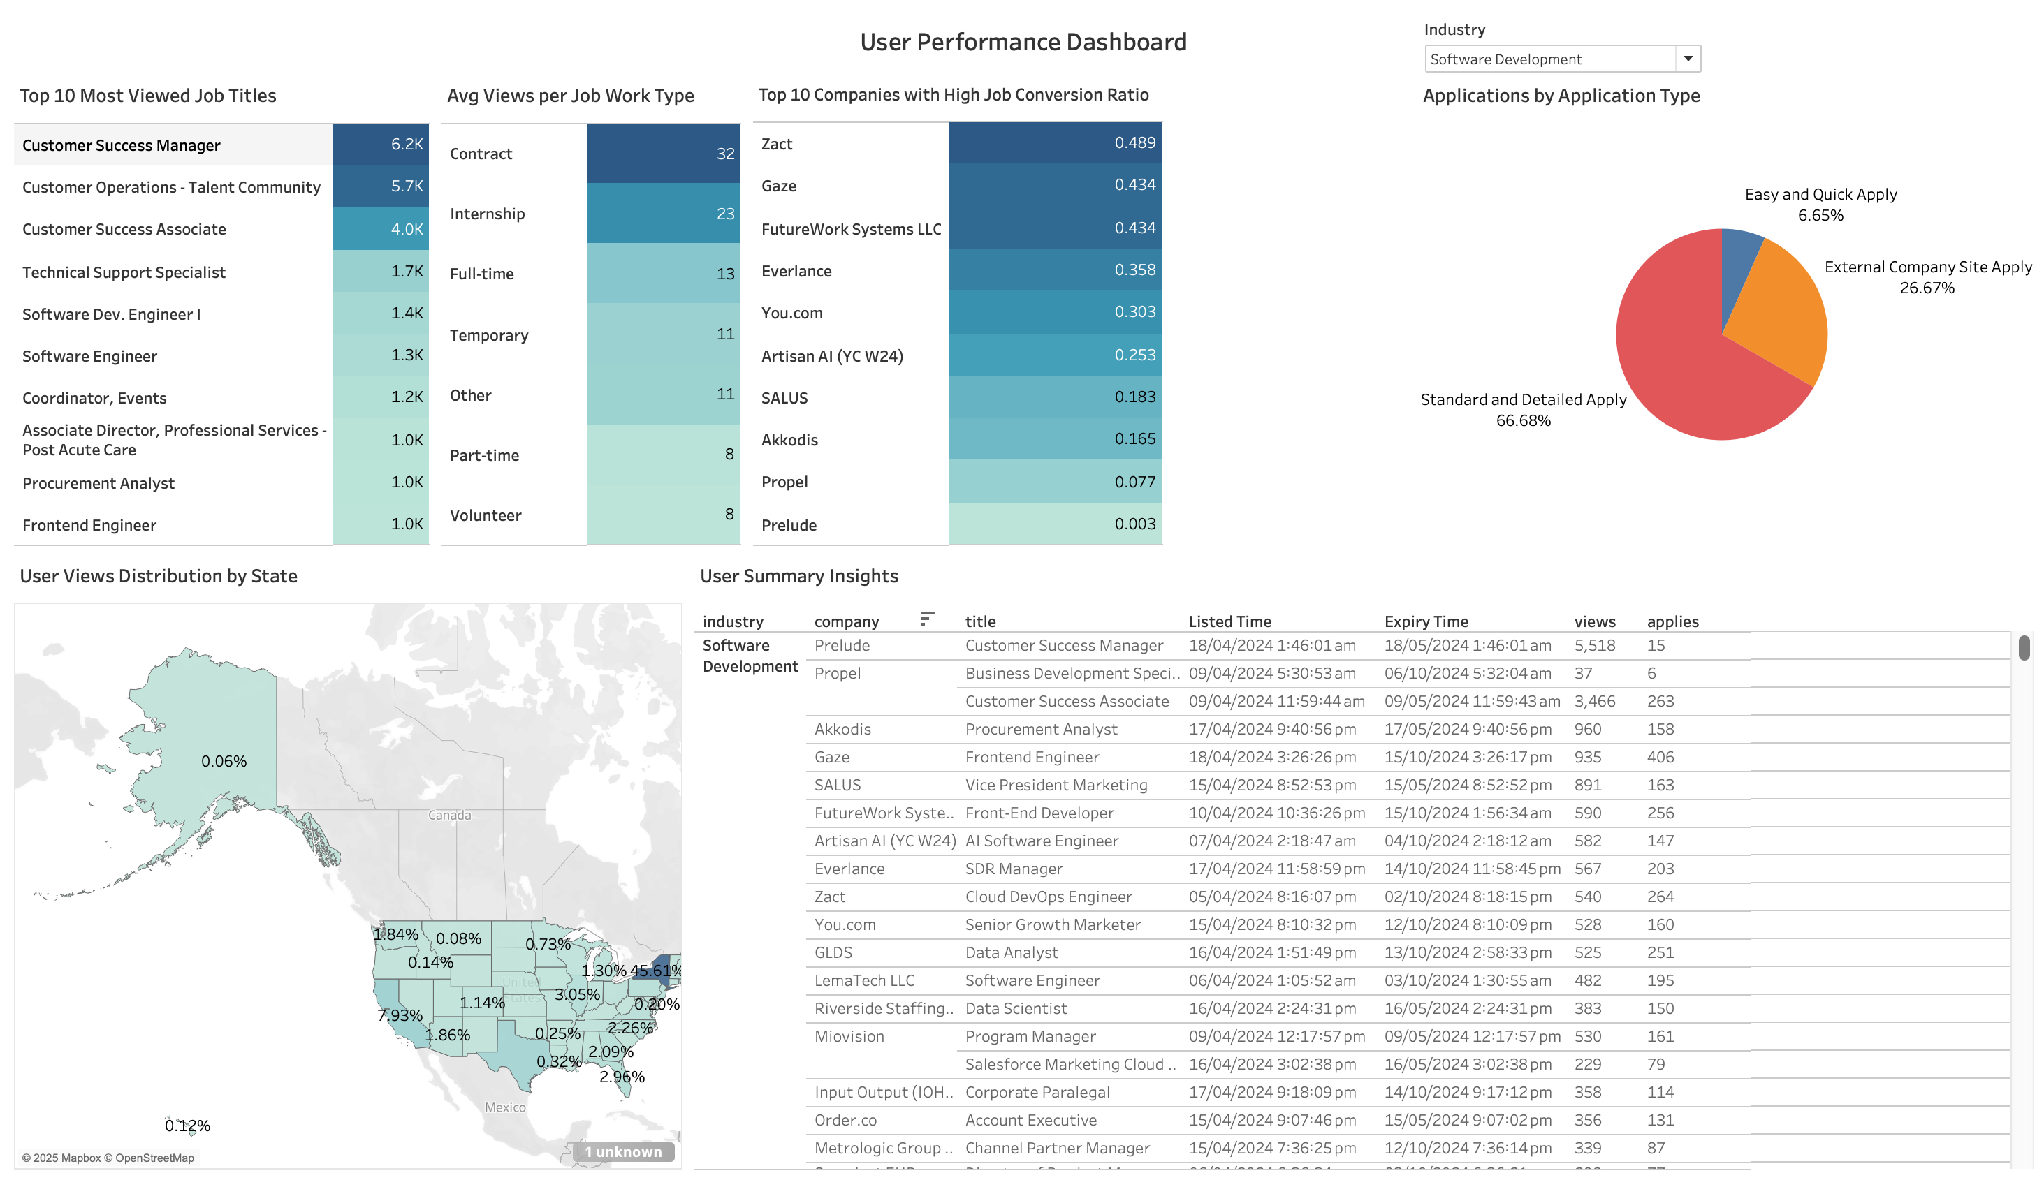
Dashboard 2

Slide 15
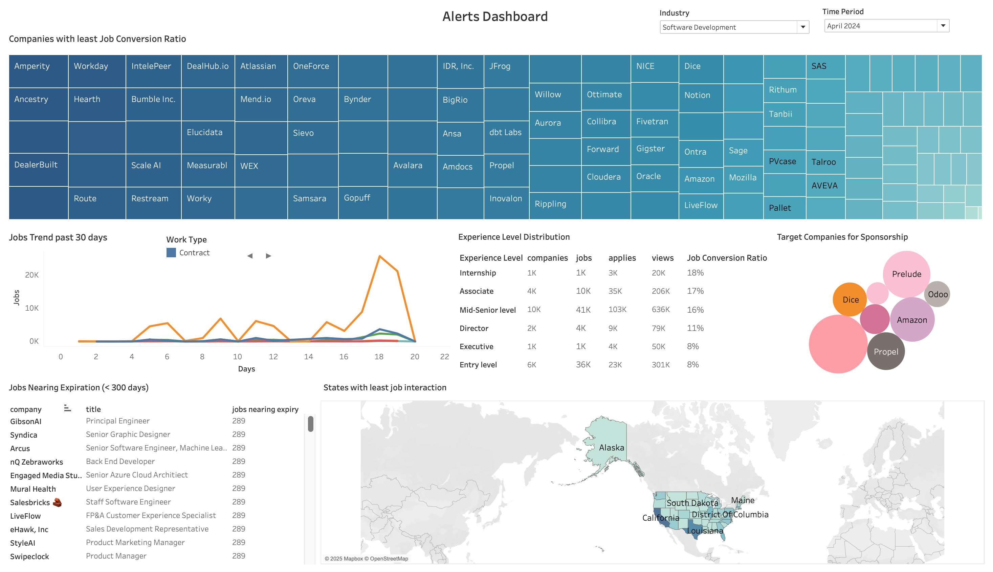
Dashboard 3

Slide 16
Tools and Framework
Tool / Framework | Type | Business Use
Salesforce Sales Cloud | CRM Sales System | Central platform for managing employer accounts, contacts, job listings, opportunities
LinkedIn Sales Navigator | Sales Intelligence | Salesforce CRM connector to LinkedIn data: Fetch job poster’s activity
Tableau | BI / Reporting | Build interactive dashboards
Salesforce Connector | BI & Analytics Tool | Connect salesforce CRM sales data to Tableau
Miro | Planning / Collaboration | Visualize process flows, journey, actions, steps, plan, strategy
draw.io | Data Modeling | Create ERDs and system architecture diagrams
SWOT Analysis | Strategic Framework | Evaluate LinkedIn Jobs' strengths/weaknesses in talent solution space
Balanced Scorecard | Strategic Performance Mgmt | Track KPIs across Financial, Customer, Internal Ops, Learning & Growth
PDCA - CIP (Continuous Improvement Process) | Process Framework | Iterative improvement on CRM flows, sales strategy

Slide 17
Outcome
User Role | Key Activities
Sales/Account Reps | Monitor employer activity, follow up on poor listings, upsell premium
Recruiters (Employers) | View listing insights (embedded Tableau), receive automated suggestions
Marketing Team | Run campaigns to retain clients or promote sponsorship
Executives | View platform-wide dashboards on churn, ROI, engagement

Slide 18
Thank You
Professor Vikas Sahni
&
All

