Slide 1



Surya Chandra Raju Kurapati
x23396920

Slide 2
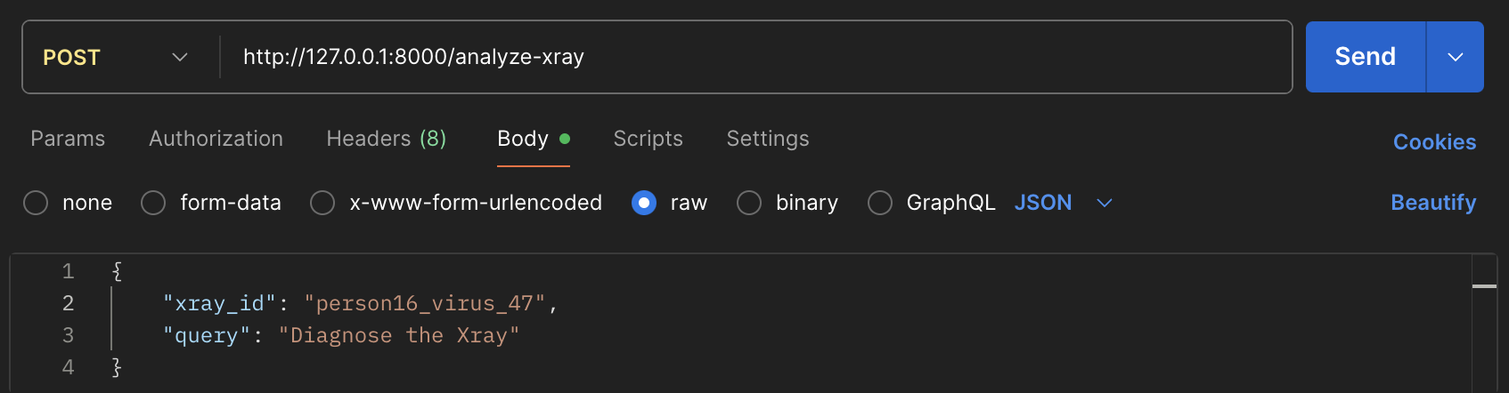

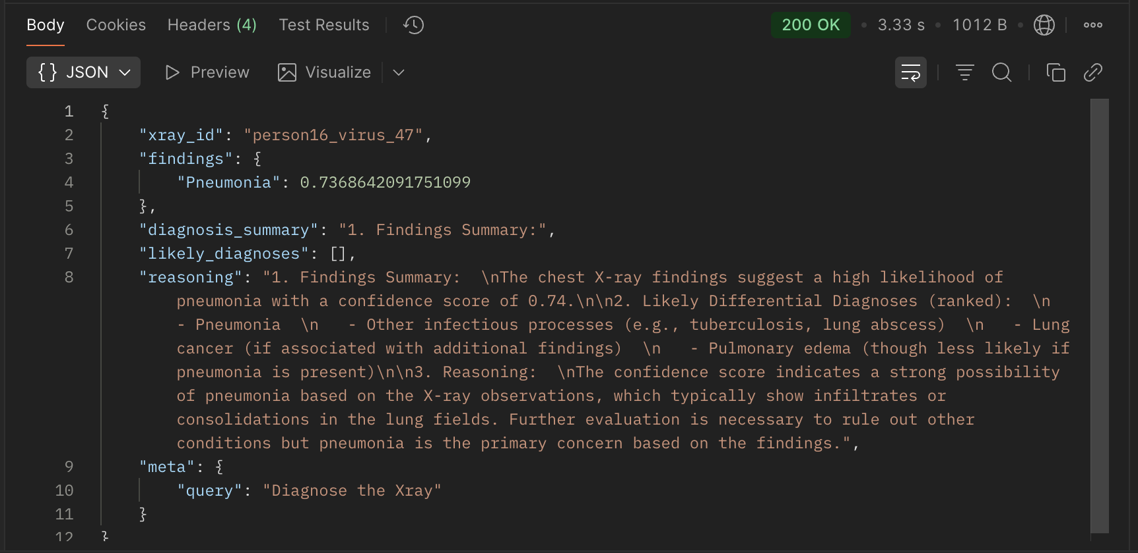
What is the product?
Product Overview
Input Request
Response
User: Radiologist

Slide 3
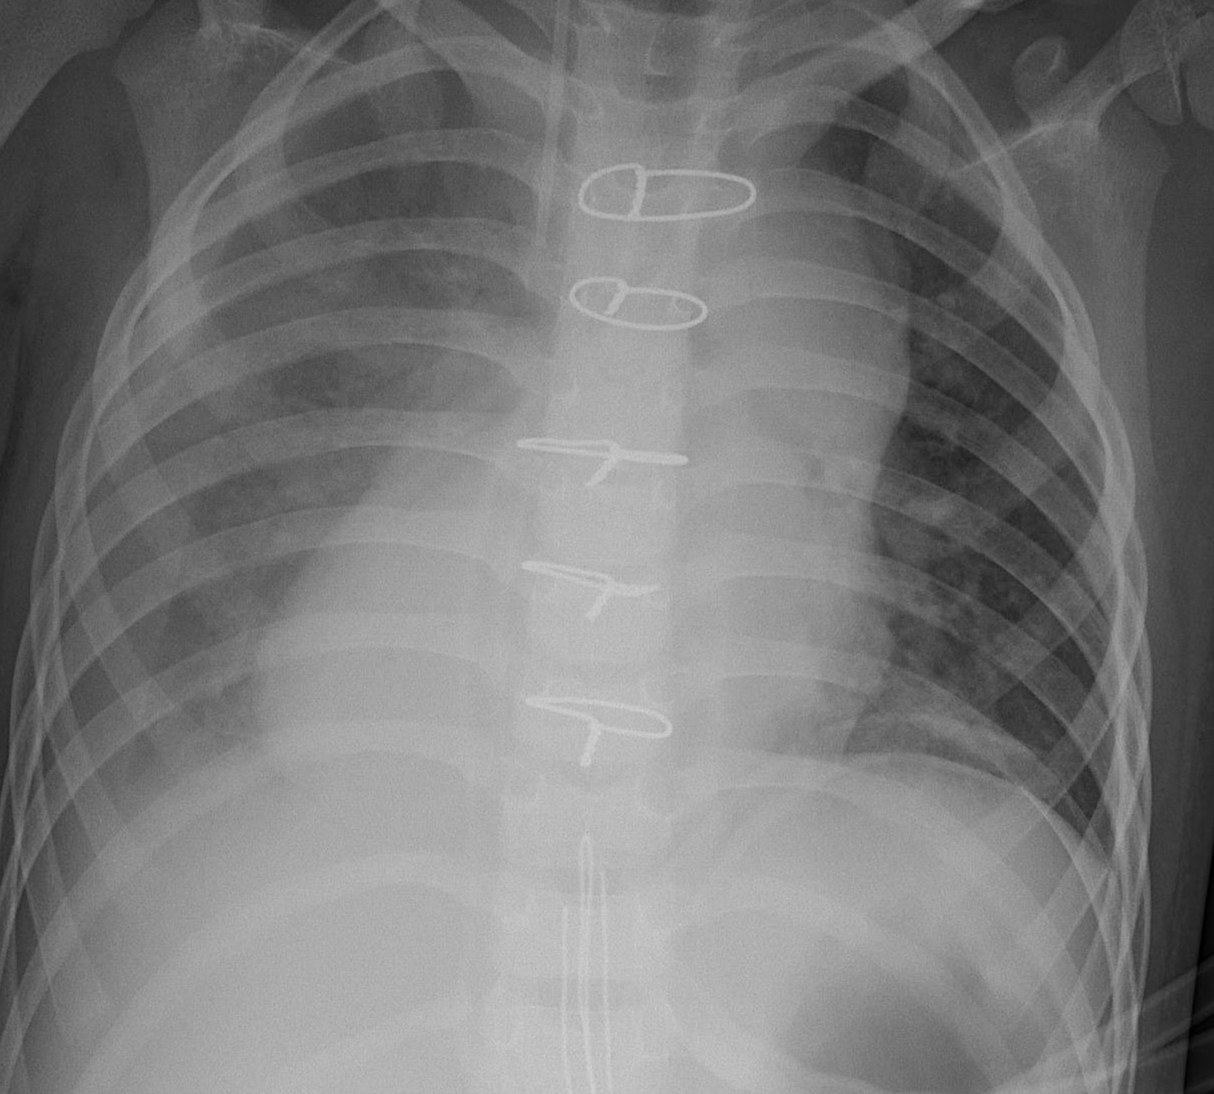
Motivation
Increasing utilization of chest imaging in US emergency departments from 1994 to 2015
(173% of chest imaging per 1000 ED visits)
Great, but what’s the concern ?
Errors in Radiology: A Standard Review
(42% - underreading, 22% satisfaction-of-search, 9% faculty reasoning errors)
Radiologist’s inefficiencies leading to X-ray reading errors ?
Work overload and diagnostic errors in radiology
(Recent study in 2023 says, radiologists who made diagnostic errors had an avg. of 121% daily workload)
(Frequently used imaging procedure globally in diagnosing various thoracic conditions like pneumonia, infiltration, consolidation, hernia)
Accuracy at speed ?
Classification of Paediatric Pneumonia Using Modified DenseNet-121 Deep-Learning Model
(Deep Learning based approaches such as DenseNet121 CNN showcased reliability of 97.3% in pneumonia detection)
Certainly reliable, how about interpretability ?
Call for an reliable, interpretable, rapid, and accurate thoracic-condition detector ?
Notes:
Frequently performed imaging procedure globally for diagnosing various thoracic conditions like pneumonia, pneumothorax
In US alone, 173% increase in chest imaging utilization per 1000 ED visits between 1994 to 2015
42% - underreading, 22% satisfaction-of-search, 9% faculty reasoning errors
Recent study in 2023 says, radiologists who made diagnostic errors had an avg. of 121% daily workload
Hence, call for radiology assistant
Deep Learning based approaches such as DenseNet121 CNN showcased reliability of 97.3% in pneumonia detection
Furthermore, an LLM attached to above diagnosis results to generate clinical reasoning serve quick and better patient care

Slide 4


RadAssistIQ – High Level Understanding
Domain & Technology
Product
Core Concepts
Concept 1: Explainable AI (XAI)
Department: Radiology (X-Ray)
Concept 2: Generative AI (GenAI)
Domain: Healthcare
Product: Radiology Assistant IQ
Convolutional Neural Network
(DenseNet121)
Large Language Model
(gemini-2.5-pro)
Technology: Artificial Intelligence

Slide 5
Technical Architecture
Input Layer
API Layer
AI Layer
Output Layer
Dataset Source: Kaggle
{
"xray_id": "person3_bacteria_10",
"findings": {
"Infiltration": 0.7697662711143494
},
"reasoning": "1. **Findings Summary** \nThe X-ray shows a notable infiltration.\n\n2. \nThe presence of infiltration on the X-ray often indicates an abnormal density in the lungs, which can be due to infection (such as pneumonia), fluid accumulation (like pulmonary edema), interstitial inflammation (common in interstitial lung disease), or a mass (such as in lung neoplasm). Further clinical correlation and additional imaging may be required to reach a definitive diagnosis."
}
Local Storage
5000+ X-Rays
Request Body
Diagnose X-Ray
CNN (DenseNet121)
{
"xray_id": "person3_bacteria_10",
"query": "Diagnose the Xray"
}
POST
Fast API
/analyze-xray
Read X-Ray
PIL (pillow) Library
Reasoning
LLM (gemini-1.5-pro)

Slide 6
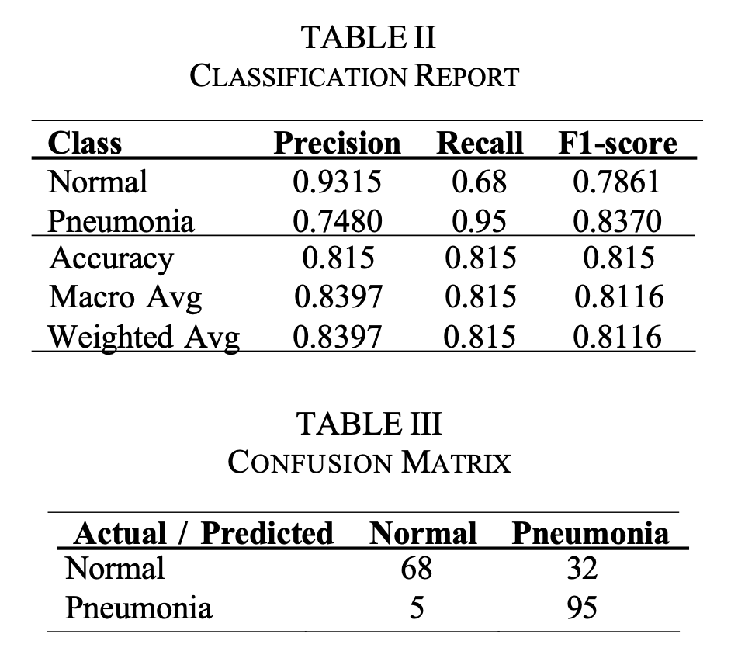
Evaluation

Slide 7
Future Enhancement & Integrations
Integrate EMR data to enhance LLM clinical context
Fine-tune DenseNet121 on large, diverse datasets using high-end GPU systems
Leverage secure, advanced Azure OpenAI LLMs such as gpt-4
Use asynchronous model calling for efficiency
Deploy via AWS Kubernetes with multi-pod scaling

Slide 8
Thank you

