Slide 1

Intelligent Medical assistant for patients and prescribers to revisit the clinical visit
Surya Chandra Raju Kurapati
(x23396920)
Nisarga Holenarasipur Ramesh
(x24101028)
Saranya Munikannaiah
(x23434821)

Slide 2
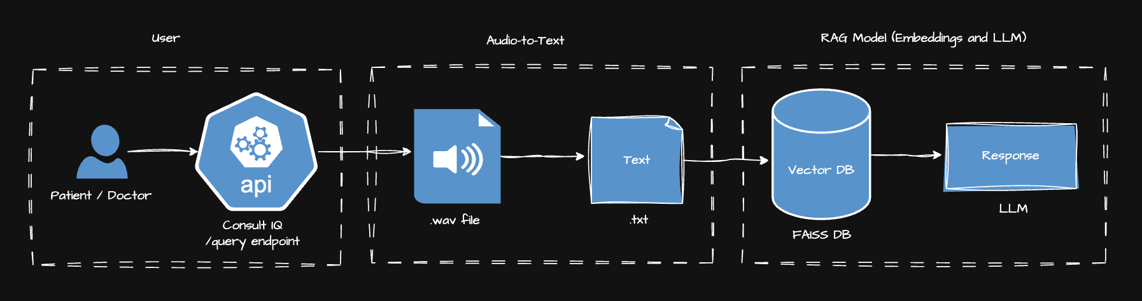
High-Level Overview

Slide 3


Pain:
Lack of an interface for quick clinical “Re-Visit”
Dependency on human memory to revisit any critical medical instructions
Emergency unpreparedness due to fragmented health records
Gain:
Real-time response of medical visit in less than 5-10 seconds
Automatic transcription and summarization powered by AI
Prescriber’s critical medical instructions available handy to immediate patient’s family

Slide 4
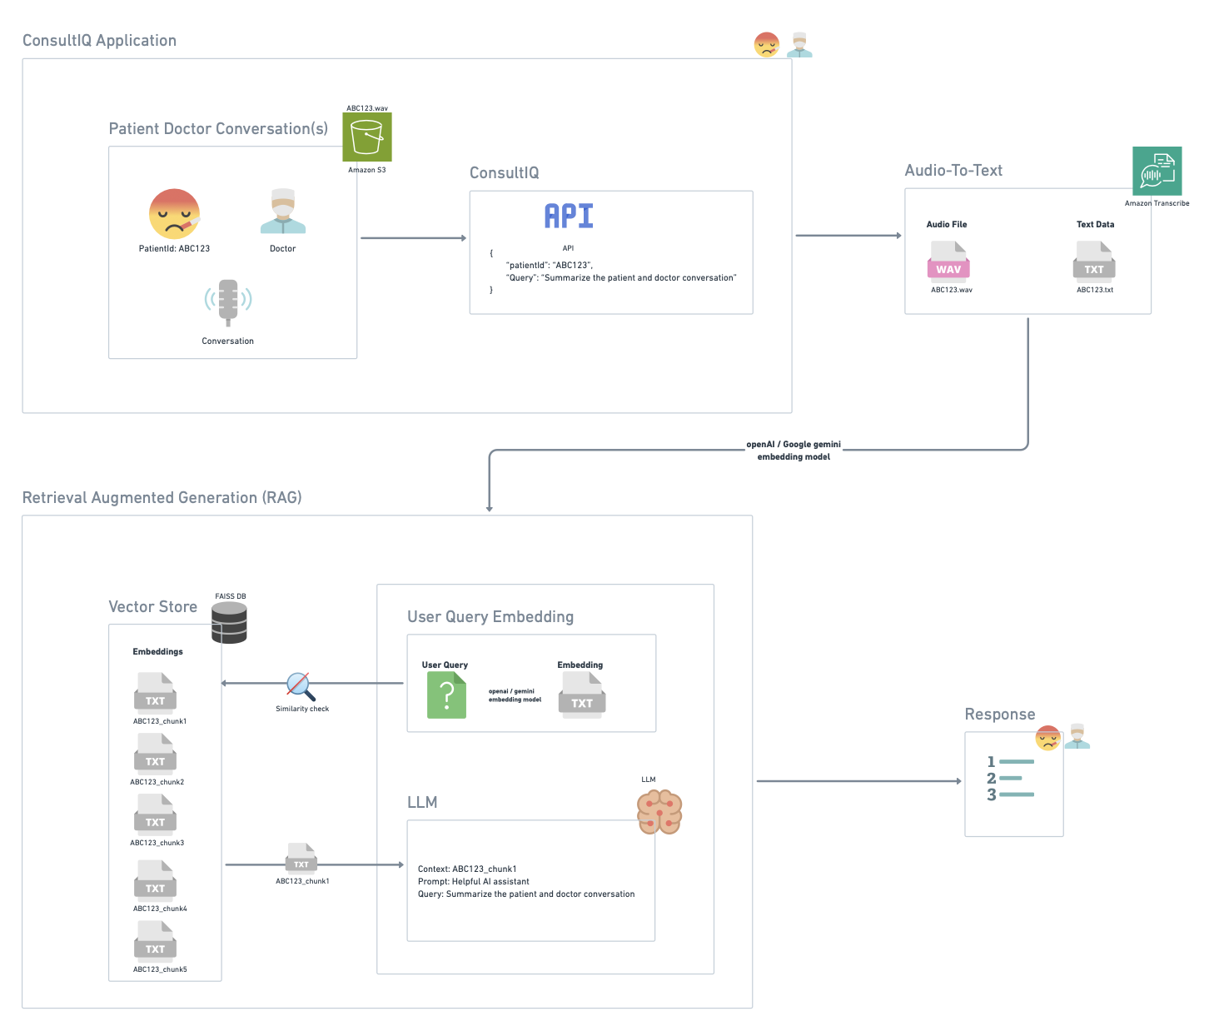
Architecture

Slide 5
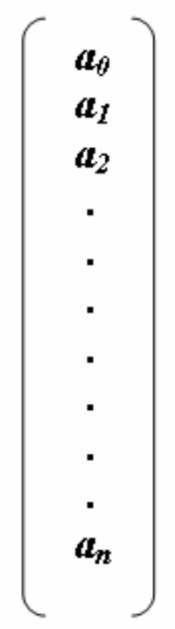
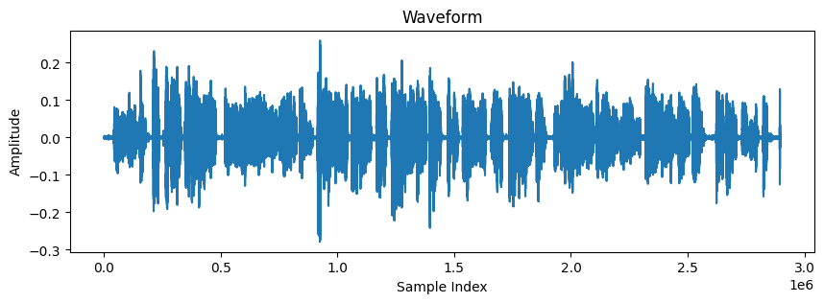
Speech to Text workflow
1D-PyTorch tensor (librosa)
CNN - wav2vec2 tokenizer
Wav2vec2 CTC decoder
(Connectionist Temporal Classification)
Logits (1 audio file, 150 frames, 32 vocab)
Source File
Frame/Time Step | 0 | 1 | 2 | 3 | 4 | 5 | . | . | . | 32
1 | 4.5 | 0.9 | 0.3 | 0.7 | 0.2 | 0.8 | . | . | . | 0
2 | 0.7 | 5.1 | 0.3 | 0.5 | 0.4 | 1.1 | . | . | . | 0
. | 0 | 0 | 0 | 0 | 0 | 0 | . | . | . | 0.1
. | 0 | 0 | 0 | 0 | 0 | 0 | . | . | . | 0.1
150 | 0.4 | 0.6 | 0.5 | 0.7 | 3.5 | 0.9 | . | . | . | 0
.wav file
16KHz / sec
Argmax (1, 150)
Decode
[4.5, 5.1,…, 0.1,…3.5]
[“h”, “I”, …..,” “]
“hi “
Say, 3 sec audio file with “hi “
Frame into 20 msec chunk with 320 samples
3 sec * 1000 msec/sec / 20 msec = 150 frames
n = 48000 waveforms / samples
(3 sec * 16000 Hz)
Models:
Speech-to-text: facebook/wav2vec2-base-960h
Embeddings: all-MiniLM-L6-v2
LLM: gemini-2.0-flash

Slide 6
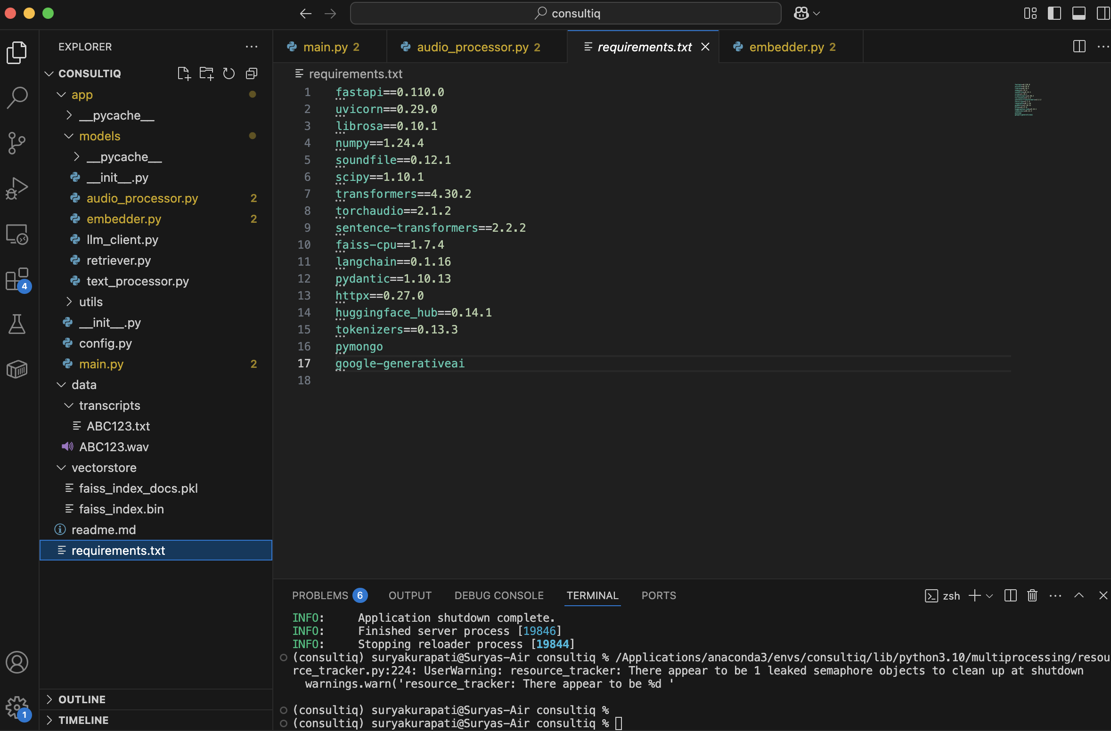
Code Artifact

Slide 7
Tools & Technology
Category | Tool / Library | Usage / Purpose
Audio Processing | librosa | Load .wav, convert to waveform, resample, extract audio features
Speech Recognition | facebook/wav2vec2-base-960h | Pretrained model for English speech-to-text conversion
Text Splitter | langchain | Splits the large text file into chunks with an overlap of words
Embedding | all-MiniLM | A senetence transformer that converts text to dense vectors
Vector Database | FAISS | Store and retrieve similar vectors (semantic search)
Large Language Model | gemini-2.0-flash | Generate answers to questions based on context
API Server | FastAPI | High-performance async Python API for backend endpoints
Database | MongoDB | Store API keys and metadata
Async Processing | asyncio | Used for asynchronous I/O calls
Data Processing | NumPy | Convert waveform arrays, mathematical operations

Slide 8
Many Thanks to all the Healthcare Practitioner’s and Engineer’s
Thank you All
Queries ??

