Slide 1

Should a deblurring model know the physics?
Classical vs. modern inverse-function learning
“Inverse function learning for image deblurring”
Mid evaluation . Statistical Methods in AI
Surya Manoj Pentakota (2026701036) · Kevin Paul Reddy Janagari (2026900006) · IIIT Hyderabad
Notes:
We are comparing deblurring methods that differ in one thing: whether they use the physics of the blur. This mid evaluation covers what is done (two of three arms), how it is built, what went wrong and how we fixed it, what is left, and what we expect at the final evaluation.

Slide 2






What this talk covers
1. Work completed
2. Algorithms, models
3. Implementation
Status, protocol and timeline
M1 networks, M2 solvers, M3 unrolled nets
Evaluator, GPU port, statistics
4. Results so far
5. Challenges and fixes
6. Remaining work, plan
Mismatch, stability, texture, perceptual
What broke and how we addressed it
Next steps and expected outcomes
Notes:
Six parts, matching the evaluation requirements: work completed; algorithms, models and implementation; results; challenges; remaining work and future plans; expected outcomes.

Slide 3
The short version: what we found so far
Is the deep network better on training kernels?
Tied in PSNR (27.48 vs 27.43 dB); NAFNet is better perceptually
Tie
Does it survive an unseen blur kernel?
Not on motion: it loses half its gain; ADMM-EPLL wins every unseen-kernel cell, by up to 6.4 dB
M2 wins
Is the gap about not knowing the noise level?
No: knowing σ is worth at most 0.25 dB to NAFNet; the kernel is the missing information
Kernel
Does image texture explain it (H2)?
No: NAFNet's small edge comes from smooth images, the opposite of H2
Not H2
Is the deep network stable (H3)?
ADMM-EPLL is 2–17× more stable at σ ≥ 5; at σ = 1 under mismatch it is not
Mostly M2
Headline: neither side simply wins. Physics-awareness is what transfers.
Notes:
If you remember one slide, it is this one. On the kernels the network was trained on, the two arms are tied. On kernels it never saw, especially new motion directions, the physics-aware solver wins clearly. The rest of the talk explains how we know.

Slide 4

Deblurring is an ill-posed inverse problem
y = A x + ε
x: sharp image · y: what the camera records
A: blur by a point-spread function (PSF) k
ε: sensor noise, Gaussian with level σ
A's spectrum decays to ~0 at high frequencies, so naive inversion amplifies noise
The question
Should the restoring function g be built around the physics of A, or learned purely from data?
Published methods differ along exactly this axis but are tested under different protocols. We compare them under one.
Notes:
A sharp image is blurred by a known kind of operator and corrupted by noise. The operator is badly conditioned, so inverting it directly blows up the noise. The question is whether a good restorer should use the operator itself, or learn everything from example pairs. Existing papers use different data and settings, so their numbers cannot be compared; our contribution is running them under one locked protocol.

Slide 5
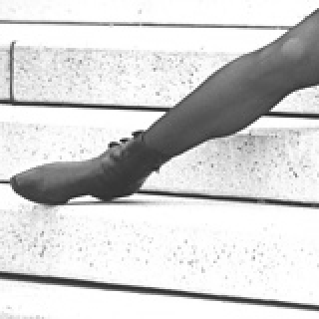
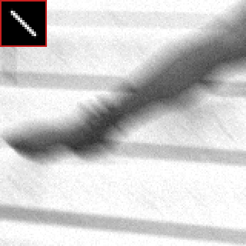
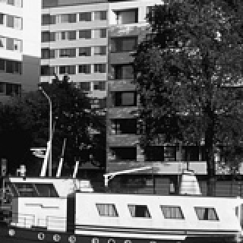
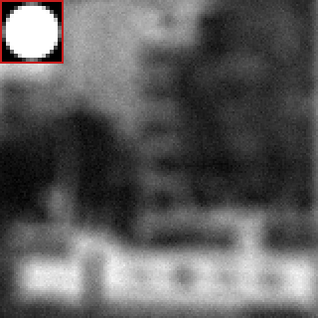

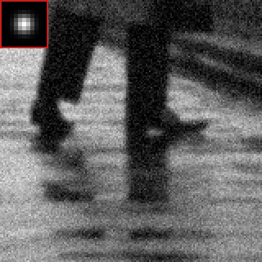
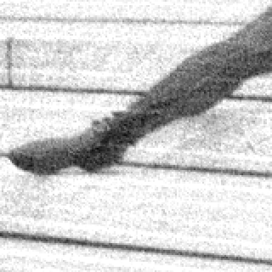

What blur does, and why inverting it fails
sharp → observed
sharp → observed
sharp → observed
Motion blur
Defocus blur
Gaussian blur + strong noise
15 px at 45°, noise σ = 5
disk of radius 7 px, noise σ = 5
σk = 1.4, noise σ = 15
Undoing the blur directly boosts the frequencies the blur destroyed, and the noise with them (middle). Every good method adds a prior: an assumption about what natural images look like (right).
The question is where that prior and the blur model come from.
Observed
Direct inverse (Wiener)
With a learned prior
Notes:
Top row: three kinds of blur from our test set. Bottom: if you simply invert the blur, the noise is amplified, as in the middle image. Adding a prior gives the clean result on the right. Every method we compare is a different way of combining the blur model with a prior.

Slide 6



Three arms and three hypotheses
M1 · data-only
M2 · classical ML, physics-aware
M3 · unrolled, physics-aware
NAFNet, U-Net
ADMM-EPLL, FISTA-TV, Wiener, R–L
USRNet, ISTA-Net, LISTA
Sees only y. Learns the inverse end to end.
Knows k and σ. Learned shallow prior + solver.
Knows k and σ. Deep prior inside a solver.
H1
Physics-awareness pays off as information degrades: more noise, more texture, kernel mismatch
H2
Prior depth matters most on texture: deep priors win on natural texture
H3
Physics-awareness buys stability against tiny adversarial perturbations
Notes:
M3 is the control arm: it shares M2's physics and M1's deep prior, so it separates the two axes. Each hypothesis is stated over the arms; today we can test them for M1 versus M2.

Slide 7
Status at mid-evaluation: M1 and M2 complete
7
5
27,000
133
M1 models trained
GMM priors fitted
cells per method
unit tests
NAFNet, U-Net, 5 per-σ specialists
K = 1, 4, 16, 64, 200
200 images × 27 PSFs × 5 noise levels
operators, protocol, solvers, models
done
Shared foundation: FFT operator, PSF library, protocol, metrics
done
Analyses: mismatch, σ-oracle, inverse crime, H2, H3, LPIPS
done
M1: training and full test evaluation
blocked
M3: implemented and unit-tested; two bugs to fix
done
M2: priors, λ tuning, full test evaluation, K-sweep
next
M3 training and three-arm evaluation
Notes:
Two of the three arms are trained and fully evaluated. Every method has been scored on the same 27,000 test cells. M3 is coded and unit-tested but has two bugs we found while smoke-testing; we deferred it to finish M1 versus M2 first.

Slide 8




One locked protocol for every method
Data
PSF set | Kernels | Role
P1 (12) | Gaussian σk 0.7–2.0; motion 9, 15 px at 0/45/90/135° | training + in-distribution test
P2-interp (11) | Gaussian σk 0.9–1.8; motion 11, 13 px at 22.5/67.5/112.5/157.5° | unseen parameters
P2-extrap (4) | defocus disks, radius 3–9 px | unseen family
BSDS500 luminance · 200 train / 100 val / 200 test
Noise grid
σ ∈ {0, 1, 5, 15, 25} / 255
Seeded cells
noise seeded per (image, PSF, σ): every method sees the identical y
Circular FFT convolution, observations clipped to [0, 1]. M1 trains only on P1; P2 measures kernel mismatch.
Selection on val only
fixed 10-image val subset; one checkpoint per model; test never used
Notes:
The protocol is what makes the comparison fair. Same images, same kernels, same noisy observations, selection on validation only. P1 is what M1 trains on; P2-interp has unseen settings of the same kernel types, and P2-extrap is a kernel type nobody trains on.

Slide 9
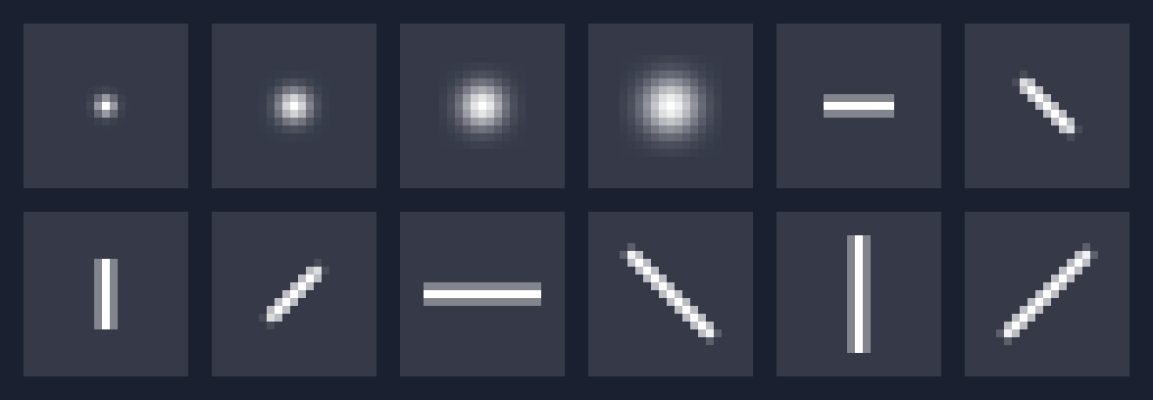
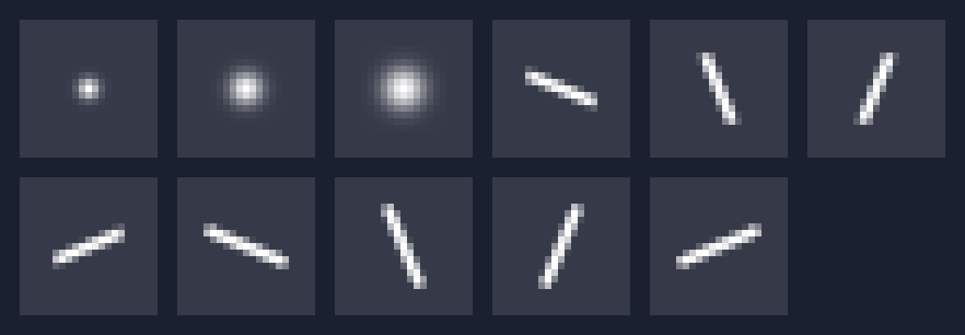

Training kernels vs. unseen kernels
P1 · training kernels (12)
4 Gaussian widths and 8 motion blurs: lengths 9 and 15 px at 0°, 45°, 90°, 135°. M1 learns from these.
P2-interp · unseen settings (11)
Same families, new parameters: Gaussian widths in between, motion of 11 and 13 px at 22.5°, 67.5°, 112.5°, 157.5°.
P2-extrap · unseen family (4)
Defocus disks of radius 3, 5, 7, 9 px: a kind of blur no model trains on.
Notes:
Each square is one blur kernel: the pattern a single bright point is smeared into. P1 is what the network trains on. P2-interp keeps the same kinds of blur but changes the settings, for example new motion directions. P2-extrap is a new kind of blur, defocus. Physics-aware methods are given the correct kernel in every case; the data-only network has to cope without it.

Slide 10

M1: data-only networks learn y → x directly
NAFNet
U-Net
Training recipe
primary
architecture baseline
One model on P1 × all noise levels
128² patches; k and σ drawn uniformly per patch
AdamW, L2 loss, batch 16, lr 2×10⁻⁴
100k iterations, bf16, RTX 3090 Ti
17.1 M parameters
7.8 M parameters
U-Net of NAFBlocks: SimpleGate, simplified channel attention, no nonlinear activations
Plain encoder–decoder with skip connections
29.67 dB val · 2.8 h
28.43 dB val · 0.5 h
Ablation: five per-σ specialists
NAFNet fine-tuned 10k iterations at one noise level each, to measure what knowing σ would be worth to M1.
Notes:
M1 never sees the kernel or the noise level. NAFNet is a recent state-of-the-art restoration network; the U-Net is there to check whether results depend on the architecture. Both are trained once over all training kernels and noise levels, and the checkpoint is chosen on validation only.

Slide 11
M2: physics-aware solvers with learned or fixed priors
x̂ = argmin ½‖Ax − y‖² + λ R(x) (true k and σ are given)
Wiener
Richardson–Lucy
Closed form in Fourier: X̂ = K̄Y / (|K|² + λ). Untuned baseline.
Multiplicative EM for a Poisson likelihood, 30 iterations. Untuned baseline.
FISTA-TV
ADMM-EPLL (primary)
Accelerated proximal gradient with a total-variation prior; TV prox by ADMM. 100 × 30 iterations.
Half-quadratic splitting with a 200-component GMM patch prior. Data step in closed form (FFT); prior step = per-patch Wiener filter of the most likely component; denoiser strength annealed 49/255 → σ.
λ tuned per noise level on val: 10 multiples (2⁻⁵ … 2⁴) of a default → M2 has five tuned scalars per method. GMM fitted by EM on 100k patches (7 min).
Notes:
All M2 solvers solve the same MAP problem with the true blur and noise level. ADMM-EPLL is the primary method: its prior is a Gaussian mixture over 8x8 patches learned from training images. FISTA-TV uses a hand-crafted total-variation prior. Wiener and Richardson-Lucy are classical untuned baselines. Only five regularisation weights per method are tuned.

Slide 12

M3: unrolled networks put a deep prior in the solver
USRNet
ISTA-Net
LISTA
primary
ablation
ablation
4.5 M
0.19 M
117
parameters
parameters
parameters
8 unrolled HQS iterations: closed-form FFT data step + ResU-Net prior; an MLP maps σ to per-iteration weights
Unrolled ISTA with a learned convolutional transform and soft-thresholding
Unrolled ISTA with a shared 1×1 analysis/synthesis pair: the smallest prior
Status: implemented and unit-tested, not yet trained
Same training regime as M1 (P1 × all noise levels; batch 8, lr 1e-4, ≤ 30k iterations), but the network also receives the true PSF spectrum and σ.
Notes:
M3 combines the two: a closed-form physics step and a learned deep prior, iterated. It is what lets us separate 'knows the physics' from 'has a deep prior'. The code is in place; training is the main remaining work.

Slide 13






Techniques and implementation details
Unified evaluator
GPU port of M2
Paired statistics
Scores any arm on identical cells plus the unrestored input, so every row has a paired gain. Seeded subsets and sharding.
FISTA-TV and ADMM-EPLL rewritten in PyTorch, operation for operation; max difference 10⁻¹³ / 2×10⁻⁷ vs NumPy.
Image as the unit (n = 200); Wilcoxon signed-rank with Holm correction over 30 tests.
Stability attack (H3)
Unbiased examples
Reproducible
20-step PGD on NAFNet in an L2 ball; the same perturbed y is given to ADMM-EPLL (transfer attack).
Qualitative images are the median case of each cell, crops chosen by detail, never by eye.
Protocol manifest + git commit in every run; every table generated by a script from per-cell CSVs.
Notes:
The evaluator is shared by all arms, so numbers pair one to one. The GPU port of the classical solvers made the M2 evaluation feasible. Statistics treat the image as the unit, so the 27 kernels of one image are not counted as independent samples.

Slide 14




How we measure: the metrics in plain language
PSNR (dB, higher is better)
SSIM (0–1, higher is better)
LPIPS (lower is better)
Pixel accuracy. +1 dB is a clearly visible improvement; it can favour slightly blurry results.
Local structural similarity: closer to how an image looks than PSNR, still simple.
A learned perceptual distance: images that look alike score low even if pixels differ.
Data consistency (lower)
“Blurred” baseline
Paired tests
Re-blur the output with the true kernel: does it reproduce the observation? It should leave about σ.
The unrestored observation. A method below this line is worse than doing nothing.
Is a difference consistent over all 200 images? Wilcoxon signed-rank, Holm-corrected.
Notes:
A quick guide before the numbers. PSNR measures pixel accuracy, LPIPS how similar images look to a person. Data consistency asks whether the output explains what the camera recorded. 'Blurred' is the do-nothing baseline. Noise levels are always quoted on the 0–255 scale.

Slide 15
PSNR vs noise: networks sink on unseen kernels
P1 · training kernels
P2-interp · unseen settings
P2-extrap · unseen family
Blurred input
Wiener
R–L
FISTA-TV
ADMM-EPLL
U-Net
NAFNet
Notes:
Each line is a method; higher is better; the black line is the unrestored image. On the training kernels (left) the teal M2 solvers and the rust M1 networks sit together. On unseen kernels (middle, right) the networks fall almost onto the black baseline at low noise, while ADMM-EPLL and FISTA-TV keep their margin. At high noise everything converges.

Slide 16
Tied on training kernels; M2 wins under mismatch
27.48 vs 27.43
dB on P1: NAFNet vs ADMM-EPLL, a tie
+6.4 dB
largest ADMM-EPLL win (P2-interp, σ = 1); all P2 differences p < 10⁻⁴
½
of NAFNet's gain lost on unseen kernels; ADMM-EPLL keeps almost all
Notes:
Gain over the blurred input, averaged over noise levels. On the training kernels NAFNet and ADMM-EPLL are tied. On unseen kernels the networks lose about half their gain while the physics-aware solvers keep it. The per-sigma specialists gain at most 0.25 dB, so the networks are missing the kernel, not the noise level. The failure is concentrated on unseen motion directions.

Slide 17
Where M1 fails, and why we trust M2
PSNR by kind of blur (mean over σ > 0)
Data consistency at σ = 1 (lower is better)
A consistent restoration leaves about the noise level (1). On unseen kernels NAFNet leaves 3–4×: its output, blurred again, does not match what was recorded.
Unseen Gaussian widths cost NAFNet 0.7 dB; unseen motion directions cost it 3.6 dB, leaving it just above the blurred input.
Notes:
Breaking results down by kind of blur shows where the network fails: it handles new Gaussian widths, but not new motion directions. The right chart explains why we trust the solvers: if you blur their output again with the true kernel you get back what the camera saw. NAFNet's output does not pass that check on unseen kernels.

Slide 18
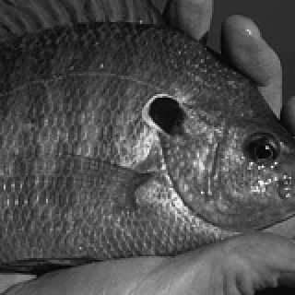
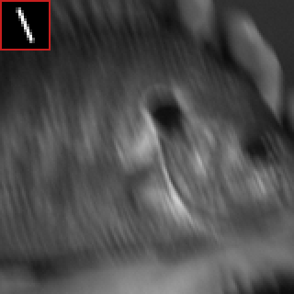



Unseen motion: NAFNet does not undo the blur
Sharp
Observed
FISTA-TV
ADMM-EPLL
NAFNet
reference
27.27 dB
33.42 dB
34.23 dB
26.34 dB
Motion blur of 13 px at 67.5°, an angle never seen in training; noise σ = 1/255
NAFNet adds streaks and scores below the unrestored input; both physics-aware solvers remove the smear (+6⁠–⁠7 dB)
Image chosen as the median case of this cell for EPLL − NAFNet, not hand-picked; PSNR on the full image
Notes:
This is the typical case, not the best case: the image with the median difference between ADMM-EPLL and NAFNet for this cell. The network was trained on eight motion directions and does not generalise to a new one; the solvers use the true kernel.

Slide 19


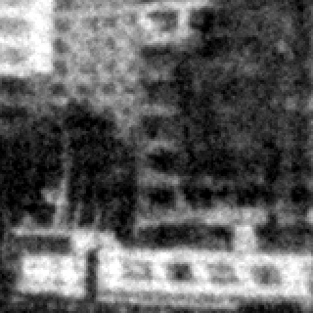



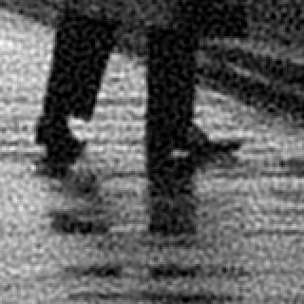



Three more cases, chosen without looking
Sharp
Observed
Wiener
FISTA-TV
ADMM-EPLL
NAFNet
In distribution
P1 motion 15 px, 45°, σ = 5
PSNR (dB)
19.95
22.34
26.24
28.26
28.43
Unseen family
defocus, radius 7 px, σ = 5
PSNR (dB)
17.17
19.14
19.49
20.12
18.48
High noise
Gaussian σk = 1.4, σ = 15
PSNR (dB)
23.01
23.19
27.72
28.84
29.14
Notes:
Same selection rule as before: each row is the median image for its condition, not a favourite. In distribution, NAFNet and ADMM-EPLL look alike. On defocus, an unseen kind of blur, every method struggles and the solvers recover more edges. At high noise, NAFNet gives the cleanest result: knowing the kernel matters least when noise dominates.

Slide 20
Knowing σ barely helps; bigger priors saturate
Specialist for one σ vs. the single NAFNet
ADMM-EPLL vs. GMM size K (50 test images)
At most +0.25 dB: the network is not missing the noise level. It is missing the kernel.
1 → 4 components: +1.8 dB; 64 → 200: +0.02 dB. The mismatch gap stays the same for every K.
Notes:
Left: if we give NAFNet the noise level by training one specialist per level, it gains at most a quarter of a dB, and nothing on unseen kernels. Right: making the classical prior richer helps at first and then flattens out, and it never changes the robustness to unseen kernels. Robustness comes from the known blur model, not from prior capacity.

Slide 21
H3: M2 resists NAFNet's perturbations at σ ≥ 5
2–17× smaller
drop for ADMM-EPLL at σ ≥ 5/255, in 99–100% of cells
σ = 1: not stable
perturbation ≈ noise; weakly regularised EPLL amplifies it (holds on P1, reverses on P2)
Transfer attack
η is NAFNet's worst case, not EPLL's: a white-box M2 attack is remaining work
Notes:
We optimise a small perturbation to break NAFNet, then give the same perturbed image to ADMM-EPLL. From sigma 5 up, the solver barely notices it. At sigma 1 the perturbation is as large as the noise, and the solver, tuned for almost no regularisation, amplifies it. Because the attack targets NAFNet, this is not a worst case for M2.

Slide 22
Two surprises: texture (H2) and perceptual quality
Mean LPIPS (lower is better)
 | P1 | P2-interp | P2-extrap
NAFNet | 0.246 | 0.368 | 0.507
U-Net | 0.258 | 0.350 | 0.479
ADMM-EPLL | 0.310 | 0.323 | 0.447
FISTA-TV | 0.276 | 0.281 | 0.364
In distribution the networks are perceptually best, even where PSNR is tied
Under mismatch FISTA-TV is perceptually best: EPLL wins PSNR, TV keeps sharper edges
H2 not supported: NAFNet's lead comes from smooth images (ρ = −0.54, p < 10⁻¹⁶); no texture effect under mismatch
Notes:
Two results went against expectations. First, the deep network's small in-distribution advantage comes from smooth images, the opposite of H2. Second, LPIPS ranks things differently from PSNR: NAFNet is perceptually best on the training kernels, and on unseen kernels the TV solver is best, even though ADMM-EPLL has the higher PSNR. The physics-aware arm wins under mismatch by both metrics.

Slide 23
A trap we caught: the σ = 0 inverse crime
Why 100 dB?
Test images were blurred with exactly the operator the solvers invert, with no noise: inversion becomes trivially exact.
The check
Rounding the same images to 8 bits (an error of 0.0011) makes Wiener collapse to 12.6 dB; ADMM-EPLL loses 7 dB; NAFNet is unaffected.
What we did
σ = 0 is excluded from every average and claim. Future protocol: quantize observations or add a noise floor.
Notes:
An 'inverse crime' is testing on data made with exactly the model you invert. Without noise the Wiener filter scores 100 dB, which is meaningless. Rounding to 8 bits, as any real camera does, exposes it. This is why the noiseless condition is excluded from our claims.

Slide 24
Hypothesis scorecard so far (M1 vs M2)
H1
Gap grows with kernel mismatch
Supported
tied on P1 → +2 to +6 dB for M2 on P2
H1
Gap grows with noise
Not supported
M2's advantage shrinks as noise grows
H1
Gap grows with texture
Weak
in distribution only
H2
Deep prior wins on texture
Not supported
NAFNet's lead comes from smooth images
H3
Physics-aware arm resists perturbations
Supported at σ ≥ 5
2–17× smaller drop; weak or reversed at σ = 1
M3 is needed to test H1 and H2 as stated (deep prior with physics); the white-box M2 attack completes H3.
Notes:
Kernel mismatch is the solid, headline result. The noise and texture parts of H1 and all of H2 did not hold for M1 versus M2. H3 holds from sigma 5 up under a transfer attack. These are honest negative results, and M3 will test the hypotheses as originally stated.

Slide 25





Challenges and how we addressed them
ADMM-EPLL barely deblurred
M2 too slow on CPU
σ = 0 inverse crime
Penalty schedule started too high: 21.4 → 21.9 dB even without noise. Switched to the DPIR schedule: 35.2 dB.
50–70 s per image; days for the test set. GPU port verified against NumPy: 33–50× faster.
Same operator for data and inversion → Wiener 100 dB. 8-bit check: 12.6 dB. σ = 0 excluded from claims.
λ optimum at grid edge
Shared, busy hardware
M3 bugs (open)
Initial ¼–4× grid too narrow. Widened to 2⁻⁵–2⁴; all optima for σ > 0 now inside.
GPU and 6 physical cores shared. One GPU job at a time, lowest priority, wait for free memory.
USRNet pads to ×4 but needs ×8, and returns the wrong output; ISTA-Net/LISTA start far below the blurred input.
Notes:
The EPLL bug was the most important: with the original schedule the solver hardly moved away from the blurred image. The GPU port turned a multi-day CPU job into about a day. The noiseless condition turned out to be an inverse crime, which we demonstrated with quantization and excluded. M3's bugs were found by smoke tests before any long run was wasted.

Slide 26
Remaining work and plan to the final evaluation
Days 1–2
Day 3
Days 4–5
Days 6–7
1
2
3
4
Fix and train M3
Evaluate all arms
Robustness
Write-up
USRNet padding and output; skip connections for ISTA-Net/LISTA; fix 3 tests; train all three (6⁠–⁠12 h GPU)
Full test set, paired tests, mismatch, texture, LPIPS, qualitative; H3 with M3
White-box attack on M2; σ = 0 protocol fix (quantized observations); 2 more NAFNet seeds
Final report and presentation with the completed scorecard
Optional, time permitting: family-balanced kernel sampling for M1 · LPIPS on the full test set · GoPro real blur · DeepDeblur, K‑SVD
Notes:
M3 is the critical path: fix two bugs, add skip connections so training starts from the identity, then train. Because the evaluator and analysis scripts already exist, M3 drops into every table. Robustness work and the write-up follow.

Slide 27


Expected outcomes for the final evaluation
A complete three-arm comparison
PSNR, SSIM, LPIPS, consistency, mismatch and stability for M1, M2, M3 on identical observations, with paired statistics
M3 combines M1's prior with M2's robustness
Expect a P2 drop close to M2's (≈ −0.35 dB, not −2.9 dB) and P1 accuracy at or above NAFNet. If M3 degrades like M1, the learned prior overrides the physics
A fuller stability test
M3 more stable than M1 under transfer attack; white-box M2 attack shows whether M2's advantage survives its own worst case
A diagnosis for a follow-up method
Physics-aware network with a locally adaptive prior (GMM-routed experts or spatially varying λ)
Notes:
The main expected outcome is the full three-arm comparison. The key prediction is that M3 keeps M2's robustness to unseen kernels while matching M1 in distribution; if it does not, that is itself an informative result. We also expect a fairer stability test and a clear motivation for the follow-up method.

Slide 28
Knowing the physics is what transfers
On training kernels a 17 M-parameter network and a GMM with five tuned scalars are tied; on unseen kernels the physics-aware solver wins by up to 6.4 dB.
Questions?
Notes:
Summary: in distribution, the deep network and the classical solver are on par. Under kernel mismatch, using the physics is what transfers. M3 will show whether a deep prior inside a physics-aware solver gets the best of both.

Slide 29
Appendix: glossary
PSF / kernel k | the blur pattern a single point is smeared into
P1 / P2 | training kernels / unseen kernels (interp: new settings; extrap: new family)
σ | noise level, on the 0–255 scale
PSNR / SSIM | pixel accuracy (dB) / structural similarity (0–1); higher is better
LPIPS | learned perceptual distance; lower is better
Data consistency | RMSE of re-blurred output vs. observation
EPLL / GMM | patch prior: a Gaussian mixture over 8×8 image patches
TV / FISTA | total-variation prior / accelerated proximal-gradient solver
ADMM / HQS | splitting methods that alternate a data step and a prior step
Unrolled network | a fixed number of solver iterations with learned parts (M3)
PGD | projected gradient ascent: finds the worst small perturbation
Transfer attack | perturbation optimised against one model, applied to another
Inverse crime | testing on data made with exactly the inverted model and no noise
K-sweep / σ-oracle | vary GMM components / specialist trained for one noise level
Notes:
Reference slide for questions; not presented.

