Slide 1

Amigos
Project Space 4.O
“3-Tier Web Applications using Cloud”

Slide 2
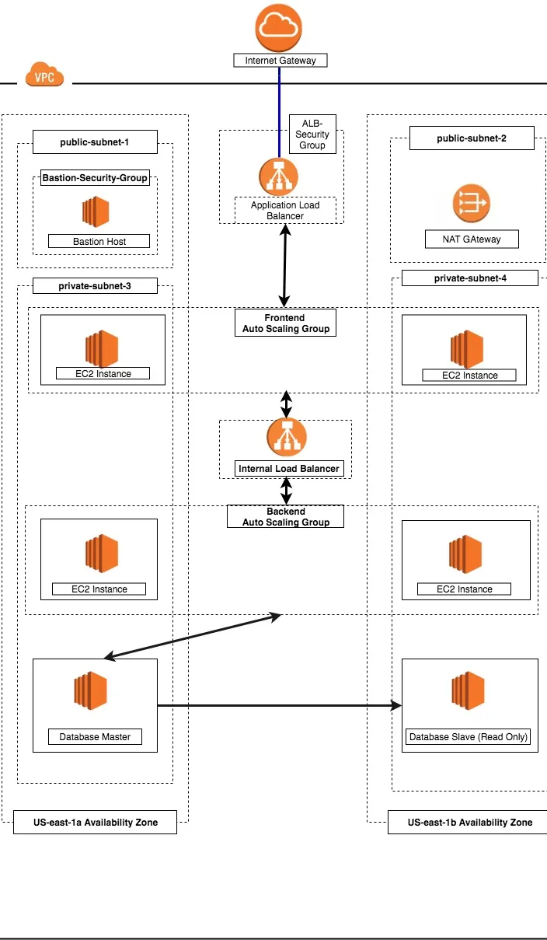
Scope of Project
Thesis Defense
Introduction
01
The multi-tier application (three-tier, n-tier, and so forth.) has been a cornerstone architecture pattern for decades, and remains a popular pattern for user-facing applications. Although the language used to describe a multi-tier architecture varies, a multi-tier application generally consists of the following components:
Presentation tier: Component that the user directly interacts with (for example, webpages and mobile app UIs).
Logic tier: Code required to translate user actions to application functionality (for example, CRUD database operations and data processing).
Data tier: Storage media (for example, databases, object stores, caches and file systems) that hold the data relevant to the application.

Slide 3
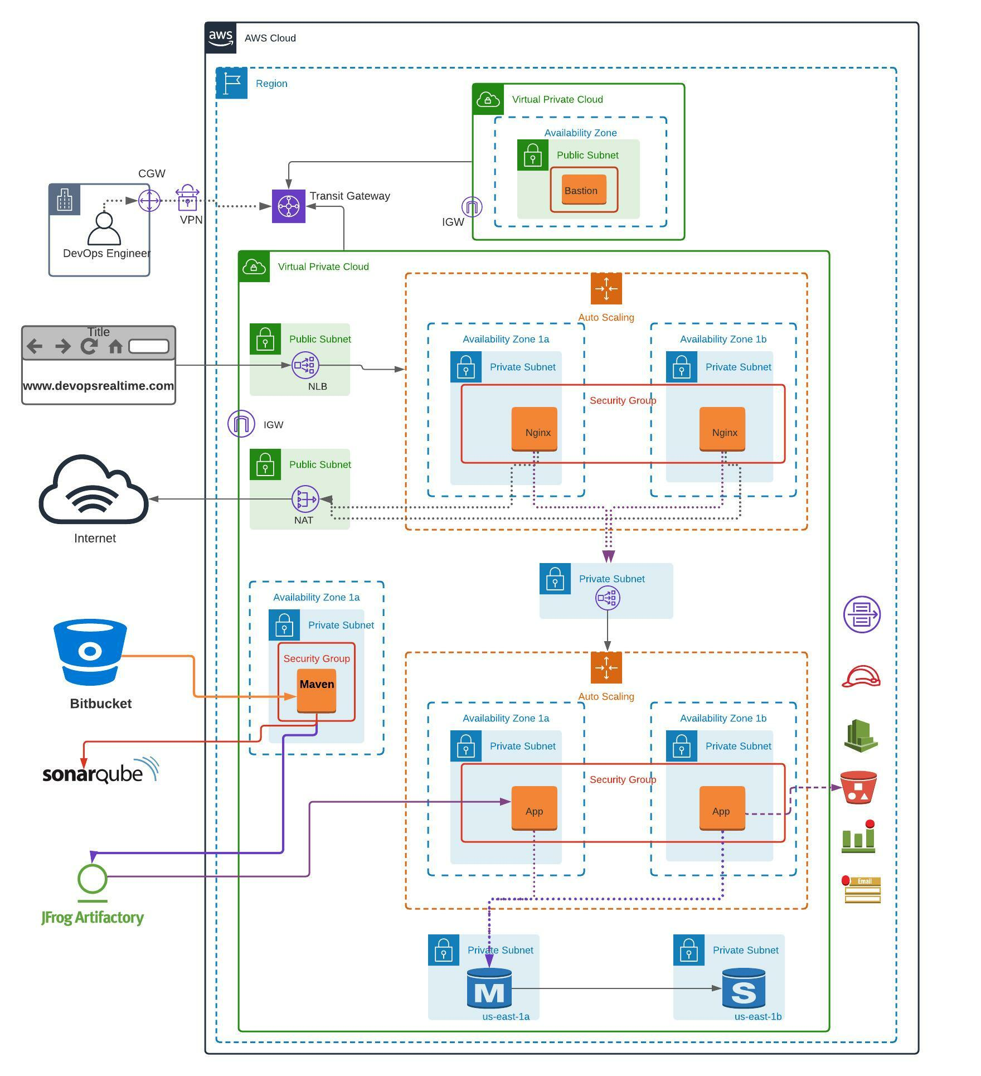
IMPLEMENTATION
Thesis Defense

Slide 4
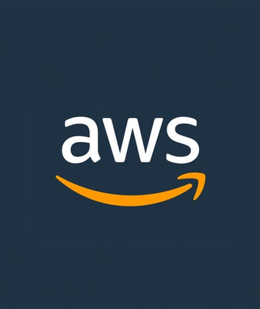
Thesis Defense
Faculty of Recorded Media Arts
Tools and Technologies
Department of Film and Television
REQUIREMENTS:-
Cloud Platform AWS
Required Services
Amazon API Gateway → Used for logic tier
Amazon Lambda → Used for logic tier
Amazon CloudFront → Used for Presentation tier
Amazon Simple Storage Service →Used for Presentation tier
Amazon Aurora → Used for Data tier
Amazon Dynamo DB →Used for Data tier

Slide 5
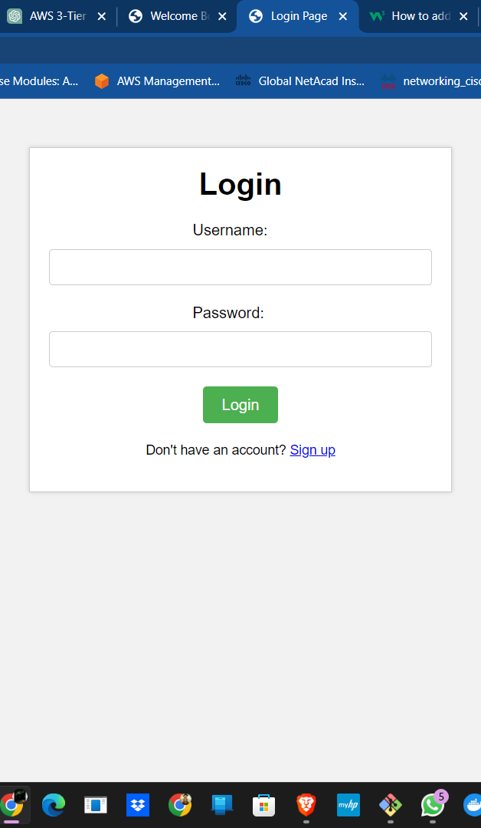
Tier One {PRESENTATION LAYER}
Thesis Defense
Presentation Tier: The presentation tier is responsible for handling user requests and rendering the application's user interface. AWS provides several services that can be used to build this tier, such as Amazon S3 for hosting static web content, AWS Elastic Beanstalk for deploying and managing web applications, or AWS App Runner for quickly deploying containerized applications.
Services Required: CloudFront and Amazon S3

Slide 6
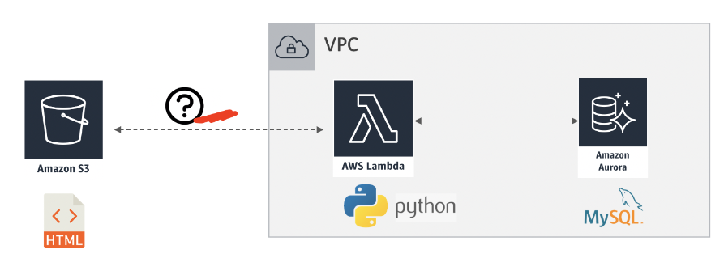
Tier Two {APPLICATION LAYER}
Thesis Defense
Application Tier: The application tier is responsible for implementing the application's business logic and processing user requests. AWS provides several services that can be used to build this tier, such as AWS Lambda for serverless computing, AWS EC2 for virtual servers, or AWS Elastic Kubernetes Service (EKS) for running and managing containerized applications.
Services Required: AWS LAMBDA AND AMAZON AURORA

Slide 7
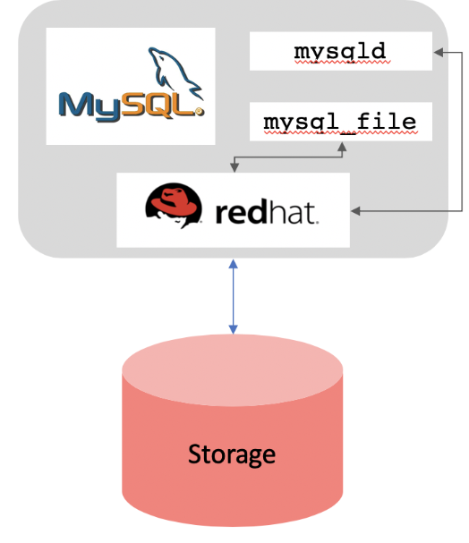
Tier Three {DATABASDE LAYER}
Thesis Defense
Database Tier: The database tier is responsible for storing and managing the application's data. AWS provides several services that can be used to build this tier, such as Amazon RDS for running and managing relational databases, Amazon DynamoDB for NoSQL databases, or Amazon Aurora for high-performance databases.
Services Required: AWS AURORA AND RDS

Slide 8
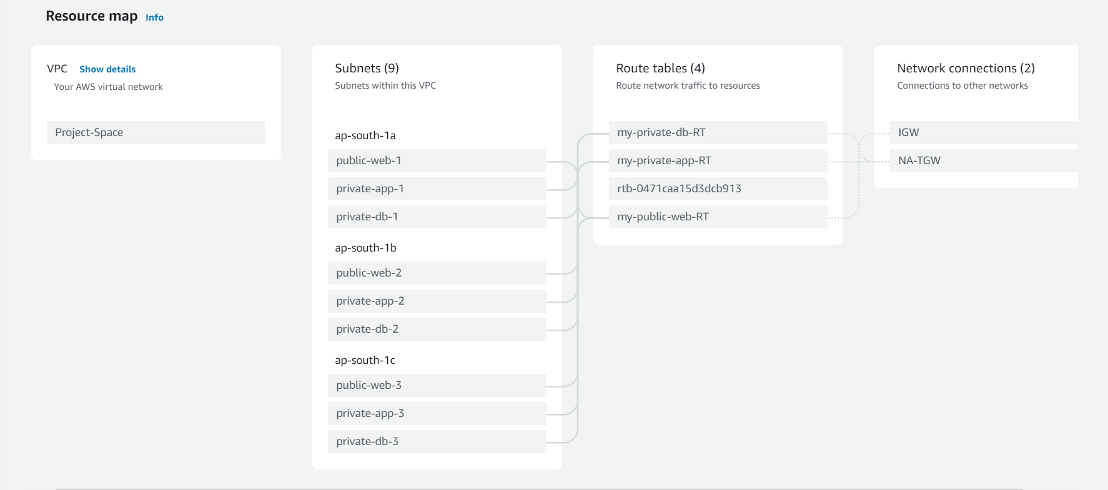
Construction of 3-tier Architecture using AWS
05
THE PHASE → ONE
Creating an VPC{virtual private cloud} with the subnets
Attach this VPC with EC2{elastic compute cloud}
THE PHASE → TWO
Create an LOAD BALANCER with TARGET GROUPS
Attach this load balancer with the public instance (ec2)
THE PHASE → THREE
Create an RDS {Rational database service}
Attach this RDS with the private instance (ec2)

Slide 9

Conclusion
Successfully deployed website

Slide 10

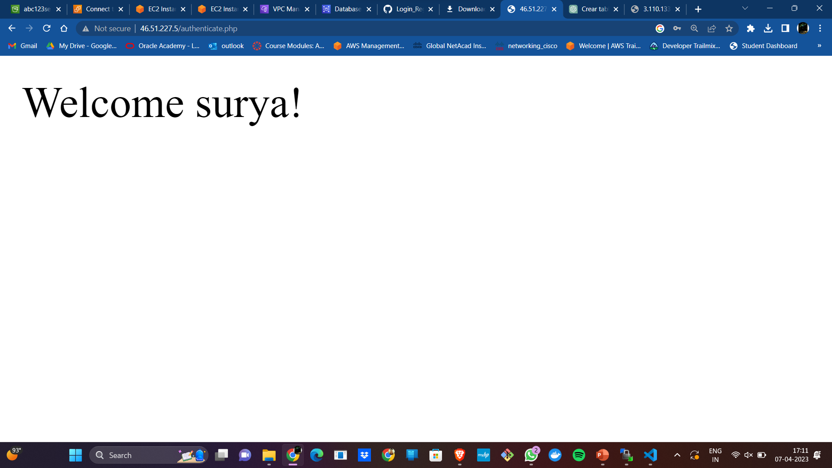
Thesis Defense
Outcome

Slide 11
Thank You
By Team Amigos

