Slide 1
JPEG Image Compression
By –
Bbiswabasu Roy – 19EC39007
Jothi Prakash – 19EC39023

Slide 2
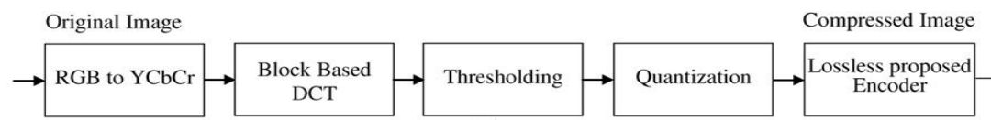
JPEG Pipeline

Slide 3
RGB TO YCbCr
1

Slide 4
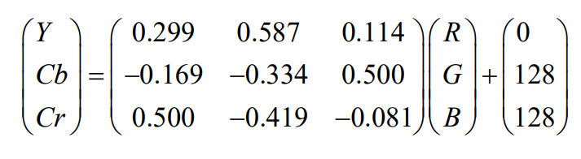
Color Specification Process
The YUV colour coordinate defines Y, Cb, and Cr components of one color image, where Y is commonly called the luminance and Cb, Cr are commonly called the chrominance. Describing of a colour in terms of its luminance and chrominance content separately enable more efficient processing and transmission of colour signals in many applications.

Slide 5
Block Based DCT
2

Slide 6
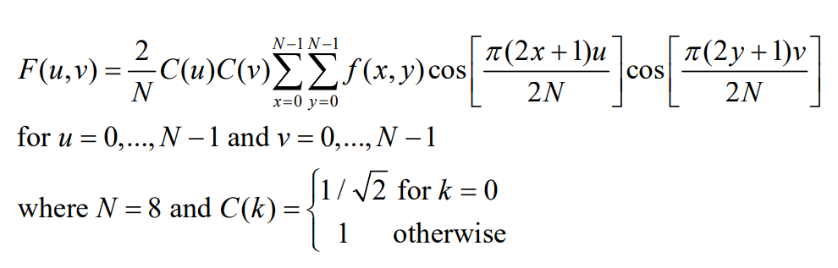
Discrete Cosine Transform Process
After colour coordinate conversion, the next step is to divide the three colour components of the image into many 8×8 blocks. For an 8-bit image, in the original block each element falls in the range [0,255]. Data range that is centred around zero is produced after subtracting The mid-point of the range (the value 128) from each element in the original block, so that the modified range is shifted from[0,255] to [-128,127]. Images are separated into parts of different frequencies by the DCT

Slide 7
Quantization
3

Slide 8
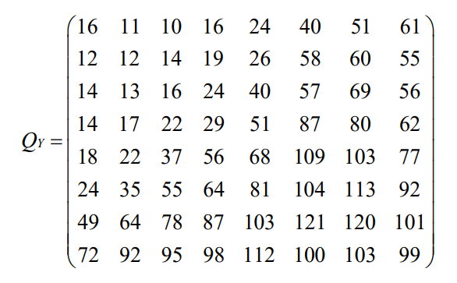
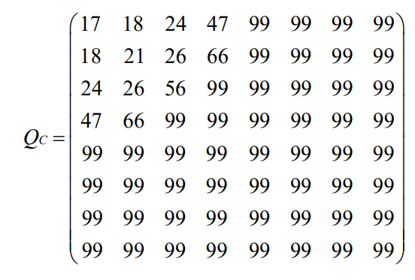
Quantization Process
We actually throw away data through the Quantization step. We obtain the Quantization by dividing transformed image DCT matrix by the quantization matrix used . Values of the resultant matrix are then rounded off

Slide 9
Zig Zag Ordering
4

Slide 10
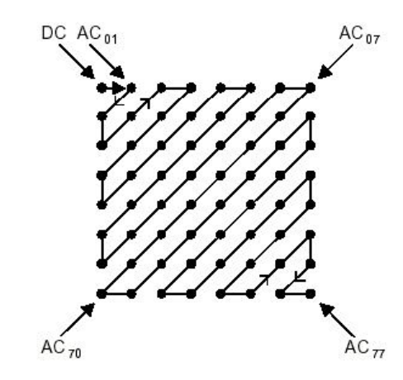
Zig Zag Ordering Process
After quantization, the "zig-zag" sequence orders all of the quantized coefficients. In the "zig-zag" sequence, firstly it encodes the coefficients with lower frequencies (typically with higher values) and then the higher frequencies (typically zero or almost zero).

Slide 11
Huffman Encoding
5

Slide 12
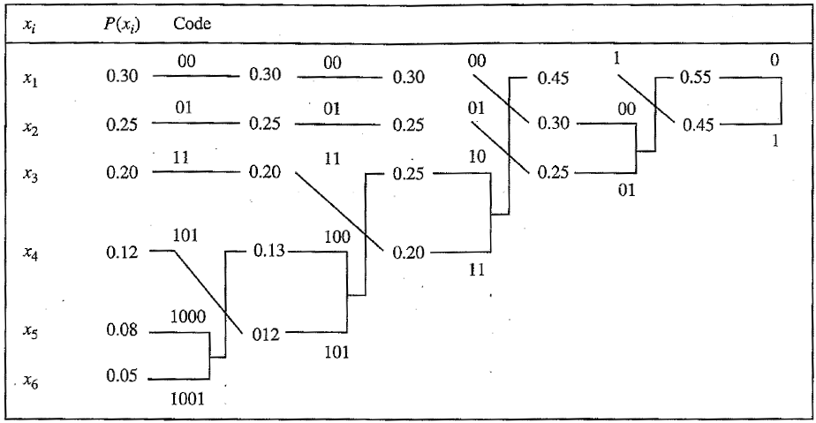
Huffman Coding Process
Entropy Coding achieves more lossless compression by encoding more compactly the quantized DCT coefficients. Huffman coding is used in the baseline sequential codec, but all modes of operation use Huffman coding and arithmetic coding.

Slide 13
Results
Output Images are generated by using the JPEG Image compression algorithm

Slide 14
Cameraman
1

Slide 15
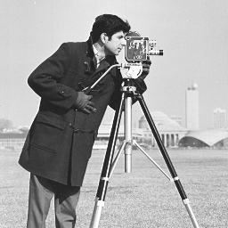

Compression Ratio – 5.244
Compression Ratio – 7.93

Slide 16

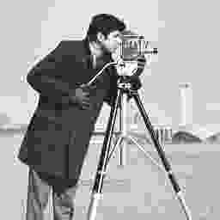
Compression Ratio – 11.89
Compression Ratio – 28.96

Slide 17
Lena
2

Slide 18
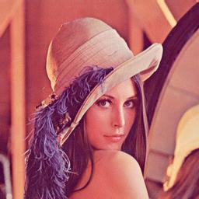

Compression Ratio – 3.87
Compression Ratio – 13.38

Slide 19

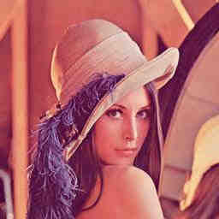
Compression Ratio – 18.04
Compression Ratio – 30.26

Slide 20
Corn
3

Slide 21
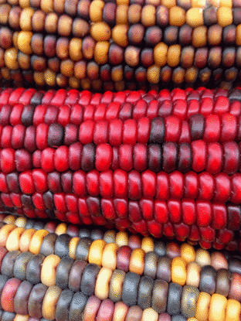
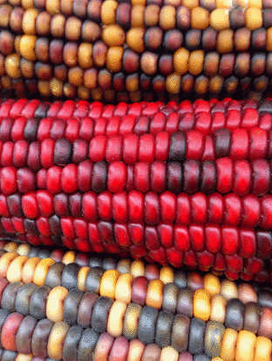
Compression Ratio – 2.84
Compression Ratio – 4.55

Slide 22

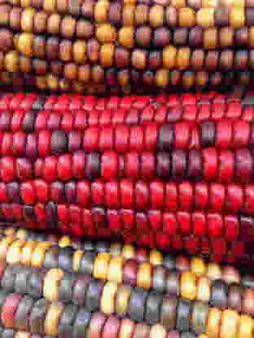
Compression Ratio – 7.18
Compression Ratio – 20.09

Slide 23
Thank You

