Slide 1
Health on Hands
Group members:
Nithyananda Reddy Marri
Surya Prakash Nellutla
Satya Jayanth Tamire

Slide 2
Introduction:-
Health on Hands is a platform that works for a multispecialty hospital where patients can easily book appointments online based on the vaccination and doctor they need, which simplifies the scheduling procedure. User-friendly interfaces make it simple for patients to select their preferred time based on the doctor’s schedule. All things considered; our platform improves overall patient satisfaction in all the fields related to hospitals.
In our application, we have three modules: hospital, doctor and patient. Here, the hospital will add and view the doctors and also nurses. The hospital will add the vaccinations and assign a doctor and nurse to that vaccination in our application. Then the doctor will login to the application and can add the timings according to his availability. For example if a doctor adds the timings from 10 am to 12 pm then slots divide automatically with 15 mins. Now the patient will register by giving the basic details of the patient; after that, with a registered email and password, the patient will login to the application.

Slide 3
Database description:
The database Description contains nine collections:
Admin, vaccines, doctor, patient, officer, Time-slots, appointment, payment,Prescription.The Admin collection contains the user_name,password.
And the admin can add the vaccines, officer and doctor. The vaccines collection contains the vaccine_name, about-vaccine, is prescription needed, picture, start-time, end_time and price. The admin will add the officers and doctors. The officer collection contains the officer_name . The doctor collection contains the name, email ,phone
,password, specialisation, designations, experience, about_doctor, picture, start_time, end_time and price.
The patient will register into the website with their valid details then login into the website, the patient collection contains the name, email, password, phone, gender, age and address.

Slide 4
Then the patient will view the vaccines if the vaccine doesn’t contain doctor prescription then the patient will book the appointment with their details and choose the time slot and the admin will assign the officer for the vaccination or if the vaccine contains doctor prescription then the patient will view the doctors time slot and book the appointment.The appointment collection contains the time_slot_id, appointment_date, booked_date, status, officer_id, vaccine_id and patient_id,doctor_id.
After the appointment booked the doctor will check the patient based on that prescription will given to the patient the prescription collection contain appointment_id, prescription, start_date, end_date, doctor-id and patient_id based on the appointment patient will pay the amount, the payment collection contains patient_id, appointment_id, total-amount, card-number, Holder_name, expiry_date and status if they payment is completed the status is updated to transaction successful,otherwise transaction failed.

Slide 5
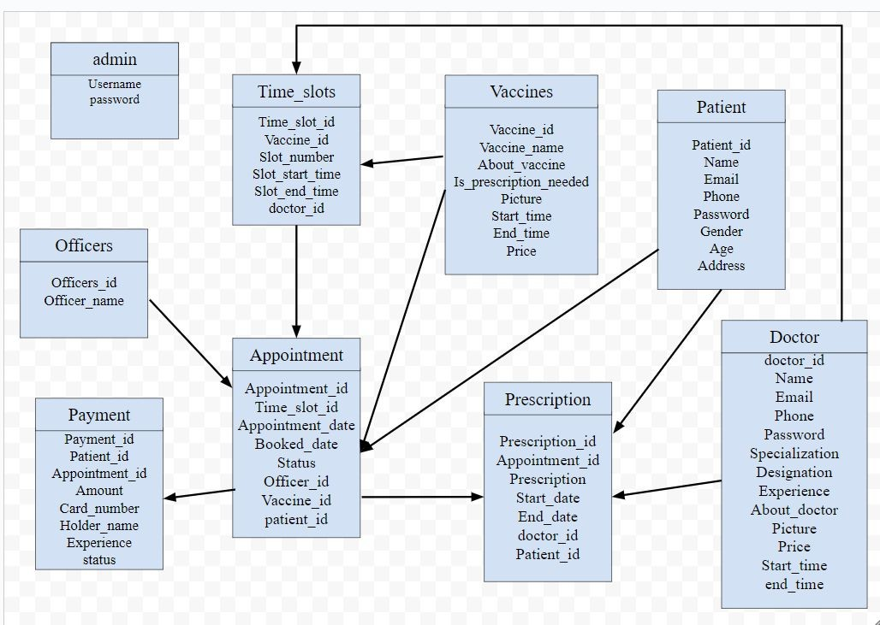
Database Diagram:-

Slide 6
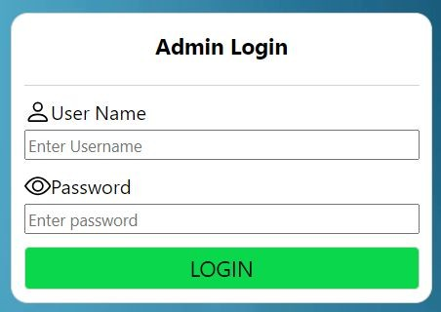
Website Home Page :
Admin Login Page :

Slide 7

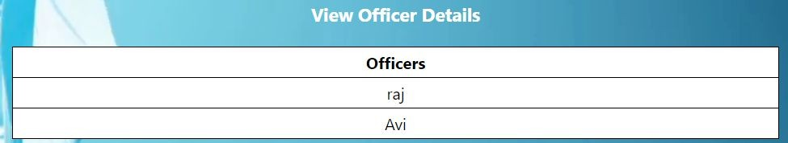
Admin Home :
Add Officers details:
View Officers details:

Slide 8
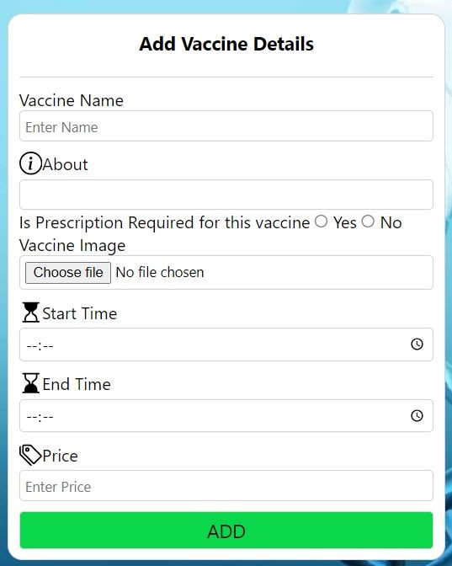
Add Vaccine Details :

Slide 9
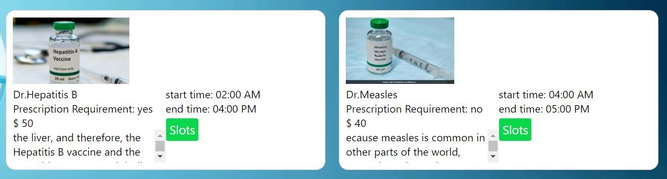
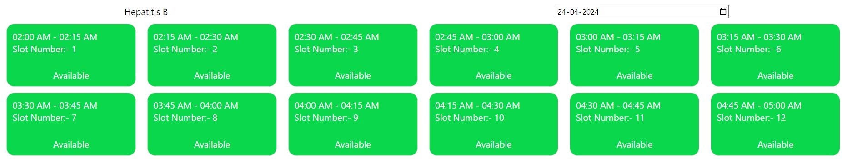
View Vaccine Details :
View Vaccine Slots:

Slide 10
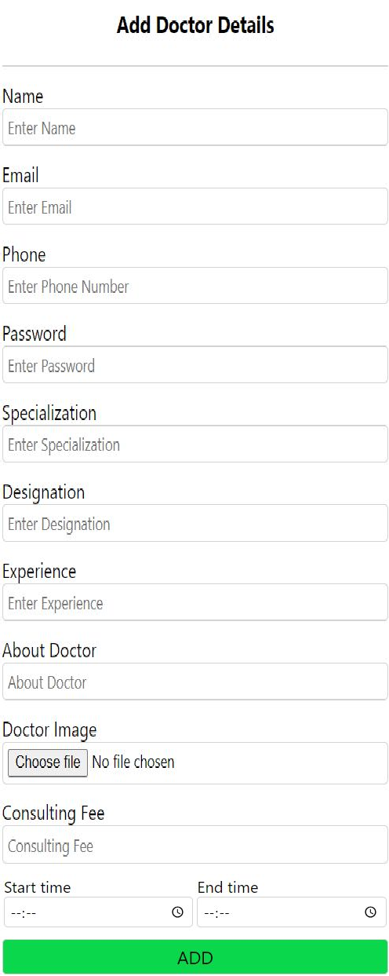
Add Doctor Details :

Slide 11
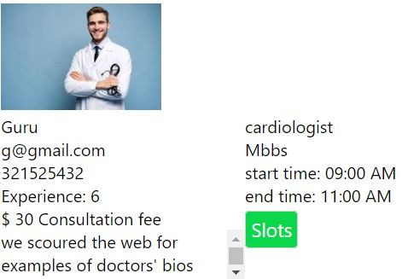
View Doctor Details :

Slide 12
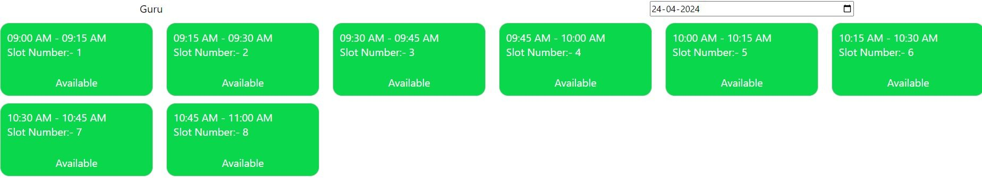
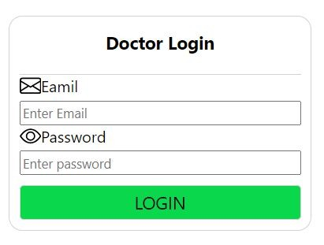
View Doctor Slots :
Doctor Login Page :

Slide 13
Doctor Home Page :
Doctor Appointments:

Slide 14
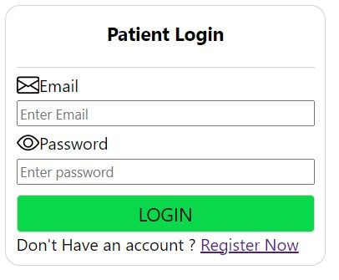
Patient Login Page :

Slide 15
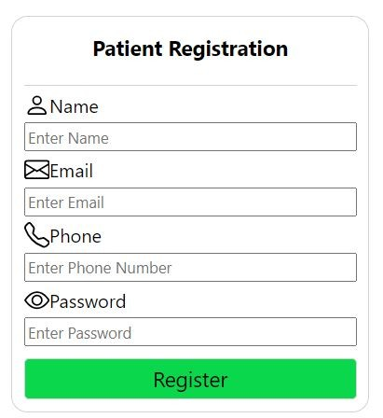
Patient Registration Page :

Slide 16
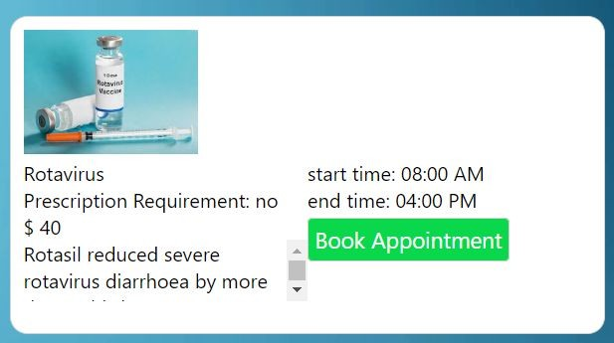
Patient Home Page :
Book Vaccine Appointment:-

Slide 17
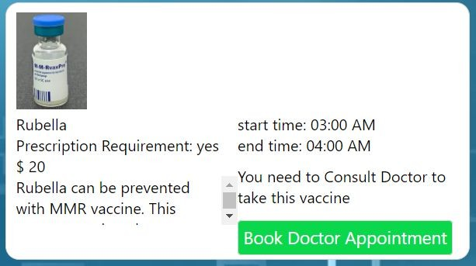
Book Doctor Appointment :

Slide 18
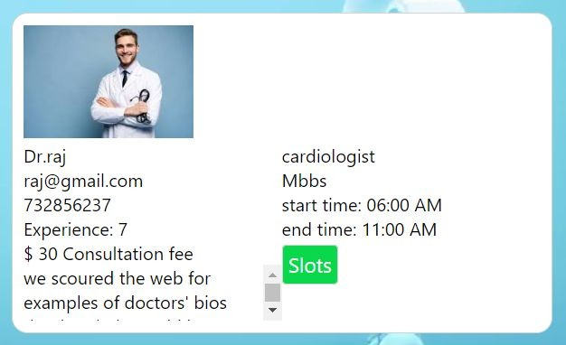
Select Doctor :

Slide 19
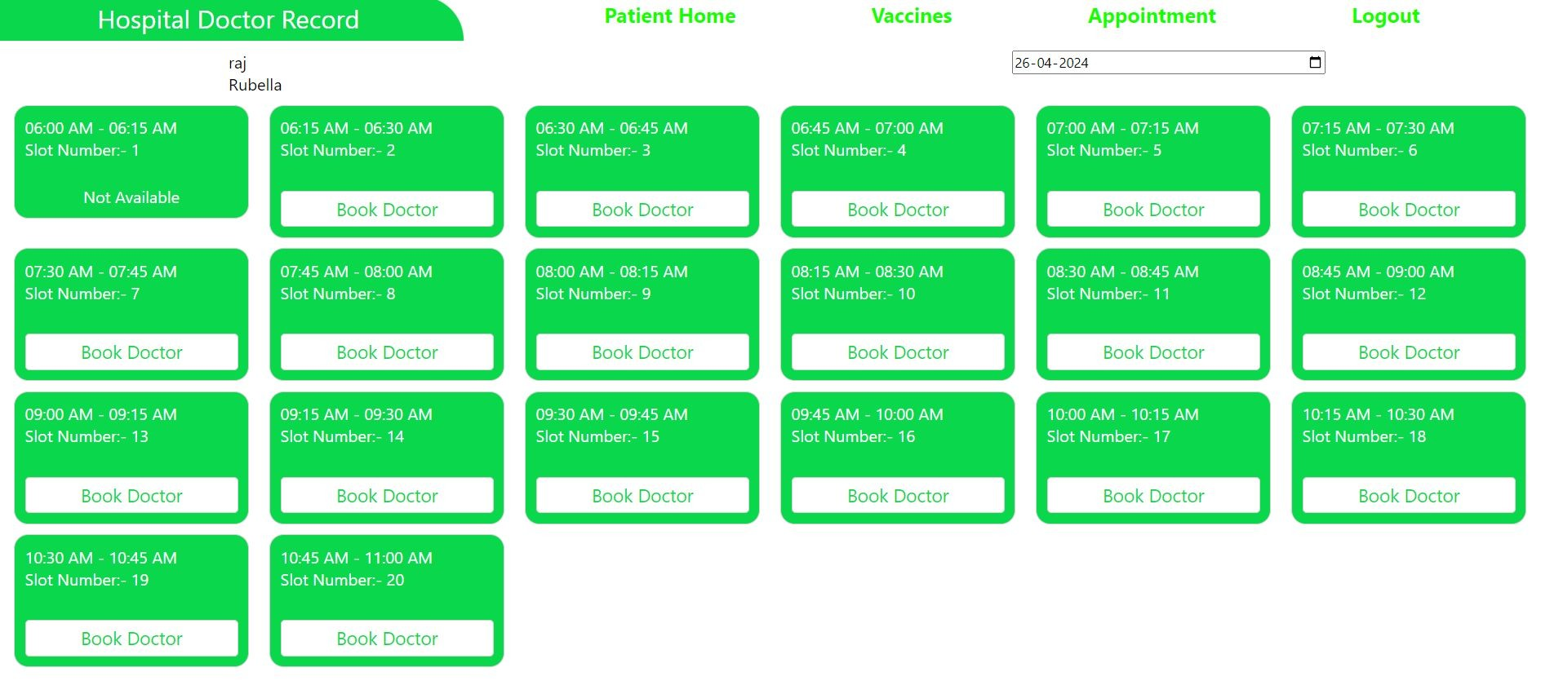
Book Doctor Appointment :

Slide 20
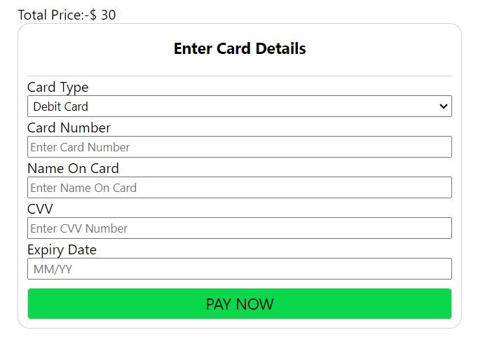
View Appointment Booked Details :
Enter Card Details :

Slide 21
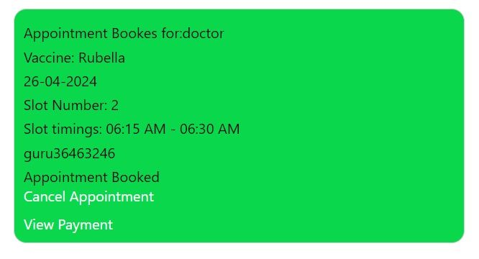
VIew Appointment Details :

Slide 22
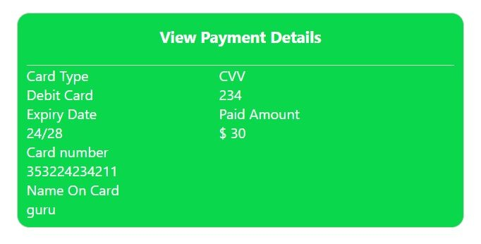
View Payment Details :

Slide 23
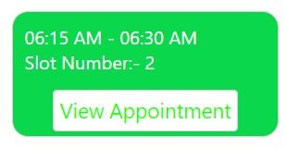
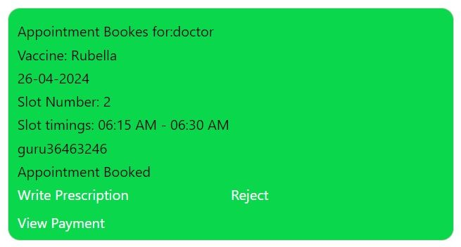
Doctor check Appointment :
Doctor views Patient Appointment :

Slide 24
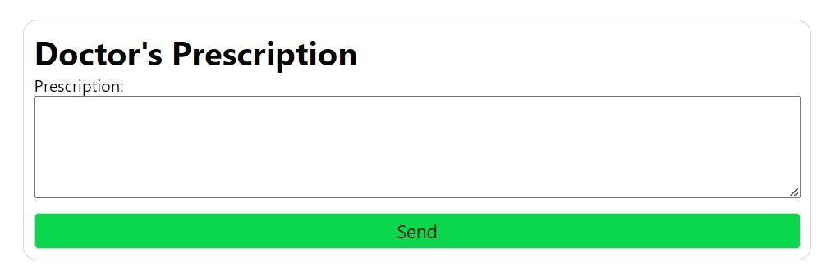
Doctor’s Prescription :

Slide 25
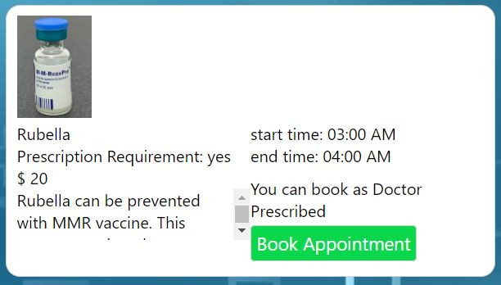
Book Appointment :

Slide 26
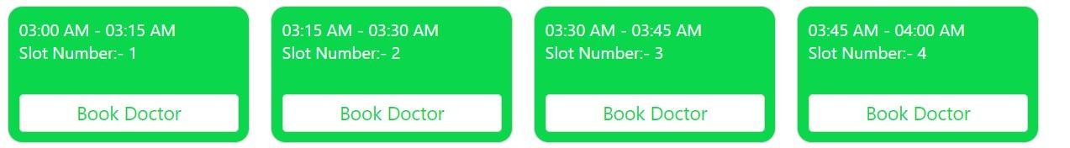
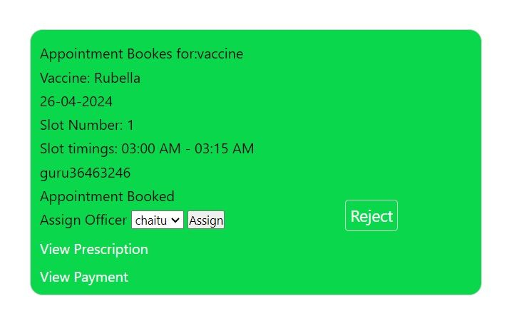
Book Appointment :
Assigning Officer :

Slide 27


