Slide 1

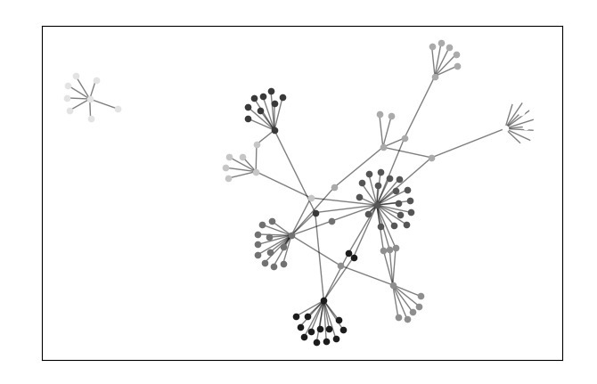
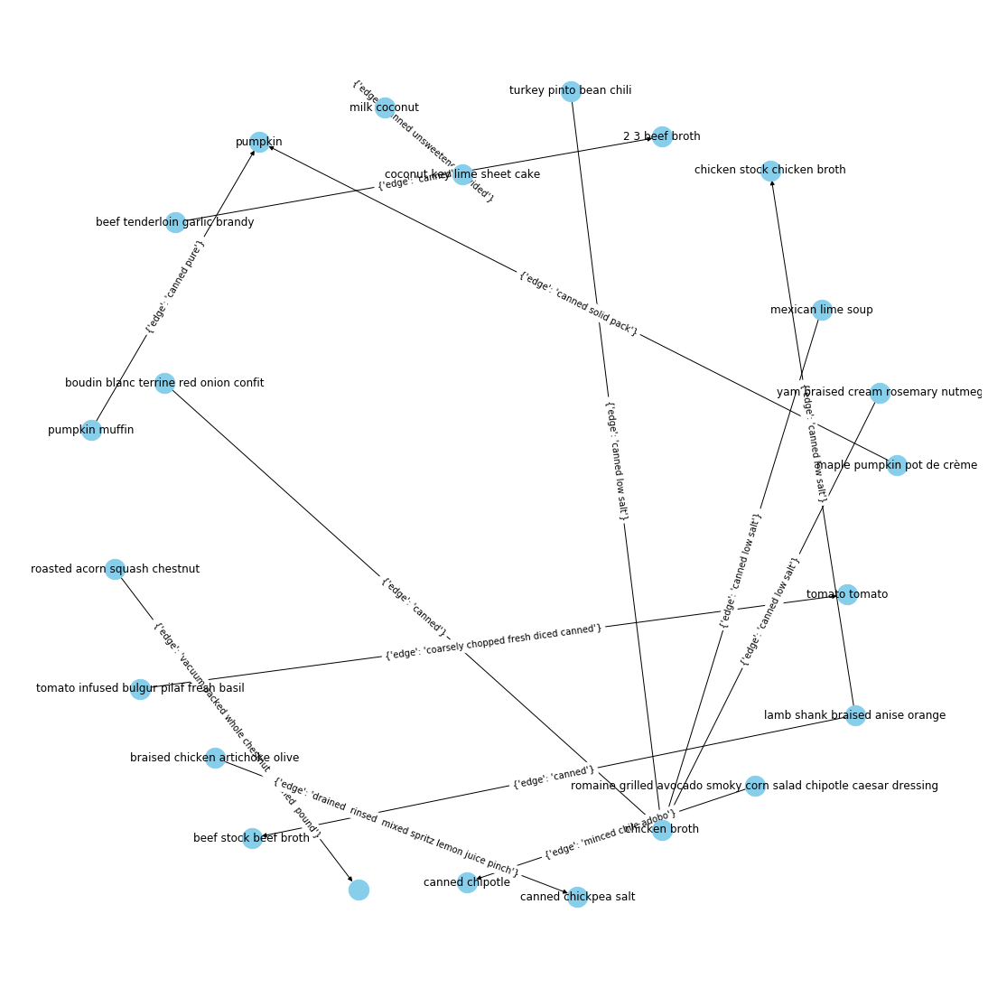
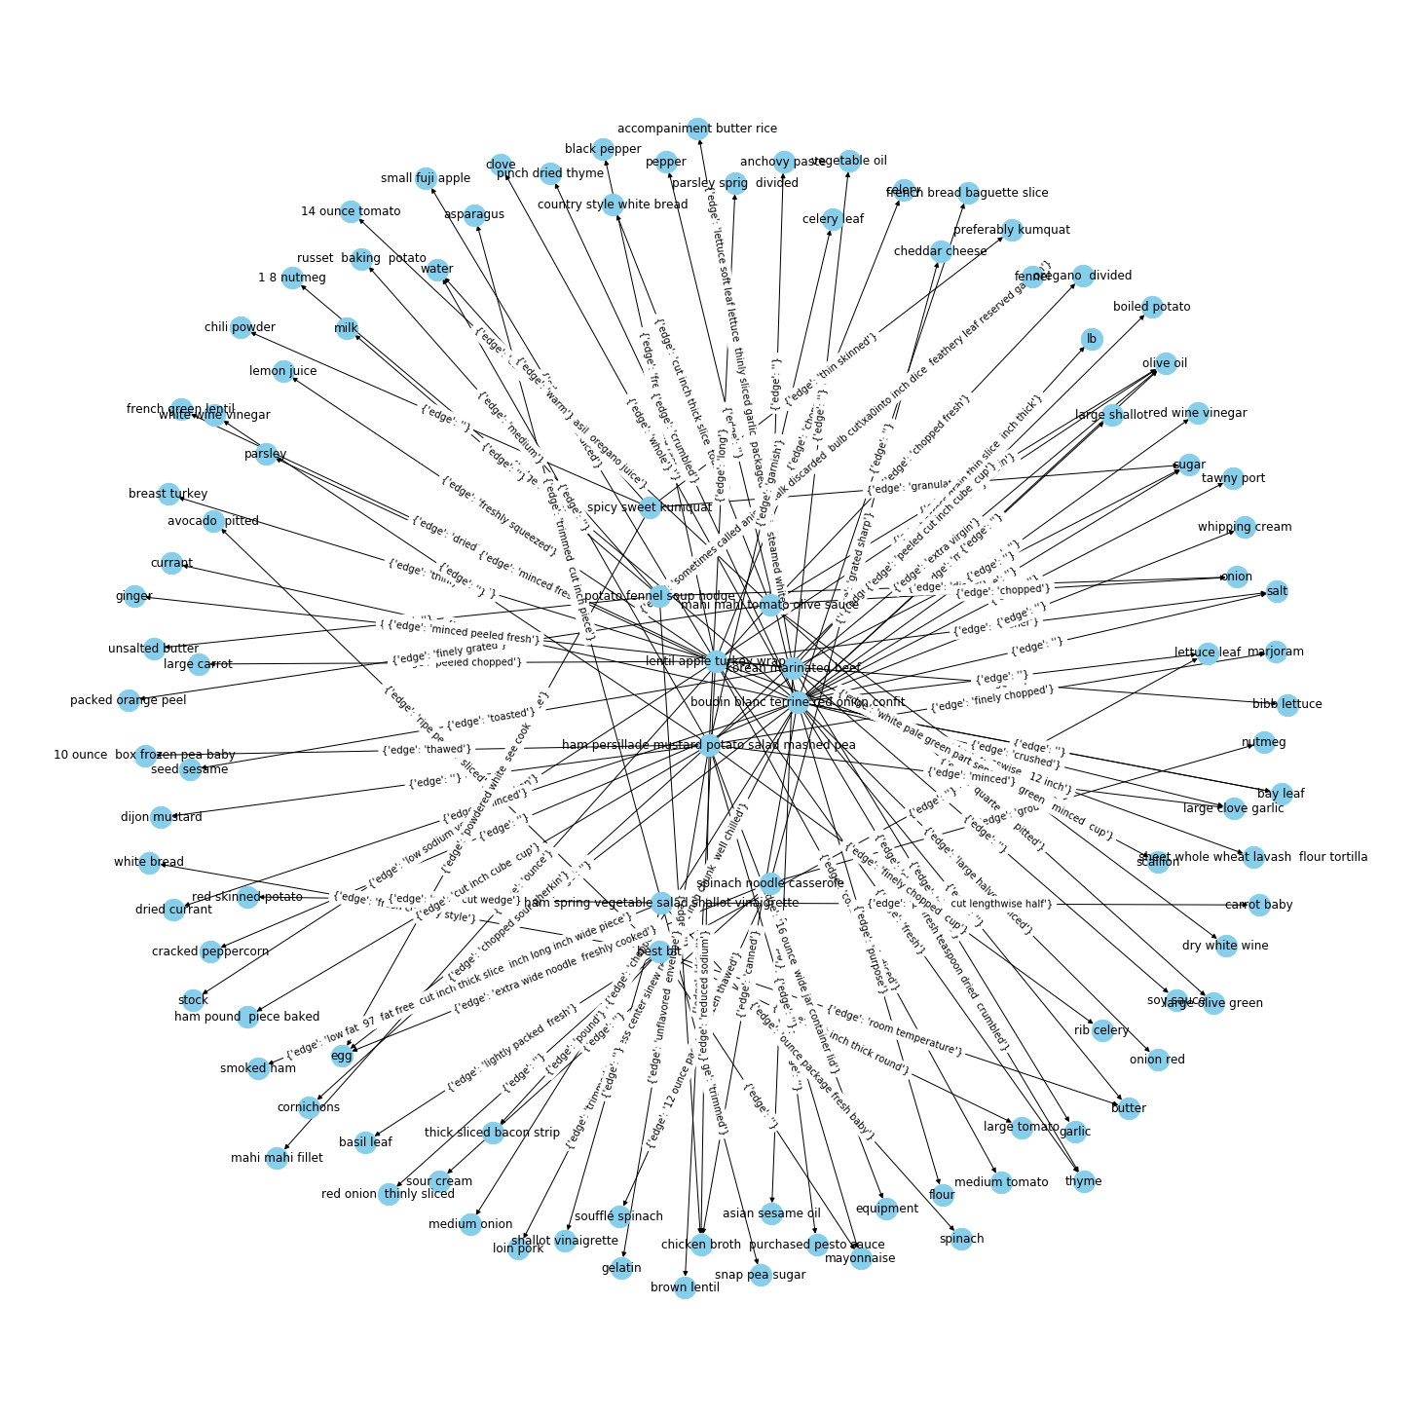
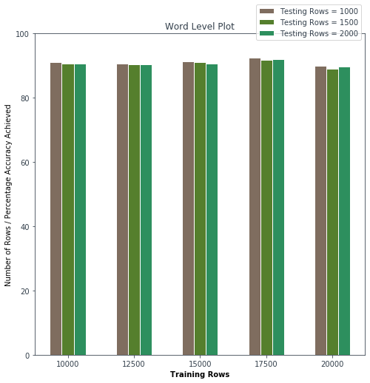
Structured recipe from unstructured corpus
Suryank Tiwari (MT19019), Rose Verma (MT19052), Prateek Agarwal (MT19070)
Introduction
Methodology
Results and Inferences
There are a large number of cooking websites that present food recipes ranging among various different cuisines and styles of cooking.
Even though there is a large amount of recipe driven data, there is little to no structure to it.
Any structures if present, are not really competent for deriving useful patterns from them.
Corpus to Structured recipe
The data corpus consists of the ingredients w.r.t each recipe. The ingredients need to be predicted as a sequence of labels and hence is a structured prediction problem.
The model is trained on input ingredients and a model file is generated. This model file is then used along with the Conditional Random Fields model (CRF++) to generate the structure which is a json.
Structured recipe to Knowledge Graph
Finding sets of triples from the structured json data obtained.
Using the triples as source, targets and edges for the knowledge graph.
A knowledge graph querying system that prints all subgraphs found in KG with keywords found in edges or nodes and it’s neighbours.
Finding analytics on the Knowledge graph based on betweenness centrality, eigen centrality and similar metrics.
A knowledge graph constructed from a corpus of 100 recipes with 2 connected components had 9 communities within.
The communities hint at a possible classification of the recipes that can be performed. These clusters have recipes of the same kind.
Problem Statement
To derive well defined recipe structures from an unstructured corpus of food recipe data along with meaningful relationships between the recipe entities. Using the derived structure to arrive at knowledge graphs, a query system and several inferences.
Partial Input: ‘2 teaspoons extra virgin olive oil’
Partial Output:
{
‘name’: ”olive oil”,
‘quantity’: ”2”,
‘unit’: ”teaspoons”
‘comment’: ”extra virgin”,
‘input’: ‘2 teaspoons extra virgin olive oil’
}
Fig: Communities within the knowledge graph
Query: canned – subgraph output
Knowledge graph sample:
Objectives
Extraction of semantics and structure out of the unstructured data of the recipes.
To design knowledge graphs out of the structured data obtained.
Drive queries and inferences from the knowledge graph obtained.
Querying the Knowledge graph on its nodes and edges based on keywords and obtaining sub graphs of the results obtained.
References
[1] Agarwal, Rahul and Kevin Richard Miller. ‘In-formation Extraction from Recipes.‘ (2011).
[2] Erica Greene. ‘NY times Ingredient Tagger‘.
Fig: Word Level Plots
Fig: A knowledge graph with 10 recipes

