Slide 1

Notes:
Intro video with sound. Click the slide to start playback, then click again to advance to the title slide.

Slide 2
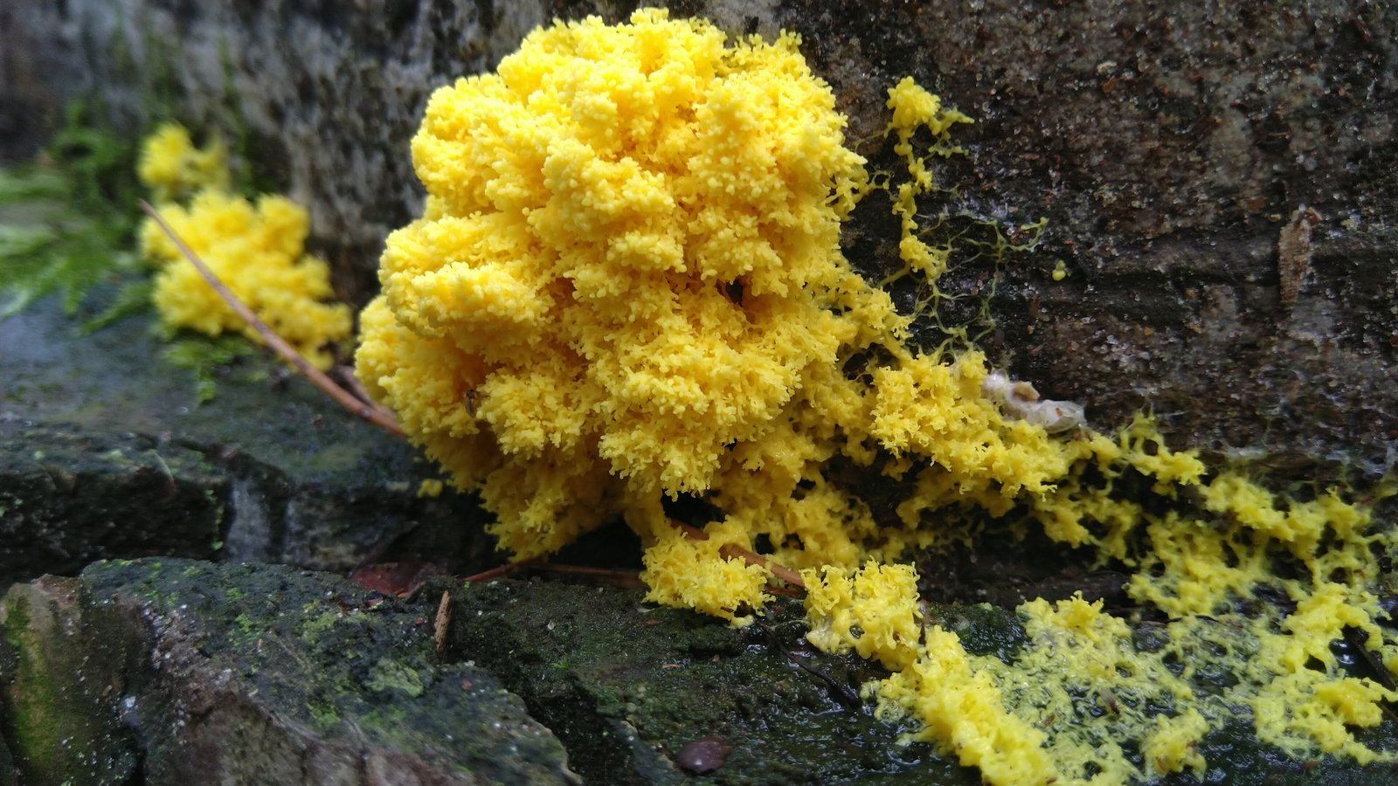
A BIO-INSPIRED ALGORITHM
SLIME
MOULD
OPTIMIZATION
How a brainless blob of slime solves problems that stump our best algorithms.
VINAYAK MANGAL
C-304
SURYANSH MISHRA
C-315
KRISHNA MISTRY
C-318
SOHA NANAL
C-326

Slide 3








What we're covering
01
02
03
04
Problem Statement
Biology of Mould & How It Works
Research Timeline
Applications of the Algorithm
05
06
07
08
Pros and Cons
Statistical Data
Summary & Future Possibilities
Comparisons with Other Algorithms

Slide 4
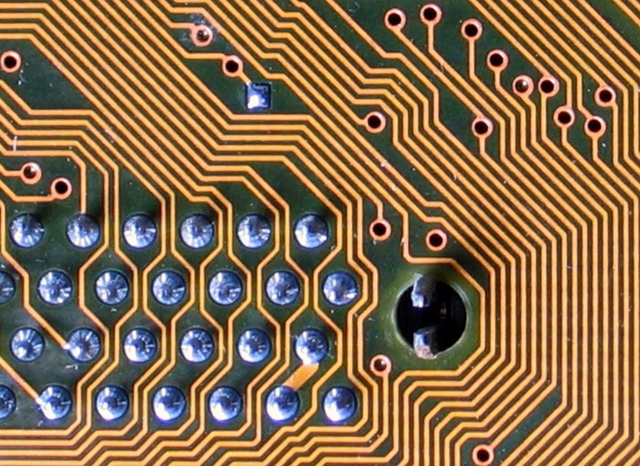
01
Problem Statement
Why our best algorithms still fall short

Slide 5
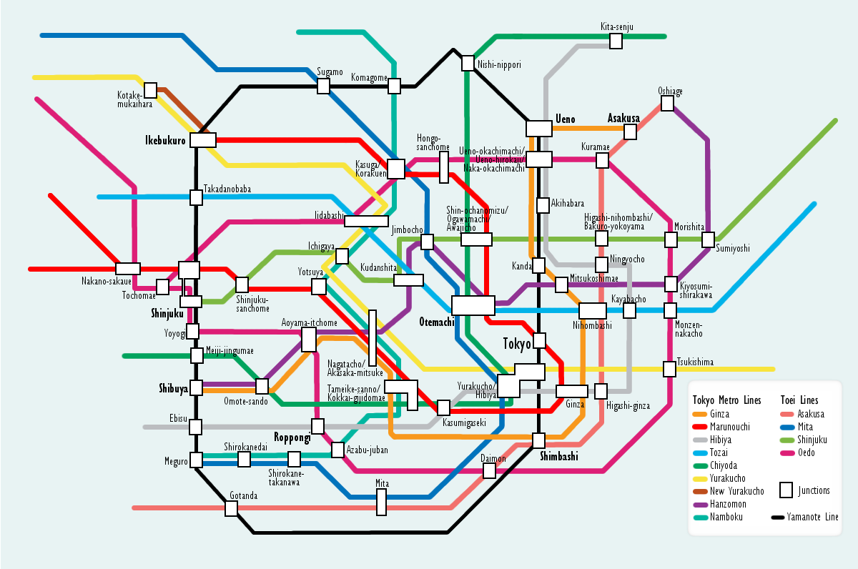
01 — PROBLEM STATEMENT
One goal at a time
Classical algorithms optimize a single thing, and trade away the rest.
Dijkstra's gives you the shortest path.
Kruskal's gives you the cheapest network.
Neither balances cost, speed and resilience together.

Slide 6
01 — PROBLEM STATEMENT
One cut, and the map
falls apart
A minimum-cost network is brittle by design — it carries no spare routes.
Snap a single link and whole districts go dark.
Redundancy costs money, so it gets designed out.

Slide 7
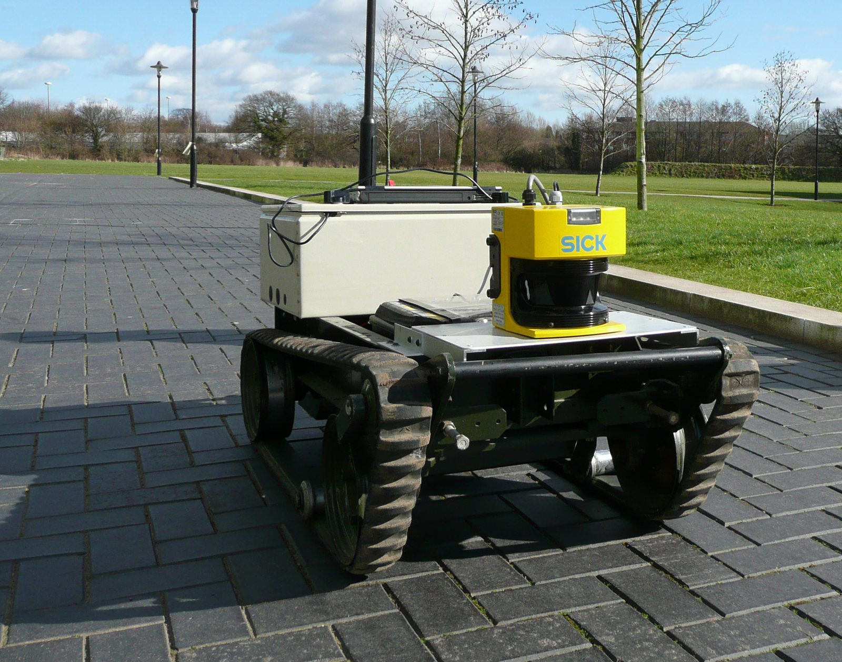
01 — PROBLEM STATEMENT
It needs the whole map —
and still can't keep up
These algorithms are centralized. They need the complete graph before they start, and real infrastructure never sits still.
No partial knowledge, no head start.
Traffic shifts, links fail, demand moves.
By the time it finishes recomputing, the map changed again.

Slide 8
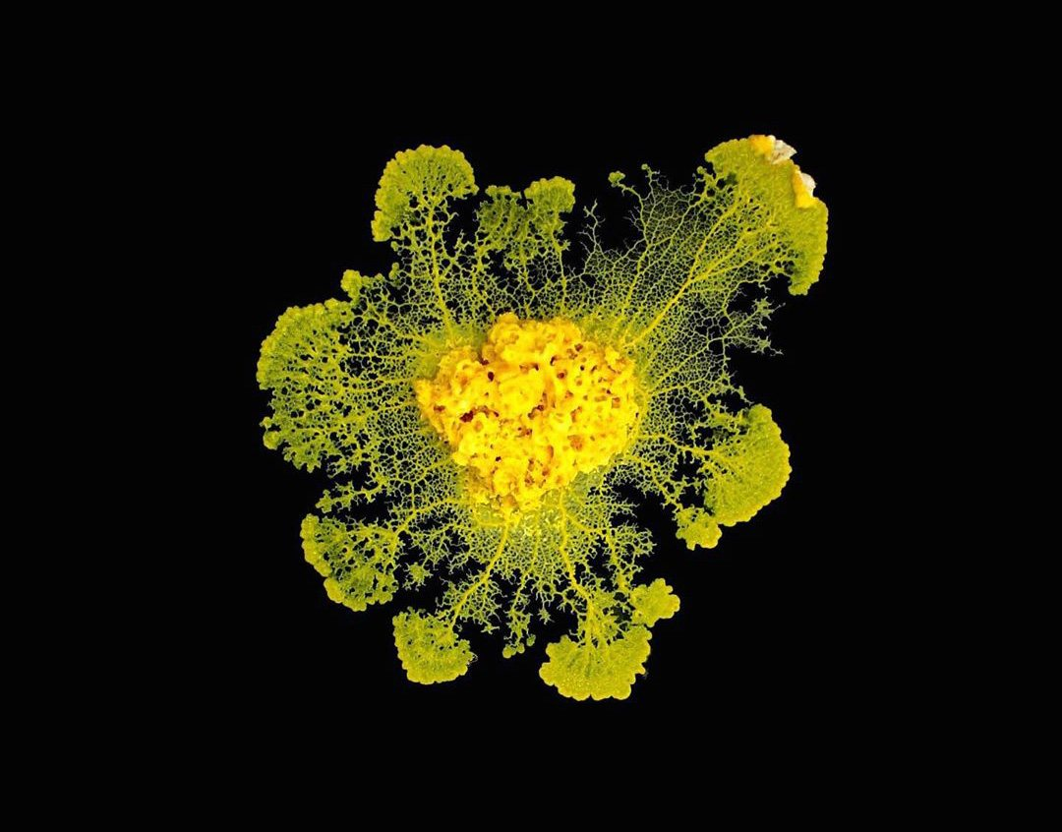
Three goals.
One organism.
COST · EFFICIENCY · FAULT TOLERANCE
Nature solved all three at once — roughly a billion years before we started trying.

Slide 9
02
Biology & How It Works
One cell. No brain. Real decisions.

Slide 10
02 — BIOLOGY · MEET THE ORGANISM
Physarum polycephalum
A single cell the size of a dinner plate, with millions of nuclei and not one neuron.

Slide 11
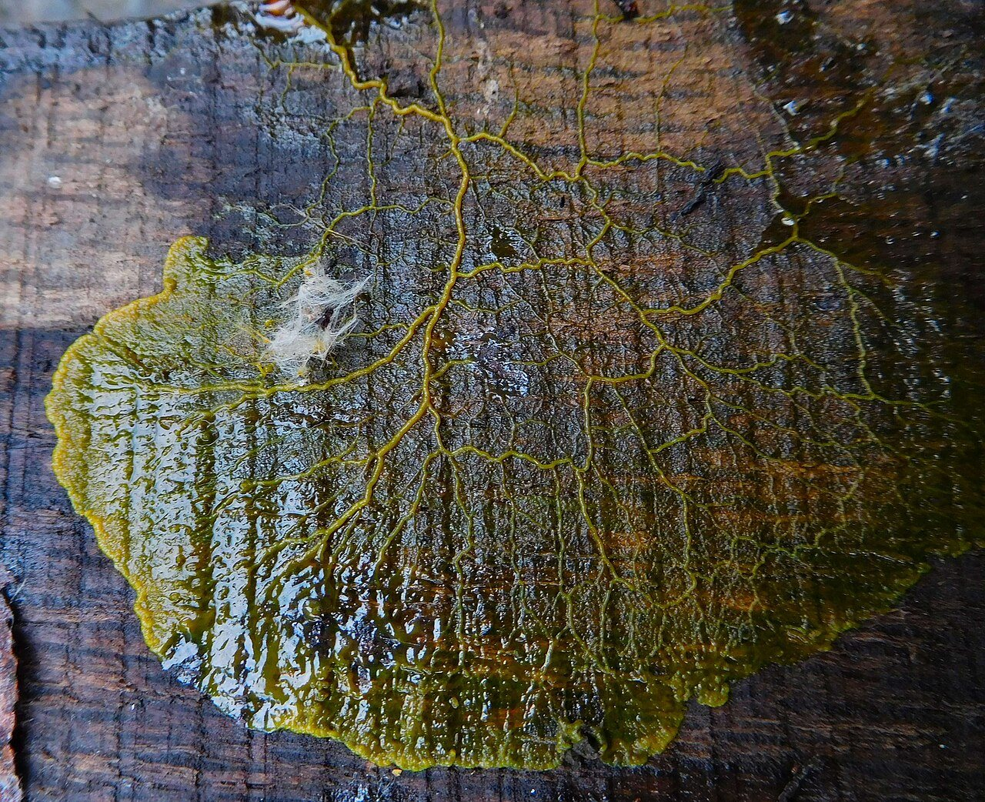
02 — BIOLOGY
Not a plant.
Not a fungus.
Not an animal.
It borrows traits from all three kingdoms and fits cleanly into none.
Cellulose in its spore walls, like a plant.
Spreads by spores, like a fungus.
Crawls and swallows bacteria whole, like an animal.
Physarum polycephalum growing on a stored oak post — its natural habitat is damp, rotting wood.

Slide 12
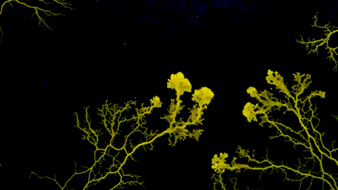
02 — BIOLOGY · HOW IT WORKS
It grows.
It prunes.
It pushes veins outward in every direction, then dismantles the ones that didn't pay off.
Reaches toward food in all directions at once.
Thickens the tubes carrying the most flow.
Starves and abandons every dead end.
Time-lapse: the plasmodium exploring and consolidating its network.

Slide 13
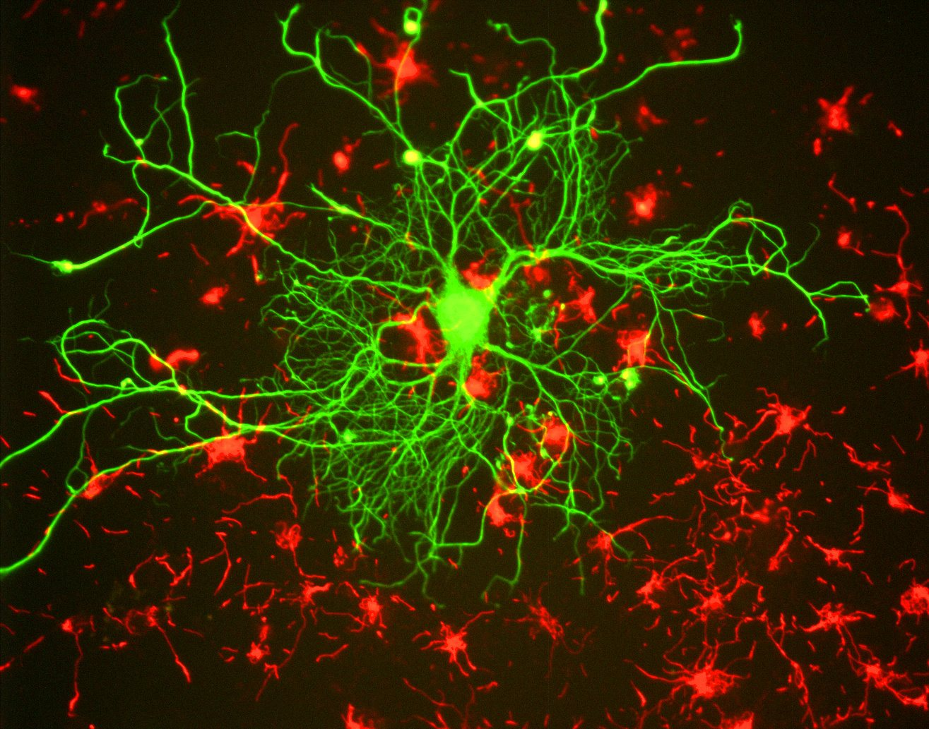
02 — BIOLOGY
This is what it
doesn't have
A real neuron: branching fibres, synapses, a whole architecture built to move signals between cells.
Physarum has none of it — no neurons, no nerves, no centre.
Its decisions come out of oscillating chemistry alone.
Fluorescence-stained neuron (green) among glial cells (red) — shown for contrast, not a slime mould.

Slide 14
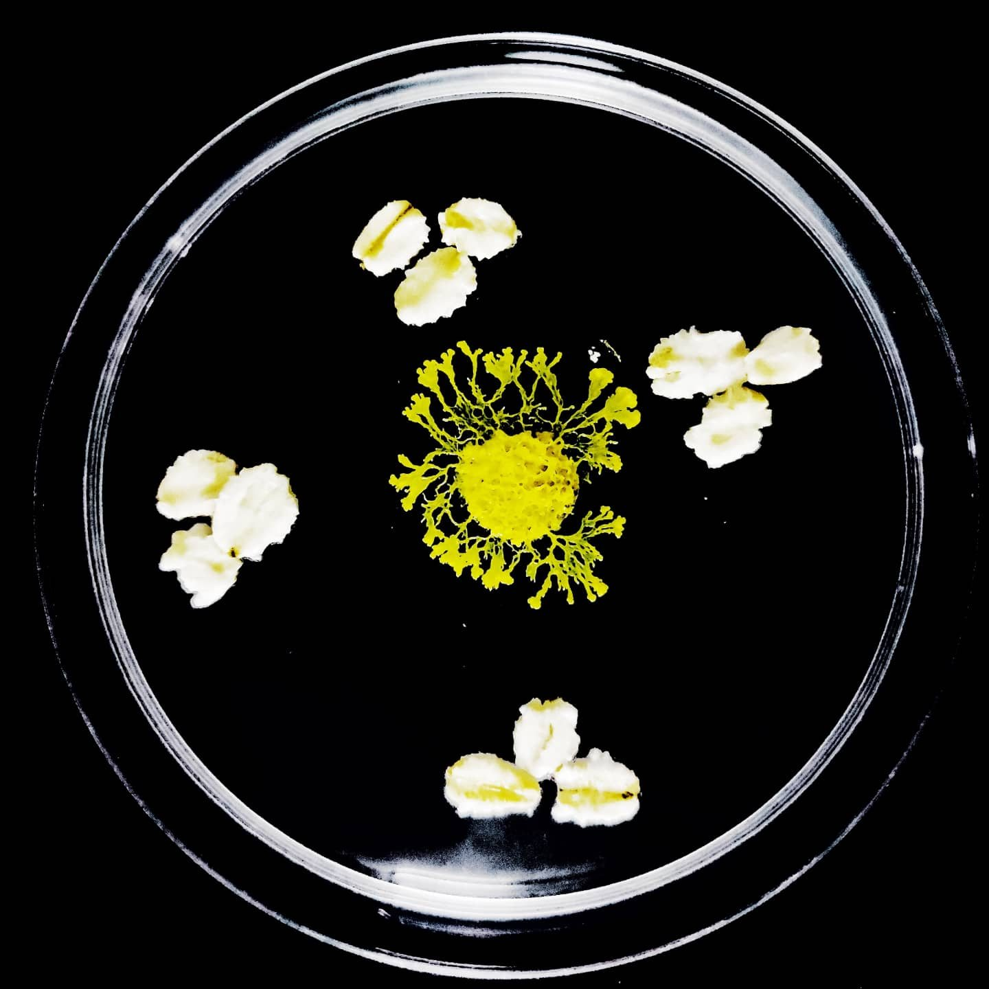


02 — BIOLOGY · MEMORY
Three things it does that shouldn't be possible
Remembers where it's been
Learns to ignore a nuisance
Passes learning by touch
It reads the slime trail it left behind and refuses to re-enter it — enough to escape a U-shaped trap that stumps simple robots.
Repeatedly exposed to a harmless irritant, it stops reacting. Rest it, and the avoidance comes back — textbook habituation.
Fuse a trained plasmodium to an untrained one and the tolerance transfers straight across. No synapse required.
REID ET AL., 2012
BOISSEAU ET AL., 2016
VOGEL & DUSSUTOUR, 2016

Slide 15
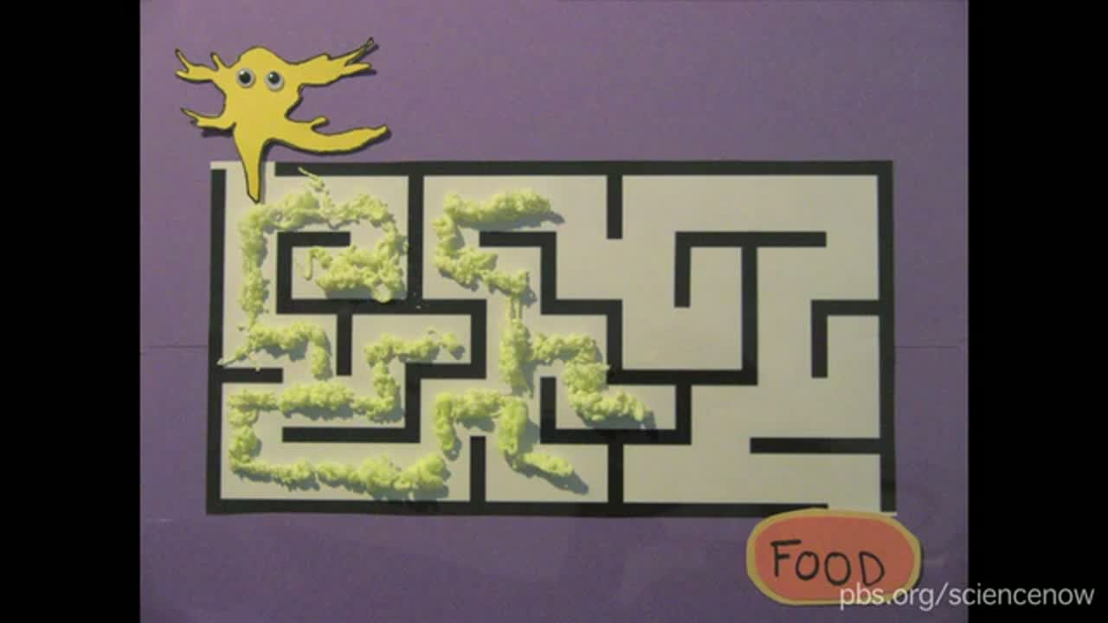
02 — BIOLOGY · WATCH
NOVA scienceNOW: Slime Mold Smarts
PBS on the maze-solving and problem-solving behaviour covered on the last few slides.
NOVA scienceNOW, Season 6 Episode 5 — PBS.

Slide 16
02 — HOW IT WORKS · RULE 1
Follow the strongest smell
Every search agent moves toward the best result found so far — or gambles on somewhere new entirely.
How close you already are to the best decides which you do.
Confident agents commit. Lost agents wander.

Slide 17
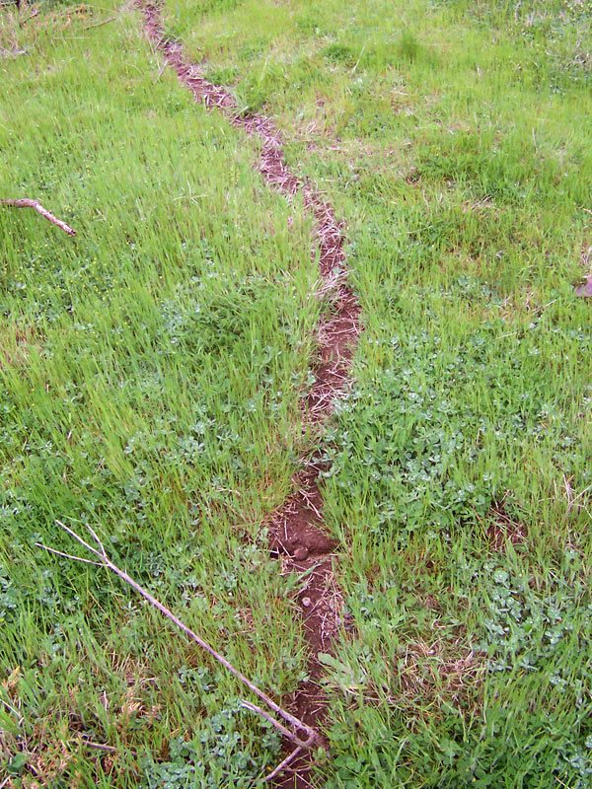
02 — HOW IT WORKS · RULE 2
Feed what works.
Starve what doesn't.
Paths carrying real traffic get reinforced. The rest quietly wither away.
This dirt track exists only because ants kept using it.
Same rule in the mould's veins, and in the algorithm's weights.
A trail worn into grass by repeated use — reinforcement, with no one in charge.

Slide 18
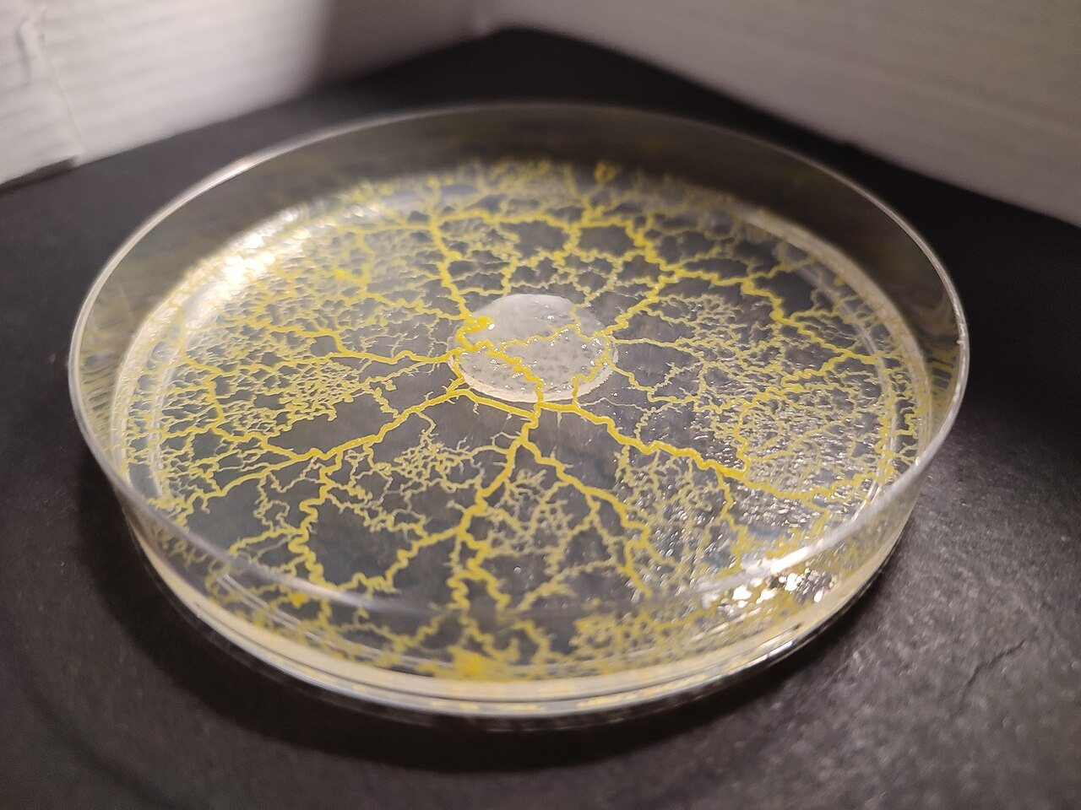
02 — HOW IT WORKS · RULE 3
Occasionally,
jump somewhere random
Every so often an agent abandons its position entirely and restarts somewhere unrelated.
Looks wasteful. Isn't.
It's the only thing stopping the whole swarm converging on a mediocre answer.

Slide 19
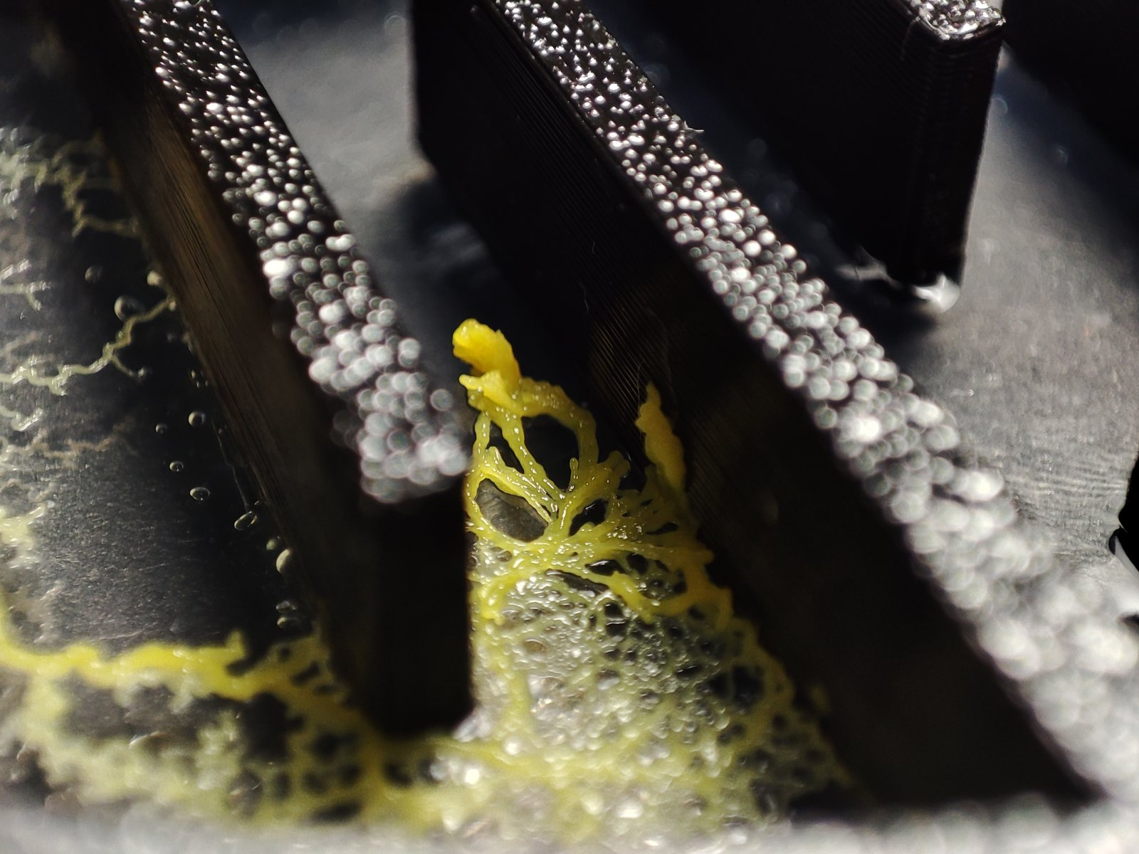
03
Research Timeline
A maze, and the Tokyo rail network

Slide 20

RESEARCH TIMELINE
Foundational work on Physarum's contraction waves and protoplasm streaming was done, not yet ‘algorithms’, just biology.
Toshiyuki Nagagaki and his team discovered the working of Physarum polycephalum, and founded ‘Physarum computing’.
1931
1990’s
1970’s - 80’s
2000
Frank Leslie Howard lays the biological groundwork for Physarum polycephalum's life cycle.
Foundational work on Physarum's contraction waves and protoplasm streaming was done, not yet ‘algorithms’, just biology.

Slide 21
RESEARCH TIMELINE
Scientists published a paper "Physarum solver," a biologically-inspired method for road-network, which became one of the most cited papers in this field.
A wave of network-design papers applies Physarum models to efficient network, computation, circuit and electronics design.
2004
2010
2006
2010-2012
Tsuda, Aono, and Gunji publish work to start using the slime mould for logic gates.
The famous Tokyo rail network experiment, showing that Physarum could replicate real-world infrastructure design was conducted.

Slide 22
RESEARCH TIMELINE
Scientists publish a cellular-automated, bio-inspired algorithm for designing data trees in wireless sensor networks, extending slime mould logic into telecom infrastructure.
Slime Mould Algorithm (SMA) is introduced as a named metaheuristic optimizer, based on the oscillation nature of slime mould in nature.
2013
2018
2015
2020
Physarum movement is used as inspiration for early soft-robotics applications.
Researchers at Lanzhou University demonstrate that Physarum can solve the Traveling Salesman Problem .

Slide 23
2020 - Present
Notes:
Biology of slime mould

Slide 24
LANDMARK EXPERIMENT · 2010
Same network, grown two ways
GROWN BY A SLIME MOULD
BUILT BY TOKYO'S ENGINEERS
Oat flakes were placed at Tokyo's major stations. The network the mould grew matched the real rail map on cost, efficiency and fault tolerance — all three at once.

Slide 25
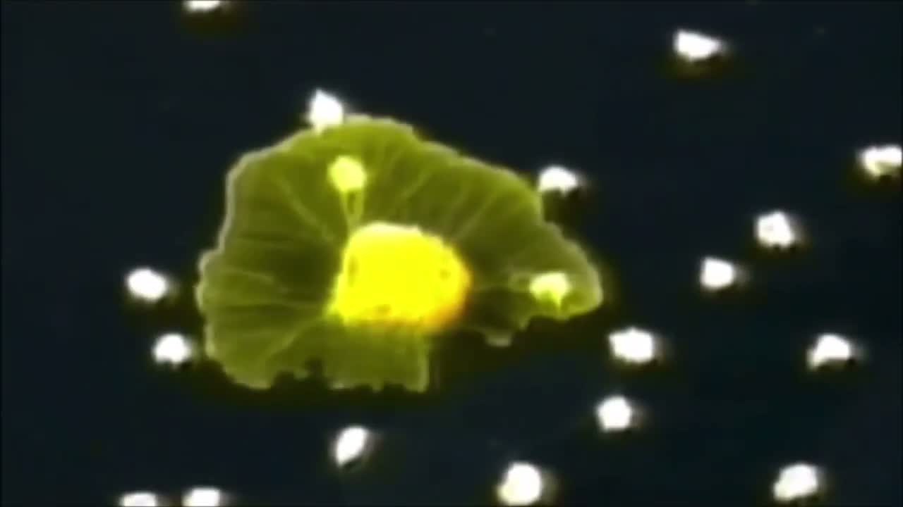
03 — RESEARCH TIMELINE · WATCH
Darwin's Simple Cell vs. the Tokyo Subway
BioGraphic / Creation Evidence — the Tokyo rail experiment explained, right after seeing it above.
Darwin's Simple Cell vs Slime Mold: Tokyo Subway System — BioGraphic / Creation Evidence.

Slide 26
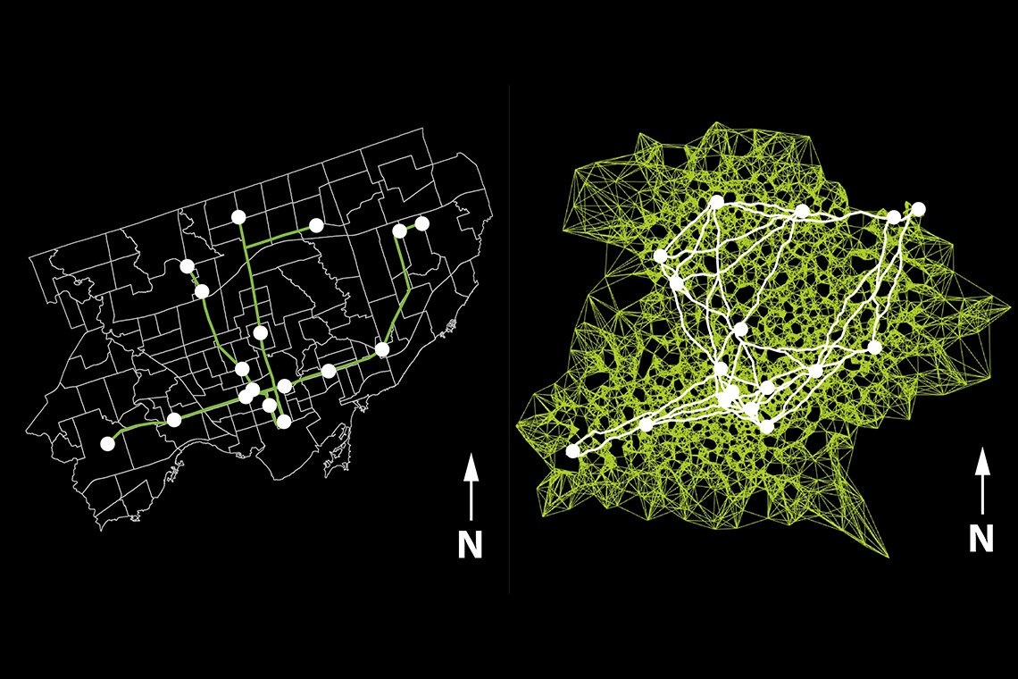

Slide 27
04
Applications
Roads, robots, solar cells, silicon — and the cosmos

Slide 28
04 — APPLICATIONS · ROBOTICS
Robots that plan
without a map
An enhanced variant plans obstacle-avoiding routes for autonomous robots, optimizing length and smoothness together.
Beats baseline planners on standard benchmark maps.
Works from local sensing — no global map handed to it.
Zheng et al., Drones, 2023.

Slide 29
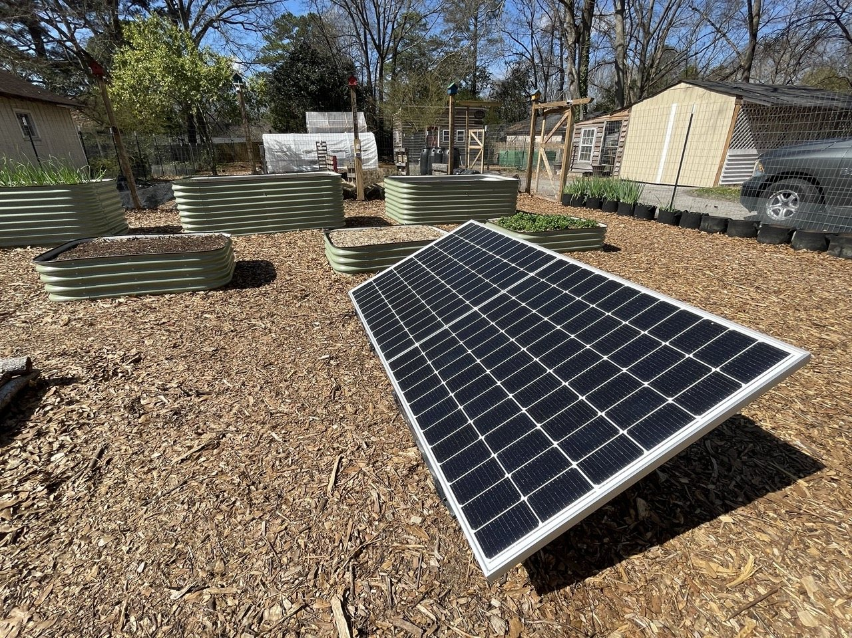
04 — APPLICATIONS · ENERGY
Reading a solar panel's
hidden numbers
A photovoltaic cell hides its own electrical parameters behind a nasty non-linear problem.
SMA fits single- and double-diode models directly.
Matches or beats established methods on speed and accuracy.
Kumar et al., Optik, 2020.

Slide 30
04 — APPLICATIONS · HARDWARE
The organism as the circuit
Not inspiration — literal hardware. Physarum has been wired into working components.
Computed a spanning tree on a water surface (2008).
Its tubes behave as memristors — a living, self-growing component (2015).
Adamatzky & Jones, 2008 · Gale, Adamatzky & de Lacy Costello, 2015.

Slide 31
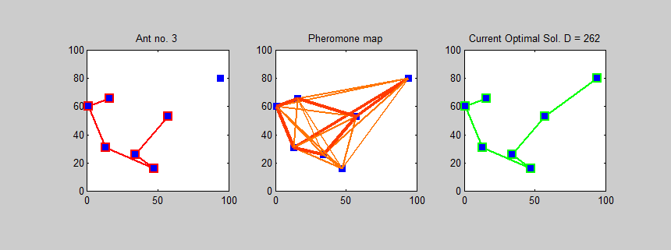
04 — APPLICATIONS · OPTIMIZATION
Its closest rival, its best partner
Ant Colony Optimization works on the same instinct — lay a signal, let it guide the next round. It's the algorithm SMA is most often measured against.
SMA carries fewer parameters and pushes harder on global exploration.
ACO leans hard on the previous generation's trail, so it stalls in local optima.
−73.55%
convergence time — see full stats
in Comparisons (Liu et al., 2021)
ANT COLONY OPTIMIZATION SOLVING A 7-CITY TOUR

Slide 32
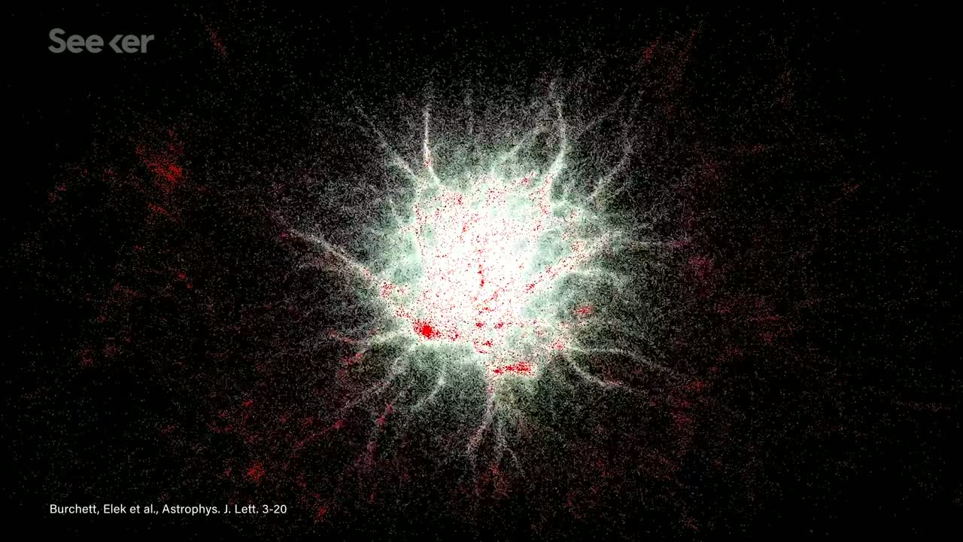
04 — APPLICATIONS · WATCH
This Brainless Organism Is Mapping Dark Matter
The newest, strangest application: cosmologists use Physarum's growth rules to trace the universe's invisible cosmic web.
Seeker — This Brainless Organism is Mapping Dark Matter.

Slide 33

05 — PROS AND CONS
Honest scorecard
WHERE IT WINS
WHERE IT DOESN'T
Balances cost, speed and resilience at once
No guarantee of the true optimum
Self-healing — no single point of failure
Overkill for a simple two-point route
Needs no global map to begin
Can still stall in local optima
Very few parameters to tune
Barely tested at real infrastructure scale
Ranked 1st of 13 across 33 benchmark functions

Slide 34
06 — STATISTICAL DATA
The numbers behind the blob
#1 of 13
17.87 %
0.092 s
1.75 × MST
Friedman rank across all 33 benchmark functions
faster task completion in a multi-robot mesh
for a new robot to join a live network
Physarum's real cost ratio vs. Tokyo rail's 1.8×
Li et al., 2020 · Martinelli et al., 2025 · Tero et al., 2010

Slide 35


07 — SUMMARY & FUTURE POSSIBILITIES
Still early
Already steering robot swarms
Three autonomous robots coordinating with no central controller, forming a network in under two seconds.
Already running as hardware
Living logic gates, memristors and spanning-tree computers built from the organism itself.
Not yet tested at city scale
Almost all evidence is simulation or bench-scale. Real transit and utility deployment is still open ground.
Ninety years of watching a blob. We're only now learning to read it.

Slide 36
08
Comparisons
Against real infrastructure, and against the classics

Slide 37
08 — COMPARISONS · THE ACTUAL NUMBERS
vs. real infrastructure
Physarum's grown network vs. the actual Tokyo rail system — measured, not estimated.
COST (TL / MST)
EFFICIENCY (MD / MST)
FAULT TOLERANCE
1.75
0.85
14%
PHYSARUM
PHYSARUM
PHYSARUM
1.80
0.85
4%
TOKYO RAIL
TOKYO RAIL
TOKYO RAIL

Slide 38
08 — COMPARISONS · THE ACTUAL NUMBERS
vs. Ant Colony Optimization
SMA hybridized with ACO (SMACFA) vs. ACO alone, solving the chn31 TSPLIB benchmark route.
−73.55%
−80.25%
convergence time to reach a comparably good solution
algorithm time complexity
Liu, M. et al. (2021). A slime mold–ant colony fusion algorithm for solving the travelling salesman problem. IEEE Access, 8, 202508–202521.

Slide 39
08 — COMPARISONS · SHARED BENCHMARK
Shortest-path algorithms: what one study measured
Same benchmark for all three: 15 random graphs · 15–2,000 nodes · 40 runs per graph
Algorithm
What it solves
Published result on this benchmark
How to read it
Dijkstra
Shortest path
Fastest runtime
Fastest in this study’s implementation and test graphs.
Improved Physarum
Shortest path
Faster than ACO
Slower than Dijkstra
Middle runtime rank in the same experiment.
Ant colony (ACO)
Shortest path
Slowest runtime
Slowest in this study’s implementation and test graphs.
REAL-NETWORK EVIDENCE
Physarum vs. Tokyo rail (36 cities): 1.75 ± 0.30× vs. 1.80× MST length | 0.85 ± 0.04× vs. 0.85× MST mean distance | 14 ± 4% vs. 4% fault risk
A* and Kruskal are omitted: neither paper reports them in this shared empirical benchmark, so adding scores would not be data-based.
Sources: Zhang, X. et al. (2014). The Scientific World Journal, 2014, 487069. doi:10.1155/2014/487069
Tero, A. et al. (2010). Science, 327, 439–442. doi:10.1126/science.1177894
Notes:
[Sources]
- Zhang, X. et al. (2014). An Improved Physarum polycephalum Algorithm for the Shortest Path Problem. The Scientific World Journal, 2014, 487069. doi:10.1155/2014/487069.
Shared benchmark: 15 random graphs spanning 15–2,000 nodes; each instance run 40 times. Reported runtime ordering: Dijkstra fastest, improved Physarum faster than ACO. The paper does not give a reusable numeric runtime table, so slide labels show only the published ordering.
- Tero, A. et al. (2010). Rules for Biologically Inspired Adaptive Network Design. Science, 327(5964), 439–442. doi:10.1126/science.1177894.
Tokyo comparison: 36 cities; Physarum length 1.75 ± 0.30 × MST vs Tokyo rail 1.80 × MST; Physarum mean distance 0.85 ± 0.04 × MST vs rail 0.85 × MST; fault risk 14 ± 4% vs rail 4%.

Slide 40
REFERENCES
Sources
FOUNDATIONAL BIOLOGY
ALGORITHM & APPLICATIONS
Nakagaki, Yamada & Tóth (2000). Maze-solving by an amoeboid organism. Nature, 407, 470.
Li, Chen, Wang, Heidari & Mirjalili (2020). Slime mould algorithm. Future Gen. Computer Systems, 111, 300–323.
Tero et al. (2010). Rules for biologically inspired adaptive network design. Science, 327, 439–442.
Liu et al. (2021). A slime mold–ant colony fusion algorithm for TSP. IEEE Access, 8, 202508–202521.
Reid, Latty, Dussutour & Beekman (2012). Slime mold uses an externalized spatial memory. PNAS, 109(43).
Zheng et al. (2023). Path planning of autonomous mobile robots. Drones, 7(4), 257.
Boisseau, Vogel & Dussutour (2016). Habituation in non-neural organisms. Proc. R. Soc. B, 283.
Kumar et al. (2020). Estimation of solar PV cell parameters. Optik, 223, 165277.
Video: NOVA scienceNOW (PBS) · BioGraphic/Creation Evidence · Seeker. Photography: Wikimedia Commons, CC BY-SA.

Slide 41
THANK YOU
Questions?
LIVE MODEL
eob-website.vercel.app
Vinayak Mangal · Suryansh Mishra · Krishna Mistry · Soha Nanal
C-304 · C-315 · C-318 · C-326

