Slide 1
Simulation of a 3 D.O.F Delta Robot
Introduction to AI Robotics + Math for Computing - 4
Suryansh Ram Menon – CB.SC.U4AIE23255

Slide 2
Objective
The objective of the project is to simulate the 3DOF Delta Robot using the Levenberg-Marquardt theorem

Slide 3
Introduction
Delta robots are a type of parallel robot with three arms that are connected to universal joints at the base. They are known for their parallel-link arm design and high-speed capabilities. Delta robots are used in a variety of applications, including pick and place tasks, inspection and reconnaissance missions, and factory automation.
Arms
The arms of a delta robot have concurrent prismatic or rotary joints and use parallelograms to maintain the orientation of the end effector.
Base
The motors of a delta robot are contained in the base structure, which is fixed and connects to a moving platform through three parallel kinematic chains. Each chain has a rotational joint that is activated by actuators in the base platform.
Axes
Delta robots have three axes and can move in all three dimensions, but have limited rotation.

Slide 4
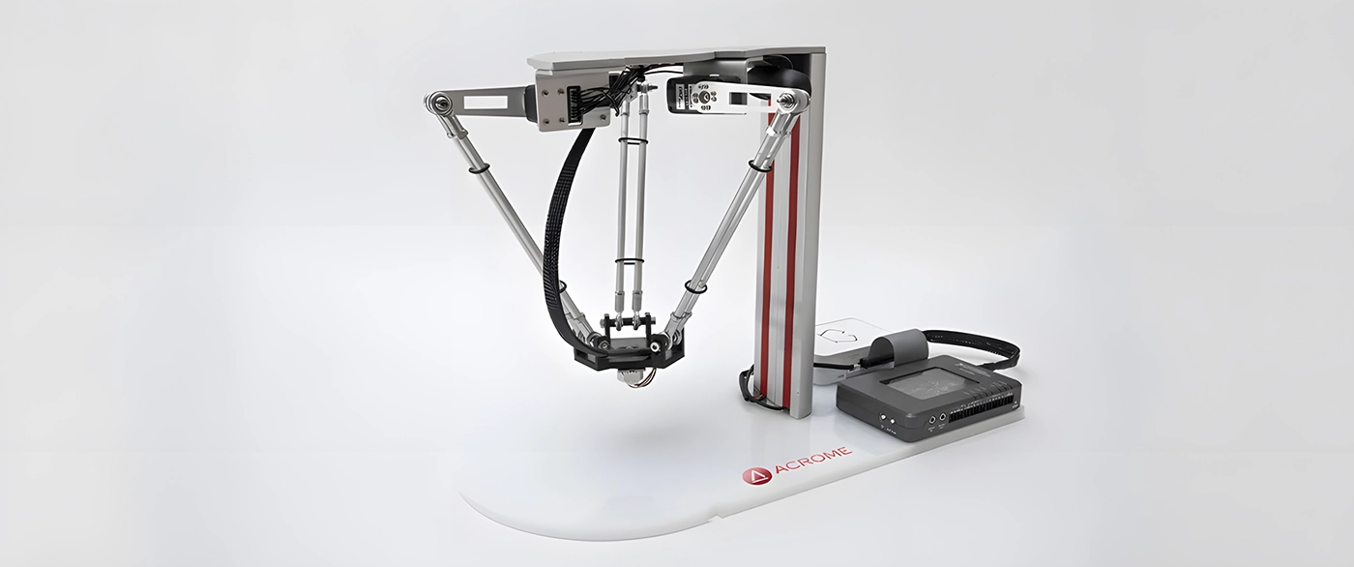

Slide 5
Literature Review
SL NO. | Title | Description | Techniques Used | Drawbacks
1 | Development of Delta Robot Arm Simulation in ROS2 Foxy Fitzroy Environment | Researchers have explored the potential of Delta robots through simulations in the ROS 2 Foxy Fitzroy environment, with a focus on creating a robust framework | USES SOLIDWORKS, GAZEBO SIMULATION SOFTWARE | Closed source, Platform dependent
2 | Dynamic Analysis of a Delta Parallel Robot with Flexible Links and Joint Clearances | A new DPR is proposed and developed with dynamic optimization | Uses ADAMS, Inverse Kinematics | Closed source work, purely hypothetical

Slide 6
3 | Matlab Kinematic Simulattor | Leverages Simulink, Kinematic solver to help simulate mobile robots | Uses Matlab, simulink | No room for customizing parameters

Slide 7
Levenberg-Marquardt Algorithm
An efficient iterative method combining gradient descent and Gauss-Newton to solve non-linear least squares problems.
To find the best-fitting model, we minimize the sum of the squares of these errors.
Non-Linear Least Squares:
For non-linear models, finding the best parameters is harder. There isn't a direct formula. Instead, we use iterative methods to approach the solution step-by-step.

Slide 8
Iterative Process
Start with an initial guess for the parameters.
Calculate the model's predictions and the error (difference between predictions and actual data).
Update the parameters using a combination of gradient descent and Gauss- Newton adjustments.
Check if the error has decreased. If not, adjust λ and try again. Repeat until the error is minimized (or changes very little).
Combining the Two Methods
The LM algorithm adjusts the parameters by blending the gradient descent and Gauss-Newton approaches. It uses a parameter, λ, to decide how much to rely on each method.
When λ is large, it behaves more like gradient descent.
When λ is small, it behaves more like the Gauss-Newton method.

Slide 9
The Levenberg-Marquardt algorithm is particularly useful in robotic kinematics for solving problems related to the robot's movement and positioning, such as inverse kinematics.
The Challenge of Inverse Kinematics:
Inverse kinematics is typically a non-linear problem.
There might be multiple solutions or no exact solution at all.
Applying Levenberg-Marquardt to Inverse Kinematics:
Objective: Minimize the difference between the desired position/orientation of the end-effector and the position/orientation obtained from the calculated joint parameters.
Error Function: Define an error function that quantifies this difference. This function often involves the sum of the squared differences between the desired and actual positions (and possibly orientations) of the end- effector.

Slide 10
Iteration: Uses the Levenberg-Marquardt algorithm to iteratively adjust the parameters to minimize this error. This involves:
Calculating the Jacobian matrix, which represents how changes in parameters affect the position/orientation of the end-effector.
Updating the parameters using a combination of gradient descent and Gauss-Newton steps, controlled by the λ parameter.
Convergence: The algorithm converges when the error is minimized, providing the parameters that achieve the desired end-effector position/orientation.

