Slide 1
System Security
The Security Problem
Authentication
Program Threats
System Threats
Securing Systems
Intrusion Detection
Encryption
Windows NT

Slide 2
The Security Problem
Security must consider external environment of the system, and protect it from:
  unauthorized access.
  malicious modification or destruction
  accidental introduction of inconsistency.
  These are management, rather than system, problems.
Easier to protect against accidental than malicious misuse.
We say that the system is secure if its resources are used and accessed as intended under all circumstances.

Slide 3
The Security Problem…
Unfortunately total security can not be achieved.
It is easier to protect against accidental misuse than malicious misuse.
Intruder or cracker: attempt to breach the security
Threat: potential of security violation such as discovery of vulnerability
Attack: an attempt to break security
Form of malicious access
  Breach of confidentiality: Unauthorized reading of data (theft of information)
  Breach of integrity: Unauthorized modification of data
  Breach of availability: Unauthorized destruction of data
  Theft of service: Unauthorized use of resources.
  Denial of service: Preventing legitimate use of the system (denial of service)
Absolute protection against malicious use is not possible, however cost of perpetrator can be sufficiently high to deter unauthorized attempts.

Slide 4
The Security Problem…
Four levels of security measures must be taken.
  Physical
    Against armed or surreptitious entry by intruders.
  Human
    Careful screening of users to reduce the chance of unauthorized access.
  Network
    No one should intercept the data on the network.
  Operating system
    The system must protect itself from accidental or purposeful security beaches.
A weakness at a high level of security allows circumvention of low-level measures.
In the remainder of this chapter we discuss security at OS level

Slide 5
Security measures at OS level
User authentication
  Verifying the user’s authentication
Program threats
  Misuse of programs unexpected misuse of programs.
System threats
  Worms and viruses
Intrusion detection
  Detect attempted intrusions or successful intrusions and initiate appropriate responses to the intrusions.
Cryptography
  Ensuring protection of data over network

Slide 6
Authentication
User identity most often established through passwords, can be considered a special case of either keys or capabilities.
Easy to understand and use
However,
  they can be easily guessed, illegally transferred
  Visual or electronic monitoring, network sniffing
Passwords must be kept secret.
  Frequent change of passwords.
  Use of “non-guessable” passwords.
  Log all invalid access attempts.
Passwords may also either be encrypted or allowed to be used only once.
  For given a value of x, f(x) is calculated and stored. It is difficult to guess x by seeing f(x).
One time passwords
  Password is different for each session.
Example: My mother’s name is K…
  Password “MmnisK”

Slide 7
Authentication…
Biometrics
  Palm and hand readers: temperature map, finger length, finger width and line patterns.
  Fingerprint readers.
Two factor authentication scheme
  Password plus fingerprint scan

Slide 8
Program Threats
Trojan Horse
  Code segment that misuses its environment.
  Exploits mechanisms for allowing programs written by users to be executed by other users.
    Consider the use of “.” character in a search path. The “.” tells the shell to include the current directory. If the user sets current directory to a friends directory, the program runs in users domain and effects friends directory.
Trap Door
  The designer of the code might leave a hole in the software that only she is capable of using.
  Specific user identifier or password that circumvents normal security procedures.
  Could be included in a compiler.
Logic Bomb
  Security threat only under certain circumstances.
Stack and Buffer Overflow
  Exploits a bug in a program (overflow either the stack or memory buffers.)

Slide 9
Program Threats…
Stack and Buffer Overflow
  Exploits a bug in a program (overflow either the stack or memory buffers.)
The attacker determines the vulnerability and writes a program to do the following.
  Overflow an input-field, command-line argument, or input buffer until it writes into the stack.
  Overwrite the current return address on the stack with the address of the exploit code in the next step.
  Write a simple set of code for the next space in the stack that includes commands that the attacker wishes to execute, for example, spwan a shell.

Slide 10
System Threats
Worms – use spawn mechanism; standalone program
  The worm spawns copies of itself, using up systems resources and perhaps locking out system use by all other processes.
Internet worm
  Exploited UNIX networking features (remote access) and bugs in finger and sendmail programs.
  Grappling hook program uploaded main worm program.
Viruses – fragment of code embedded in a legitimate program.
  Mainly effect microcomputer systems.
  Downloading viral programs from public bulletin boards or exchanging floppy disks containing an infection.
  MSWORD (micros)
    RTF format is safe
  Safe computing.
Denial of Service
  Overload the targeted computer preventing it from doing any useful work.
  Downloading of a page.
  Partially started TCP/IP sessions could eat up all resources.
  Difficult to prevent denial of service attacks.

Slide 11
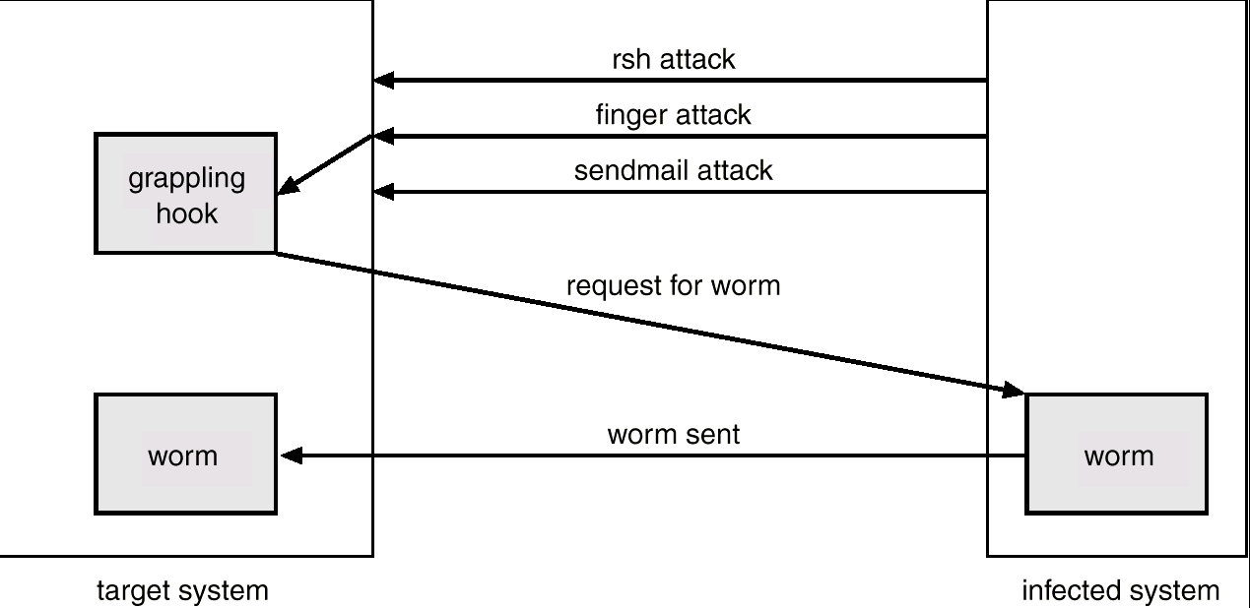
The Morris Internet Worm

Slide 12
Threat Monitoring
Check for suspicious patterns of activity – i.e., several incorrect password attempts may signal password guessing.
Audit log – records the time, user, and type of all accesses to an object; useful for recovery from a violation and developing better security measures.
Scan the system periodically for security holes; done when the computer is relatively unused.

Slide 13
Threat Monitoring (Cont.)
Check for:
  Short or easy-to-guess passwords
  Unauthorized set-uid programs
  Unauthorized programs in system directories
  Unexpected long-running processes
  Improper directory protections
  Improper protections on system data files
  Dangerous entries in the program search path (Trojan horse)
  Changes to system programs: monitor checksum values

Slide 14
FireWall
A firewall is placed between trusted and untrusted hosts.
  A firewall is a computer or router that sits between trusted and untrusted systems. It monitors and logs all connections.
The firewall limits network access between these two security domains.
Spoofing: An unauthorized host pretends to be an authorized host by meeting some authorization criterion.

Slide 15
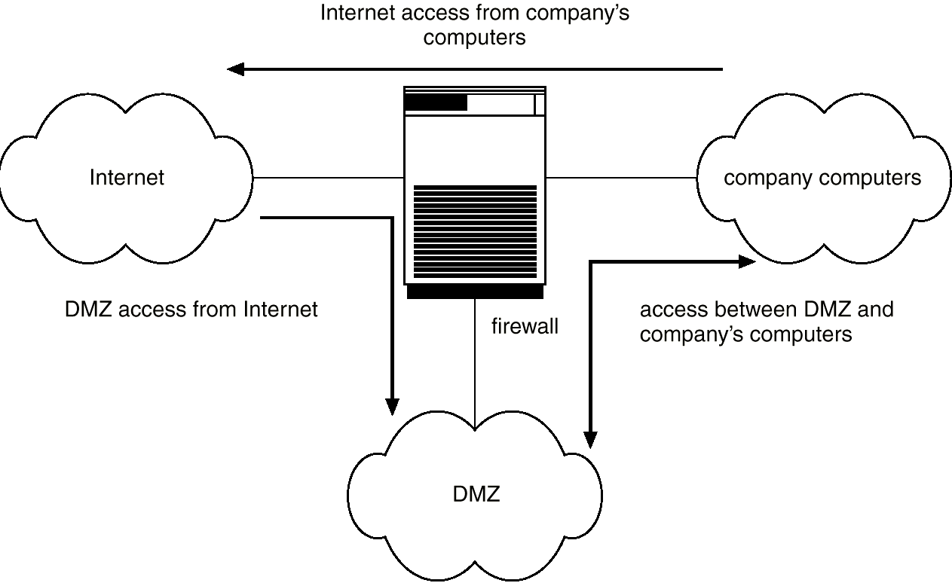
Network Security Through Domain Separation Via Firewall
DMZ: Demilitarized zone

Slide 16
Intrusion Detection
Detect attempts to intrude into computer systems.
Wide variety of techniques
  The time of detection
  The type of inputs examined to detect intrusion activity
  The range of response capabilities.
    Alerting the administrator, killing the intrusion process, false resource is exposed to the attacker (but the resource appears to be real to the attacker) to gain more information about the attacker.
The solutions are known as intrusion detection systems.
Detection methods:
  Auditing and logging.
    Install logging tool and analyze the external accesses.
  Tripwire (UNIX software that checks if certain files and directories have been altered – I.e. password files)
    Integrity checking tool for UNIX.
    It operates on the premise that a large class of intrusions results in anomalous modification of system directories and files.
    It first enumerates the directories and files to be monitored for changes and deletions or additions. Later it checks for modifications by comparing signatures.
System call monitoring
  Detects when a process is deviating from expected system call behavior.

Slide 17
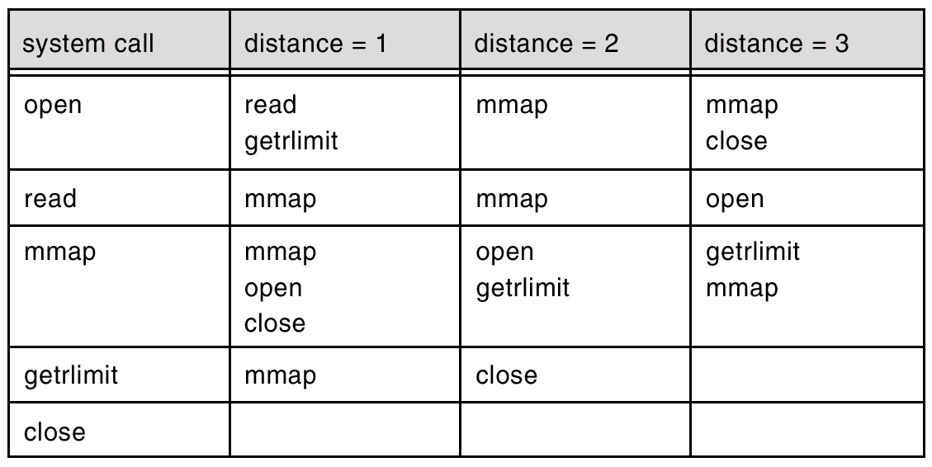
Data Structure Derived From System-Call Sequence
Open, read,mmap, mmap, open, getrlimit,mmap,close
Open, read,mmap, open, open, getrlimit,mmap,close

Slide 18
Cryptography
Eliminate the need to trust the network.
Cryptography enables a recipient of a message to verify that the message was created by some computer possessing a certain key.
Keys are designed to be computationally infeasible to derive from the messages.

Slide 19
Encryption
Encrypt clear text into cipher text.
Properties of good encryption technique:
  Relatively simple for authorized users to incrypt and decrypt data.
  Encryption scheme depends not on the secrecy of the algorithm but on a parameter of the algorithm called the encryption key.
  Extremely difficult for an intruder to determine the encryption key.
Data Encryption Standard substitutes characters and rearranges their order on the basis of an encryption key provided to authorized users via a secure mechanism. Scheme only as secure as the mechanism.
RSA : public/private key algorithm is popular

Slide 20
Concluding remarks

Slide 21
What is an operating system ?
Operating system is a system.
Operating system is a subsystem of any tool.
Each tool constitutes machine part and operating part.
The operating part of a tool is called operating system of that tool.
The purpose of operating system is to facilitate the operation of the underlying machine or tool.
For some tools, operating system may not exist.
  Example: Pen.
For a machine, the operating system abstracts the machine part in terms of simple services by hiding the details of the machine. The OS can provide services to users or other subsystems.
Examples of typical operating systems:
  Car operating system, Telephone operating system, TV operating system and so on.

Slide 22
What is a computer operating system ?
A computer is also a tool that contains machine part and operating part.
The operating part of a computer is called Computer Operating System.
For a computer, the operating system abstracts the underlying hardware in terms of simple services by hiding the details of the hardware. The OS can provide services to users or other subsystems.
Examples of Computer operating systems:
  WINDOWS2000, Macintosh, UNIX, SOLARIS, LINUX and so on.
In the rest of this course, operating system means computer operating systems.

Slide 23
Objectives
The main objective is to understand the operational part of any computer.
Understanding the general principles of OS design.
  Focus on general-purpose, multi-user, uni-processor systems.
  Emphasis on widely applicable concepts rather than any specific features of any specific OS.
Understanding problems, solutions and design choices.
Understanding the structure of specific OSs: UNIX, LINUX, WINDOWS2000

Slide 24
OUTCOME
After completing the course, the students will understand
  the fundamental concepts of several computer operating systems such as SOLARIS, LINUX, WINDOWS and MAC.
  the solutions/options to interesting problems which have been encountered by the designers of preceding operating systems.
  the critical role of operation system in designing several computer based systems like database systems, expert systems, web based information systems, real-time systems, embedded systems and so on.

Slide 25
Modern Operating Systems
Main features
  Interrupt driven.
  Process/thread concept
  Demand paging
Multiprogramming and timesharing are the central themes of modern OSs.
Multiprogramming and time sharing requires
  CPU scheduling
  Process (thread) management, synchronization and communication
  Deadlock detection
  Memory management and protection
  Virtual memory: A program is bigger than physical memory
  Disk management
  Online file systems.
  Protection and security

