Slide 1
Machine Maintenance Insight
MechaCare Industrial Systems
Data Science Skill-Based Assessment — Rounds 2–4
EDA • Feature Engineering • Business Insights

Slide 2
Problem, data and method
Round 1 excluded; analysis follows the Use Case 25 brief
Business question: What operating patterns indicate machines that require maintenance attention?
Five source datasets: sensor, machines, usage, alarms and maintenance.
Workflow: quality audit → cleaning → machine-day integration → EDA → engineered features → feature selection.
Dataset scale: 16 machines; 23,000 raw sensor records; 20 recorded service events.
All data is synthetic for educational demonstration; it is not real plant telemetry.

Slide 3
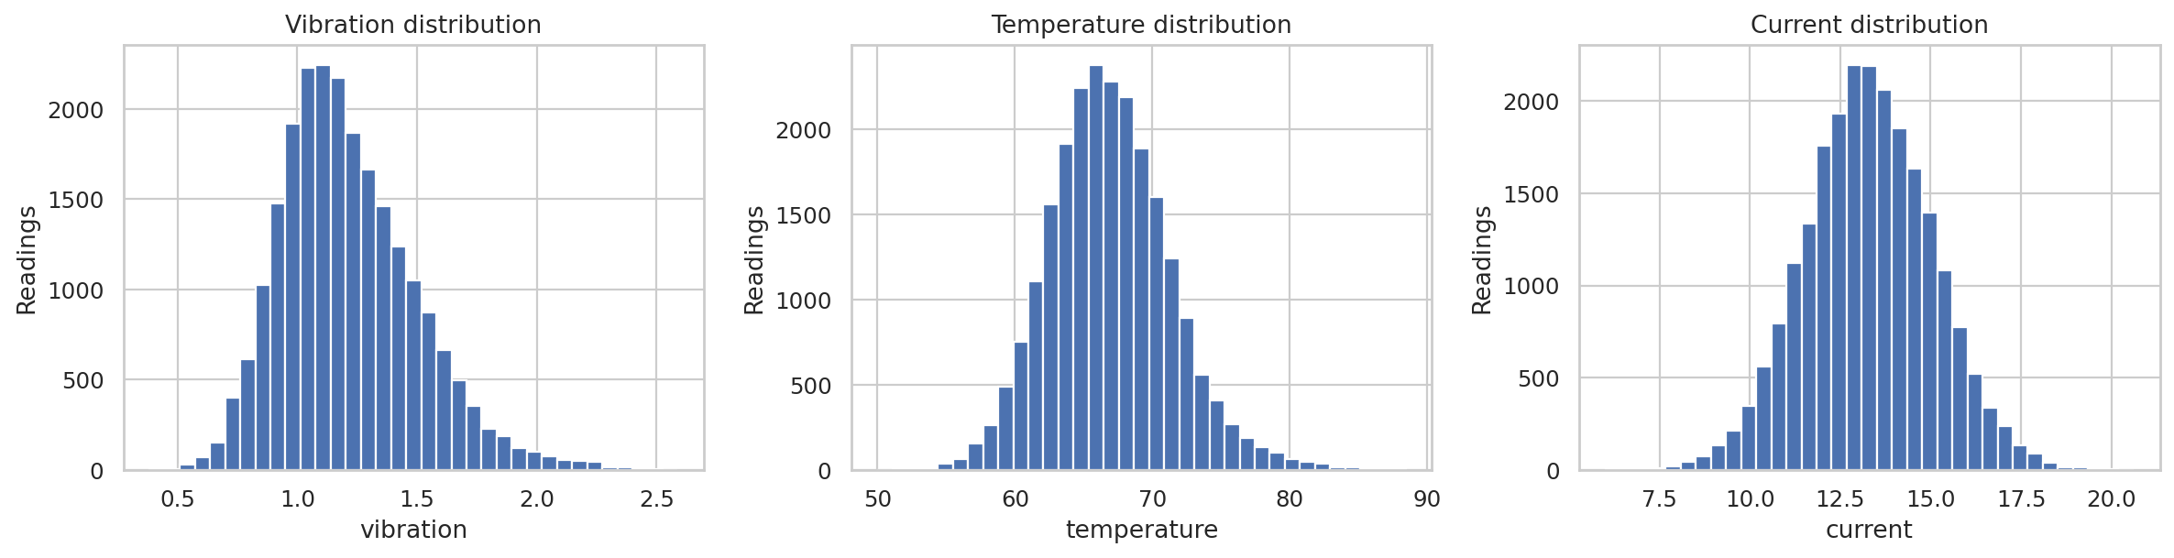
Sensor behavior and data quality
Sensor distributions after duplicate removal and treatment of implausible readings

Slide 4
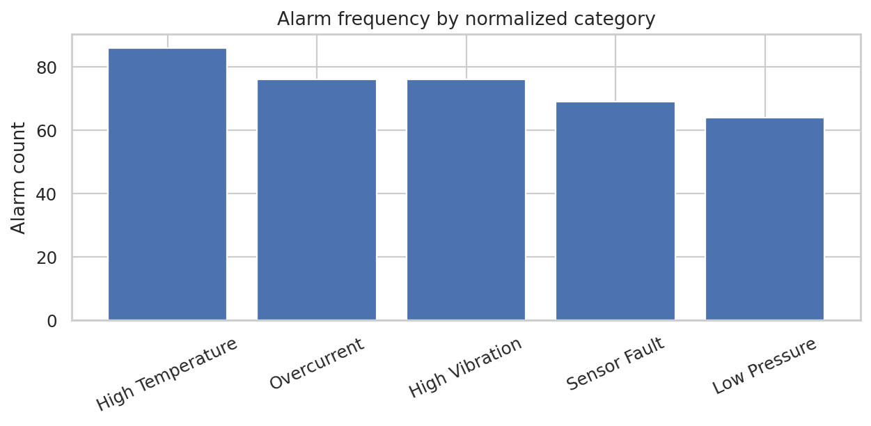
Alarm frequency
Inconsistent alarm spellings were normalized into common categories before counting

Slide 5
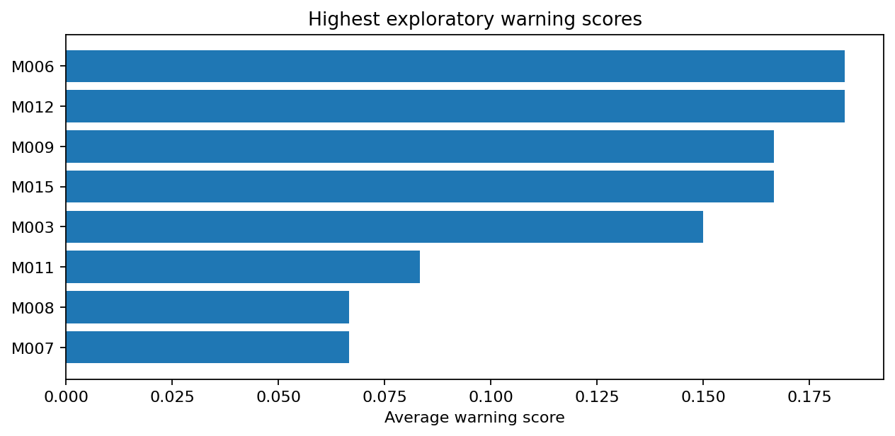
Machines to investigate first
Exploratory warning score combines sensor thresholds and alarm activity; it is not a failure probability

Slide 6
Business recommendations
Use the results to prioritize inspection and improve maintenance records
Investigate high-priority candidates first: M012, M006, M015, M009, M003. Confirm their sensor patterns against OEM limits.
Most frequent normalized alarm category in this synthetic dataset: High Temperature. Check whether alarms recur alongside rising vibration or temperature.
Recorded service counts are highest for: Compressor; incomplete logs may affect this comparison.
Improve maintenance records with failure mode, component replaced, root cause and exact downtime.
Do not infer causality from load–downtime correlation. Validate thresholds against confirmed failures before any operational use.

