Slide 1

The Glass Game
THE GLASS BOX PROBLEM
AI pipeline with full observability, replayability, and context engineering
Team members:
Sabarri T.M.
Mannam Surya Pavan Kumar
Gutti Saiteja
Harish s

Slide 2
Problem Understanding
The problem: An AI pipeline may work today, but when it fails tomorrow, developers may not know what happened or why.
Track focus: Build an AI system where every step, decision, and cost can be inspected.
Required capabilities: Observability across LLM calls, tool calls, and pipeline steps, plus context engineering for long conversations.

Slide 3
Technical Architecture
Tech stack: Next.js + React + Three.js + Groq / Puter.js
Input: User prompt and conversation context
AI pipeline: Prompt → context selection → LLM call → structured scene plan → Three.js rendering
Observability: Log and trace each LLM call, tool call, step, decision, and cost for replay and debugging.

Slide 4
Proposed Solution
One-line solution: The Glass Game makes an AI-to-3D pipeline transparent, traceable, and controllable.
How it solves the problem: Each generation is recorded as a sequence of inputs, decisions, model calls, tool calls, outputs, and costs.
Context engineering: Long conversations are summarized, trimmed, or selectively passed to the model so the AI stays accurate and on topic.

Slide 5
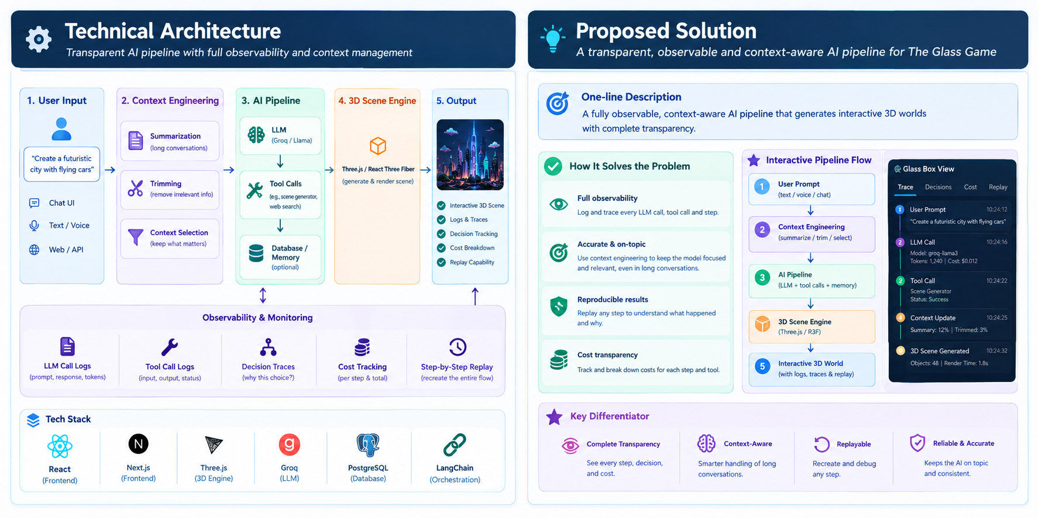

Slide 6
Innovation & Novelty
Glass Box observability: Users and judges can inspect what happened at every stage instead of seeing only the final result.
Replayable pipeline: A scene generation can be traced step-by-step to understand how the final output was produced.
Context-aware AI: The system controls what information reaches the model instead of sending the entire conversation every time.

Slide 7
Impact & Benefits
Debugging: Quickly identify which LLM call, tool call, context decision, or pipeline step caused an unexpected result.
Transparency: Make AI behavior understandable instead of treating the pipeline as a black box.
Cost awareness: Track model and tool usage at each step.
Reliability: Context selection, summarization, and trimming help maintain accuracy during long conversations.

Slide 8
