Slide 1
Bluestock Mutual Fund Analytics
Performance • Risk • Investor Behaviour • Dashboard
Final Capstone Presentation | August 2026
By
Surya PB

Slide 2
Problem & Objective
• Mutual-fund information is distributed across multiple datasets and granularities.
• Objective: build a reliable end-to-end analytics workflow from cleaned data to decision-ready insights.
• Focus: performance, downside risk, investor behaviour, portfolio concentration and interactive reporting.

Slide 3
Data Sources
• Fund Master — scheme metadata and risk classification
• NAV History — historical NAV and daily returns
• AUM / SIP / Category Inflows — asset and flow trends
• Investor Transactions — investor behaviour and cohorts
• Benchmark Indices — market comparison
• Portfolio Holdings — sector concentration
• Scheme Performance — return and risk-adjusted metrics

Slide 4
ETL / Analytics Architecture
• Raw data → validation → cleaning → processed datasets
• Python/Pandas for ETL and advanced analytics
• SQL for structured analytical queries
• Power BI for interactive reporting
• Outputs: CSV reports, charts, notebooks, dashboard and documentation

Slide 5
EDA Highlights — Data Quality & Behaviour
• Historical NAV observations standardized by scheme and date.
• Daily returns calculated chronologically for 40 schemes.
• Investor transactions segmented by SIP, Lumpsum and Redemption.
• Portfolio holdings standardized by fund, sector and weight.
• Cleaned datasets reused across analytics and dashboard layers.

Slide 6
EDA Highlights — Investor & Portfolio Patterns
• 2024 cohort total investment: approximately ₹225.81 crore.
• 2025 cohort average SIP: approximately ₹13,505.
• Cohort preference analysis identifies the most transacted fund per cohort.
• HHI analysis highlights differences in sector concentration across equity funds.

Slide 7
Performance Metrics — Returns & Sharpe
• Daily returns form the base for performance and risk calculations.
• Rolling 90-day Sharpe = rolling mean return / rolling standard deviation × √252.
• Five key funds were monitored through time.
• Fund performance is viewed alongside benchmark movements in the dashboard.

Slide 8
Performance Metrics — VaR, CVaR & HHI
• SBI Small Cap Fund - Direct Plan - Growth: VaR 95% = -2.69%; CVaR = -3.24%.
• The five most negative VaR observations were Very High-risk small-cap equity funds.
• Axis Bluechip Fund - Regular - Growth: HHI = 0.2064 in the supplied results.
• Higher HHI indicates greater sector concentration.

Slide 9
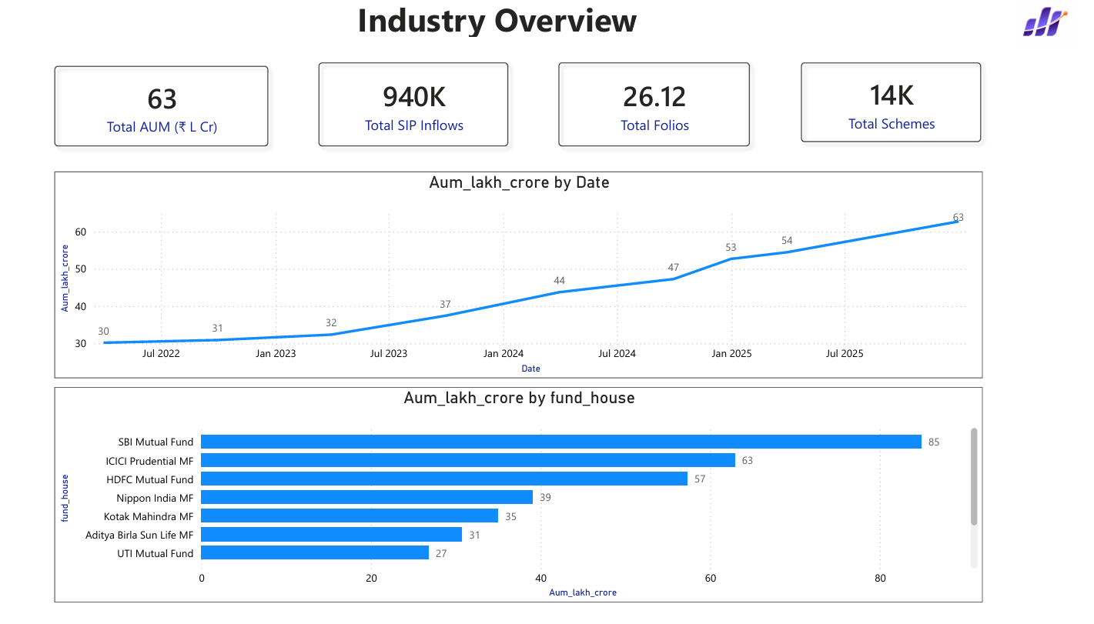
Dashboard — Industry Overview

Slide 10
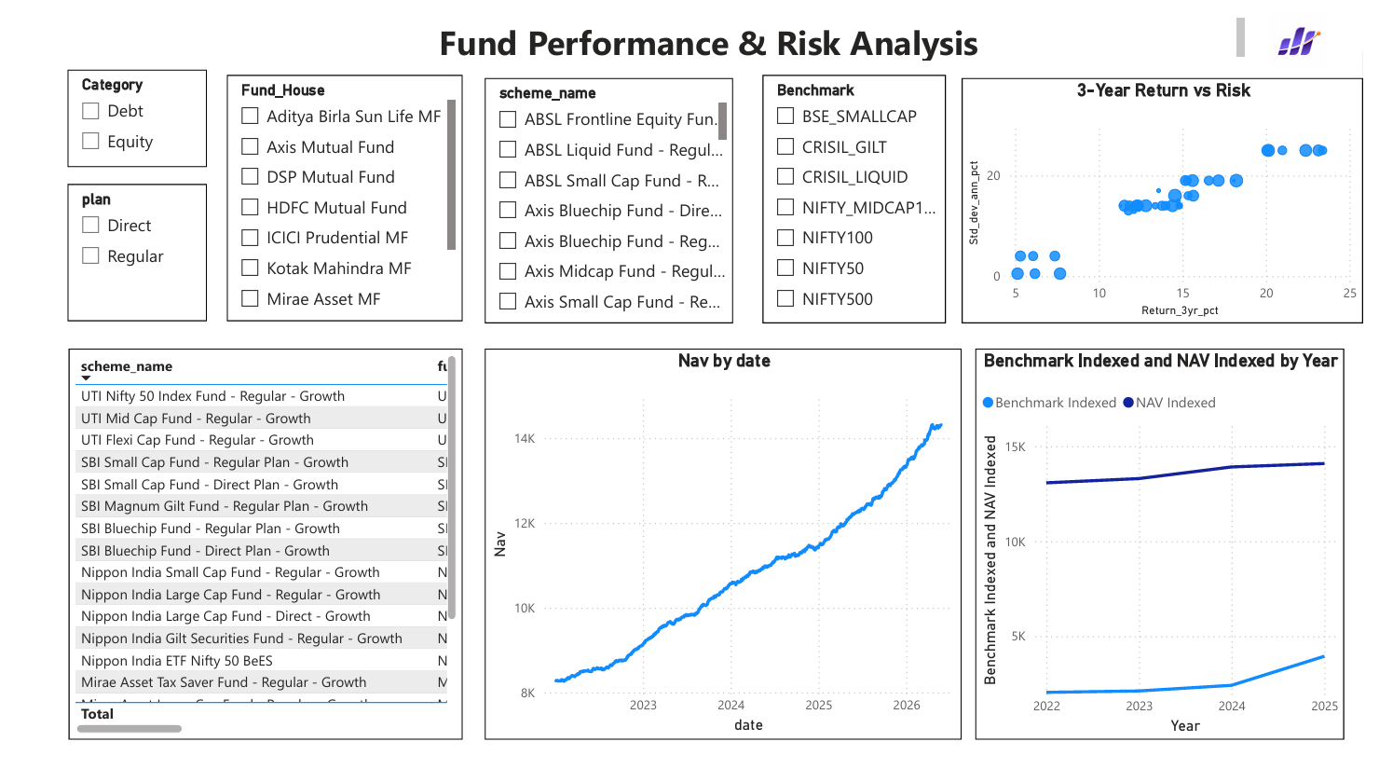
Dashboard — Fund Performance & Risk Analysis

Slide 11
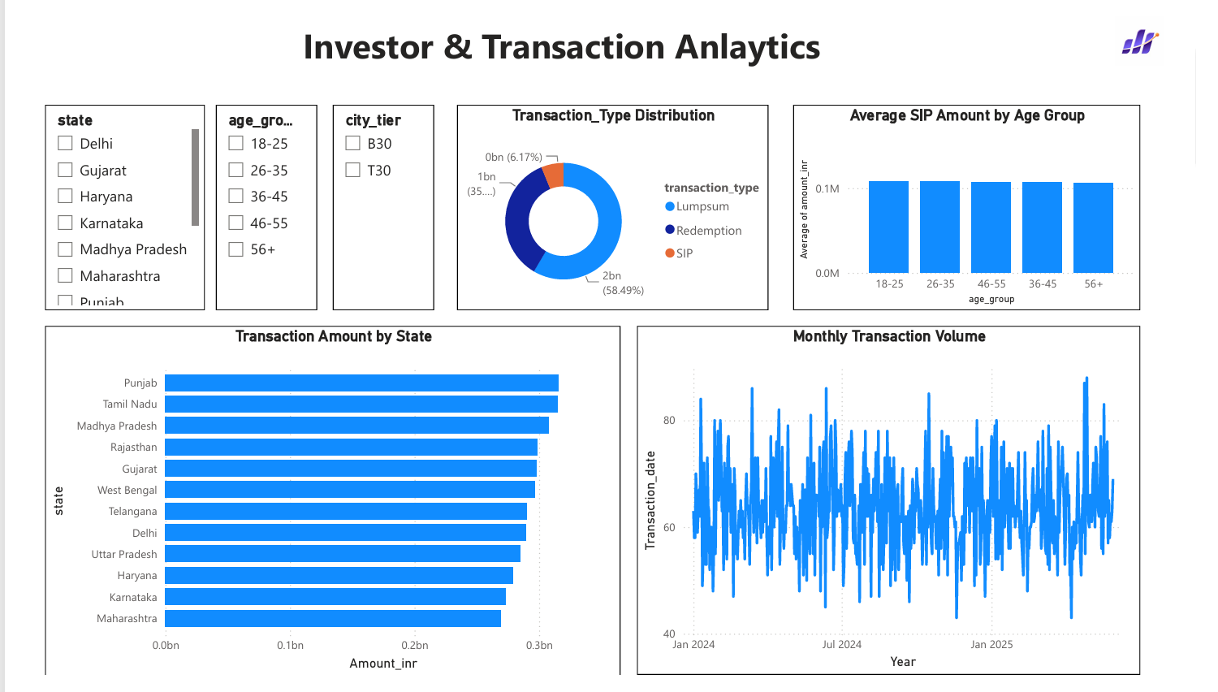
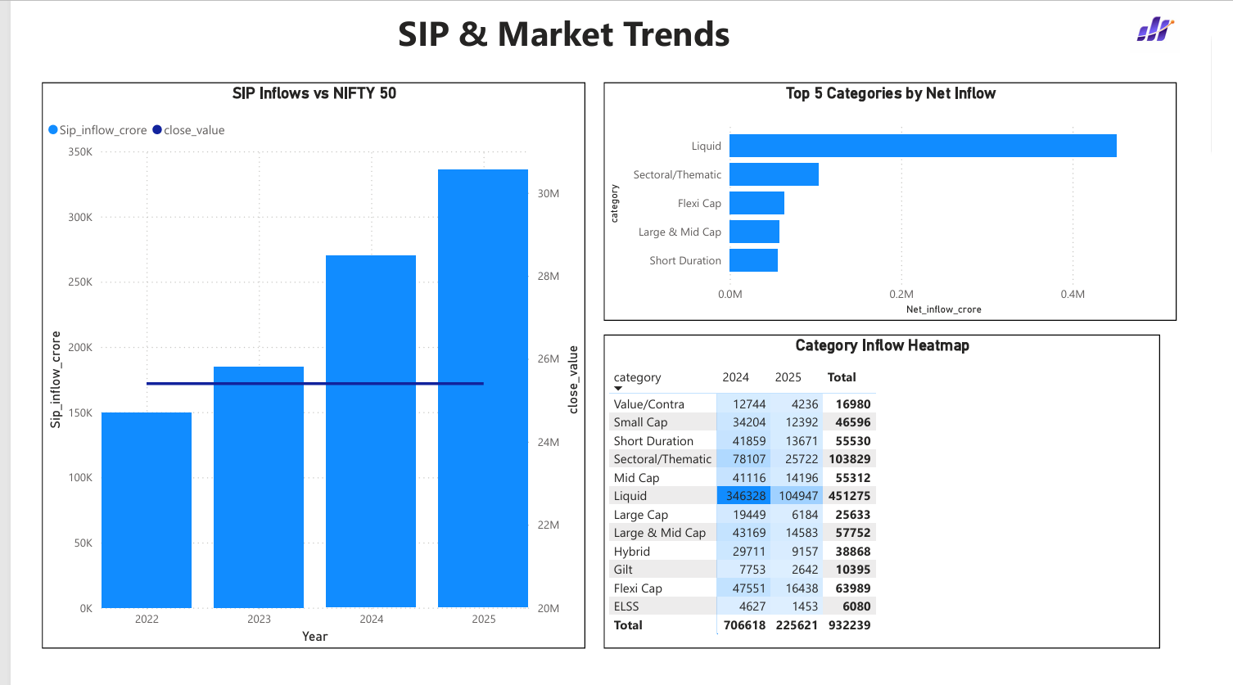
Dashboard — Investor & SIP/Market Trends
• Investor Analytics: transaction mix, SIP behaviour, state-wise transaction amount and monthly volume.
• SIP & Market Trends: SIP inflows versus NIFTY 50, category ranking and category heatmap.

Slide 12
Key Findings & Recommendations
• Small-cap Very High-risk funds show the strongest downside exposure in the VaR ranking.
• 97.8% of eligible investors were classified as at-risk under the 35-day SIP-gap rule.
• Risk-based recommendations differ by risk appetite.
• Monitor concentration and SIP continuity as complementary risk/retention indicators.
• Refresh the model periodically for current decision support.

Slide 13
Thank You
Bluestock Mutual Fund Analytics
Questions & Discussion

