Slide 1

Analysis on Prices of Laptops Available on Flipkart

Slide 2
About me
Background
Bachelor of Technology (B.Tech) in Computer Science Engineering.
Why I Want to Learn Data Science
To strengthen my skills in data analytics, machine learning, and artificial intelligence.
To gain expertise in data-driven decision-making and predictive modeling.
To transition into the field of Generative AI Development by combining my software development experience with advanced AI and data science knowledge.
Work Experience
Over 10 years of experience as a Software Professional specializing in backend development.
Experienced in designing and developing scalable web applications and APIs.
Proficient in technologies such as:
PHP
Node.js
MongoDB
MySQL
AngularJS
Docker
Strong experience in database design, API development, and backend system architecture.
LinkedIn URL : www.linkedin.com/in/suryaprabha-rebba-6558ba334

Slide 3
Agenda
1. Business Problem
2. Business Objectives
3. Web Scraping Process
4. DataSet Summary
5. Exploratory Data Analysis
i) Data Cleaning Steps
ii) Data Manipulation Steps
iii) Univariate Analysis Steps
iv) Bivariate Analysis Steps
v) Multivariate Analysis (Correlation)
6. Key Business Questions
7. Business Insights for Final Report
8. Conclusion

Slide 4
Business Problem
The laptop market on e-commerce platforms offers a wide range of products with varying prices, specifications, brands, and customer ratings. Customers often find it difficult to identify the factors that influence laptop prices and determine which products provide the best value for money.
The objective of this project is to analyze laptop data collected from Flipkart and understand how different features such as brand, processor type, RAM, storage capacity, operating system, screen size, customer ratings, reviews, and discounts impact laptop prices.
Use Case / Domain Understanding
Domain
E-Commerce / Retail Analytics
Use Case
This analysis can help:
Customers
Compare laptops based on specifications and price.
Identify laptops that offer the best value for money.
E-Commerce Platforms
Understand pricing trends across different brands and configurations.
Optimize product recommendations.
Improve inventory planning and promotional strategies.
Laptop Manufacturers
Analyze competitor pricing.
Understand customer preferences.
Design products that align with market demand.

Slide 5
Business Objectives
Analyze the distribution of laptop prices on Flipkart.
Identify the most popular laptop brands and configurations.
Study the relationship between laptop prices and specifications such as RAM, storage, processor type, and screen size.
Analyze the impact of customer ratings, reviews, and discounts on laptop prices.
Generate actionable insights that can support customer decision-making and business strategies.
Target Variable
Price of Laptop (Prices)
The primary objective is to understand which factors influence laptop prices and how strongly they contribute to price variations across different laptop models.
Web Scraping Process
Website : Flipkart
Category: Laptops
Tools : Python, Requests, BeautifulSoup, Regular Expression, Pandas, Matplotlib, Seaborn
Pages Scraped : 21+
Attributes : Price, Brand, Processor type , RAM, OS, Screen size, Storage, Reviews, Ratings and Discount

Slide 6
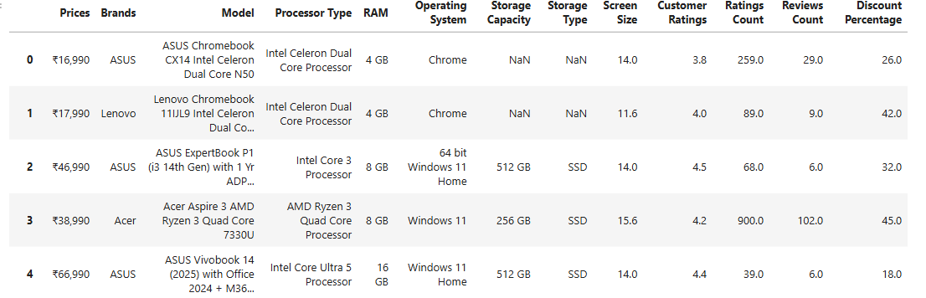
DataSet Summary
Source: Flipkart Laptop Listings
Total Records: 504 Laptops
Total Features: 13 (excluding the index column)
Domain: E-Commerce / Retail Analytics

Slide 7
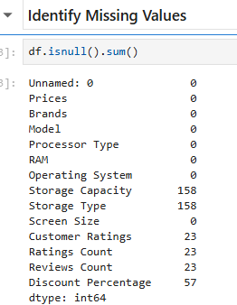
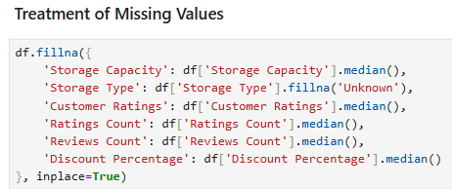
Exploratory Data Analysis:
1. Data Cleaning Steps
Removed special characters and converted columns such as Price, RAM, Storage Capacity into appropriate numeric data types.
Handled missing values using median for numerical features such as Storage Capacity, Ratings Count, Review Count, Discount Percentage and checked for duplicate records.

Slide 8
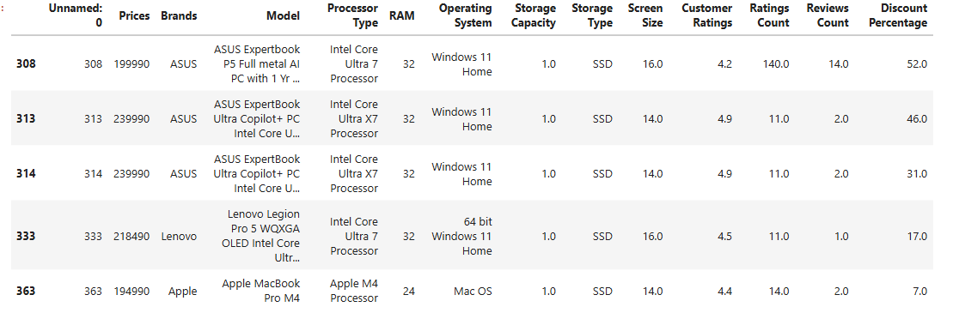
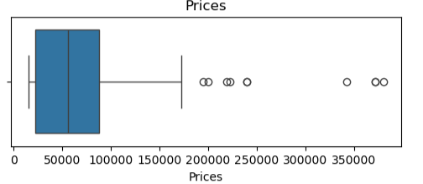
Exploratory Data Analysis:
2. Data Manipulation Steps
Extracted meaningful information (Brand, Processor Type, RAM, Storage, Screen Size, etc.) from the scraped data using Regular Expressions (Regex).
Created a structured Pandas DataFrame, standardized column names, and formatted data for analysis and visualization.
Checked and treated outliers : For Laptop brand-wise and price analysis problem statement, expensive gaming laptops and premium laptops are real observations, not errors.

Slide 9
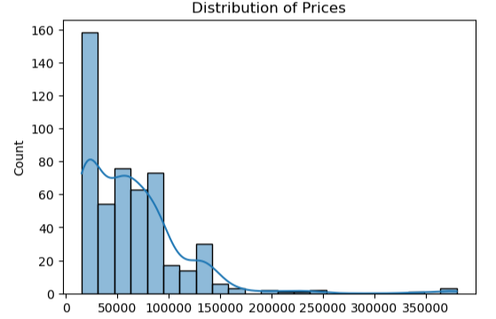
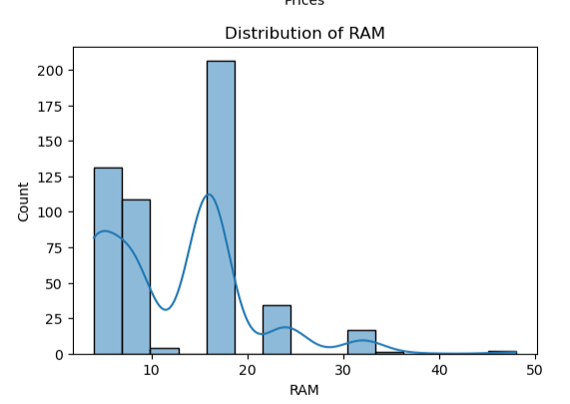
Exploratory Data Analysis:
3. Univariate Analysis Steps (Numerical Features)
- Most laptops are concentrated in the ₹30,000–₹60,000 range.
- RAM is dominated by 8 GB configurations.

Slide 10
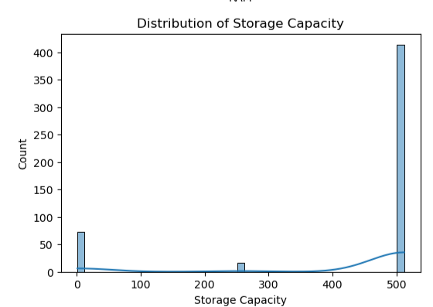
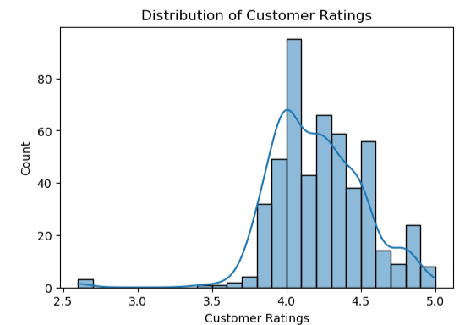
Exploratory Data Analysis:
3. Univariate Analysis Steps (Numerical Features)
- 512 GB is the most common storage capacity.
- Most customer ratings lie between 4.0 and 4.5.

Slide 11
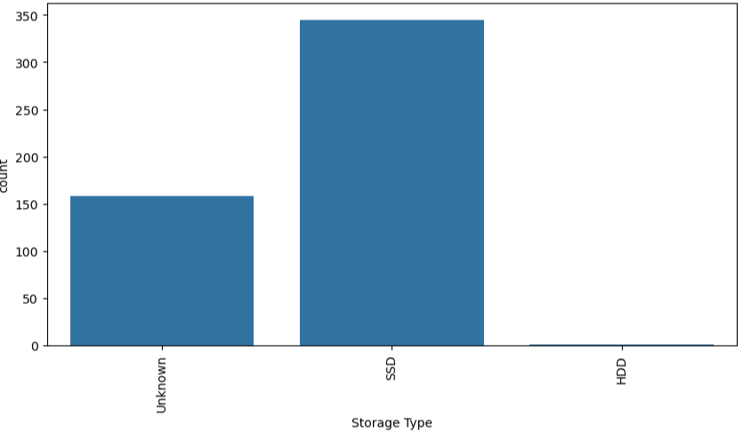
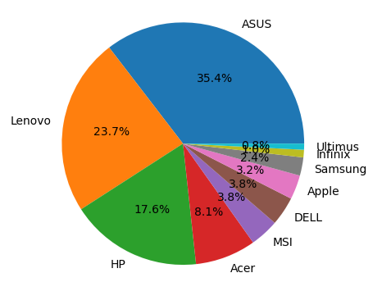
Exploratory Data Analysis:
3. Univariate Analysis Steps (Categorical)
ASUS, HP, and Lenovo have the highest number of listings.
SSD is the most common storage type

Slide 12
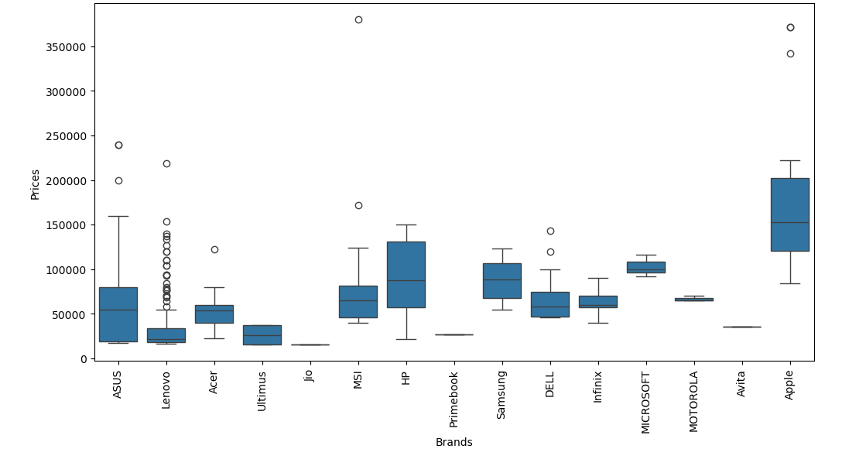
Exploratory Data Analysis:
4. Bivariate Analysis Steps (Price vs Other Features)
- Premium brands have higher median prices. - Budget brands have lower price ranges.

Slide 13
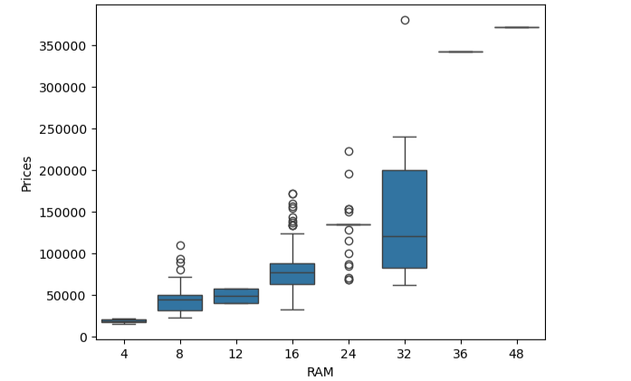
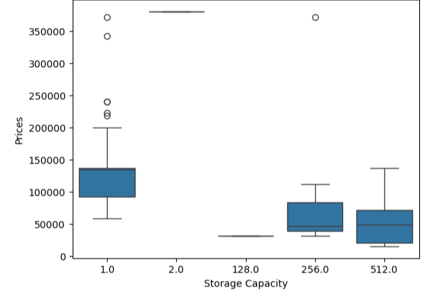
Exploratory Data Analysis:
4. Bivariate Analysis Steps (Price vs Other Features)
- Laptop prices increase as RAM capacity increases. - Laptops with larger SSD capacities tend to be more expensive.

Slide 14
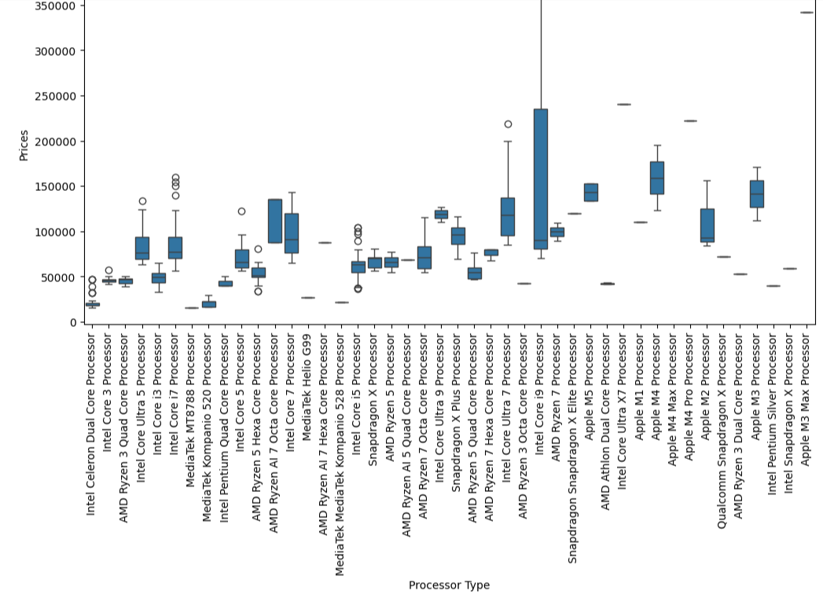
Exploratory Data Analysis:
4. Bivariate Analysis Steps (Price vs Other Features)
- Higher-end processors are associated with higher laptop prices.

Slide 15
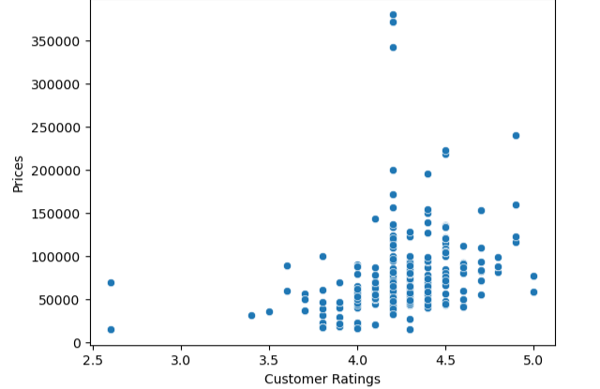
Exploratory Data Analysis:
4. Bivariate Analysis Steps (Price vs Other Features)
- Customer ratings show only a weak relationship with price.

Slide 16
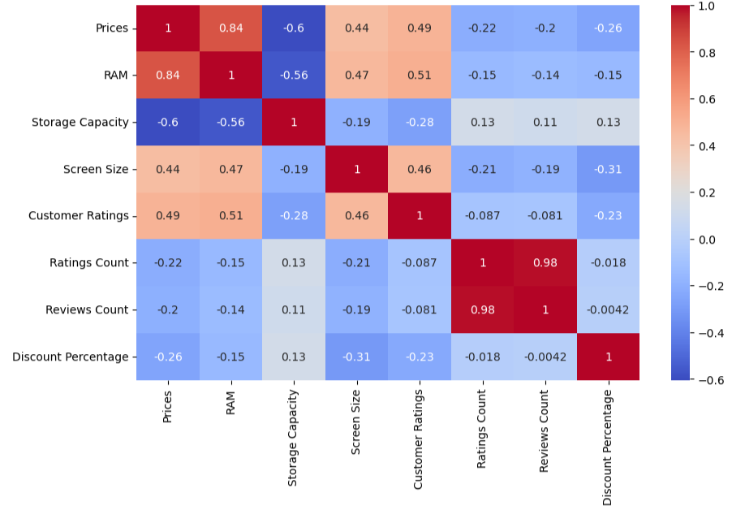
Exploratory Data Analysis:
Multivariate Analysis (Correlation )
Price is positively correlated with RAM.
Price is positively correlated with Storage Capacity.
Ratings Count and Reviews Count are usually highly correlated.
Discount Percentage may show a negative relationship with Price.

Slide 17
Key Business Questions
Which brands are most expensive ?
How does RAM impact Price ?
How do ratings and reviews relate to price ?
Which Configurations provide best value ?
Business Insights for Final Report
Most laptops sold on Flipkart fall within the mid-range price segment.
8 GB RAM and 512 GB SSD are the most common configurations.
Higher RAM and storage capacities significantly increase laptop prices.
Windows 11 dominates the laptop market.
SSD storage is preferred over HDD storage.
Premium brands generally command higher prices.
Customer ratings have limited impact on pricing.
Reviews Count and Ratings Count are strongly related, indicating that popular laptops attract more customer engagement.

Slide 18
Conclusion
Successfully scraped and analyzed 500+ laptop records from Flipkart using Python and BeautifulSoup.
Performed data cleaning, preprocessing, and exploratory data analysis to identify the key factors influencing laptop prices.
The analysis showed that brand, processor type, RAM, storage capacity, and discount percentage have a significant impact on laptop pricing.
The insights from this project can help customers make informed purchasing decisions and support businesses in developing effective pricing and product strategies.

Slide 19

THANK YOU

