Slide 1
CHAT BOT USING NLU

Slide 2
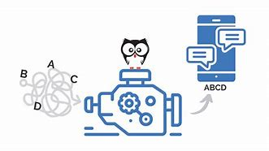
NATURAL LANUGAGE UNDERSTANDING (NLU)
Natural language understanding (NLU) is a field of computer science that deals with the interaction between computers and human (natural) languages. It is a subfield of artificial intelligence that deals with the ability of computers to understand and process human language, including speech and text.
NLU can be used to improve the accuracy of user intent recognition in a number of ways.

Slide 3
Natural Language Understanding (NLU) is crucial for improving user intent recognition in various applications, including chatbots, virtual assistants, and customer support systems.
Identify the key entities in a user's utterance (e.g., the name of a product or service, the location of a store, etc.)
Understand the relationships between the different entities in a user's utterance
Identify the sentiment of a user's utterance (e.g., whether they are happy, angry, frustrated, etc.)
Disambiguate between different possible interpretations of a user's utterance
By using NLU to better understand the meaning of user utterances, conversational AI systems can more accurately identify the user's intent and respond in a way that is more relevant and helpful.
Here are some specific examples of how NLU can be used to improve the accuracy of user intent recognition in conversational AI systems:

Slide 4
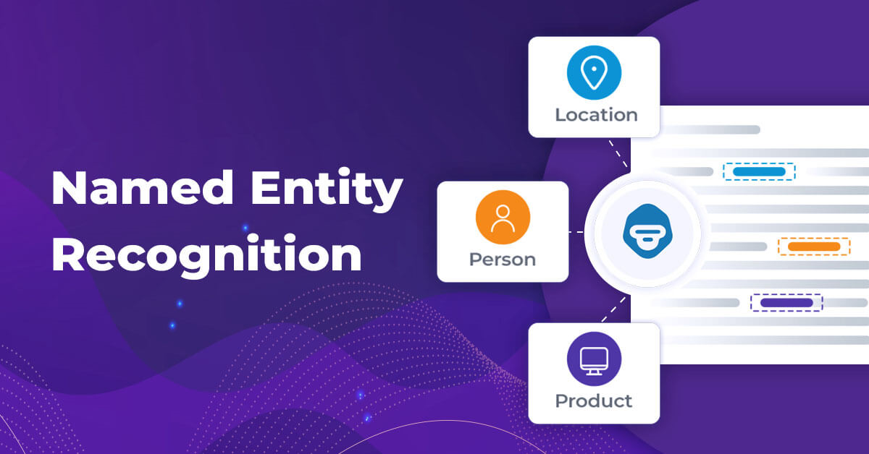
FEATURES
Identifying key entities: NLU can be used to identify the key entities in a user's utterance, such as the name of a product or service, the location of a store, or the date and time of an appointment. This information can then be used to better understand the user's intent and respond in a more relevant way. For example, if a user says "I'm looking for a restaurant in San Francisco that serves Italian food," the NLU system can identify the key entities "restaurant," "San Francisco," and "Italian food." This information can then be used to provide the user with a list of Italian restaurants in San Francisco.

Slide 5
Understanding relationships between entities:
NLU can also be used to understand the relationships between the different entities in a user's utterance. For example, if a user says "I'm flying from New York to London on June 10th," the NLU system can understand that the "New York" and "London" are the origin and destination of the flight, and that the "June 10th" is the date of the flight. This information can then be used to provide the user with information about the flight, such as the flight number, departure and arrival times, and gate number.

Slide 6
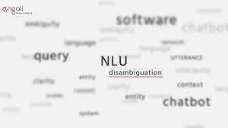
Disambiguating between different possible interpretations: NLU can also be used to disambiguate between different possible interpretations of a user's utterance. For example, if a user says "I'm looking for a bank," the NLU system could understand that they could be referring to a financial institution or to the side of a river. The system could then ask the user to clarify what they mean, or it could provide information about both types of banks.
By using NLU to better understand the meaning of user utterances, conversational AI systems can more accurately identify the user's intent and respond in a way that is more relevant and helpful.

Slide 7
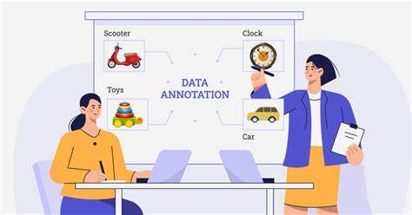
Data Collection and Annotation
Gather a diverse and representative dataset of user queries and corresponding intents.
Annotate the data with intent labels and, if needed, entity information (such as dates, locations, or product names).
Text Preprocessing:
Tokenize user input into words or subword tokens.
Remove stop words, punctuation, and other noise from the text.
Normalize text by converting it to lowercase or applying stemming/lemmatization.

Slide 8
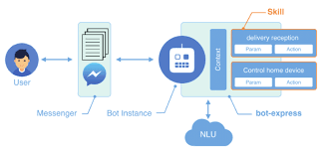
Model Training: The annotated dataset is then used to train an NLU model. There are several machine learning algorithms that can be used for this purpose, including logistic regression, decision trees, and neural networks.
Model Evaluation: The trained model needs to be evaluated on a separate test dataset to ensure that it is generalizing well to new data.
Model Tuning: If the model is not performing well, it may need to be fine-tuned by adjusting hyperparameters or using more advanced techniques such as transfer learning.

Slide 9

Deployment: Once the model is trained and evaluated, it can be deployed in a production environment where it can be used to recognize user intents in real-time.
User Testing: In addition to automated testing, real user testing and feedback are essential. Conducting usability tests and collecting user feedback can reveal issues that may not be apparent through automated evaluation alone.

Slide 10
