Slide 1

Most Popular Components in Syncfusion
Suryaprakash R(SF4647)

Slide 2
List of Most Popular Components
2
DataGrid
Charts
ListView
Sheduler

Slide 3
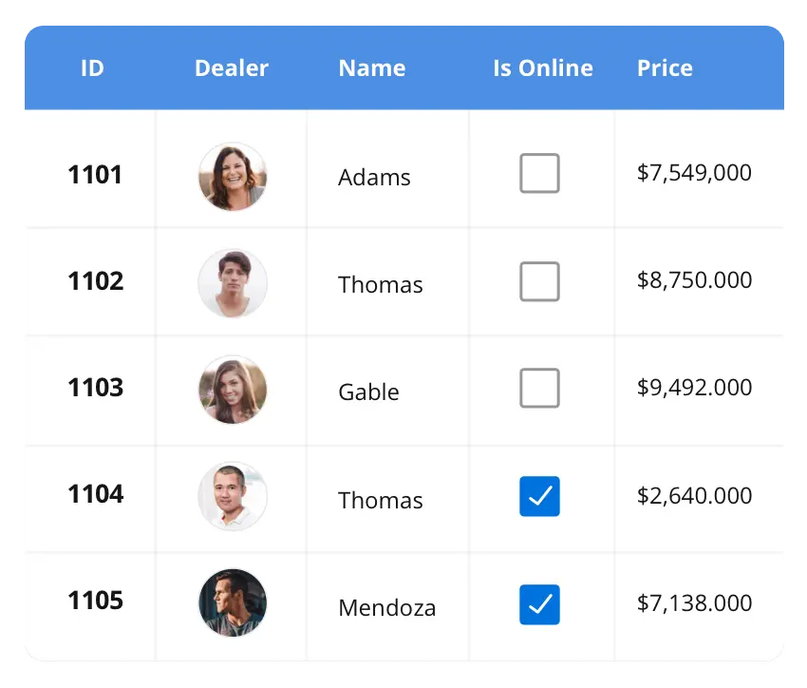





The DataGrid control is a high-performance grid component that helps display and manipulate large amounts of data in a tabular format. Its rich feature set includes functionalities like data binding, sorting, grouping, editing, filtering, swiping, dragging, resizing, loading more items, pull-to-refresh, and exporting to Excel and PDF file formats.
DataGrid Charts ListView Scheduler Diagram PDF viewer Excel Library
DataGrid
SUPPORTED PLATFORMS
JavaScript
Angular
React
Vue
Blazor
Flutter
ASP.NET MVC
ASP.NET Core
WinForms
WPF
WinUI
Flutter
Xamarin
UWP
.NET MAUI
Xamarin
UWP
JavaScript
.NET MAUI
Flutter

Slide 4
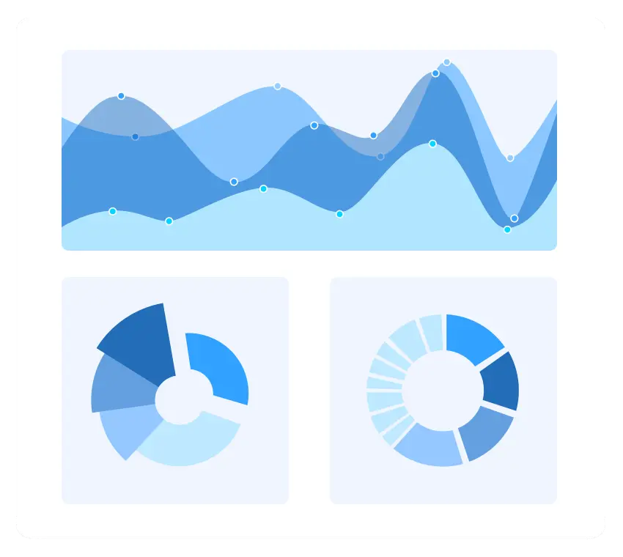
The Charts control can plot a wide range of chart types, ranging from line charts to specialized financial charts. Its rich feature set includes functionalities like data binding, multiple axes, legends, animation, data labels, annotations, trackballs, tooltips, and zooming.
DataGrid Charts ListView Scheduler Diagram PDF viewer Excel Library
Charts
SUPPORTED PLATFORMS
JavaScript
Angular
React
Vue
Blazor
Flutter
ASP.NET MVC
ASP.NET Core
WinForms
WPF
WinUI
Flutter
Xamarin
UWP
.NET MAUI
Xamarin
UWP
JavaScript
Flutter
.NET MAUI

Slide 5
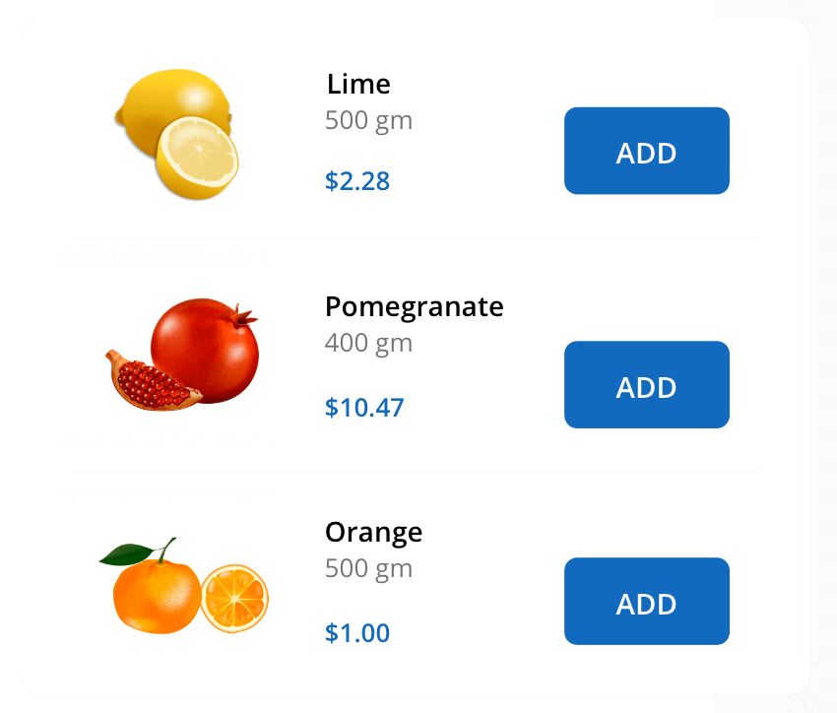
DataGrid Charts ListView Scheduler Diagram PDF viewer Excel Library
ListView
The Charts control can plot a wide range of chart types, ranging from line charts to specialized financial charts. Its rich feature set includes functionalities like data binding, multiple axes, legends, animation, data labels, annotations, trackballs, tooltips, and zooming.
SUPPORTED PLATFORMS
JavaScript
Angular
React
Vue
Blazor
Flutter
ASP.NET MVC
ASP.NET Core
WinForms
WPF
WinUI
Flutter
Xamarin
UWP
.NET MAUI
UWP
Xamarin
Flutter
JavaScript

