Slide 1
DATA WAREHOUSING WITH IBM CLOUD DB2 WAREHOUSE
TEAM MEMBERS:
K.MOHAMED SHAFIQ
K.LOKESH
T.KATHIRAVAN
P.SACHIN PRABHU
R.SURYA PRAKASH

Slide 2
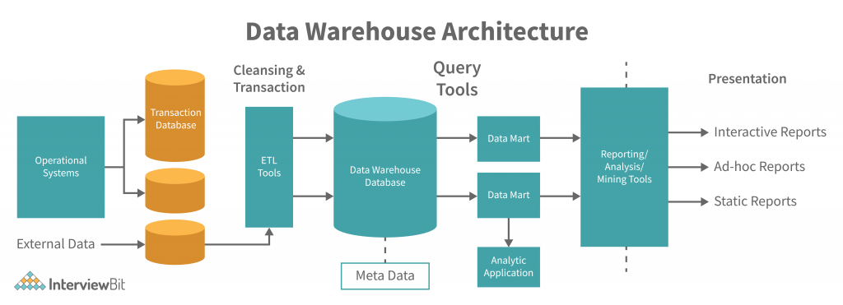
1. DATA WAREHOUSE STRUCTURE

Slide 3
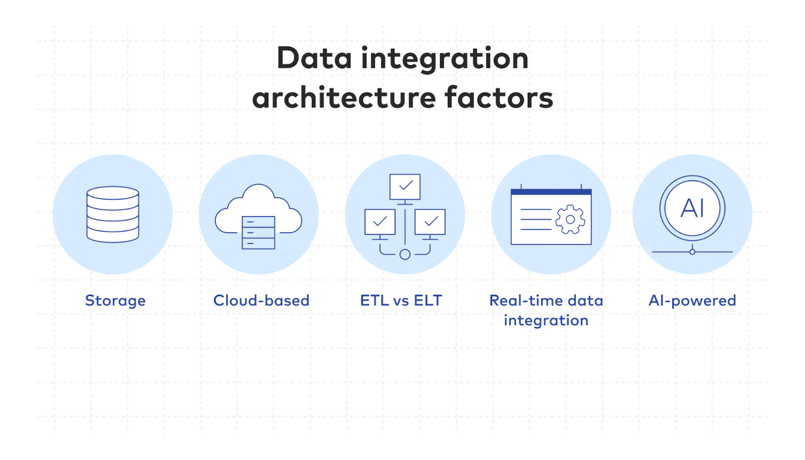
2. Data Integration

Slide 4
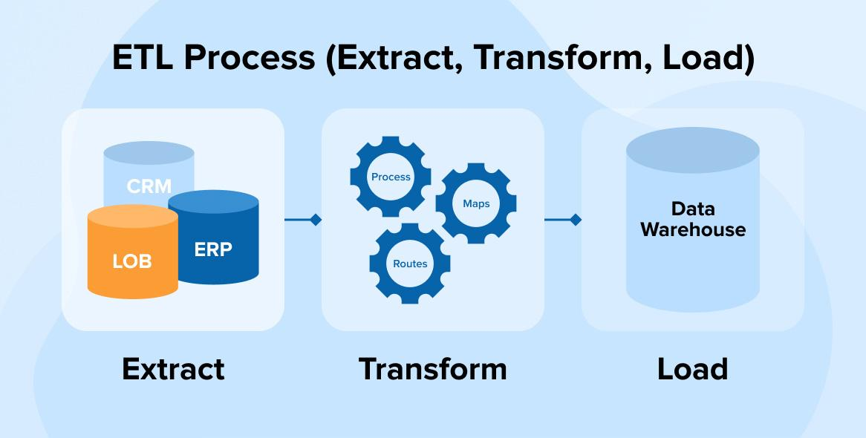
3. ETL PROCESSES

Slide 5

4. DATA EXPLORATION

Slide 6
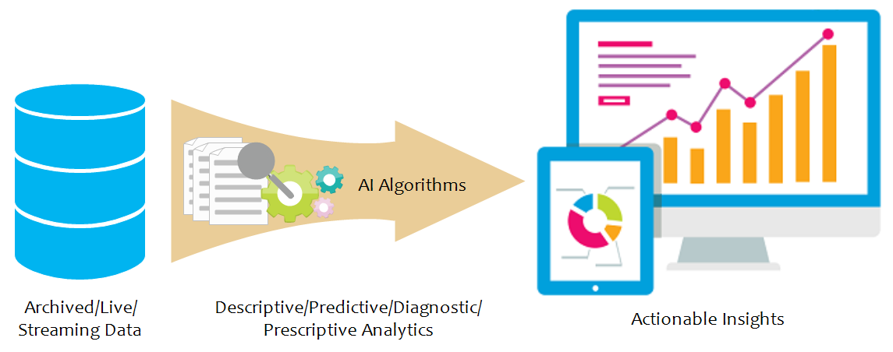
5. ACTIONABLE INSIGHTS

