Slide 1

Theme: Healthcare for underserved communities
Team Name: Dark-Knight
Team Members: Suryapratap Singh Suryavanshi

Slide 2
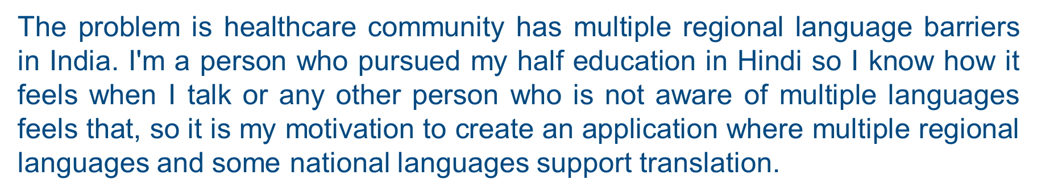
Problem Statement

Slide 3
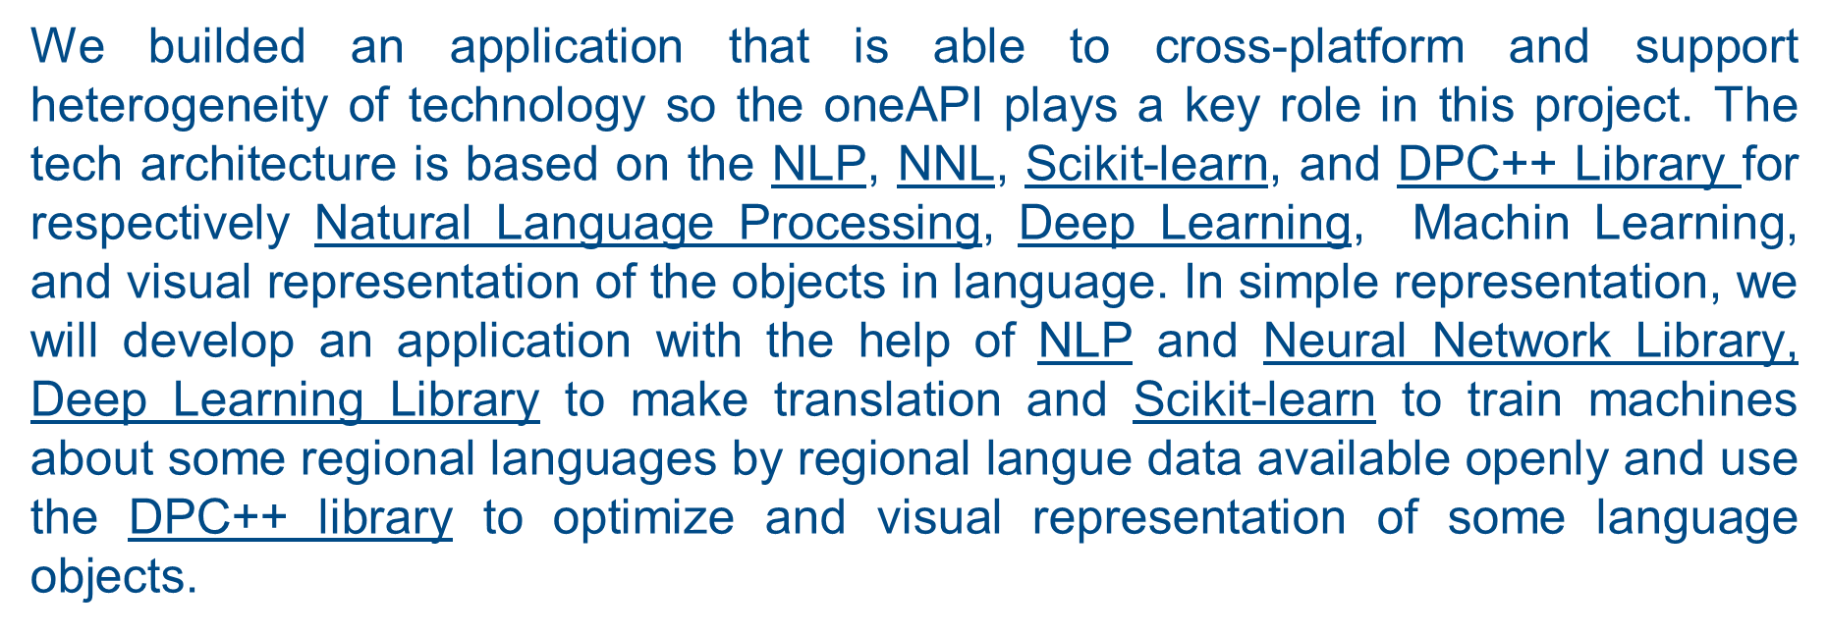
Tech Architecture

Slide 4
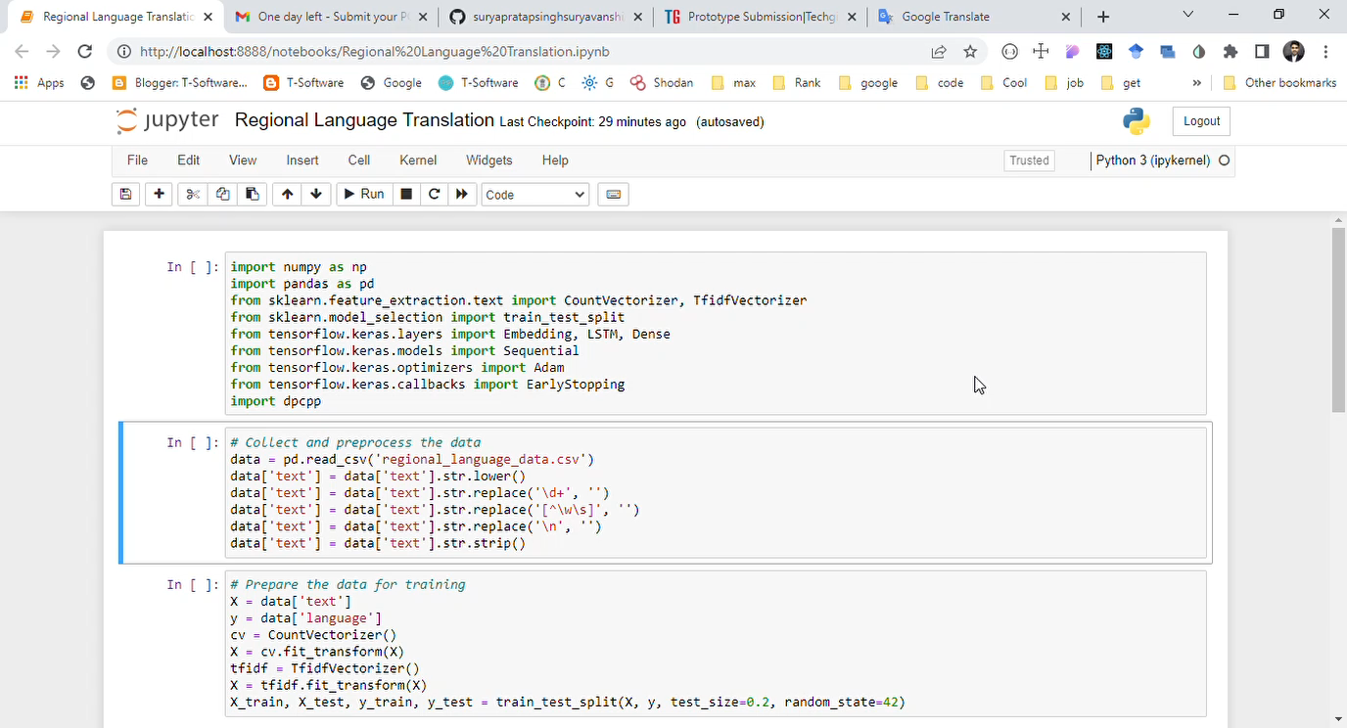
Demo Video

Slide 5
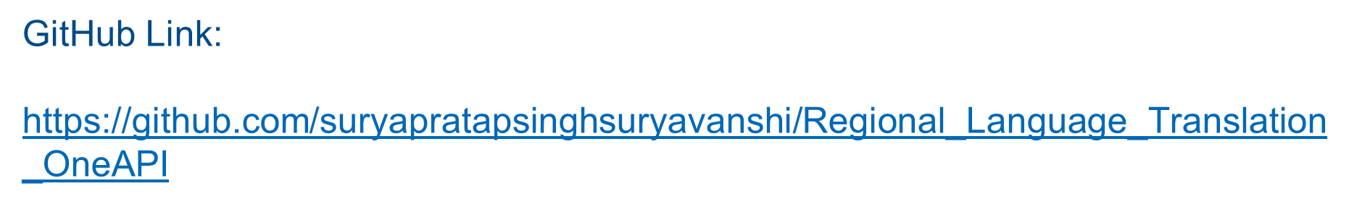
GitHub Link

Slide 6
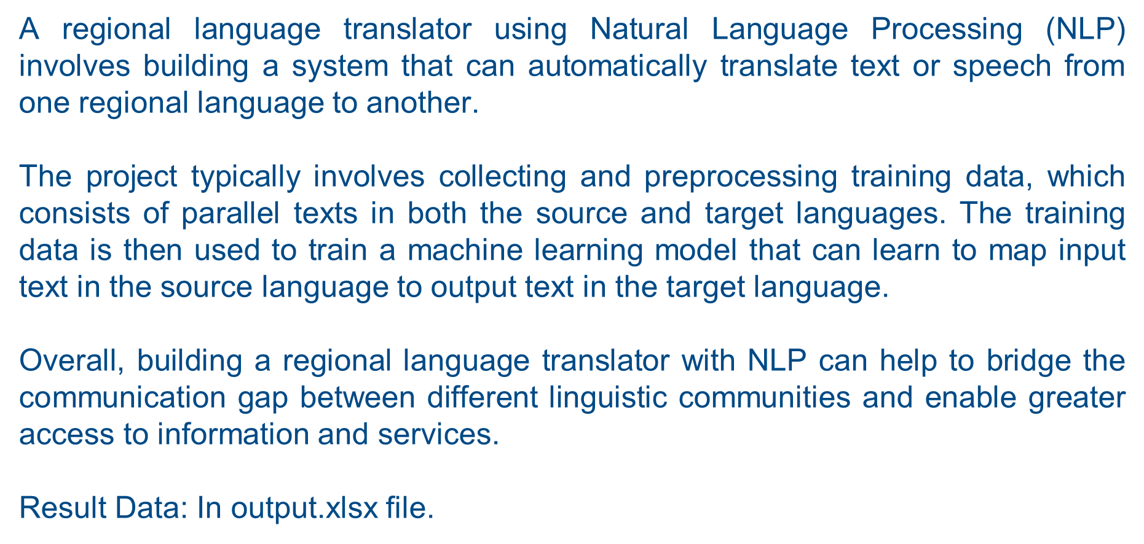
Results Summary

