Slide 1
Symp AI – Your Health Assistant
IBM HACKATHON PROJECT
Presented By: SURYA PRATIM ROY
College Name: BENGAL COLLEGE OF ENGINEERING & TECHNOLOGY
Department : BCA

Slide 2
OUTLINE
Problem Statement
Technology used
Wow factor
End users
Result
Conclusion
Git-hub Link
Future scope
IBM Certifications

Slide 3
Problem Statement
Accessing timely and reliable health information is a significant global challenge. Individuals often struggle to interpret their symptoms accurately, leading to two common pitfalls:
Delayed Care: Misinterpreting symptoms of a serious condition as minor, which can have life-threatening consequences.
Unnecessary Consultations: Seeking professional medical advice for minor ailments that could be managed at home, overburdening the healthcare system.
Proposed Solution:
Our solution, Symp AI, is an AI-powered virtual health assistant designed to bridge this gap. It utilizes advanced Natural Language Processing (NLP) and Machine Learning models to analyze user-provided symptoms, predict possible diseases with a confidence score, assess their severity, and offer helpful home remedies. This solution empowers users to take an informed first step in managing their health.

Slide 4
Technology used
IBM Cloud (Watsonx.ai): The core platform providing a robust and scalable environment for building, training, and deploying our AI models.
Natural Language Processing (NLP): This technology is the backbone of Symp AI, allowing it to understand the nuance and context of human language. It processes and interprets the symptoms described by the user.
Mistral Model: A powerful large language model integrated via IBM Cloud to provide the core reasoning and generation capabilities, enabling conversational and intelligent responses.
Custom AI Agent with Google Search Tool: The agent is designed with a specific persona and task, and is augmented with a Google Search tool to perform real-time information retrieval, ensuring the most current data is used for symptom analysis.
Python + Dataset Integration (CSV or PDF): We use Python for data processing and integrating a curated dataset of symptoms and diseases (in CSV or PDF format) to train and inform the agent's knowledge base.

Slide 5
IBM cloud services used
IBM Watsonx.ai Studio: This is our development hub where we built, configured, and tested the AI agent. It provides a comprehensive set of tools for model building, prompt engineering, and agent customization.
IBM Watsonx.ai Runtime: The execution environment for our AI agent, providing the necessary compute resources to run the model and serve real-time user requests.
IBM Cloud Object Storage: Used for securely storing our symptom-disease dataset and other project assets, ensuring data is persistent and easily accessible by our agent.
IBM Agent Builder Lab: A specialized tool within IBM Cloud for creating, managing, and deploying conversational AI agents, which we used to develop the core logic of Symp AI.
Granite/Mistral Model (via watsonx integration): We leveraged the power of these foundation models through the IBM watsonx.ai platform, providing the intelligence behind our agent's diagnostic and generative capabilities.

Slide 6
Wow factors
Intelligent Prediction: Our agent not only predicts a possible disease but also provides a confidence score and severity level, giving users a clearer picture of their condition.
Actionable Health Insights: Beyond diagnosis, Symp AI suggests simple and safe home remedies for common ailments, empowering users to self-manage minor issues effectively.
Enhanced Accuracy with Real-Time Data: The integration of a Google Search tool ensures the agent's knowledge isn't static. It can search for the latest medical information or contextual details, providing a more robust and accurate analysis
.
Scalable and Flexible Design: The architecture is designed to be easily expanded. We can add more datasets, integrate new models, and adapt to emerging healthcare needs and technologies.
Future-Ready Deployment: By building on IBM Cloud Services, our solution is ready for large-scale, enterprise-level deployment, ensuring reliability and performance as it grows.

Slide 7
End users
General Public: Provides a free, accessible, and immediate first point of contact for anyone with a health-related query, reducing anxiety and promoting better health literacy.
Remote Villagers/Underprivileged Communities: Acts as a vital tool in areas with limited access to doctors, offering a crucial preliminary diagnosis and guidance when professional healthcare is not immediately available.
Telemedicine Platforms: Can be integrated as a preliminary triage tool, collecting patient information and suggesting potential diagnoses before a virtual consultation with a doctor, making the process more efficient.
Healthcare Startups: Serves as a foundational technology for health-tech startups looking to build innovative products in patient care, wellness, and digital health.
Medical College Projects: Provides a practical and educational example for students and researchers exploring the application of AI and NLP in the medical domain.

Slide 8
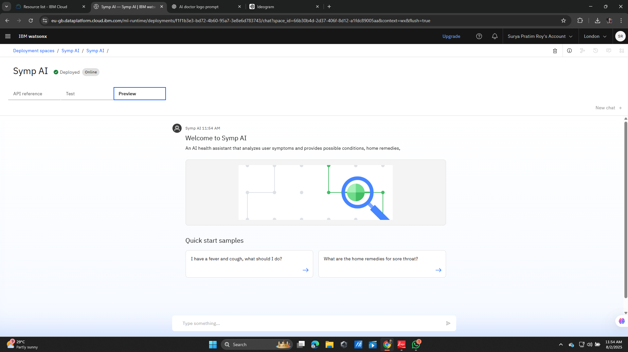
Results

Slide 9
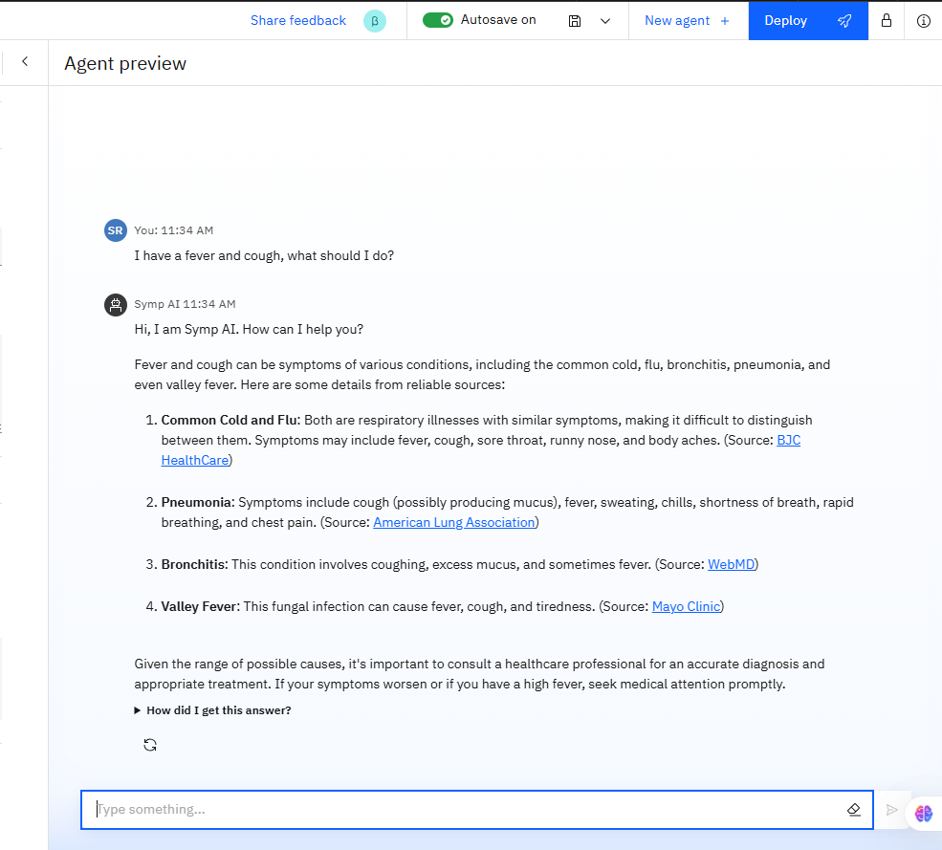
Results

Slide 10
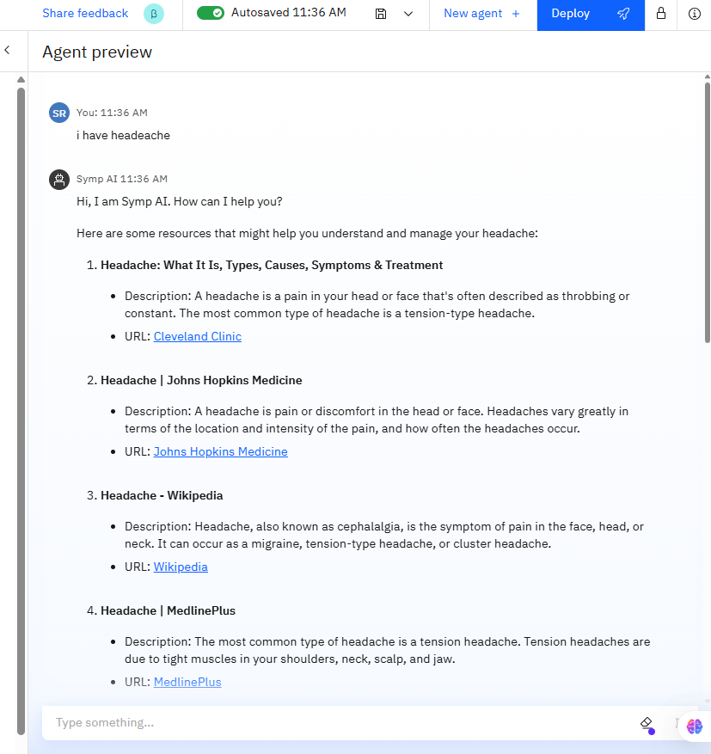
Results

Slide 11
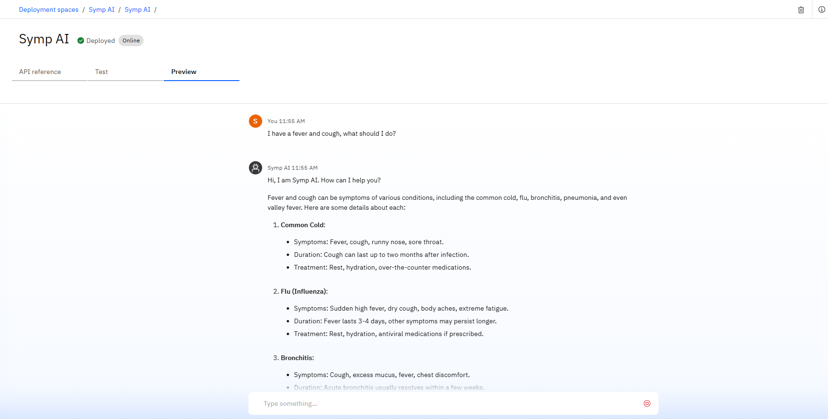
Results
Deployed AI Agent

Slide 12
Conclusion
Symp AI represents a significant step forward in democratizing access to health information. By leveraging the power of AI, it reduces the reliance on immediate doctor consultations for preliminary queries and provides users with quick, data-driven health insights. This project not only simplifies the initial diagnosis process but also empowers individuals to be more proactive about their health, ultimately fostering a more informed and efficient approach to personal well-being.

Slide 13
GitHub Link
https://github.com/suryapratimroy

Slide 14
Future scope
Integration with Voice-Based Assistants: Develop a voice-enabled version of Symp AI to improve accessibility for users who prefer speaking their symptoms over typing, such as the elderly or those with disabilities.
Multilingual Support: Implement support for multiple languages (e.g., Hindi, Bengali, Spanish) to expand the agent's reach to a global audience and serve non-English speaking communities.
Prescription Suggestions: With proper ethical and legal considerations, the agent could be expanded to suggest over-the-counter (OTC) medication for minor ailments, along with clear disclaimers.
Mobile App Version: Create a dedicated mobile application for Symp AI to provide a seamless user experience and enable features like push notifications and real-time health monitoring.
Real-Time Doctor Consultation: Integrate a feature for direct chat or video call with a verified doctor, allowing users to transition from a preliminary AI diagnosis to a professional medical consultation within the same platform.

Slide 15
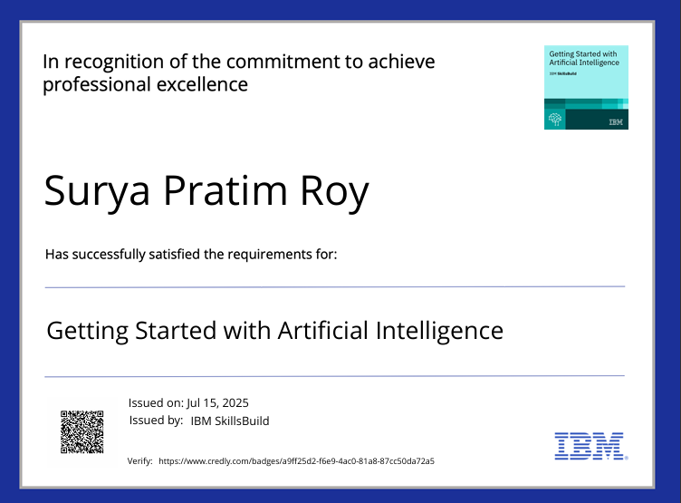
IBM Certifications
Screenshot/ credly certificate( getting started with AI)

Slide 16
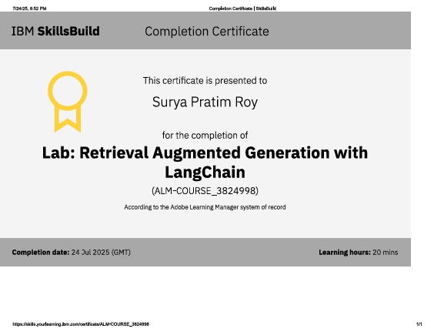
Attach your RAG LAB certificate here

Slide 17
THANK YOU

