Slide 1

Sentiment Analysis and Topic Modeling for Azure Customer Services
- Pratap Satapathy
- Anuj Gupta

Slide 2
Problem Statement:
Azure Service users interact with the customer/contact center for variety of services like Billing, Complaints, Feedback and Resolutions. For enhancing the contact center service level, customer interactions need to be analyzed using AI & ML based techniques to measure and monitor customer satisfaction.
Solution Steps:
Convert recording Speech to text and scrape the Azure reviews from the web.
Data cleansing and preprocessing.
Provide Sentiment Analysis and Topic Modeling from the text (converted in step 1) using Azure Auto ML
Use Power BI dashboards to provide KPIs and analytics

Slide 3







Architecture
Input Streams
Text
Audio
Azure Cognitive Services
Bing Speech API
Customized Code for Data Cleaning / Pre-Processing
Azure ML
Naïve Bayes, SVM, Random Forest
KPIs & Analytics for Topic Modeling and Sentiment Analysis
Pre-Processing
Web Sources

Slide 4
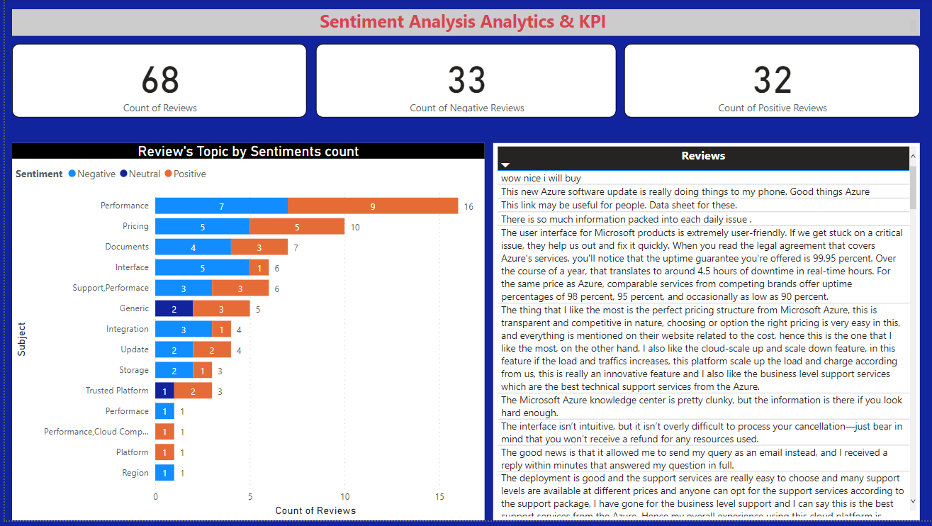
Final Output

Slide 5
Thank You !

