Slide 1
Final Project Age and Gender Prediction Presented By SURYA R 711721244057 III BTech CSBS KGISL Institute of Technology
CAPSTONE PROJECT
3/21/2024 Annual Review

Slide 2
PROJECT TITLE
Gender and Age Prediction
from Facial Images using CNN

Slide 3

AGENDA
Introduction
Problem Statement
Project Overview
End Users
Solution Highlights
Modeling Approach
Results
Conclusion

Slide 4
Introduction to Age and Gender Prediction:
Age and gender prediction is a fascinating field at the intersection of artificial intelligence and demographic analysis.
By leveraging advanced machine learning algorithms and deep neural networks, researchers and practitioners can accurately infer demographic attributes such as age and gender from various data sources, including images, videos, and text.

Slide 5

PROBLEM STATEMENT
Predicting gender and age from facial images presents a significant challenge in computer vision due to the inherent complexities and variations present in real-world images. Variations in pose, expression, and lighting conditions can significantly impact the accuracy of predictions, making it difficult to develop robust and reliable prediction models.
Existing solutions often struggle to provide accurate predictions across diverse demographics and age groups, leading to inconsistencies and inaccuracies in the results.

Slide 6

PROJECT OVERVIEW
Gather a large dataset of images spanning different age ranges and genders from publicly available sources and proprietary databases.The UTKFace dataset with annotations for age, gender, and ethnicity.
Design and implement a deep learning architecture, such as a convolutional neural network (CNN), capable of extracting relevant features for age and gender prediction from the input images.
Train the model using the training set, optimizing hyperparameters and adjusting the architecture as needed based on performance on the validation set.

Slide 7

END USERS
Researchers in computer vision and deep learning an invaluable tool for advancing the state-of-the-art in demographic analysis.
Industries Requiring Demographic Analysis from Images: Industries such as marketing, healthcare, retail, and e-commerce that rely on demographic analysis from images can benefit greatly from our solutionPotential applications in security, marketing, and entertainment industries.
security industry, our solution enhances identity verification and threat detection capabilities, improving security measures and ensuring public safety.

Slide 8

YOUR SOLUTION AND ITS VALUE PROPOSITION
Robustness to variations : the model's robustness to variations in image resolution ensures consistent performance across different types of image inputs, from high-resolution photographs to low-quality snapshots. This versatility makes our solution well-suited for real-world applications where images may vary widely in quality and conditions, allowing organizations to achieve reliable demographic analysis with confidence.
Accurate Gender and Age Prediction: Our solution utilizes state-of-the-art Convolutional Neural Networks (CNNs) to accurately classify gender and predict age from facial images, achieving a gender accuracy of 90.00% and an age Mean Absolute Error (MAE) of 6.5 years.
Scalability and Efficiency: Our solution is designed with scalability and efficiency in mind. By leveraging GPU acceleration and efficient feature extraction techniques, we ensure that the system can process large datasets with speed and accuracy.

Slide 9

THE WOW IN YOUR SOLUTION
unprecedented levels of accuracy in age and gender prediction
speed and efficiency revolutionize the way organizations conduct demographic analysis, providing instant insights and actionable intelligence at the speed of thought.
Robustness to variations in facial expressions, lighting, and image quality.
Scalability to process large datasets efficiently.
3/21/2024 Annual Review
9

Slide 10
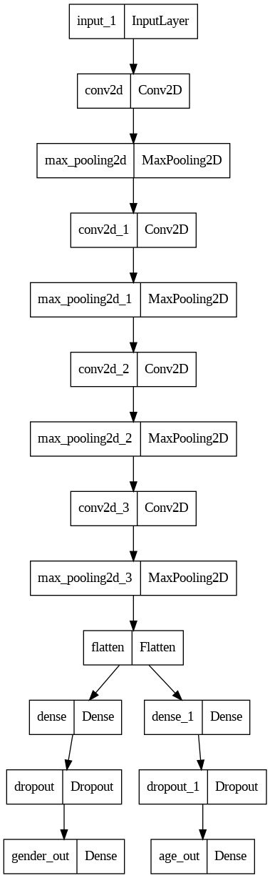
MODELLING
10

Slide 11
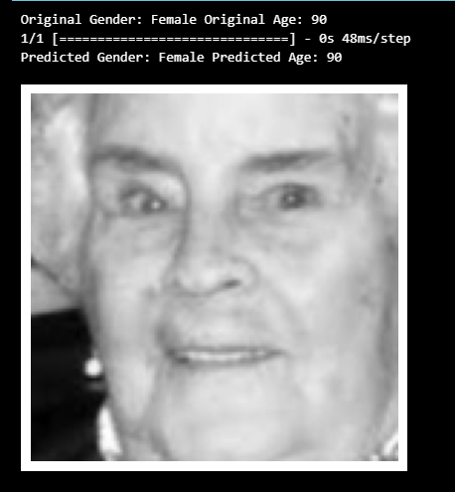
RESULTS
Gender Accuracy: 90.00%
Age Mean Absolute Error (MAE): 6.5 years
https://drive.google.com/drive/folders/15ekNxZNcftAfTkuCds6PKQoC9WXFyxYK?usp=drive_link
11

