Slide 1
SURYA R 711721244057
Final Project

Slide 2
PROJECT TITLE
Deep Learning Approach for Breast Cancer Classification

Slide 3


AGENDA
Introduction
Problem Statement
Project Overview
End Users
Solution and Value Proposition
Key Features
Modelling Approach
Conclusion
3/21/2024 Annual Review

Slide 4

PROBLESTATEMENT
Breast cancer is a big problem worldwide, with lots of new cases found every year. Even though we have better technology in medicine now, it's still hard to diagnose breast cancer correctly and quickly.
When doctors look at pictures of breast tissue or cells under a microscope, they might see things differently from each other, which can cause mistakes.
We really need machines/computer systems that can help make breast cancer diagnosis more accurate and faster. These systems would use technology to improve how we find and understand signs of breast cancer in images.

Slide 5

PROJECT OVERVIEW
Our project is all about creating a smart computer system to help doctors figure out if breast tumors are harmless or dangerous. We're using something called convolutional neural networks, which are like super-smart algorithms, to analyze pictures of breast tissue from mammograms and microscopes.
We're going through different stages in our project: collecting lots of images, preparing them for analysis, teaching our system to recognize patterns, and then making sure it's doing its job right by testing it.
Our big dream is to make a tool that doctors can use to be more sure about their diagnoses, which could mean better outcomes for patients.

Slide 6

WHO ARE THE END USERS?
The primary end users of our solution are healthcare professionals involved in breast cancer diagnosis, including radiologists and pathologists.
By providing them with a reliable and efficient tool for image analysis, we aim to enhance their diagnostic capabilities and streamline the decision-making process.
Patients and their families will also benefit from faster diagnosis and treatment initiation, potentially improving survival rates and quality of life.
Additionally, healthcare institutions and policymakers may benefit from the system's ability to optimize resource allocation and reduce healthcare costs associated with manual image interpretation.

Slide 7
YOUR SOLUTION AND ITS VALUE PROPOSITION
Our deep learning-based solution offers several key benefits:
Improved diagnostic accuracy: By analyzing digital images with advanced algorithms, our system can detect subtle patterns indicative of breast cancer with high precision.
Enhanced efficiency: Automation of image analysis reduces the time required for diagnosis, enabling prompt initiation of treatment.
Cost savings: By minimizing the need for manual review and interpretation of images, our solution can help healthcare institutions optimize resource utilization and reduce operating costs.
Empowering healthcare professionals: Our user-friendly interface and intuitive design make it easy for radiologists and pathologists to integrate our tool into their existing workflow, without the need for extensive training in deep learning techniques.

Slide 8

THE WOW IN YOUR SOLUTION
What sets our solution apart is its ability to surpass human performance in certain aspects of breast cancer diagnosis.
Through extensive training on large datasets, our deep learning model has achieved remarkable accuracy and reliability in classifying tumors.
The system's adaptive learning capabilities enable it to continuously improve over time, ensuring ongoing reliability and effectiveness.
Moreover, our solution is scalable and can be customized to suit the specific needs and preferences of different healthcare settings, from small clinics to large hospitals.
3/21/2024 Annual Review
8

Slide 9
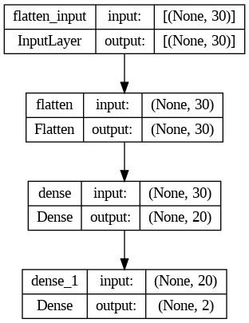
MODELLING
Input Layer:
Receives data with 30 features.
Flatten Layer:
Converts input data into a 1D array (output shape: (None, 30)).
Dense Layers:
Two dense layers:
First layer reduces dimensionality to 20.
Second layer produces final output (shape: (None, 2)).
9

Slide 10
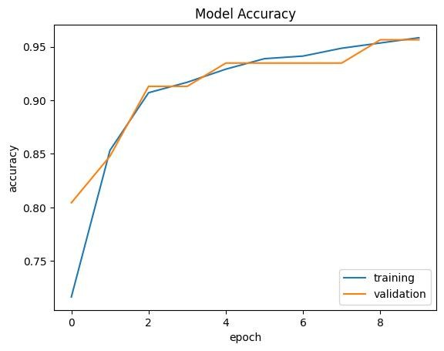
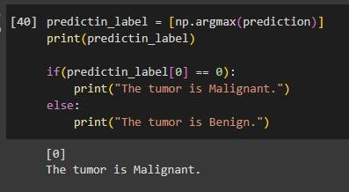
RESULTS
10

