Slide 1
Skillbook – 2018 Tech Forum Hackathon
Murugesan, Subburaj | Surya Rayarao | April 23, 2018

Slide 3

Agenda
Cost effective cloud deployment for internally managed DST applications
Candidates for internally managed application
Discuss advantages
Skillbook – socialize your internal skills
Skillbook app
Live demo

Slide 4
Cost effective cloud deployment
Candidates for internally managed application
Configuration management tools (Cost – 4000$ per year)
CMS
Skillbook
Padlet
Advantages
Maintenance and Server cost reduction from 4000 * 30 = $ 120,000 to $ 0 to 300 $
Security by reducing the usage of external open source.

Slide 5
skillbook
What is Skillbook?
Product based company knowledge share challenges.
Challenge of finding right people
What we do with Skillbook?
List your skills
Recommend others for their skills
Find the right people
Other existing similar tools
Slack

Slide 6

Live demo

Slide 7

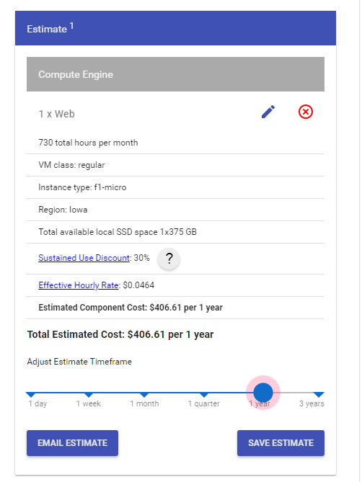
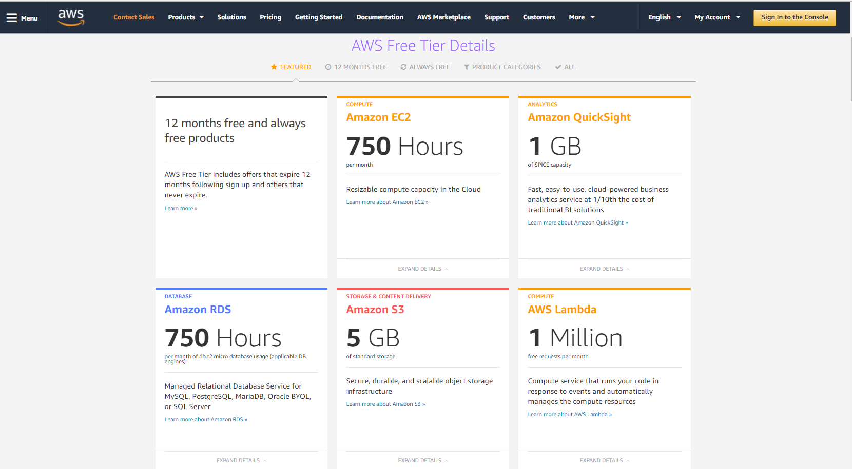

Cloud for small apps

Slide 8

Questions & Feedback

Slide 9
Thank you!
Subburaj Murugesan| SMurugesan@dstsystems.com | 816-435-8133
Surya Rayarao | SRayarao@dstsystems.com | 816-435-6396

