Slide 1
Spectral Methods for Community Detection in Static
and Dynamic Graphs
Surya Raghav B
CS21B2042
Dr. Sadagopan N
Dept. of CSE, IIITDM Kancheepuram

Slide 2
Table of Contents
Introduction
Problem Definition
Literature Survey
Contribution / Work done
Analysis / Results
Code Development
Conclusion
Future Work
References

Slide 3
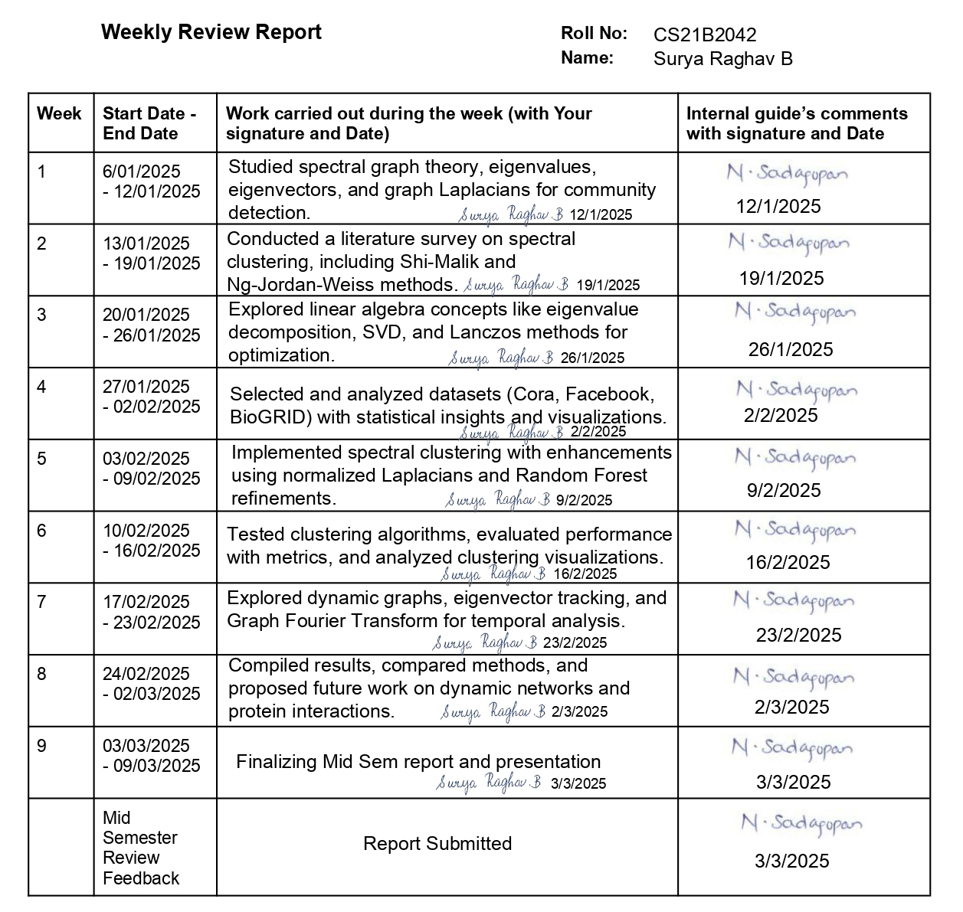
Weekly Review Report

Slide 4
Introduction
Overview:
Community detection is a fundamental problem in network analysis.
Spectral methods leverage eigenvalues and eigenvectors of graph Laplacians.
Applications in citation networks, social media, biological networks, and more.
The project extends spectral methods to both static and dynamic graphs.
Objective:
Develop and evaluate spectral clustering methods for community detection.
Enhance clustering performance using machine learning refinements.
Explore applications in real-world networks (Cora, Facebook, BioGRID).
Extend methods to dynamic graphs using Graph Fourier Transform.

Slide 5
Problem Definition
The project focuses on community detection in graphs using spectral methods. Given a network (e.g., social networks, biological networks), we aim to identify groups (communities) of closely connected nodes using spectral clustering and its enhancements. The project extends these methods to both static and dynamic graphs, incorporating graph Fourier analysis and machine learning refinements for better clustering performance.
Graph structures are prevalent in real-world domains such as social networks, citation networks, biological interactions (protein-protein networks), and financial systems.
Community detection is crucial for tasks like fraud detection, recommendation systems, disease modeling, and network security.
Extending spectral methods to dynamic graphs enables us to analyze evolving networks, which is essential for real-time applications such as monitoring social trends, tracking disease spread, and adaptive cybersecurity.

Slide 6
Literature Survey
Shi-Malik Normalized Cuts Algorithm – Uses eigenvectors of the Laplacian for graph partitioning.
Ng-Jordan-Weiss Spectral Clustering – Improves clustering stability with normalized Laplacian embeddings.
Lanczos Method for Eigenvector Computation – Efficient for large-scale graphs.
Spectral Methods in Dynamic Graphs – Extends eigenvector-based clustering to evolving networks.
Machine Learning in Graph Clustering – Uses classifiers like Random Forest for refining clusters.
Graph Fourier Analysis – Studies frequency-based graph signal processing for dynamic graphs.
Data Gatherings
Cora Citation Network – Public dataset from research citations.
Facebook Social Network – Social graph dataset with user connections.
BioGRID Protein-Protein Interaction Network – Experimental data on biological protein interactions.

Slide 7
Contributions/ Work Done
1. Theoretical Study
Studied spectral graph theory and its application to community detection.
Explored graph Laplacian-based clustering methods (Shi-Malik, Ng-Jordan-Weiss).
Working on Fourier analysis on graphs for dynamic network analysis.
2. Algorithm Development
Implemented traditional clustering (K-Means) as a baseline.
Developed spectral clustering using graph Laplacian eigenvectors.
Enhanced spectral clustering with Lanczos eigenvector computation and machine learning refinements (Random Forest).
Used an optimization-based label matching strategy for cluster refinement.
3. Experiments & Evaluation
Applied methods to Cora, Facebook, and BioGRID datasets.
Evaluated performance using Silhouette Score, NMI, Modularity, and Conductance.
Extended analysis to dynamic graphs for evolving community detection.

Slide 8
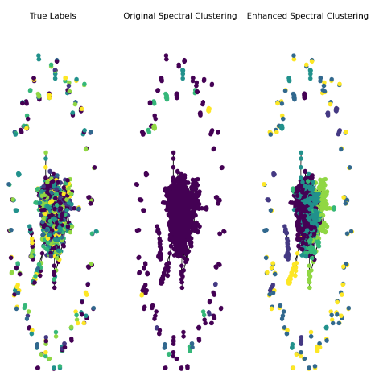
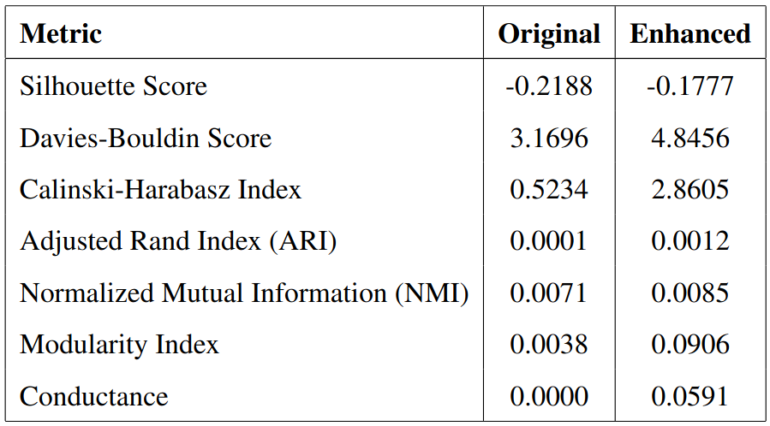
Analysis/ Results - Cora Dataset

Slide 9
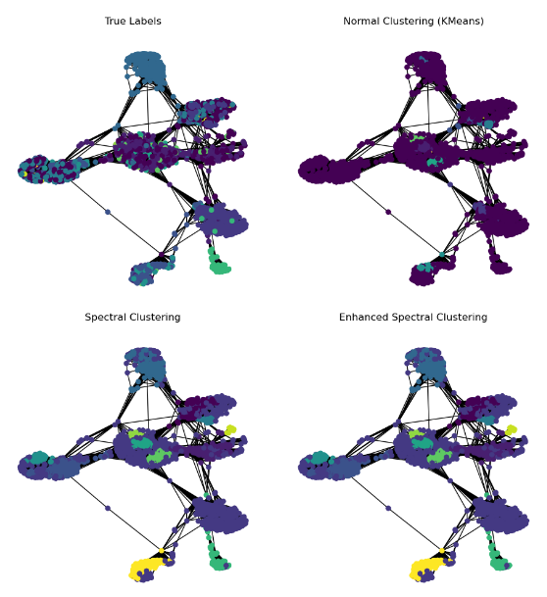
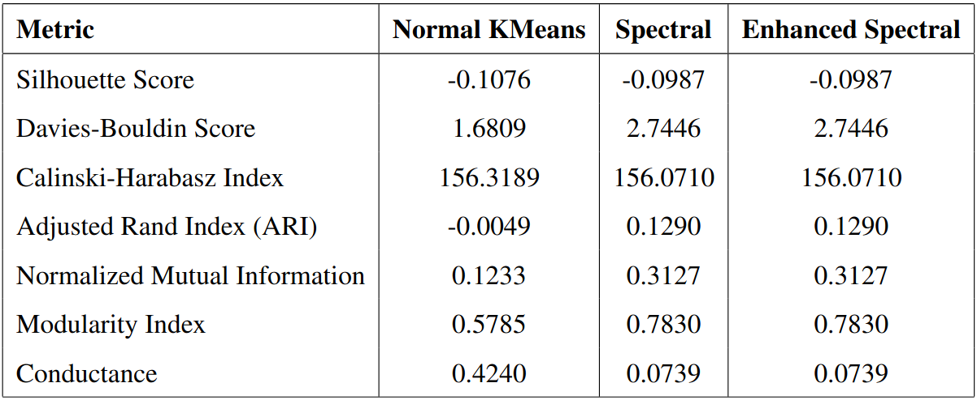
Analysis/ Results - Facebook Dataset

Slide 10
Code Development
Implementation Process
Developed algorithms in Python using libraries like NetworkX, NumPy, SciPy, Scikit-learn, and Pandas.
Implemented three clustering approaches:
Traditional Clustering (K-Means on node features).
Spectral Clustering (Eigen decomposition of Laplacian).
Enhanced Spectral Clustering (Lanczos method + ML refinement).
Dataset Handling
Processed Cora, Facebook, and BioGRID datasets into adjacency matrices.
Handled large-scale graphs using sparse matrix operations.
Performance Evaluation
Used internal, external, and graph-based metrics to assess clustering effectiveness.
Compared clustering results across datasets and algorithms.

Slide 11
Conclusion
Effectiveness of Spectral Methods:
Spectral clustering, based on eigenvalues and eigenvectors of graph Laplacians, provides a mathematically grounded approach to community detection.
Compared to traditional clustering, spectral methods leverage the global structure of the graph rather than relying solely on local node features.
Performance Improvements with Enhanced Spectral Clustering:
Incorporating the Lanczos method for efficient eigenvector computation improves scalability.
Using normalized Laplacians ensures better handling of irregular graph structures.
Refinement with machine learning techniques (Random Forest classifier) enhances clustering accuracy.
Comparison of Approaches:
Traditional methods fail to capture complex graph structures, making spectral methods a superior choice resulting in higher modularity scores.

Slide 12
Future Work
Extending to Dynamic Graphs
Develop incremental spectral clustering for evolving networks.
Utilize Graph Fourier Transform (GFT) for temporal analysis.
Protein-Protein Interaction (PPI) Networks
Apply spectral methods to identify functional protein modules.
Integrate graph neural networks (GNNs) for deeper insights.
Computational Efficiency
Optimize eigenvector computation with approximation techniques.
Implement parallel and distributed clustering methods.
Theoretical Advancements
Extend to multi-layer graphs and higher-order spectral methods.
Study graph signal processing for improved clustering.

Slide 13
References
Shi, J., & Malik, J. (2000). Normalized cuts and image segmentation. IEEE Transactions on Pattern Analysis and Machine Intelligence, 22(8), 888–905.
Von Luxburg, U. (2007). A tutorial on spectral clustering. Statistics and Computing, 17(4), 395–416.
Newman, M. E. J. (2006). Modularity and community structure in networks. Proceedings of the National Academy of Sciences, 103(23), 8577–8582.
Chung, F. R. K. (1997). Spectral Graph Theory. American Mathematical Society.
Fortunato, S. (2010). Community detection in graphs. Physics Reports, 486(3-5), 75–174.
Belkin, M., & Niyogi, P. (2003). Laplacian eigenmaps for dimensionality reduction and data representation. Neural Computation, 15(6), 1373–1396.
Rosvall, M., & Bergstrom, C. T. (2008). Maps of random walks on complex networks reveal community structure. Proceedings of the National Academy of Sciences, 105(4), 1118–1123.
Tang, L., & Liu, H. (2009). Relational learning via latent social dimensions. Proceedings of the 15th ACM SIGKDD International Conference on Knowledge Discovery and Data Mining, 817–826.

Slide 14
Thank You Any Questions?

