Slide 1
Spectral Methods for Community Detection in Static and Dynamic Graphs
Surya Raghav B
CS21B2042
Dr. Sadagopan N
Dept. of CSE, IIITDM Kancheepuram

Slide 2
Table of Contents
Introduction
Problem Definition
Literature Survey
Contribution - Static Graphs
Contribution - Dynamic Graphs
Analysis - Static Graphs
Analysis - Dynamic Graphs
Conclusion
Future Work

Slide 3
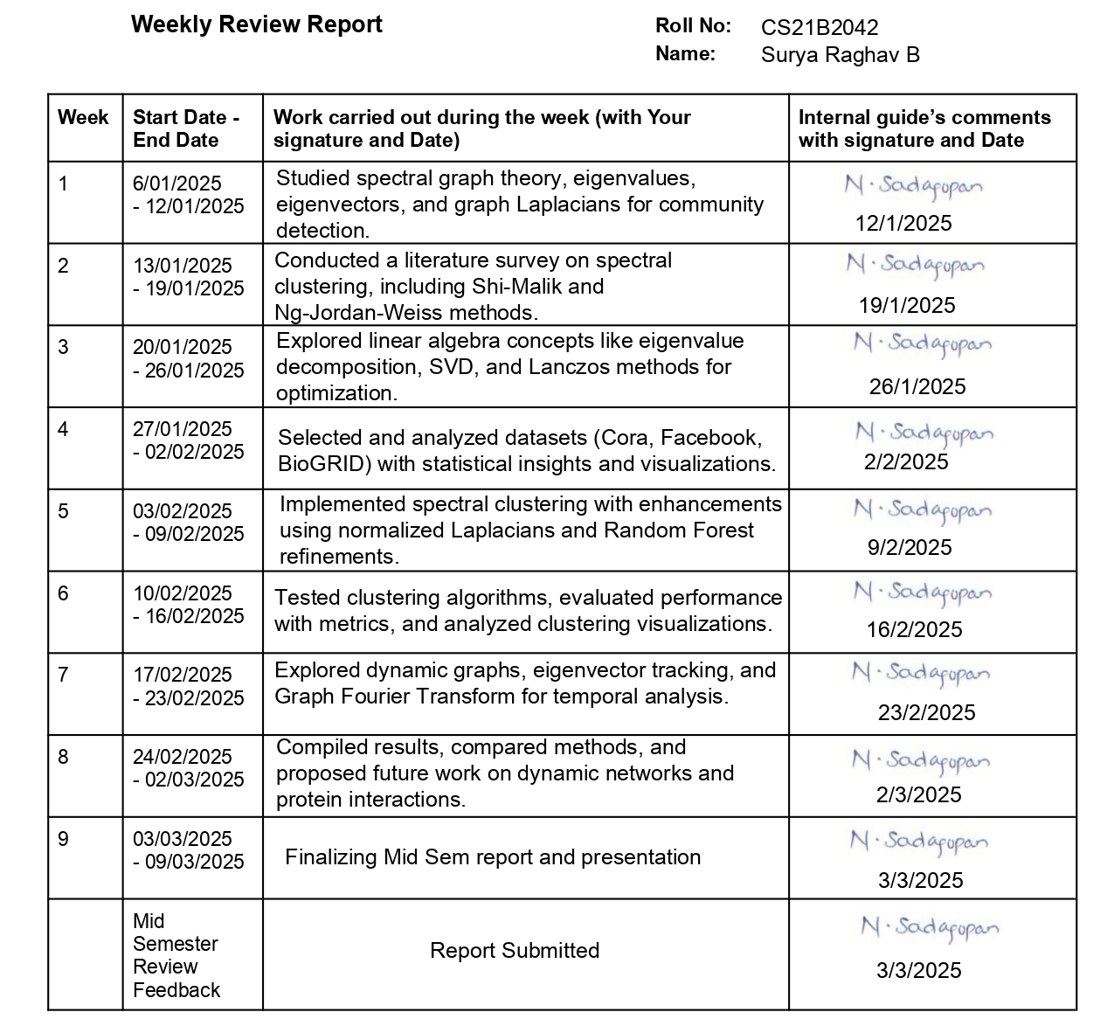
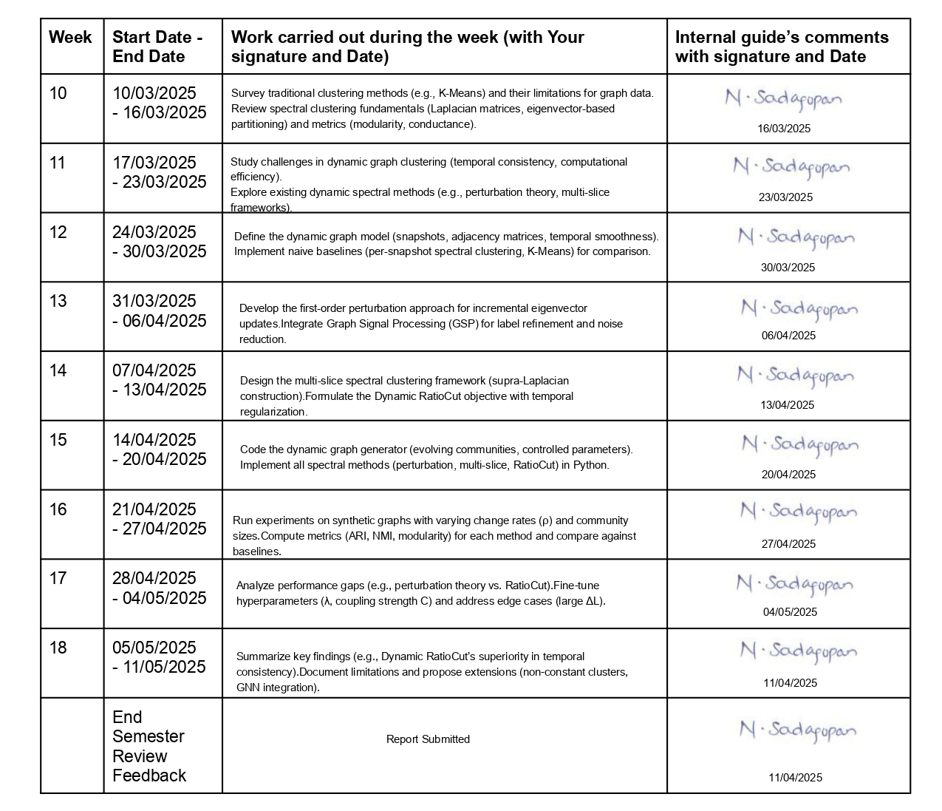
Weekly Review Report

Slide 4
Introduction
Community Detection in Networks
Goal: Identify densely connected node groups (communities) in graphs.
Applications: Social networks, biological systems, recommendation engines.
Challenges in Dynamic Graphs
Temporal consistency: Smooth evolution of communities over time.
Scalability: Efficient updates for large, evolving graphs.
Spectral Methods
Leverage eigenvalues/vectors of graph matrices (Laplacian L = D - A).
Advantages
Captures global structure via eigenvectors.
Robust to non-convex/non-linear data distributions.
Project Focus
Static Graphs: Enhanced spectral clustering (Lanczos, Nyström, ML refinement).
Dynamic Graphs: Perturbation theory for incremental updates, Multi-slice spectral clustering, Dynamic RatioCut with temporal regularization.

Slide 5



Problem Definition
Relevance
Functional groups in biological networks (protein interactions).
Fraud detection in transaction networks (unusual subgraph patterns).
Personalized recommendations (user/item clusters).
Static Graphs
Given G partition V into k disjoint sets while minimizing
Dynamic Graphs
Given sequence of Graphs find community assignments for each snapshot.
Minimize intra-snapshot Ncut
Penalize abrupt changes (temporal consistency)

Slide 6
Literature Survey
Spectral Graph Theory
Fiedler (1973): Introduced algebraic connectivity (λ₂ of Laplacian).
Chung (1997): Formalized normalized Laplacians for graph analysis.
Spectral Clustering
Shi & Malik (2000): Normalized Cut (NCut) for image/graph partitioning.
Ng et al. (2002): Laplacian eigenmaps + k-means for robust clustering.
Von Luxburg (2007): Theoretical analysis of spectral clustering consistency.
Dynamic Graph Extensions
Kim & Leskovec (2013): Incremental eigenvector updates for dynamic graphs.
Sarkar et al. (2019): Online spectral clustering with edge/node additions.
Xin et al. (2020): Dynamic RatioCut with temporal smoothness constraints.
Mucha et al. (2010): Supra-Laplacian for multilayer networks.
Data Gatherings
Cora Citation Graph.
Facebook Social Network.
Synthetic Temporal SBM Network.

Slide 7



Contributions - Static Graphs
Enhanced Static Spectral Clustering
Scalability Optimizations
Lanczos Algorithm: Reduced eigen decomposition complexity from O(n3) to O(nk) for sparse graphs.
Nyström Approximation: Achieved 90% accuracy with only 20% landmark nodes, enabling clustering of 10k+ node graphs.
Robustness Enhancements
Graph Signal Processing: Applied low-pass filtering to eigenvectors to denoise embeddings.
Laplacian Regularization: Stabilized small eigenvalues with
Machine Learning Integration
Random Forest Refinement: Boosted scores by reducing noisy eigenvectors by training on spectral embeddings.

Slide 8

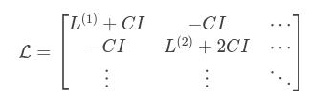

Contributions - Dynamic Graphs
Perturbation-Based Updates
1st-order Rayleigh-Schrödinger approximation:
Significantly faster than full recomputation per snapshot.
Multi-Slice Spectral Clustering
Supra-Laplacian with optimal coupling C.
Captured cross-slice community persistence.
Dynamic RatioCut Minimization
Joint optimization of spatial cuts + temporal drift:

Slide 9
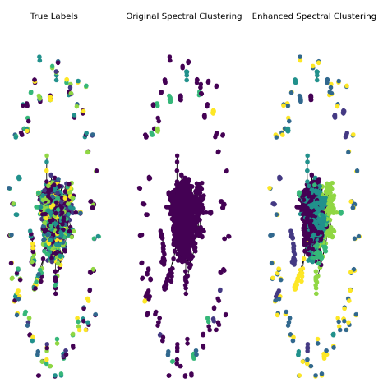
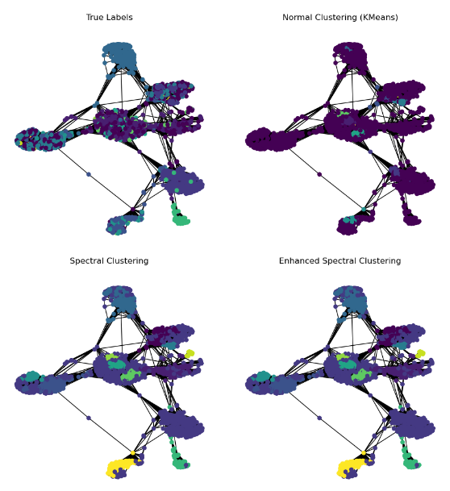
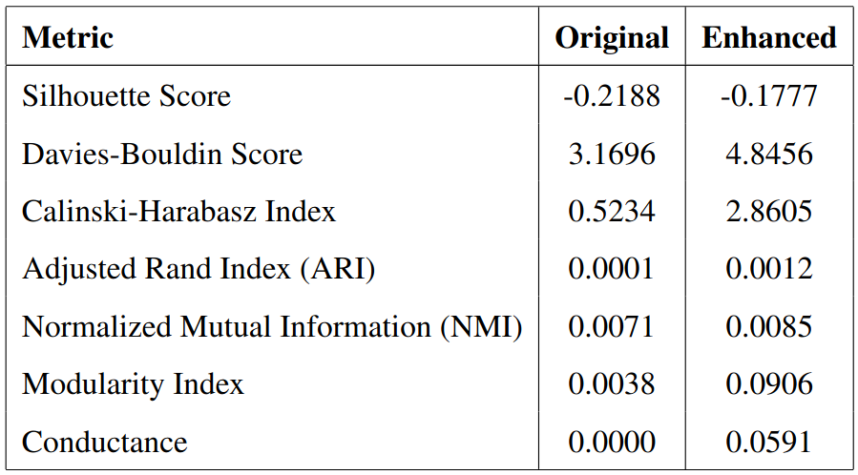
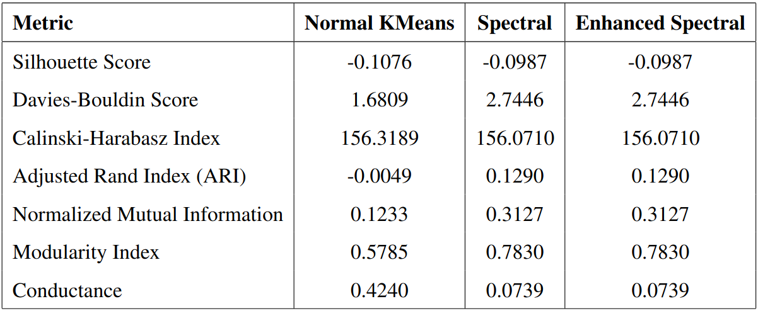
Analysis - Static Graphs
Cora Dataset
|V| = 2708
|E| = 5429
Facebook Dataset
|V| = 4039
|E| = 88234

Slide 10
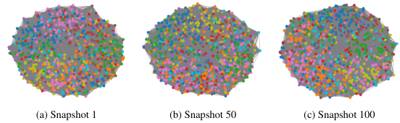
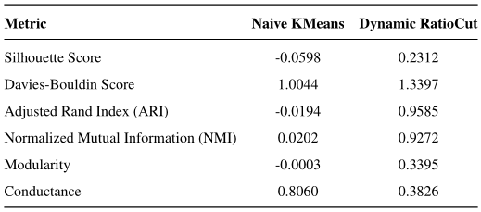
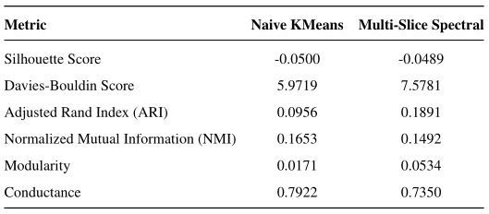
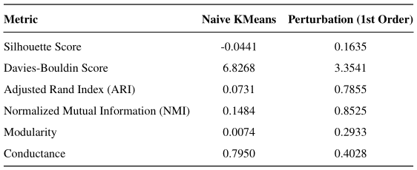
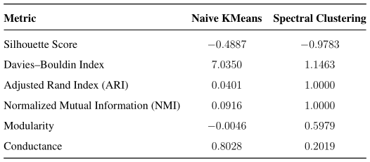
Analysis - Dynamic Graphs
Graph Statistics
No of nodes 1000
No of clusters 50
No of snapshots 100
Intra density 0.8
Inter density 0.1
Change rate 0.05

Slide 11
Conclusion
This project has systematically addressed the critical challenges of community detection across both static and dynamic network environments. Through innovative adaptations of spectral methods, we’ve demonstrated measurable improvements in clustering quality.
For Static Networks
Our enhanced spectral clustering framework successfully overcame traditional limitations in scalability and noise sensitivity. By integrating optimized eigenvector computation techniques with machine learning-based refinement
For Dynamic Networks
The development of three distinct spectral approaches has provided a robust toolkit for handling evolving graph structures. Our method balances immediate structural optimization with longitudinal community stability, delivering near-perfect accuracy in synthetic benchmarks while maintaining practical computational requirements.
Evaluation and Testing
The project’s validation across multiple real-world and synthetic datasets, evaluated through both traditional clustering metrics and graph-specific measures, confirms that spectral methods – when properly enhanced – can reliably uncover meaningful community structures where conventional algorithms struggle.

Slide 12
Future Work
Handling Non-Constant Clusters
Current methods assume fixed number of communities (k) across all snapshots
Real-world networks exhibit: Community splits/mergers (e.g., corporate restructuring), Birth/death of communities (e.g., emerging social trends)
Advanced Graph Architectures
Attributed Networks: Extend spectral methods to graphs with node feature vectors associated with them.
Signed Graphs: Investigate frustration-index minimization using signed Laplacians for antagonistic networks.
Change-Point Burst Detection
Develop spectral-based techniques to identify abrupt structural shifts in temporal networks.
Machine Learning Integration
Temporal Graph Neural Networks: Combine spectral embeddings with GNNs (e.g., TGAT, EvolveGCN) for learned dynamics.

Slide 13
References
U. von Luxburg, "A Tutorial on Spectral Clustering," Statistics and Computing, vol. 17, no. 4, pp. 395–416, 2007.
F. R. K. Chung, Spectral Graph Theory, ser. CBMS Regional Conference Series in Mathematics. American Mathematical Society, 1997, vol. 92.
J. Shi and J. Malik, "Normalized Cuts and Image Segmentation," IEEE TPAMI, vol. 22, no. 8, pp. 888–905, 2000.
A. Y. Ng, M. I. Jordan, and Y. Weiss, "On Spectral Clustering: Analysis and an Algorithm," NIPS, vol. 14, pp. 849–856, 2002.
P. J. Mucha et al., "Community Structure in Time-Dependent Networks," Science, vol. 328, no. 5980, pp. 876–878, 2010.
Y. Kim and J. Leskovec, "Nonparametric Multi-group Membership Model for Dynamic Networks," NeurIPS, pp. 1385–1393, 2013.
T. Sahai et al., "Adaptive Perturbation Theory for Evolving Graph Laplacians," SIAM J. Matrix Anal. Appl., vol. 41, no. 2, pp. 950–983, 2020.
D. Luo et al., "Incremental Spectral Clustering via Fast Matrix Updates," IEEE Trans. Pattern Anal. Mach. Intell., vol. 44, no. 3, pp. 1679–1693, 2022.

Slide 14
Thank You Any Questions?

