Slide 1
MRI Brain-print as a hidden Biometric
By
Surya Raghav B
CS21B2042

Slide 2
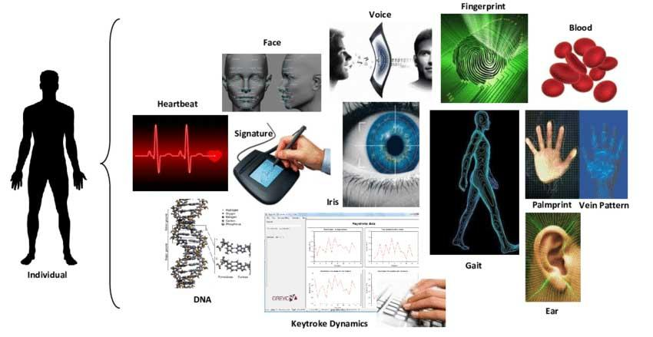
Why use Brainprints over other alternatives
Brain-prints are unique biometric traits extracted from the patterns of brain folds visible in MRI scans of the human brain. Compared to traditional biometrics like fingerprints and iris scans, brain-prints offer a significant security advantage as an individual's brain anatomy cannot be easily spoofed or recreated.
The unique folding patterns of the brain's cortex remain highly stable throughout adulthood. This stability, combined with the inherent difficulty in replicating or altering one's brain structure, makes brain-prints a compelling approach for secure biometric identification and verification.

Slide 3
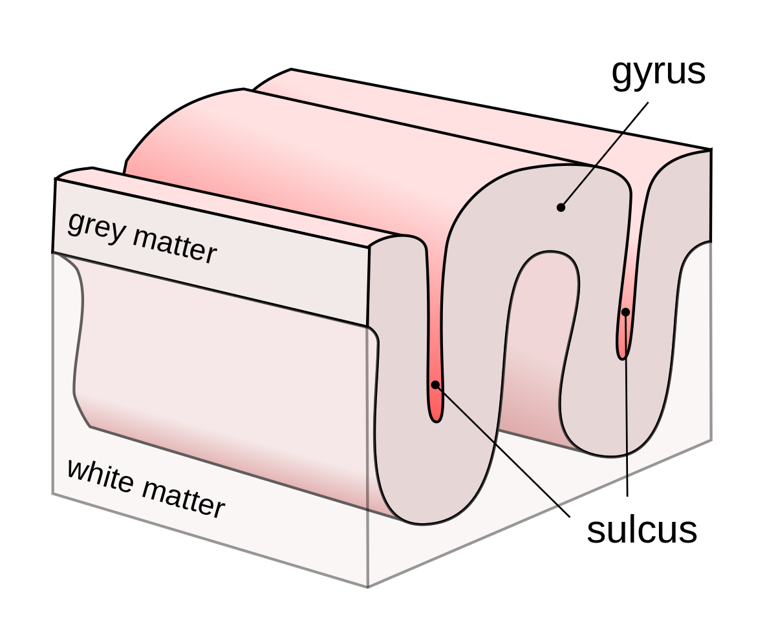
Biology of Brainprints
1. Are cortical folding patterns unique? Yes, each individual has a distinct brainprint formed by sulco-gyral patterns.
2. Are brains asymmetric? Yes, asymmetry in tissue distribution and cortical folds distinguishes each brain, even in identical twins.
3. Is brain structure heritable? Yes, genetic factors, including "jumping genes," contribute to brain folds and morphology, alongside environmental influences.
4. Are cortical folds stable? Yes, studies suggest they remain consistent throughout adulthood, making them reliable for biometric identification.

Slide 4
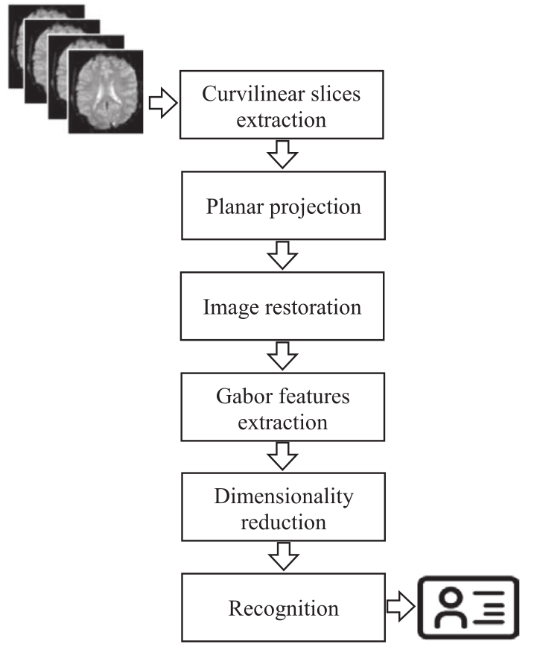
Phases of processing
1. Brain Image Acquisition: High-resolution MRI images from the OASIS dataset are used due to their non-invasive nature.
2. Image Denoising and Restoration: Techniques like Gaussian smoothing histogram equalization and contraharmonic mean filtering are applied to enhance image quality.
3. Feature Extraction: Textural features are extracted using Gabor transform to characterize cortical fold patterns.
4. Dimensionality Reduction: PCA is used to reduce data complexity while preserving discriminative information.
5. Performance Evaluation: Various classifiers assess the approach's performance, reinforcing its suitability for person identification and verification.

Slide 5
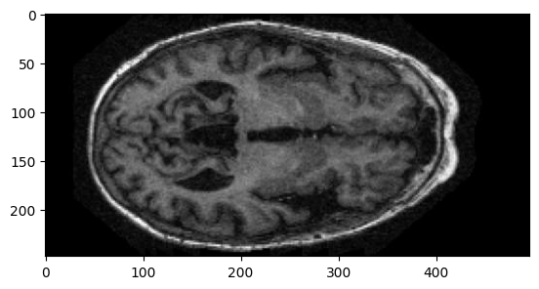
OASIS Dataset
The OASIS MRI dataset, short for Open Access Series of Imaging Studies, is a publicly available collection of neuroimaging data primarily used for research purposes in neuroscience and medical imaging. It comprises high-resolution structural MRI (Magnetic Resonance Imaging) scans from both healthy individuals and those with neurological disorders, such as Alzheimer's disease.
This set consists of a cross-sectional collection of 416 subjects aged 18 to 96. For each subject, 3 or 4 individual T1-weighted MRI scans obtained in single scan sessions are included.

Slide 6
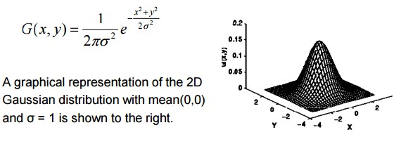
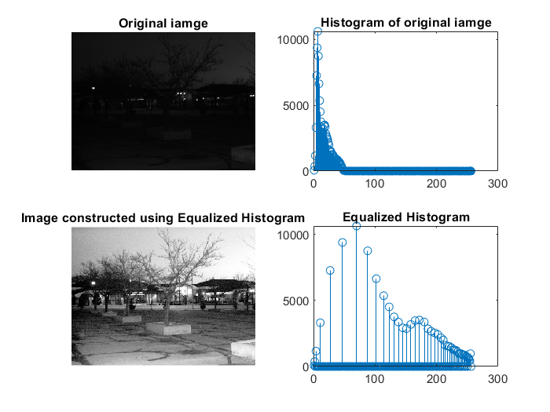

Preprocessing the MR Images
Gaussian Filtering:
Objective: Reduce noise and blur edges in images.
Method: Convolve the image with a Gaussian kernel, emphasizing central pixels.
Application: Preprocessing step in image denoising and restoration.
Histogram Equalization:
Objective: Enhance contrast and improve brightness distribution.
Method: Rearrange pixel intensity values to spread across entire histogram.
Application: Improving visibility in low-contrast images.
Contraharmonic Mean Filtering:
Objective: Remove noise while preserving image details.
Method: Calculate mean of pixel values raised to a power, where the power can be adjusted for noise removal.
Application: Effective in reducing salt-and-pepper noise in images.

Slide 7
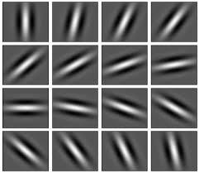
Feature extraction
Gabor Transform: A Brief Overview
Objective: Extract textural features from images, particularly useful for analyzing patterns like cortical folds in brain MRI scans.
Method: Gabor transform combines Gaussian function and sinusoidal wave to analyze local spatial frequency content.
Mathematics: Given an image, Gabor transform generates a set of filtered images across different frequencies and orientations.
Benefits:
Captures both frequency and orientation information.
Effective for feature extraction in texture analysis tasks.
Applications:
Image processing: Texture analysis, edge detection.
Biomedical imaging: Brain MRI analysis, tumor detection.

Slide 8
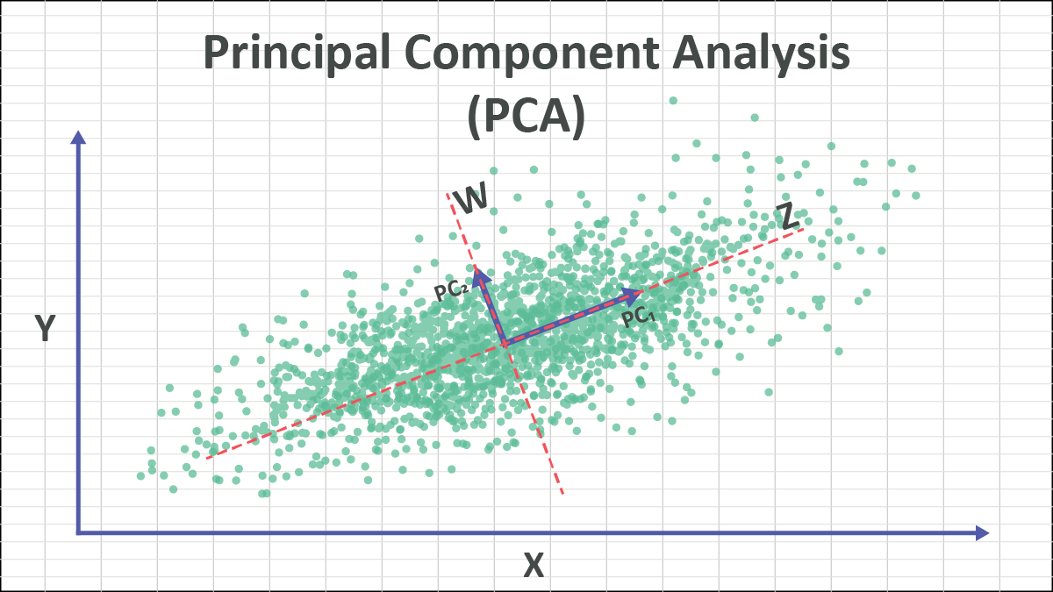
Dimensionality Reduction
Principal Component Analysis (PCA)
Objective: Reduce dimensionality while preserving data variance, aiding in data visualization and analysis.
Method: PCA transforms original features into a new set of orthogonal variables, called principal components (PCs), ordered by variance.
Mathematics:
Compute covariance matrix of input data.
Derive eigenvectors and eigenvalues from covariance matrix.
Select top eigenvectors (PCs) corresponding to largest eigenvalues.
Project data onto selected PCs to obtain lower-dimensional representation.
Benefits:
Simplifies complex data structures.
Retains essential information.
Removes multicollinearity among features.
Applications:
Dimensionality reduction in image processing, bioinformatics, finance.
Pattern recognition, feature extraction.

Slide 9
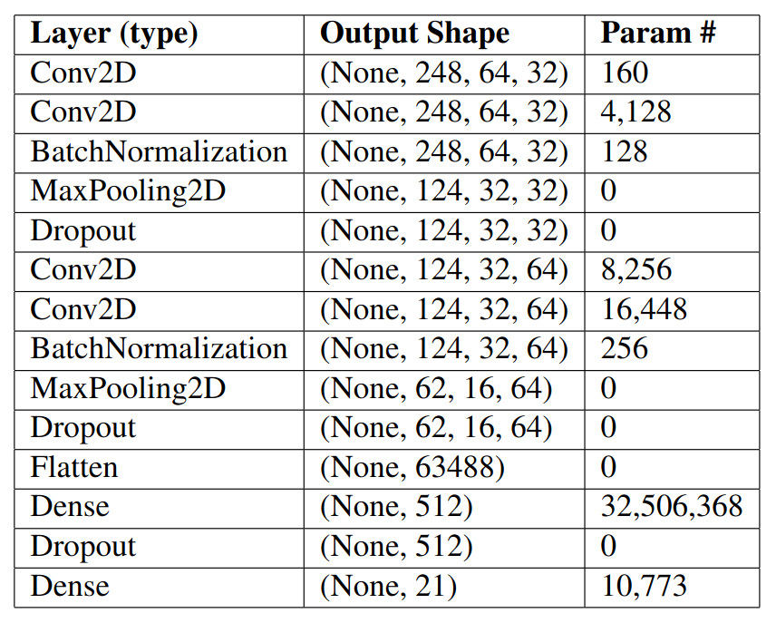
CNN Model Architecture
CNN Architecture Overview:
Conv2D: Applies 2D convolution, producing feature maps.
BatchNormalization: Normalizes activations, aiding training and reducing overfitting.
MaxPooling2D: Performs spatial data reduction, retaining vital information.
Dropout: Implements regularization to prevent overfitting.
Flatten: Converts data into 1D array for fully connected layers.
Dense: Fully connected layers with ReLU activation.
Output Layer: Dense layer with 21 units representing output classes.

Slide 10
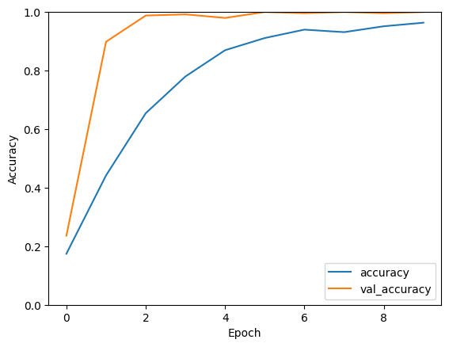
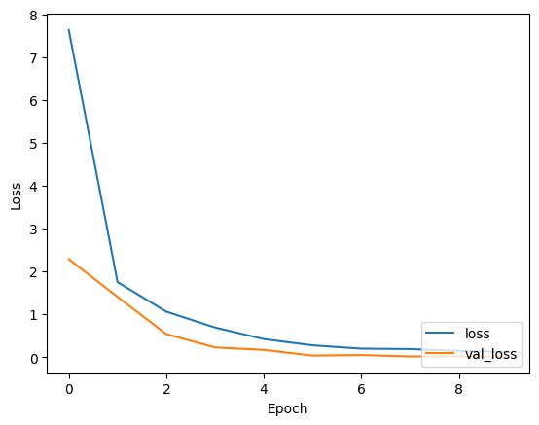
Training and Evaluation
Model Training and Evaluation
Accuracy Curves:
Training accuracy increases smoothly.
Validation accuracy rises steeply initially, then levels off.
Final accuracy: 96.30%, with validation almost at 100%.
Loss Curves:
Training loss decreases rapidly at first, then flattens.
Validation loss follows a similar trend but settles higher.
Final training loss: 0.1130, validation loss: 0.0059.
Generalization:
Minimal overfitting observed, indicated by small gap between training and validation losses.

Slide 11
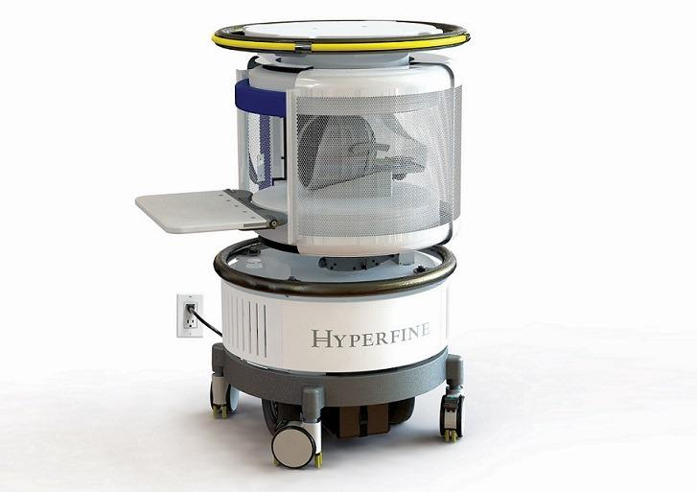
Future Scope
Moving forward, we propose expanding the database to include longer-term and diverse age group data, enhancing the accuracy and stability assessment of brainprints across demographics. Additionally, advocating for compact, cost-effective MRI devices tailored for security applications would facilitate wider deployment. Furthermore, extending the application beyond individual recognition to areas such as brain asymmetry analysis, age and gender estimation (with forensic potential), and studying genetic influences on brain morphology can provide new insights and broaden the utility of brainprints.

