Slide 1
Face detection attendance system
By
B.NAGA BHUSHAN 245521748005
B.SURYA RUSHI 245521748007
P.MAHESH 245521748048
TEAM-2
GUIDE:
MRS.K.HARINI
DEPT:
CSE[AI&ML]

Slide 2
Introduction
This project proposes to develop a face detection attendance system using machine learning. The system will automatically mark attendance for students by recognizing their faces. This will save time and effort compared to manual attendance marking, and it will also be more accurate.

Slide 3
LITERATURE SURVEY
E.Varadharaja and colleagues all suggested a face recognition-based method for automatic attendance. There are four components to the device. The first is Background Subtraction, in which the background of the image is removed. The image is subtracted, leaving only the face in the image. Face detection and cropping is the second component. Only the faces are cropped and stored in the images. The third step involves using the Eigenvalue method to recognise images. Eigen vectors are determined using formulae in this system, and images are recognised. Between the stored and testing images, the Euclidean distance is determined. After that, attendance is registered. Face recognition is difficult with this approach, which requires only simple hardware installation. The eigen vector form used in this paper has a 60-70 percent accuracy. As a result, the suggested system will detect faces using Haar features rather than the eigen vector, which yields better results than the eigen vector solution.
Shireesha Chintalapati, M.V. Raghunadh, and colleagues identified the various strategies for implementing a face recognition-based attendance monitoring system. There are two sections of the process. The first is the face detection method, and the second is the face recognition method. The Haar-features, integral graphic, Adaboost algorithm, and cascade function are the four key components of the Viola-Jones face detection algorithm, can be used to detect faces

Slide 4
Problem statement
Manual attendance marking is a time-consuming and error-prone process. Teachers or employees have to call out names and mark them off on a list, which can be tedious and inaccurate. Proxy attendance is also a common problem, where students or employees have someone else mark their attendance for them.

Slide 5
Objectives
Automate attendance marking: Develop a system that automatically marks attendance for individuals based on their facial recognition, eliminating the need for manual processes.
Improve accuracy and reduce errors: Achieve a high level of accuracy in face detection and recognition to minimize instances of missed or mistaken attendance.
Enhance efficiency and speed: Ensure the system functions quickly and efficiently, marking attendance promptly without significant delays.
Increase user convenience: Design a user-friendly system that requires minimal interaction from individuals, improving ease of use.
Scalability and adaptability: Develop a system that can be easily adapted to different environments and accommodate changes in user base.
Real-time performance: Strive for real-time processing of images and attendance marking, minimizing latency.

Slide 6
Proposed Methodology
It is a data-driven, multi-step approach that focuses on building and integrating separate models for face detection and recognition. It emphasizes continuous improvement through monitoring, error analysis, and model retraining.
KEY ASPECTS:
1. .Face detection using Haar-cascade Classifier
2. Training the Algorithm
3. Face Recognition using Local Binary Pattern Histogram (LBPH
4. Extracting the Histograms

Slide 7
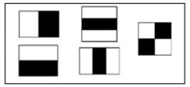
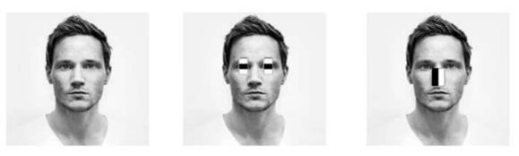
Face detection using Haar-cascade Classifier: Viola and Jones invented the Haar- cascade system, which trains machine learning to detect objects in an image. It can be used to detect faces in this context. The fundamental idea behind the Haar-based face detector is that the region with the eyes should be darker than the forehead and checks when looking at most frontal images, and the region with the mouth should be darker than the cheeks, and so on. It normally goes through about 20 levels of measurements like this to decide whether or not it's a face, so it has to do so in every possible place in the picture and with every possible size of the face, resulting in thousands of checks per image
TYPES OF HAAR FEATURES HAAR FEATUTES APPLIED ON AN IMAGE

Slide 8

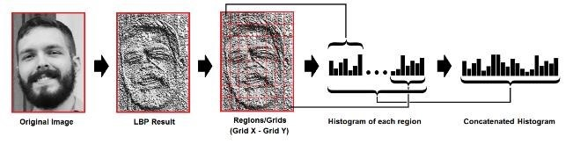
Training the Algorithm: we are training the Algorithm with the help of facial images of the students. we also need an unique identification number for each image which helps in recognition. All the images of the student should have a unique identification number.
Face Recognition using Local Binary Pattern Histogram (LBPH): The LBPH's first procedural step is to create an intermediate image that highlights the facial features of the original image and best reflects it. The algorithm accomplishes this by using the idea of a sliding window, which is dependent on the parameters radius and neighbours. This technique is depicted in the diagram below:
Extracting the Histograms: Using the Grid X and Grid Y parameters, we can now divide the map into multiple grids using the diagram generated in the previous step, as seen in the following image:

Slide 9
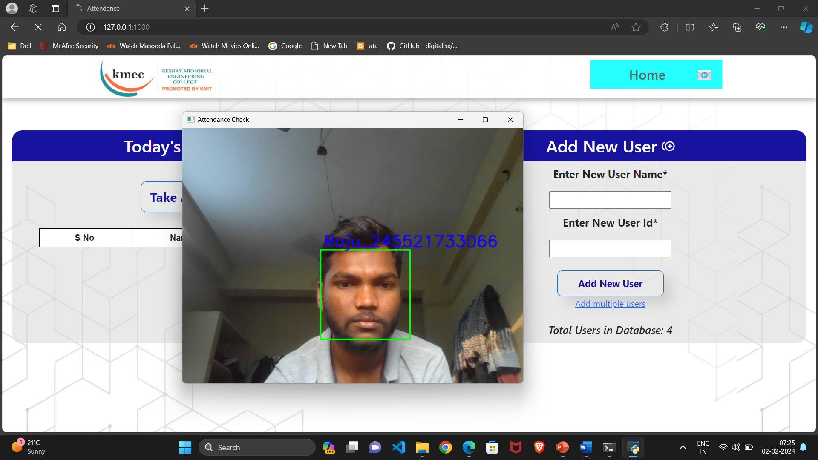
Result

Slide 10
Test cases
Sl.NO | Action | Inputs | Expected Output | Actual Output | Test Result
1. | Capture Images | A Person’s Face | Images are Captured and Stored | Images are captured and stored | Pass
2. | Train the Dataset | Stored images of a face | Create Histograms and store values | Histograms are created and values are stored | Pass
3. | Face Recognition | A live stream of a person’s face | Name of detected person is displayed on the screen | Name of detected person is displayed on the screen | Pass
4. | Update attendance for multiple people at once | Multiple faces from a live video stream | Update the Attendance for all faces detected | Attendance is updates only for a single face | Fail
5. | Detect more than 5 faces | 5 people facing the camera | Detect all 5 faces facing the camera | Only 3 faces are detected at a time | Fail

Slide 11
conclusion
The aim of implementing this system in place is to save time and money by reducing manpower. This method demonstrates a deeper understanding of the algorithm and a rigorous approach to accurately recognising users. The end result shows the system's ability to deal with improvements in face posing and projecting, as well as changes in room. According to facial recognition through machine learning, face detection addresses the problem of change in environment when the original image is transformed into a HOG representation that captures the key features of the image independent of image brightness
The accuracy is 92%.

Slide 12
future scope
The future scope of face detection attendance system using machine learning is vast and exciting!
Enhanced Accuracy and Robustness:
Continuously improve the accuracy of both face detection and recognition models .
Enhance the system's robustness to handle a wider range of lighting conditions, poses, occlusions, and facial expressions.
Additionally, the device can be used during elections to identify voters by recognizing their faces.
Advanced Features and Functionalities:
Implement liveness detection to prevent spoofing attempts using photos or videos.
Develop mobile applications for convenient system access and attendance self-service.
Privacy and Security:
Implement robust data anonymization and encryption techniques to protect user privacy.
Adhere to relevant data privacy regulations and ethical guidelines.

Slide 13
reference
Hajar Filali Jamal Riffi Adnane Mohamed Mahraz Hamid Tairi, Multiple face detection based on machine learning, 978-1-5386-43969/18/$31.00 c 2018 IEEE
(https://ieeexplore.ieee.org/abstract/document/8354058).
Shubhobrata Bhattacharya, Gowtham Sandeep Nainala, Prosenjit Das and Aurobinda Routray, Smart Attendance Monitoring System (SAMS): A Face Recognition based Attendance System for Classroom Environment, 2018 IEEE 18th International Conference on Advanced Learning Technologies, 2161- 377X/18/$31.00 ©2018 IEEE DOI 10.1109/ICALT.2018.00090.
E.Varadharajan, R.Dharani, S.Jeevitha, B.Kavinmathi, S.Hemalatha,Automatic attendance management system using Gender Classification, IEEE International Conference on Computer, Communication, and Signal Processing (ICCCSP-2017), 978-1-5090-3716-2/17/$31.00 ©2017 IEEE.

Slide 14
Thanks note
We extend our sincere gratitude to our esteemed Project Coordinators and Reviewers for their invaluable contributions to the Face Detection Attendance System. Your guidance and meticulous reviews have played a pivotal role in shaping this project with excellence. We truly appreciate your commitment to ensuring its success. Thank you for your unwavering support and expertise.

