Slide 1
Marketing Campaign Data Storytelling & Statistical Validation
Task 4 – Apex Planet Internship
Presented by: Surya Prakash Sharma

Slide 2
Project Overview
• Analyzed marketing campaign dataset.
• Explored customer demographics and spending behavior.
• Built visual dashboard to identify business insights.
• Applied statistical hypothesis testing to validate findings.

Slide 3
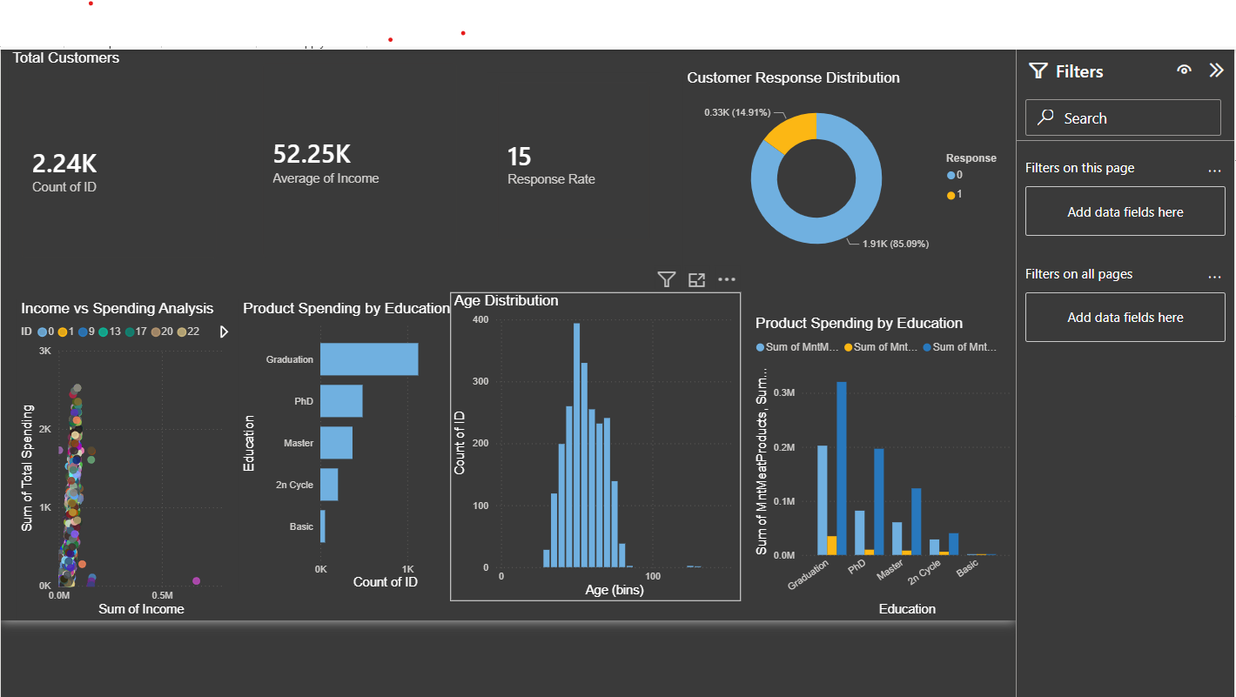
Marketing Dashboard

Slide 4
Key Business Insights
• Total Customers: 2,240
• Average Income: ₹52,247
• Average Spending: ₹605.8
• Campaign Response Rate: 14.91%
• High-income customers spend significantly more.
• Graduation customers contribute the highest spending.
• Customer segmentation can improve campaign targeting.

Slide 5
Hypothesis Testing
Null Hypothesis (H₀)
Income has no significant effect on customer spending.
Alternative Hypothesis (H₁)
Income has a significant effect on customer spending.
Statistical Test Used
Independent Two Sample T-Test

Slide 6
Statistical Results
• T Statistic: 52.964
• P Value: 0.000
• Decision: Reject Null Hypothesis
• Conclusion: Income has a statistically significant effect on customer spending.

Slide 7
Business Recommendations
• Focus campaigns on high-income customers.
• Improve targeting using customer segmentation.
• Offer personalized promotions based on education level.
• Monitor dashboard KPIs regularly.

Slide 8
Conclusion
• Dashboard successfully analyzed customer behavior.
• Statistical testing validated business insights.
• Findings support data-driven marketing decisions.
• Thank You!

