Slide 1

Notes:
SPEAKER NOTE (30 sec) Introduce yourself. One-liner: "End-to-end clinical ML pipeline that turns ICU time-series into grounded narratives and decision-support briefs."

Slide 2
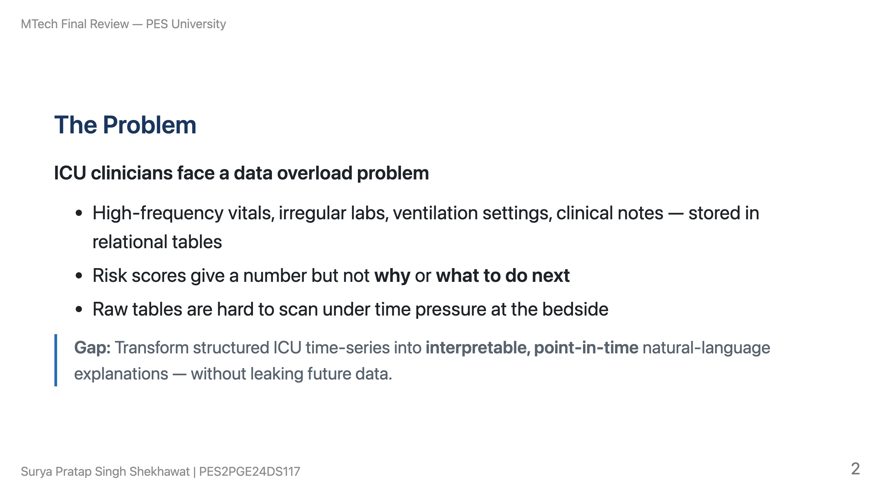
Notes:
SPEAKER NOTE (90 sec) Emphasize temporal leakage — summarizing a full stay at hour 5 using hour 10 labs is clinically wrong AND an ML serving bug.

Slide 3
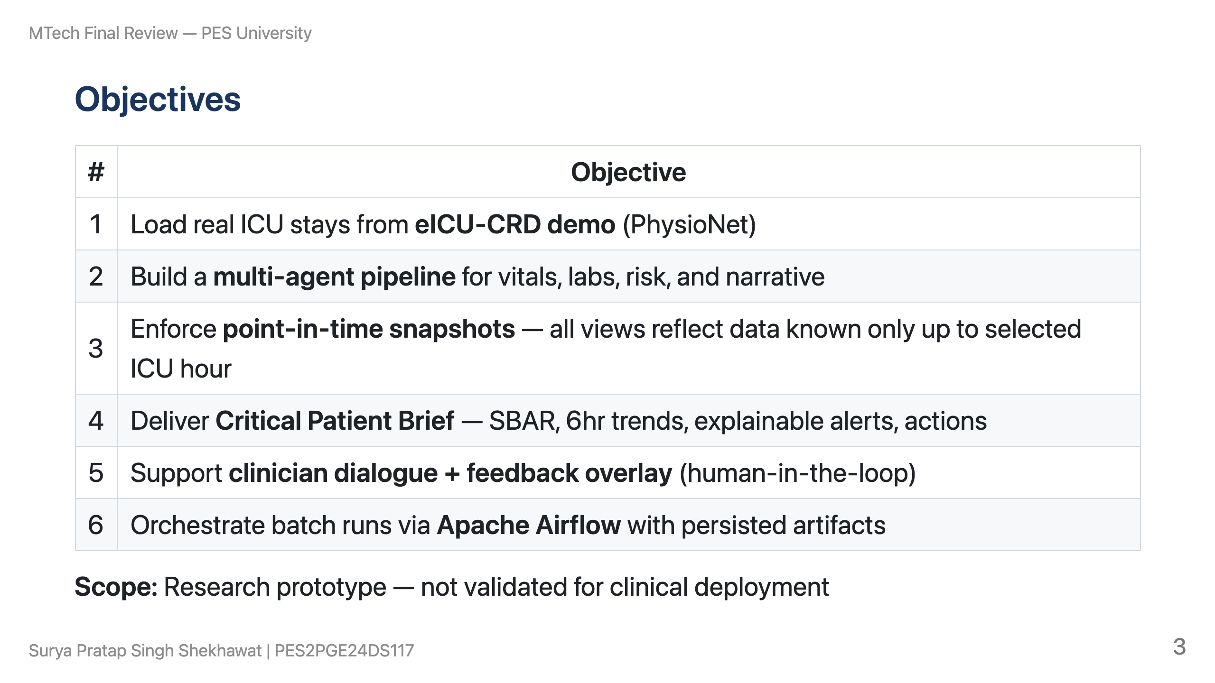

Slide 4
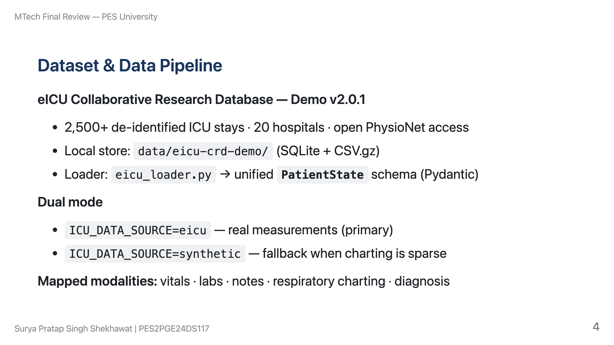

Slide 5
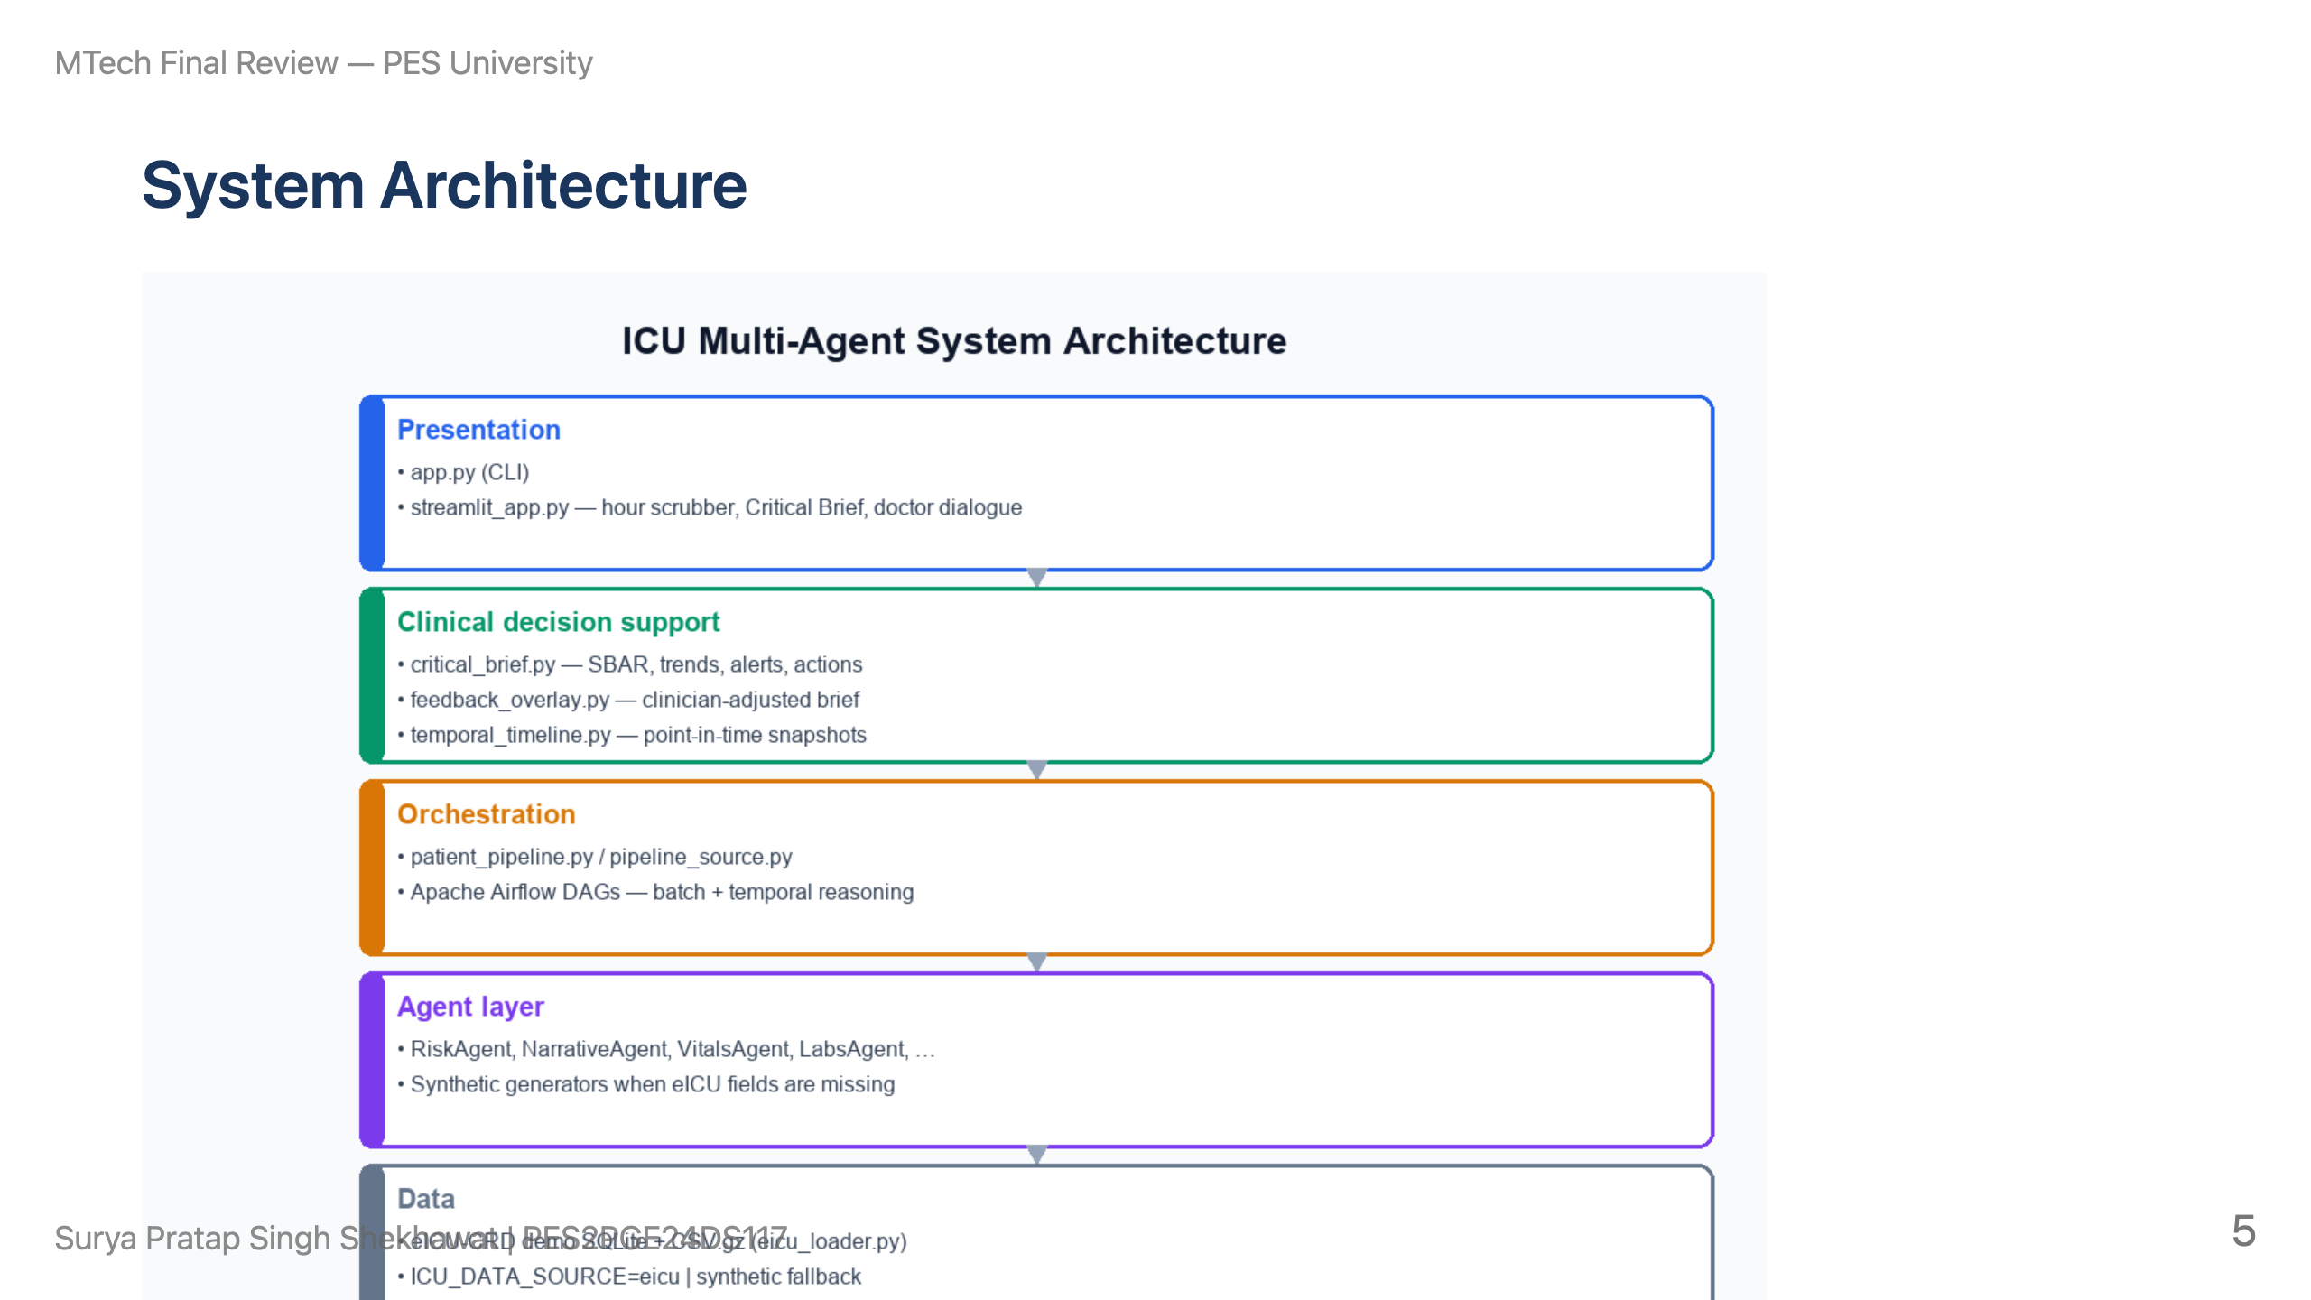

Slide 6
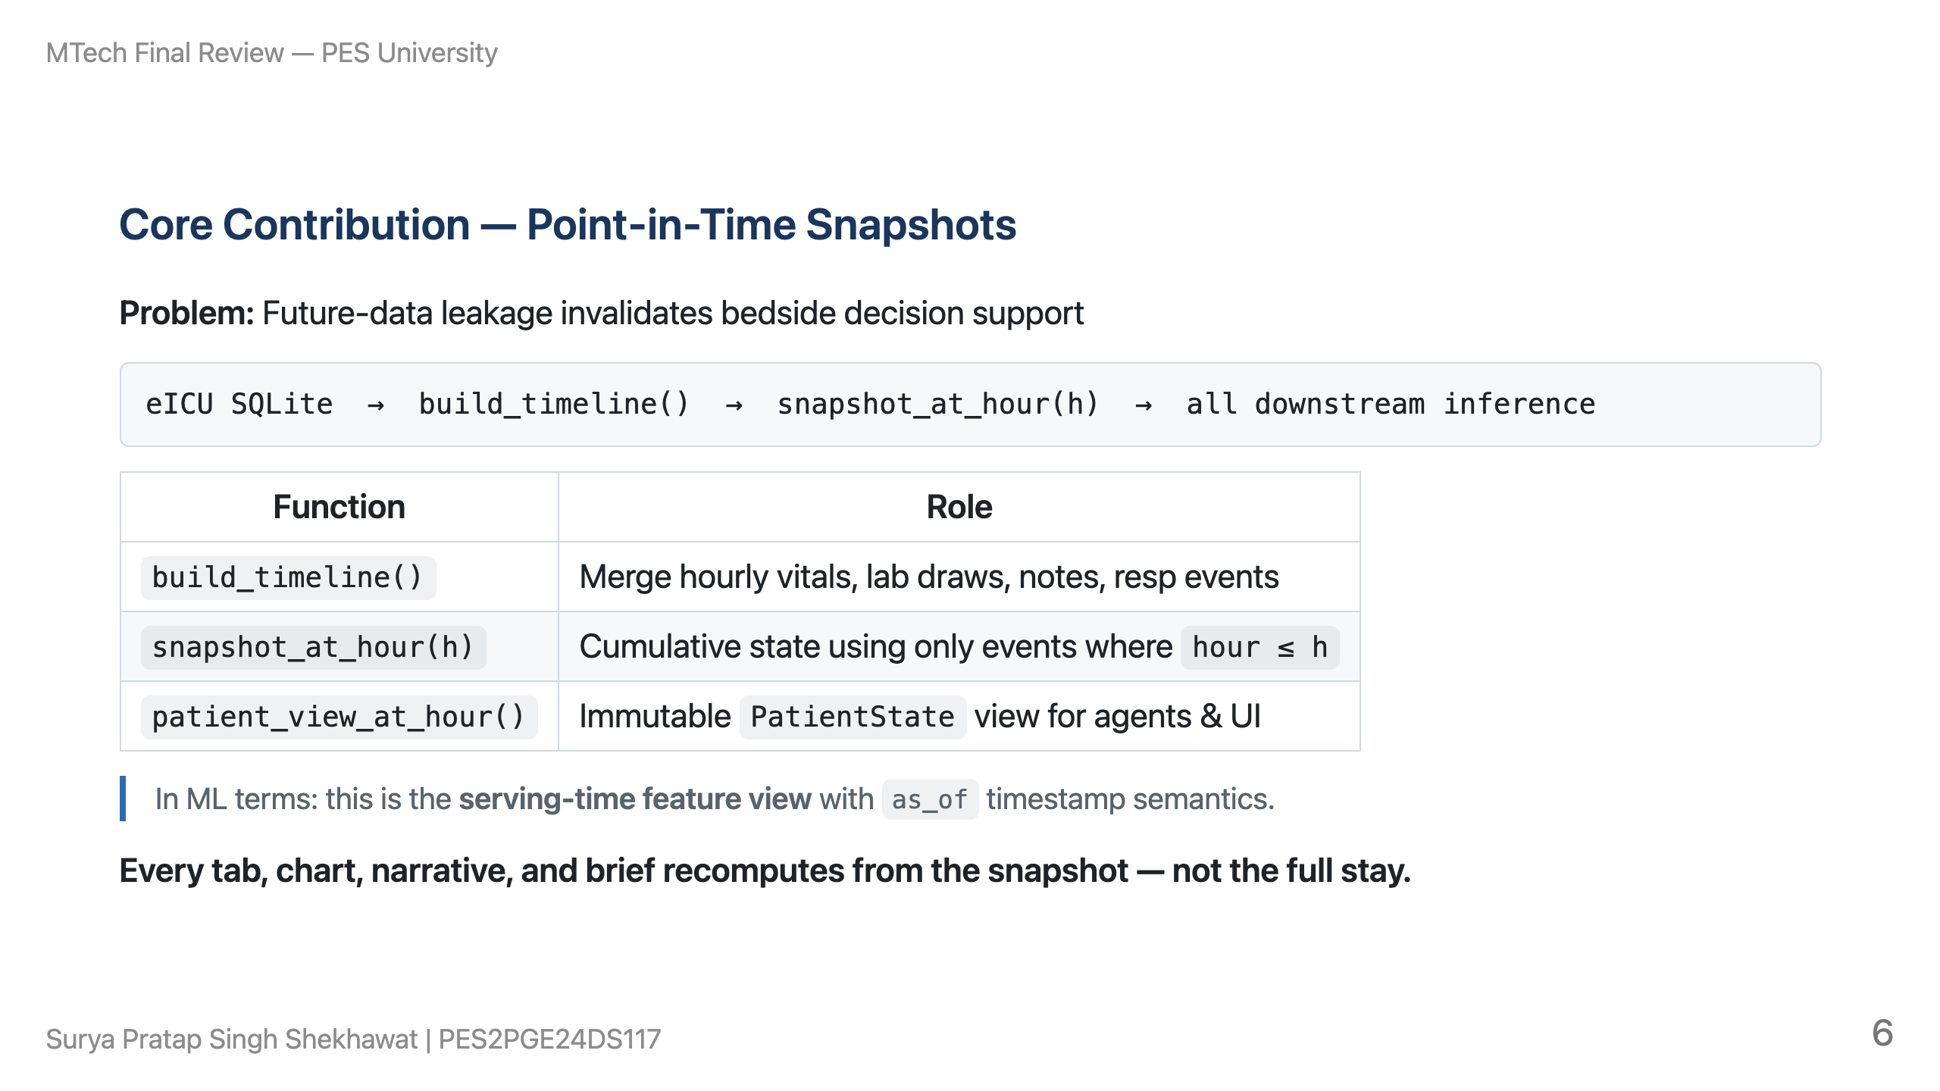

Slide 7
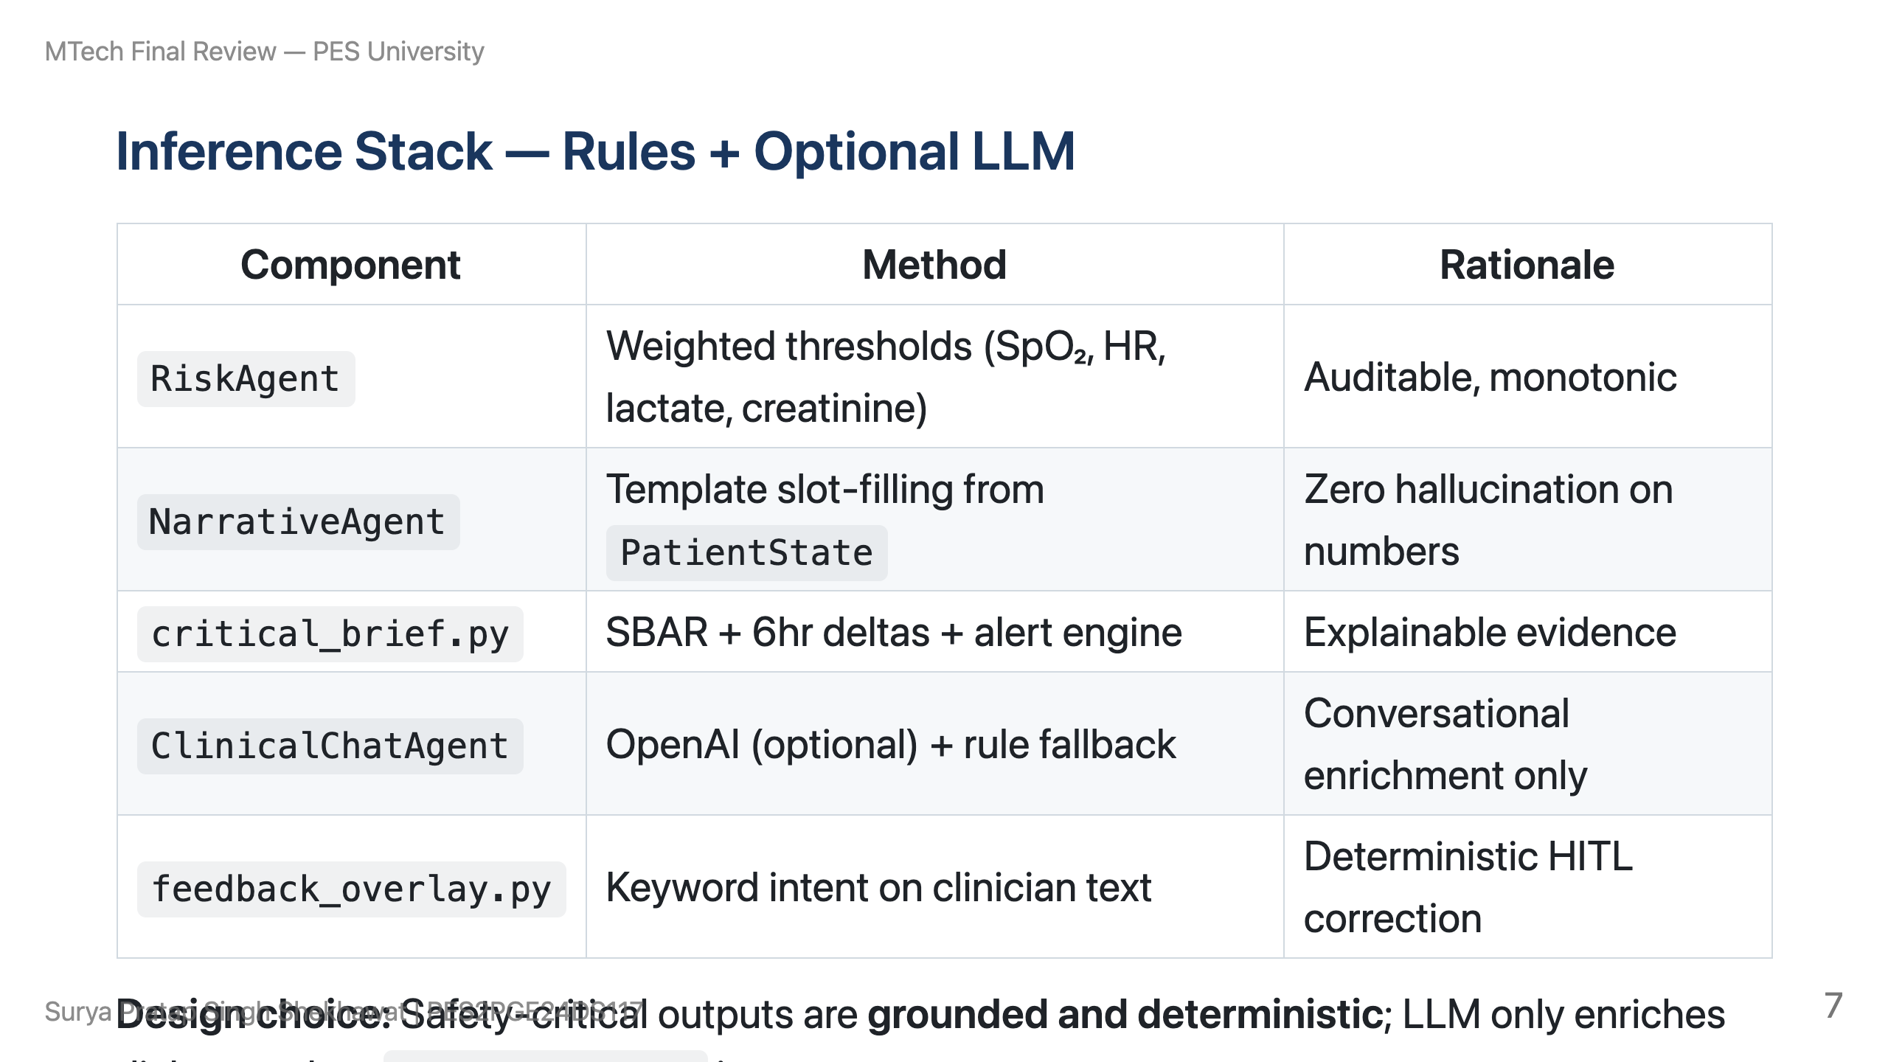

Slide 8
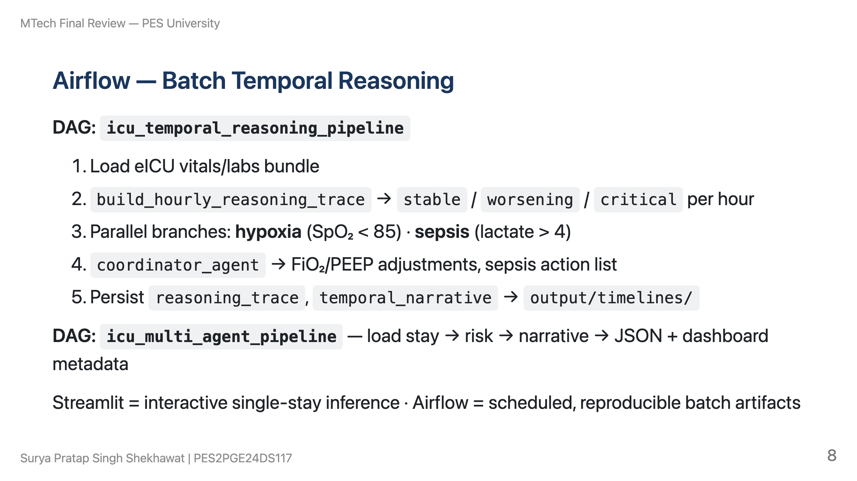

Slide 9
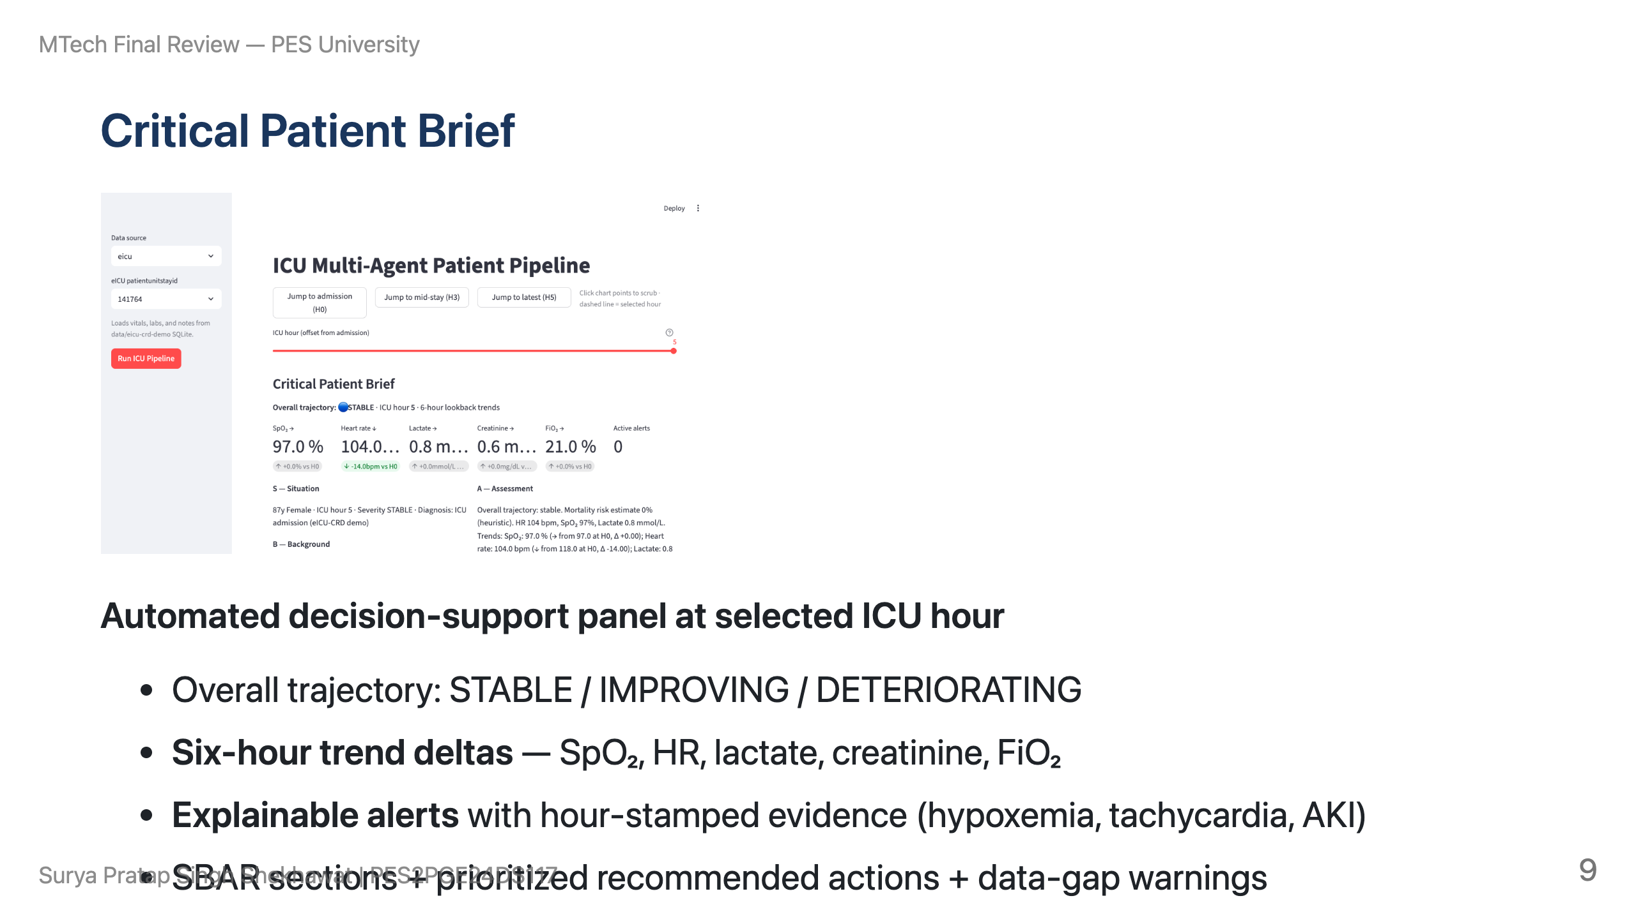

Slide 10
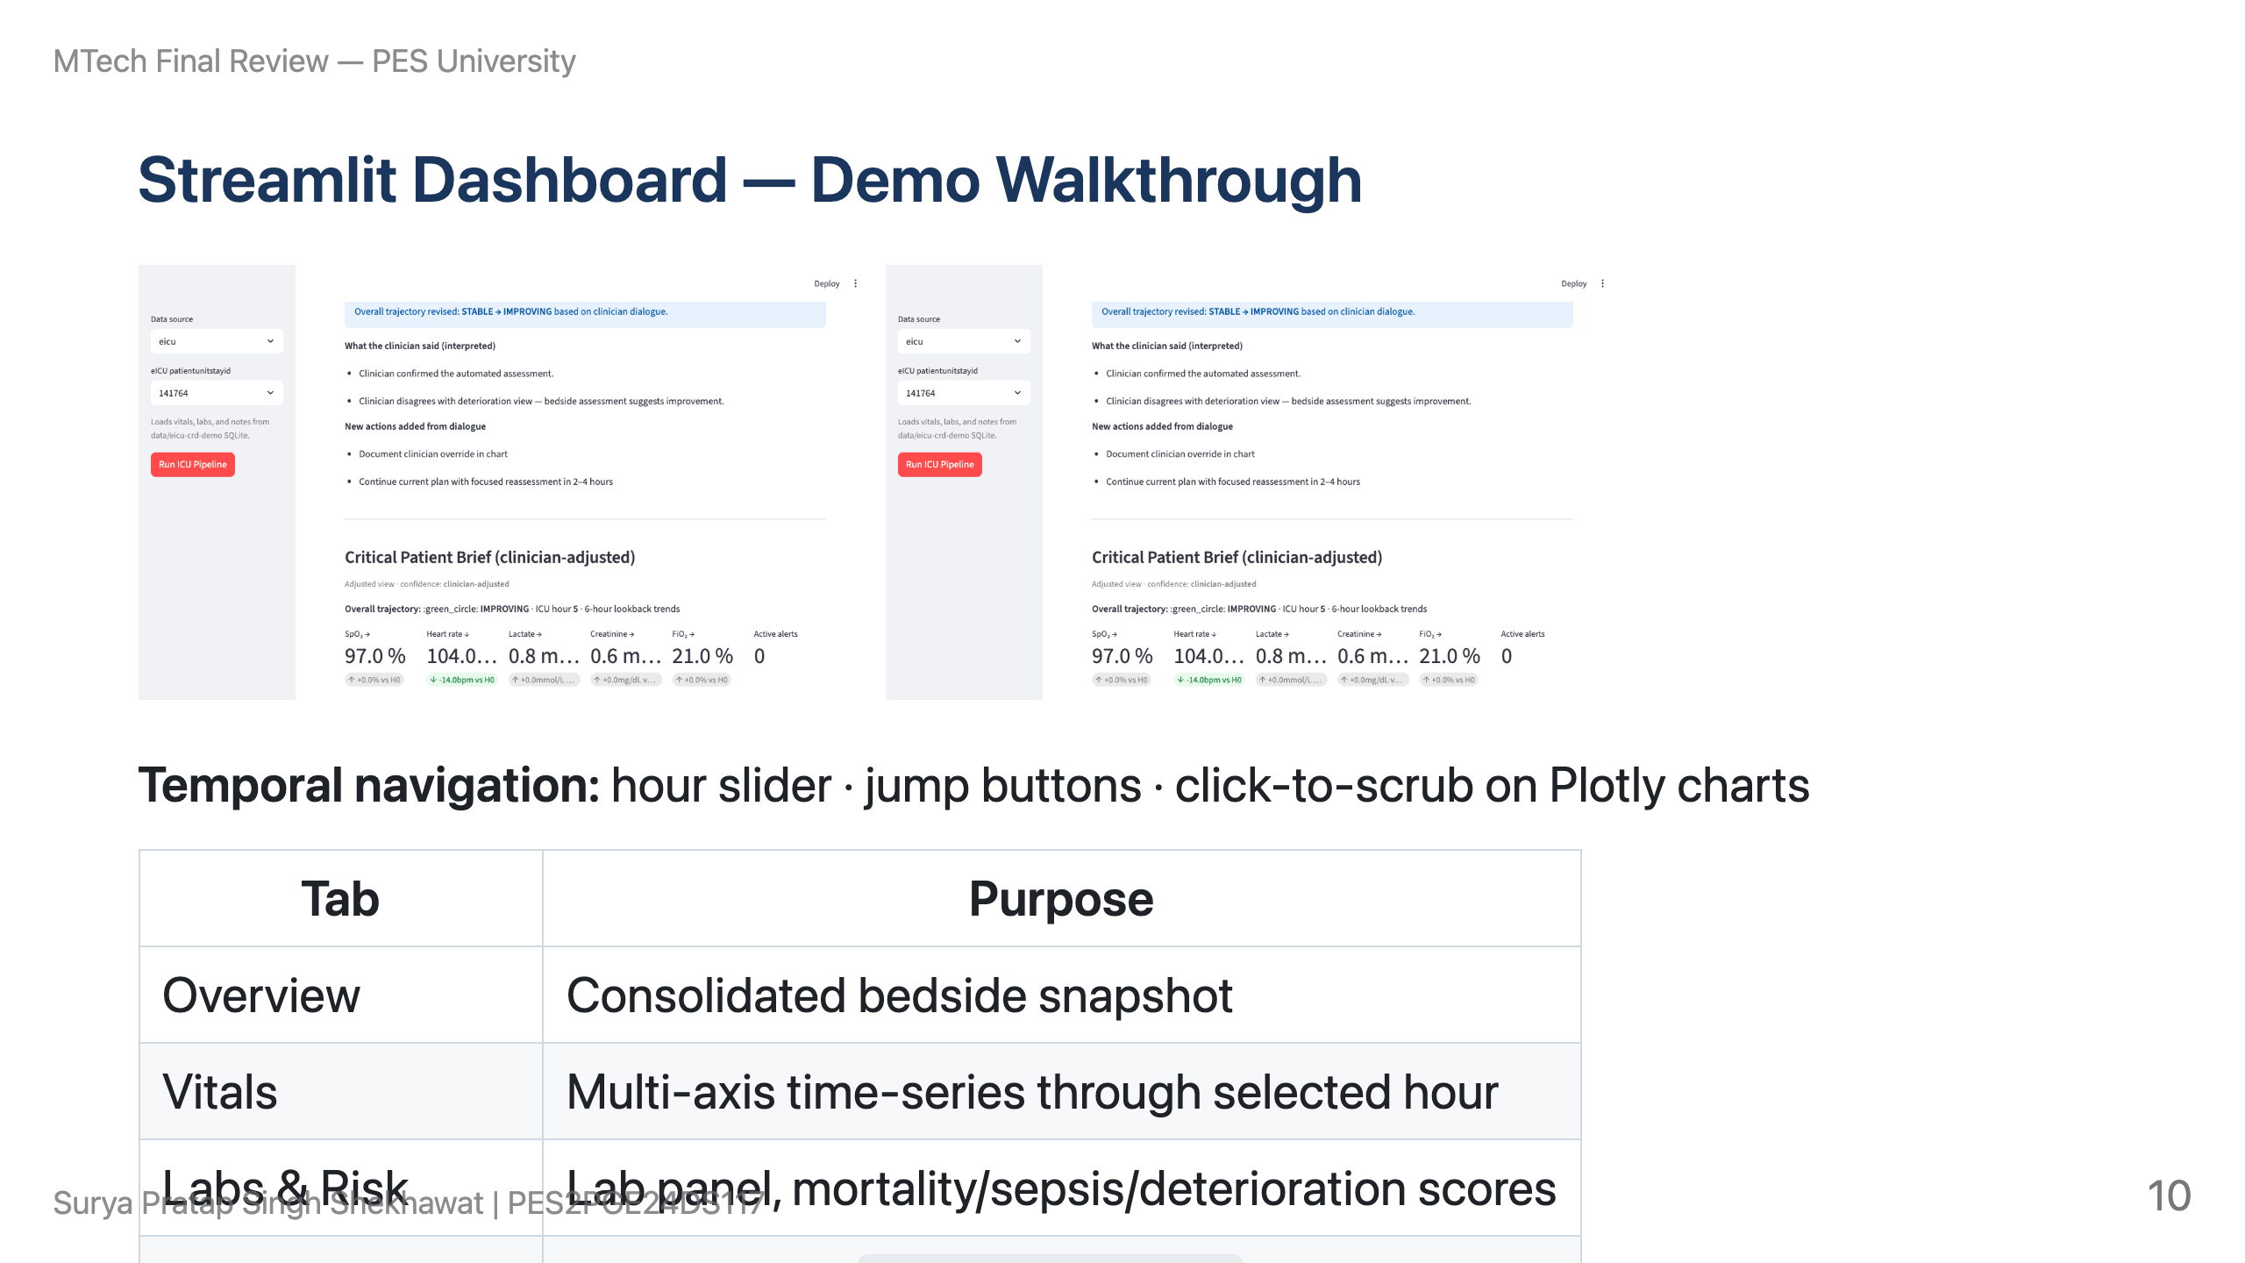

Slide 11
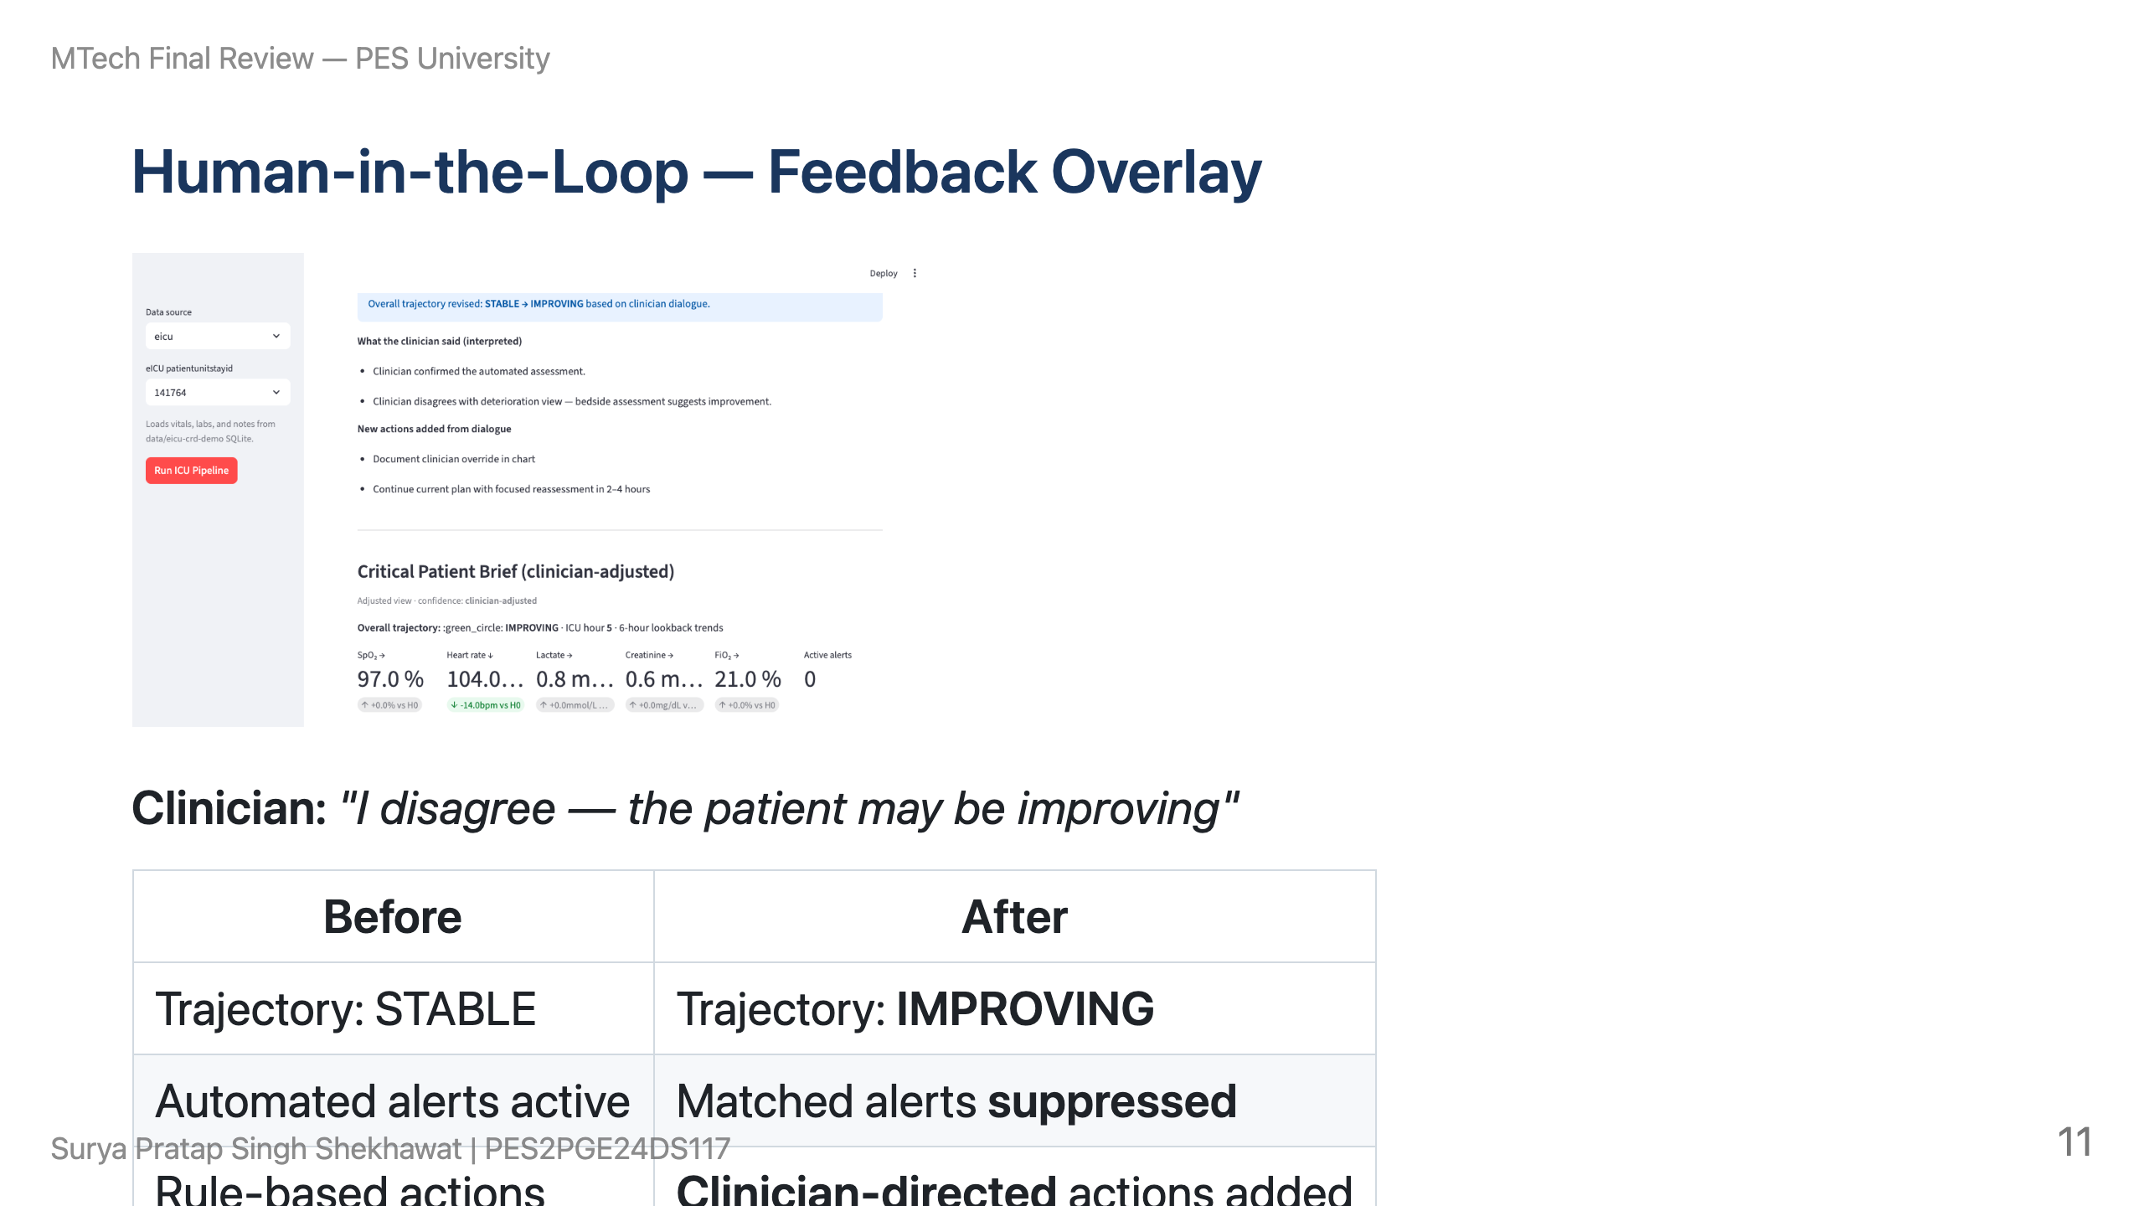

Slide 12
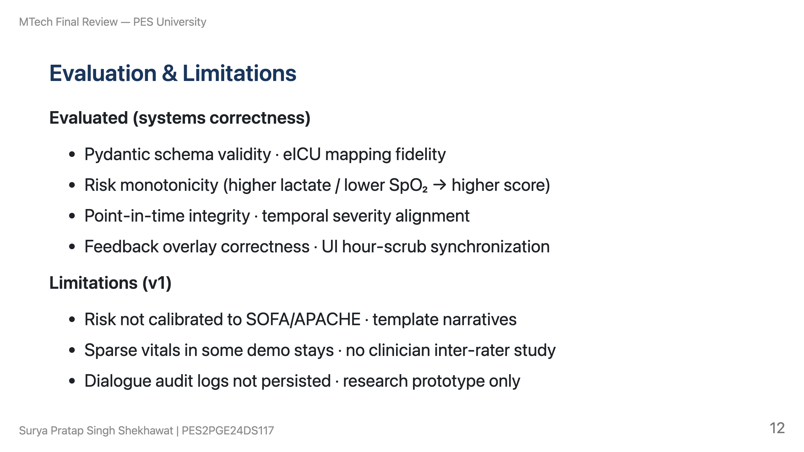

Slide 13
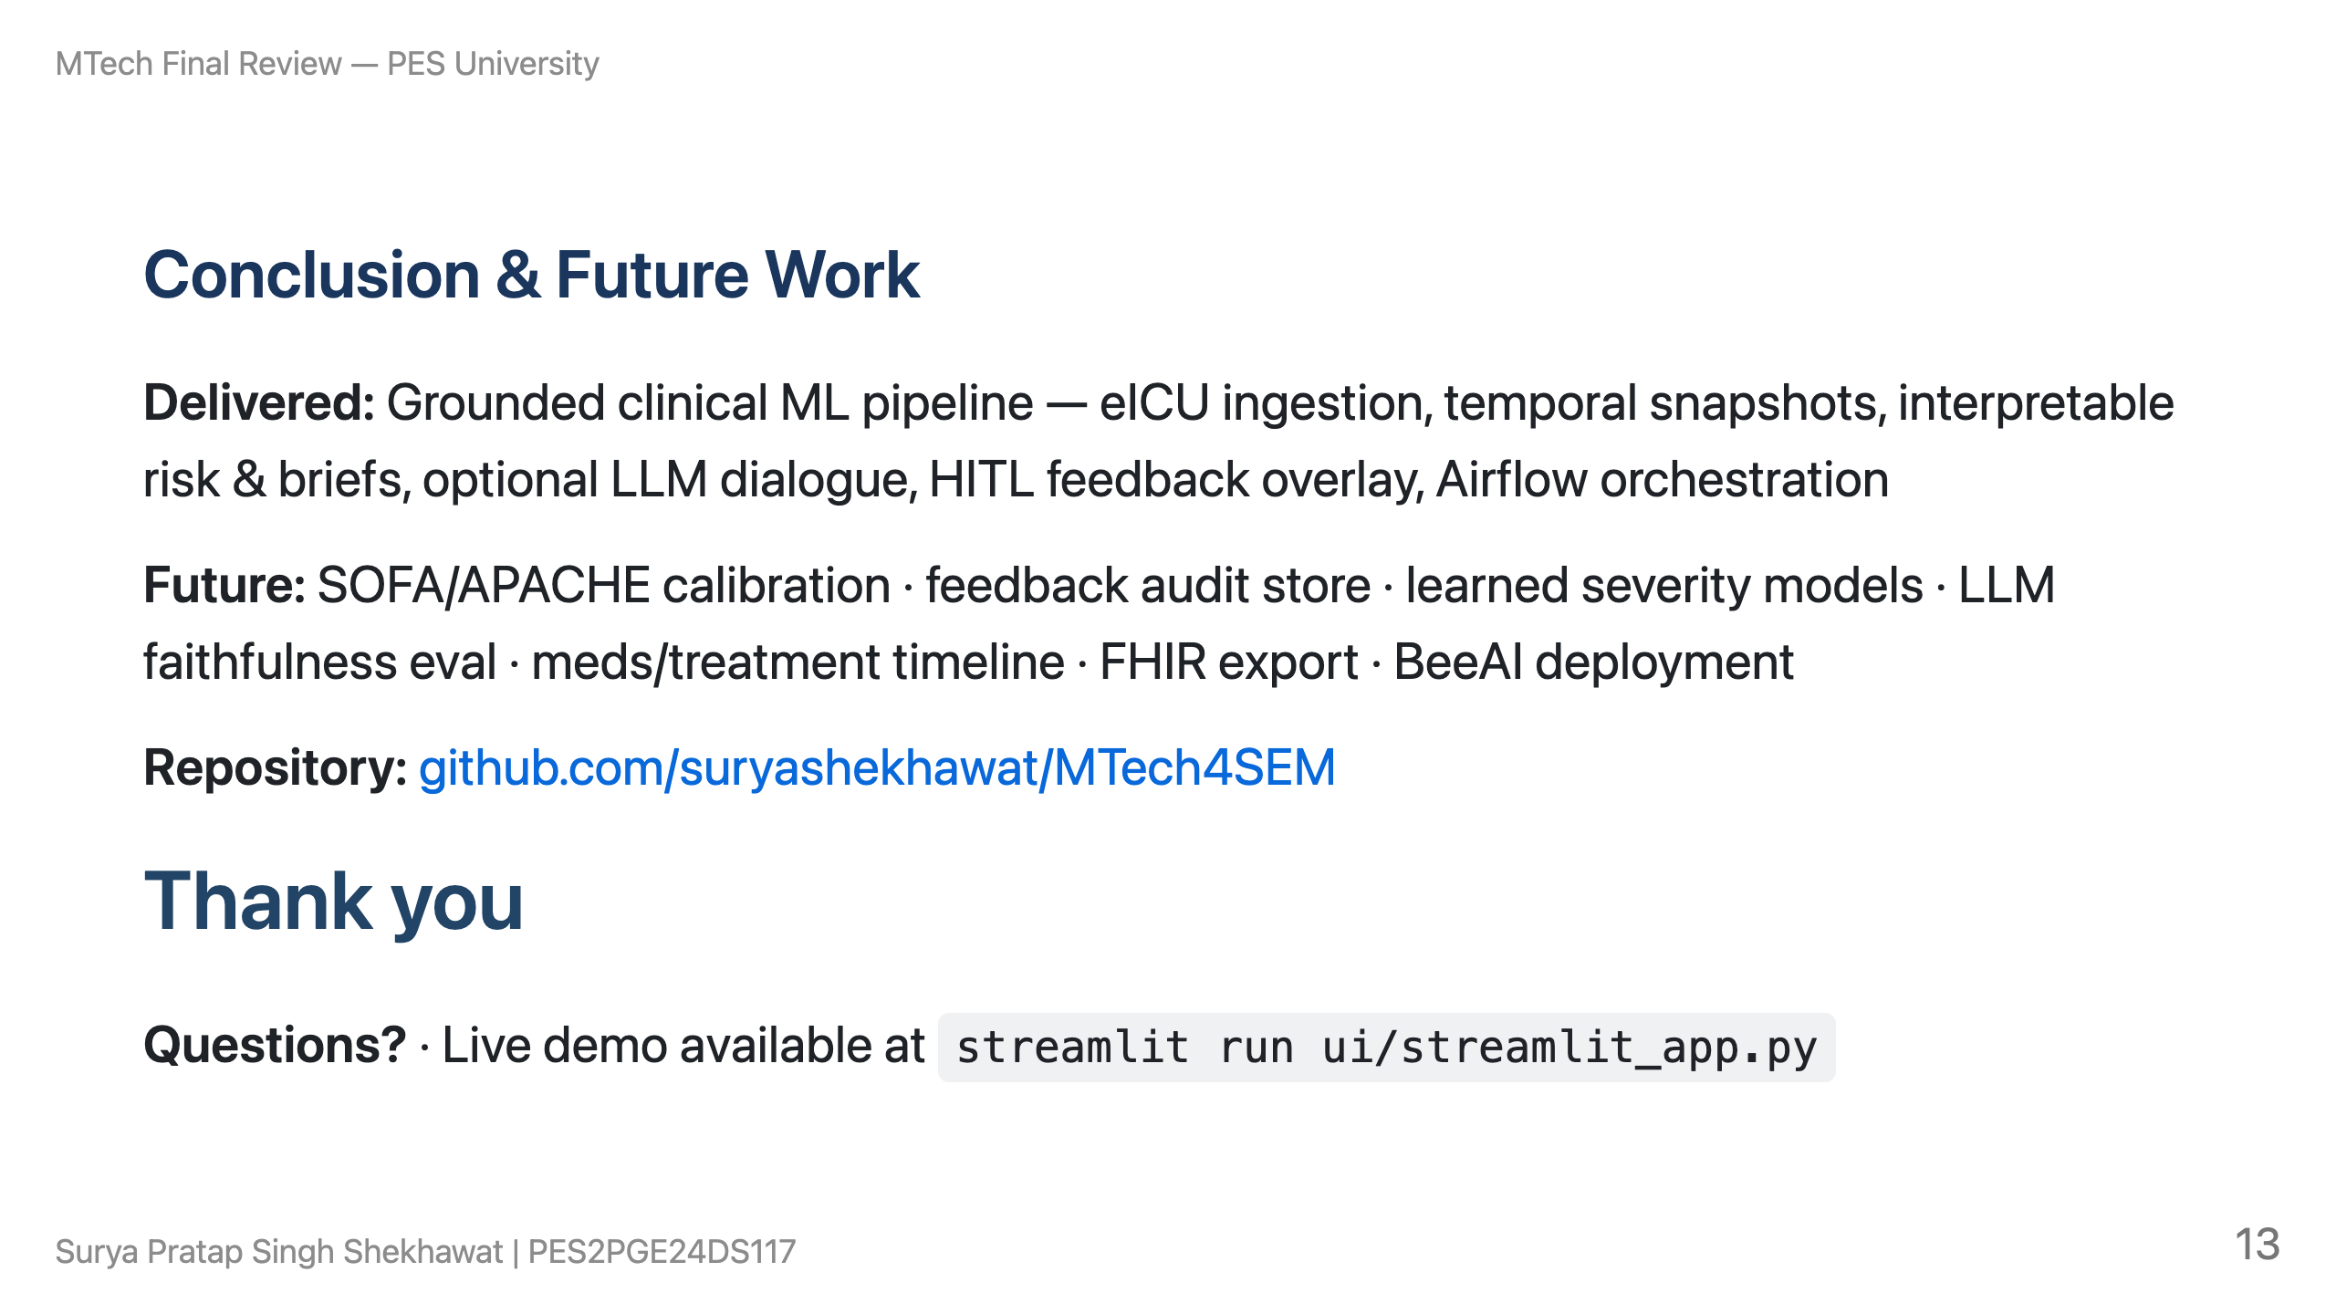
Notes:
SPEAKER NOTE (30 sec) Offer live demo or deep-dive into snapshot engine / feedback overlay.

