Slide 1
DBMS PROJECT-BASED LEARNING · REVIEW 2
Normalized Database Design & SQL
Implementation — Veterinary Clinic and
Animal Treatment Management System
3NF Normalization · DDL with Integrity Constraints · Sample Data & SQL Queries · Views
Student Name: [Your Name]
Reg. No / Roll No: [Your Reg. No.]
Course: Database Management Systems
Review 2 · Week 11

Slide 2
RECAP & AGENDA
From Review 1 to Review 2
REVIEW 1 RECAP
REVIEW 2 AGENDA
✓
Problem statement, scope & objectives defined
→
Normalize the schema to 3NF + functional dependencies
✓
14 core entities identified
→
Concise data dictionary for every table
✓
ER diagram modeled with relationships
→
DDL scripts enforcing all 5 business rules
✓
Initial (unnormalized) relational schema drafted
→
Sample data + SQL: joins, subqueries, aggregation, views
02

Slide 3
A WORKED EXAMPLE FROM OUR OWN SCHEMA
Normalizing to 3NF
In the Review 1 draft, the Animal table stored both breed_id and species_id directly — but Breed already determines Species. That's a transitive dependency, which 3NF forbids.
BEFORE (Review 1 draft) — violates 3NF
AFTER — normalized to 3NF
Animal (
animal_id PK,
animal_name,
breed_id FK -> Breed,
species_id FK -> Species,
owner_id FK -> Owner
)
animal_id -> breed_id
-> species_id
(transitive dependency)
Animal (
animal_id PK,
animal_name,
breed_id FK -> Breed,
owner_id FK -> Owner
)
Breed (
breed_id PK,
breed_name,
species_id FK -> Species
)
-- species_id now reached
-- via Breed only.
→
03

Slide 4
EVERY NON-KEY ATTRIBUTE DEPENDS ONLY ON ITS TABLE'S KEY
Functional Dependencies
Owner
owner_id → owner_name, phone, email, address
Diagnosis
diagnosis_id → consultation_id, diagnosis_desc
Species
species_id → species_name
Treatment
treatment_id → diagnosis_id, treatment_desc, treatment_date
Breed
breed_id → breed_name, species_id
Prescription
prescription_id → consultation_id, medicine_name, dosage, duration
Animal
animal_id → animal_name, dob, gender, breed_id, owner_id
Vaccination
vaccination_id → animal_id, vaccine_name, date_given, next_due_date
Veterinarian
vet_id → vet_name, specialization, phone
Test
test_id → consultation_id, test_name, test_date, result
Appointment
appointment_id → animal_id, vet_id, appt_date, appt_time, status
Bill
bill_id → consultation_id, bill_date, total_amount
Consultation
consultation_id → appointment_id, consult_date, notes
Payment
payment_id → bill_id, payment_date, amount_paid
04

Slide 5
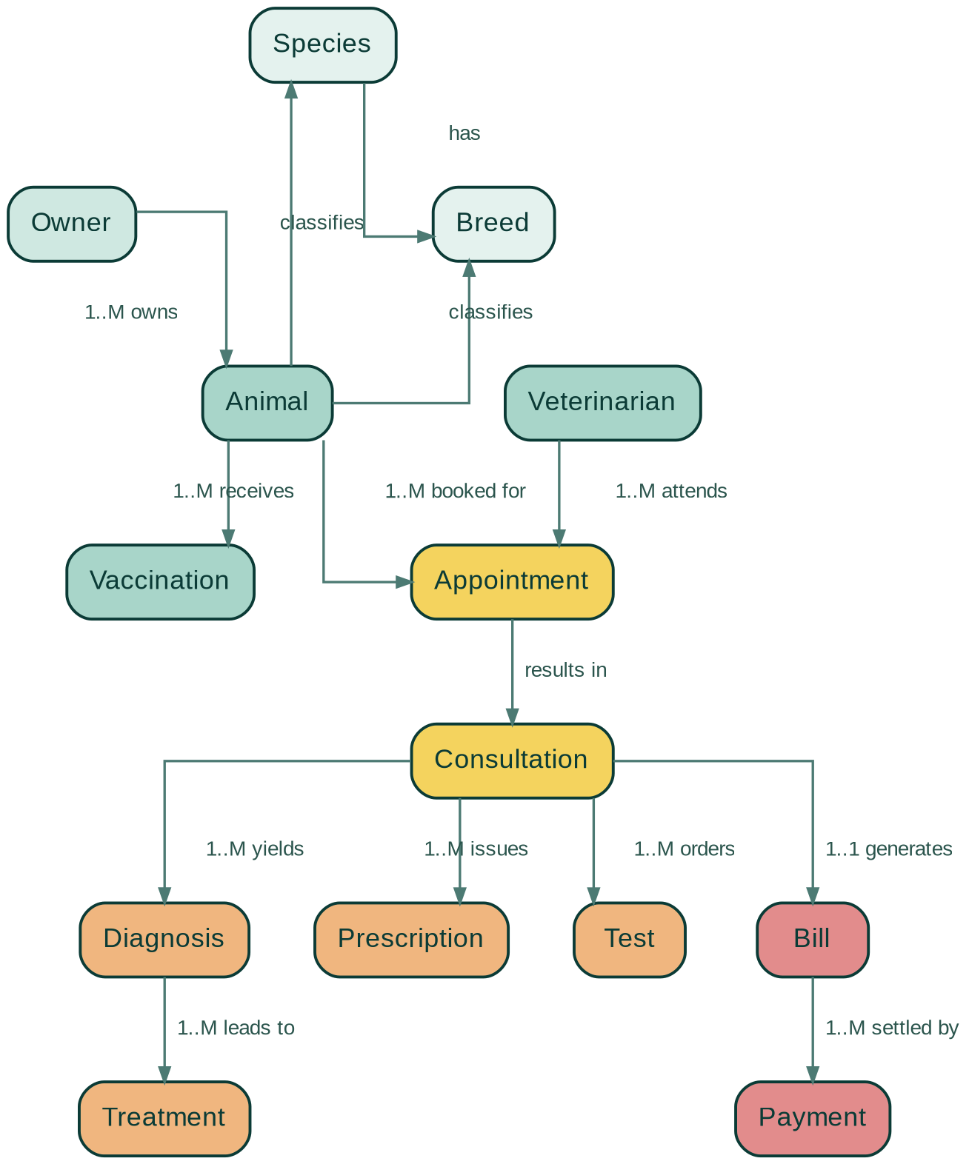
CONFIRMED CONCEPTUAL MODEL — UNCHANGED IN STRUCTURE, NOW BACKED BY A NORMALIZED (3NF) SCHEMA
Entity-Relationship Diagram
05

Slide 6
RULE-BEARING TABLES (CONCISE VIEW)
Data Dictionary
Table | Column(s) | Type | Constraint
Animal | animal_id | INT | PK
Animal | animal_name | VARCHAR(50) | NOT NULL
Animal | breed_id, owner_id | INT | FK, NOT NULL
Appointment | appointment_id | INT | PK
Appointment | vet_id, appt_date, appt_time | — | UNIQUE (no overlap)
Vaccination | date_given, next_due_date | DATE | CHECK next_due > given
Prescription | dosage | DECIMAL(5,2) | CHECK dosage > 0
Bill | total_amount | DECIMAL(8,2) | NOT NULL, CHECK ≥ 0
Payment | amount_paid | DECIMAL(8,2) | Trigger-checked ≤ balance
Full dictionary (all 14 tables, all columns) is included in the written report.
06

Slide 7
EACH RULE MAPPED TO A CONCRETE SQL CONSTRAINT
DDL — Enforcing the 5 Business Rules
✓
Unique animal identity per owner
UNIQUE (owner_id, animal_name)
on Animal
✓
No overlapping vet appointments
UNIQUE (vet_id, appt_date, appt_time)
on Appointment
✓
Valid vaccination dates
CHECK (next_due_date > date_given)
on Vaccination
✓
Positive dosages
CHECK (dosage > 0)
on Prescription
✓
Payment limits
TRIGGER before INSERT on Payment
blocks sum(paid) > bill total
07

Slide 8
ANIMAL HISTORY · VACCINATION DUE · DOCTOR SCHEDULE
SQL Queries I — Joins & Subqueries
-- Animal history
SELECT a.animal_name, c.consultation_date,
d.diagnosis_description, t.treatment_description
FROM Animal a
JOIN Appointment ap ON ap.animal_id = a.animal_id
JOIN Consultation c ON c.appointment_id = ap.appointment_id
LEFT JOIN Diagnosis d ON d.consultation_id = c.consultation_id
LEFT JOIN Treatment t ON t.diagnosis_id = d.diagnosis_id
WHERE a.animal_id = :id
ORDER BY c.consultation_date;
-- Vaccination due (subquery-style filter)
SELECT a.animal_name, o.owner_name,
v.vaccine_name, v.next_due_date
FROM Vaccination v
JOIN Animal a ON a.animal_id = v.animal_id
JOIN Owner o ON o.owner_id = a.owner_id
WHERE v.next_due_date <=
CURRENT_DATE + INTERVAL '7 days';
-- Doctor schedule for today
SELECT vt.vet_name, ap.appointment_time, a.animal_name
FROM Appointment ap
JOIN Veterinarian vt ON vt.vet_id = ap.vet_id
JOIN Animal a ON a.animal_id = ap.animal_id
WHERE ap.appointment_date = CURRENT_DATE
ORDER BY vt.vet_name, ap.appointment_time;
08

Slide 9
OUTSTANDING BILLS · REVENUE · PRESCRIPTIONS & TESTS
SQL Queries II — Aggregation & Views
-- Outstanding bills (join + aggregation + HAVING)
SELECT b.bill_id, a.animal_name, b.total_amount,
b.total_amount - COALESCE(SUM(p.amount_paid),0) AS balance_due
FROM Bill b
JOIN Consultation c ON c.consultation_id = b.consultation_id
JOIN Appointment ap ON ap.appointment_id = c.appointment_id
JOIN Animal a ON a.animal_id = ap.animal_id
LEFT JOIN Payment p ON p.bill_id = b.bill_id
GROUP BY b.bill_id, a.animal_name, b.total_amount
HAVING b.total_amount - COALESCE(SUM(p.amount_paid),0) > 0;
-- Monthly revenue view
CREATE VIEW MonthlyRevenue AS
SELECT DATE_TRUNC('month', b.bill_date) AS month,
SUM(b.total_amount) AS revenue
FROM Bill b
GROUP BY DATE_TRUNC('month', b.bill_date);
SELECT * FROM MonthlyRevenue
ORDER BY month DESC;
-- Prescriptions & tests per animal (join)
SELECT a.animal_name, pr.medicine_name, pr.dosage,
t.test_name, t.result
FROM Animal a
JOIN Appointment ap ON ap.animal_id = a.animal_id
JOIN Consultation c ON c.appointment_id = ap.appointment_id
LEFT JOIN Prescription pr ON pr.consultation_id = c.consultation_id
LEFT JOIN Test t ON t.consultation_id = c.consultation_id;
09

Slide 10
WHERE REVIEW 2 FITS IN
Progress & Next Steps
Review 1
Review 2
Review 3
Week 7
Week 11
Week 16
REVIEW 2 DELIVERABLES — COMPLETE
✓
Schema normalized to 3NF; functional dependencies documented
✓
Concise data dictionary for all 14 tables
✓
DDL scripts enforcing all 5 business rules (UNIQUE, CHECK, trigger)
✓
Sample data populated across all tables
✓
SQL queries: joins, subqueries, aggregation, and a working view
Up next — Review 3 (Week 16): Full Java/Python application with CRUD, final demo, report & viva.
10

