Slide 1

Design and Implementation of a Database Management System for Veterinary Clinic and Animal Treatment Management
Problem Identification · Conceptual Design (ER Diagram) · Initial Relational Schema
Student: Surya Siddharath | Reg. No: 25WU0102280 | Course: Database Management Systems | Review 1 · Week 7

Slide 2
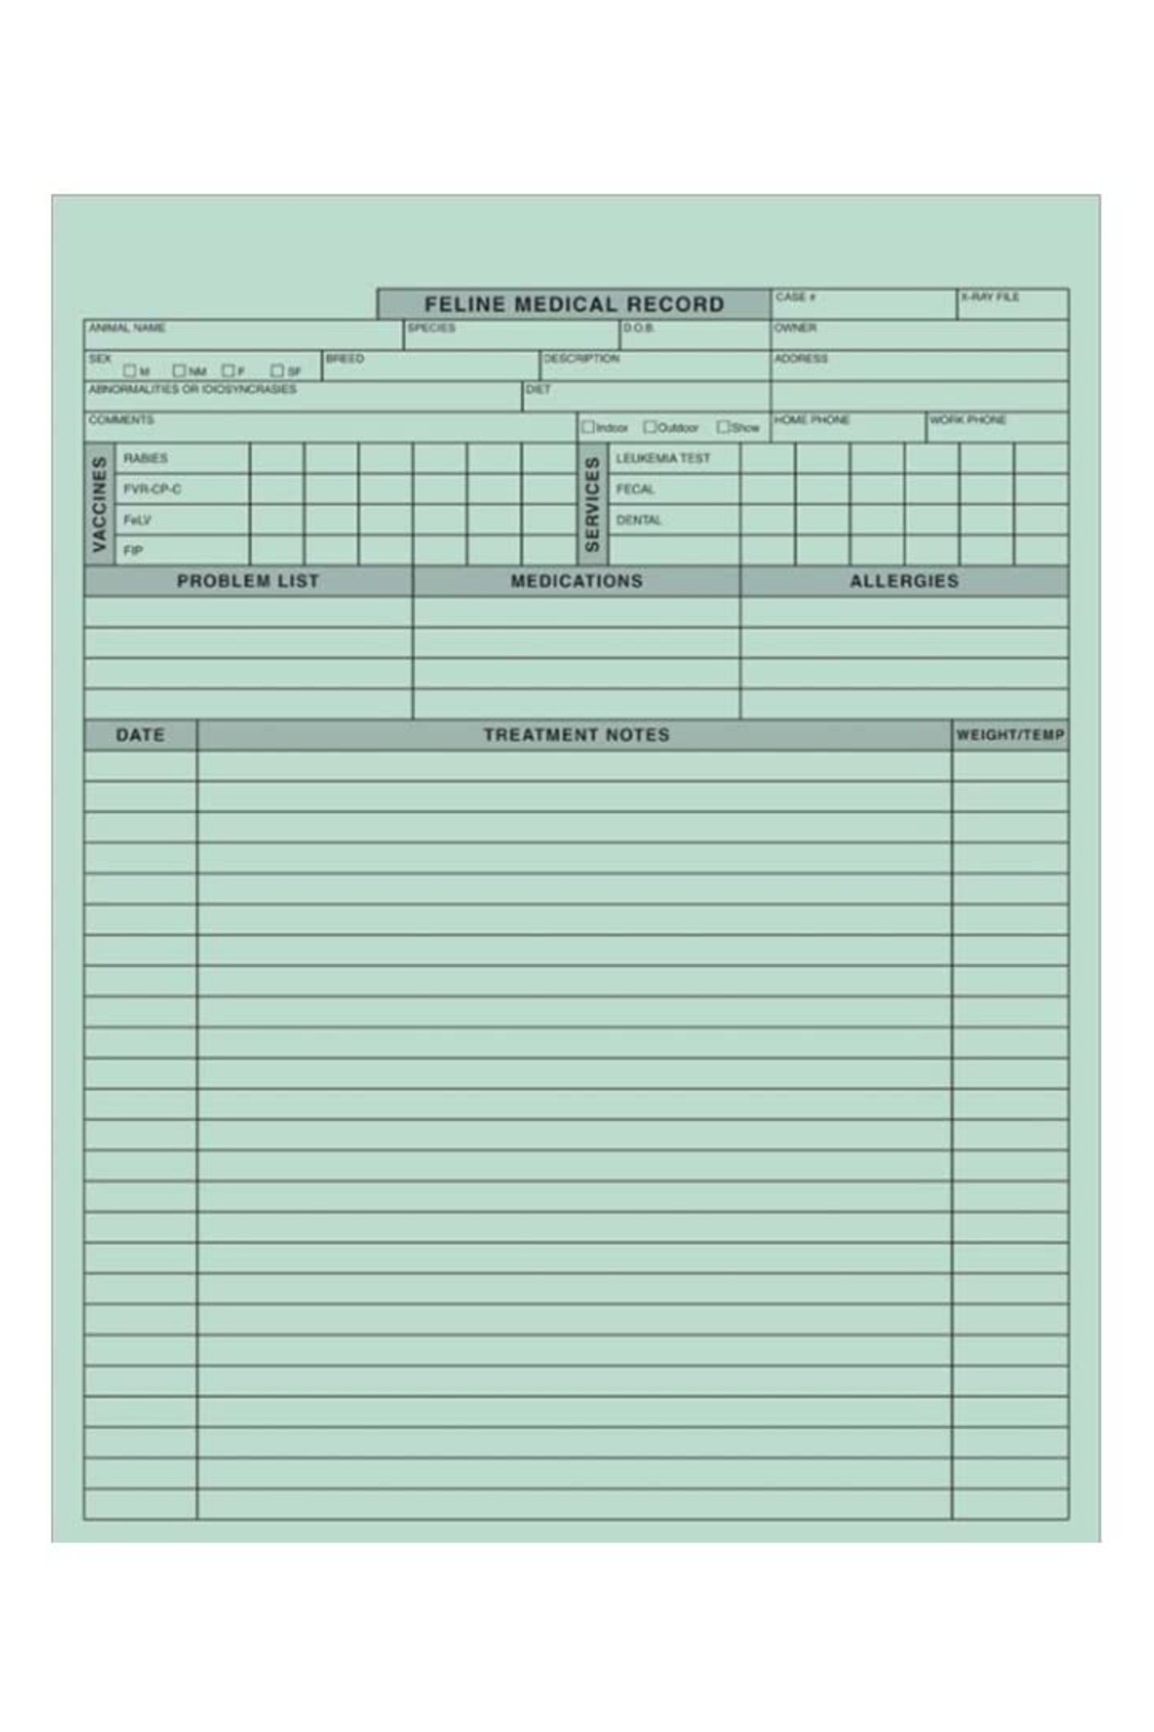
Problem Statement
Current Challenge
Solution Goal
Veterinary clinics relay on scattered paper registers and disconnected spreadsheets to manage owners, animals, appointments, and treatment history - creating costly gaps in care.
Build a centralized relational database storing every owner, animal, appointment, vaccination, diagnosis, treatment, prescription, test, and bill one reliable source of truth.
A small Java/Python front-end will let staff register animals, book appointments, log treatments, and generate reports.
Recurring Problems
Incomplete or lost medical history for an animal across visits
Vaccination due-dates missed nothing tracks them
Veterinarians double-booked for overlapping appointments
Billing errors from manually totaling consultations, tests & prescriptions

Slide 3
Scope & Objectives
In Scope
Key Objectives
Owner & animal registration
Appointment scheduling per veterinarian
Consultation, diagnosis & treatment records
Vaccination tracking with due dates
Prescriptions & lab tests
Billing and payments
Maintain complete per-animal medical history
Prevent scheduling conflicts
Track vaccination due-dates automatically
Generate accurate, auditable bills and clinic reports

Slide 4


Users & Functional Requirements
System Users
Functional Requirements
Register owners and their animals
Book & manage vet appointments (no overlaps)
Record consultations & diagnoses
Log vaccinations with next-due date
Issue prescriptions and order lab tests
Generate bills from consultations/tests
Search full history for any animal
Produce reports on schedules, dues, revenue
Receptionist / Admin
Registers owners & animals, books appointments, handles billing
Veterinarian
Records consultations, diagnoses, treatments & prescriptions
Clinic Manager
Views reports — revenue, schedules, outstanding bills

Slide 5




Conceptual Design: Core Entities
14 Entities Modeled — organized across three functional groups:
Registration
Clinical Records
Billing
Owner
Animal
Species
Breed
Veterinarian
Appointment
Consultation
Diagnosis
Treatment
Prescription
Vaccination
Test
Bill
Payment
Backbone Flow: Owner → Animal → Appointment → Consultation → Diagnosis/Treatment/Prescription/Test → Bill → Payment

Slide 6
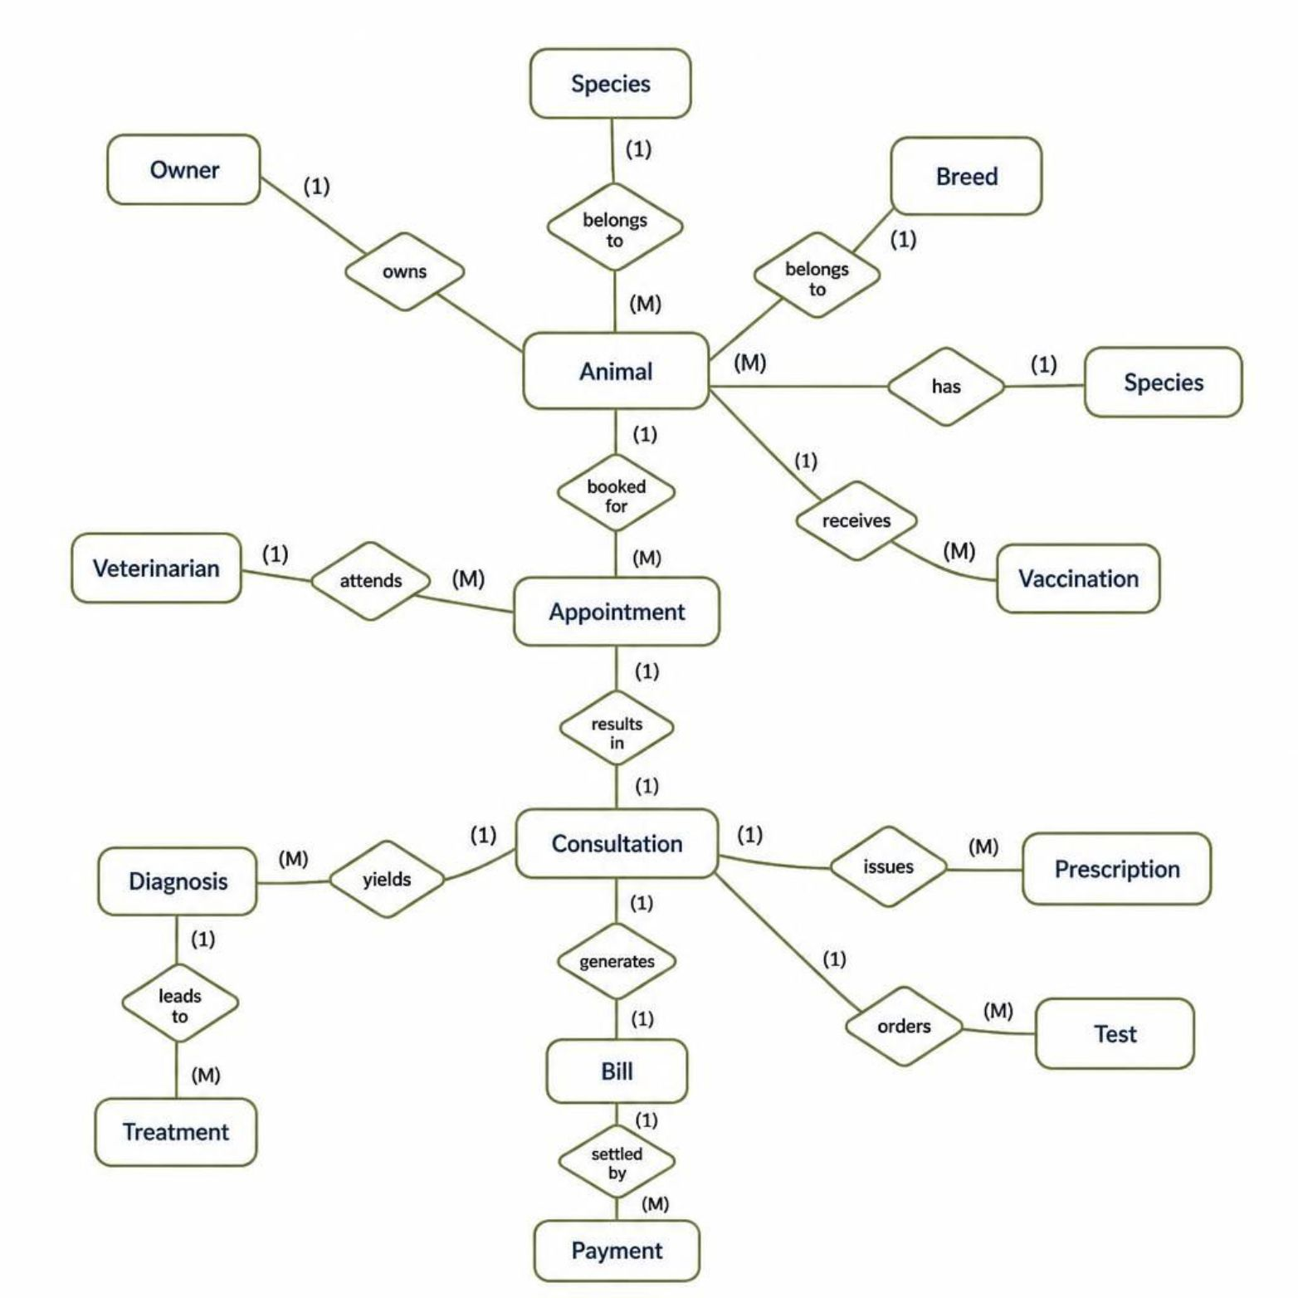
Entity-Relationship Diagram
Key Relationships
Owner 1..M owns Animal
Animal M..1 Species | Animal M..1 Breed
Species 1..M has Breed
Animal 1..M booked for Appointment
Veterinarian 1..M attends Appointment
Appointment 1..1 results in Consultation
Consultation 1..M yields Diagnosis
Diagnosis 1..M leads to Treatment
Consultation 1..M issues Prescription
Consultation 1..M orders Test
Animal 1..M receives Vaccination
Consultation 1..1 generates Bill
Bill 1..M settled by Payment

Slide 7
Initial Relational Schema
Table structure with Primary Keys and Foreign Keys for all 14 entities:
Table | Primary Key | Foreign Key(s)
Owner | owner_id | —
Animal | animal_id | owner_id, species_id, breed_id
Species | species_id | —
Breed | breed_id | species_id
Veterinarian | vet_id | —
Appointment | appointment_id | animal_id, vet_id
Consultation | consultation_id | appointment_id
Diagnosis | diagnosis_id | consultation_id
Treatment | treatment_id | diagnosis_id
Prescription | prescription_id | consultation_id
Vaccination | vaccination_id | animal_id
Test | test_id | consultation_id
Bill | bill_id | consultation_id
Payment | payment_id | bill_id

Slide 8
Key Business Rules
Unique Animal Identity
1
An owner cannot register the same animal twice — enforced via a uniqueness constraint.
No Overlapping Appointments
2
A vet cannot be double-booked for two appointments at the same time slot.
Valid Vaccination Dates
3
Vaccination date cannot be in the future beyond entry; next-due date must follow the given date.
Positive Dosages
4
Dosage values in prescriptions/vaccinations must be greater than zero (CHECK constraint).
Payment Limits
5
Total payments recorded against a bill cannot exceed the bill amount.

Slide 9

Project Timeline & Milestones
3-Part DBMS Project-Based Learning Course
Week 7 — Review 1
1
Problem statement · ER diagram · Initial relational schema
2
Week 11 — Review 2
3NF normalization · DDL with constraints · Sample data & SQL queries
Week 16 — Review 3
3
Full Java/Python application · Final demo · Report & viva-voce
Review 1 Status: Complete ✅ — Problem scope defined, 14 entities modeled, ER diagram drawn, and initial schema drafted ahead of normalization in Review 2.

