Slide 1




NEXT GEN EMPLOYABILITY PROGRAM
Creating a future-ready workforce
Team Members
College Name
Student Name : Surya S
Student ID :au713921104049
Sri Ranganathar Institute of Engineering & Technology-Coimbatore

Slide 2

CAPSTONE PROJECT SHOWCASE
Project Title
Notes Sharing Web Application using Django Framework
Abstract | Problem Statement | Project Overview | Proposed Solution | Technology Used | Modelling & Results | Conclusion

Slide 3
Abstract
In the digital era, the need for efficient and accessible educational resources is more pronounced than ever. This paper presents the development of a collaborative notes sharing web application designed to meet this demand by facilitating the sharing of academic materials among students. Utilizing the Django framework, a high-level Python web framework that encourages rapid development and pragmatic design, this application offers a robust platform for users to upload, download, and share notes in various formats. The system architecture is built on Django's Model-View-Template (MVT) architecture, ensuring a clear separation of concerns, scalability, and ease of maintenance. Key features include user authentication, file management, a search functionality for ease of access to specific materials, and a categorization system for organizing notes by subject, topic, or course. Preliminary testing indicates a user-friendly interface and a positive reception from the target audience, suggesting the application's potential to significantly enhance the learning experience by promoting collaborative study and resource sharing. Future work will focus on incorporating advanced features such as collaborative editing, integration with cloud storage services, and the implementation of machine learning algorithms to recommend personalized content to users based on their interests and study habits.
Source :Gpt 4

Slide 4
Problem Statement
The primary challenge addressed by this project is the lack of an intuitive, efficient, and collaborative platform specifically designed for the sharing and management of academic notes and resources among students and educators. Despite the availability of various online platforms, there remains a significant gap in services that cater specifically to academic collaboration, with many students resorting to fragmented and less secure means of sharing study materials. This project aims to leverage the Django framework to develop a user-friendly, secure, and scalable web application that not only facilitates the easy sharing and organization of notes but also enhances the overall learning experience through collaborative features and a community-driven approach.
Source :

Slide 5
Project Overview
In an era characterized by digital collaboration and knowledge sharing, our project aims to develop a sophisticated web application utilizing the Django framework, tailored specifically for efficient note sharing among users. This innovative platform addresses the growing need for streamlined information dissemination and collaborative note-taking, offering a robust set of features designed to enhance productivity and facilitate seamless interaction among users.
Embark on this journey with us as we embark on the development of a cutting-edge notes sharing web app using Django, poised to redefine the way individuals and teams collaborate, communicate, and create together.
Source :google

Slide 6
Proposed Solution
The proposed solution is to develop a comprehensive, secure, and user-friendly Notes Sharing Web Application tailored for students, educators, and academic institutions. This application will leverage the Django framework for its robustness, security features, and scalability. Below are the key components of the proposed solution:
1. System Architecture
Backend Development: Utilize Django for server-side logic, database management, user authentication, and session management, ensuring a secure and efficient backend structure.
Frontend Integration: Employ HTML, CSS, and JavaScript, alongside Django’s template system, to create an intuitive and responsive user interface that enhances user experience.
Database Design: Design a relational database schema that efficiently stores user data, notes, categories, and interactions to facilitate quick retrieval and secure storage of information.
2. Core Features
User Authentication and Authorization: Implement Django’s built-in authentication system to manage user accounts, secure login/logout processes, and ensure user data privacy.
Notes Management: Enable users to upload, download, and manage notes in various formats (PDF, DOCX, PPT, etc.), with features for creating, editing, and deleting notes.
Collaboration Tools: Incorporate features for users to comment on notes, rate them, and engage in discussions, fostering a collaborative learning environment.
.
Source : GPT 4

Slide 7
3. Security and Privacy
Implement Django’s security best practices to protect against common vulnerabilities such as SQL injection, Cross-Site Scripting (XSS), and Cross-Site Request Forgery (CSRF).
Ensure data privacy by adhering to regulations such as GDPR for the handling of personal information.
4. Scalability and Performance
Design the application with scalability in mind, allowing for easy adaptation to increased user numbers and data volume without performance degradation.
Utilize Django’s caching framework to enhance application performance and reduce server load.
5. User Experience (UX) Design
Follow a user-centered design approach to create an accessible and engaging platform, ensuring that the UI/UX caters to the needs and preferences of the target audience.
Implement responsive design principles to ensure the application is accessible across various devices and screen sizes.
6. Testing and Quality Assurance
Conduct thorough testing, including unit tests, integration tests, and user acceptance testing (UAT), to ensure the application is reliable, secure, and user-friendly.
Utilize Django’s testing framework to automate test cases and ensure code integrity.
Source :GPT 4

Slide 8


Technology Used
Front-end
Back-end
Source :

Slide 9
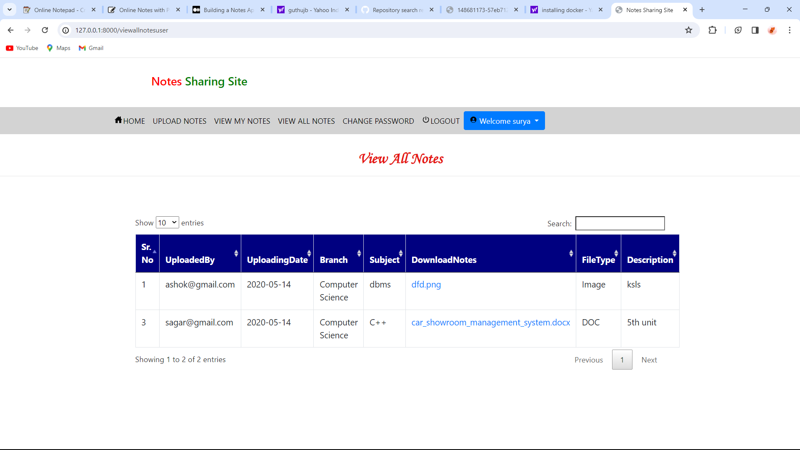
Modelling & Results
Source :

Slide 10
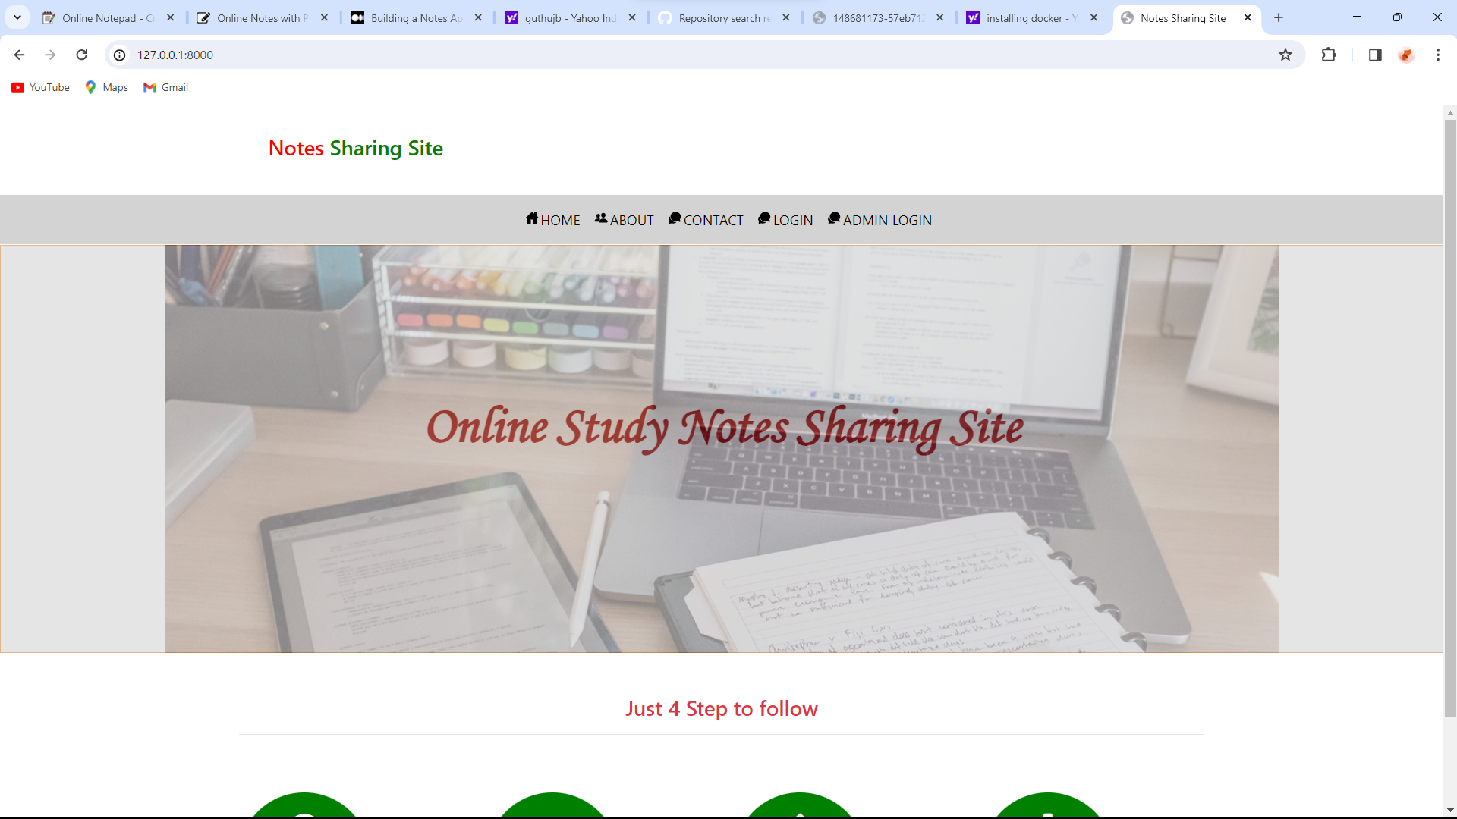
Homepage

Slide 11
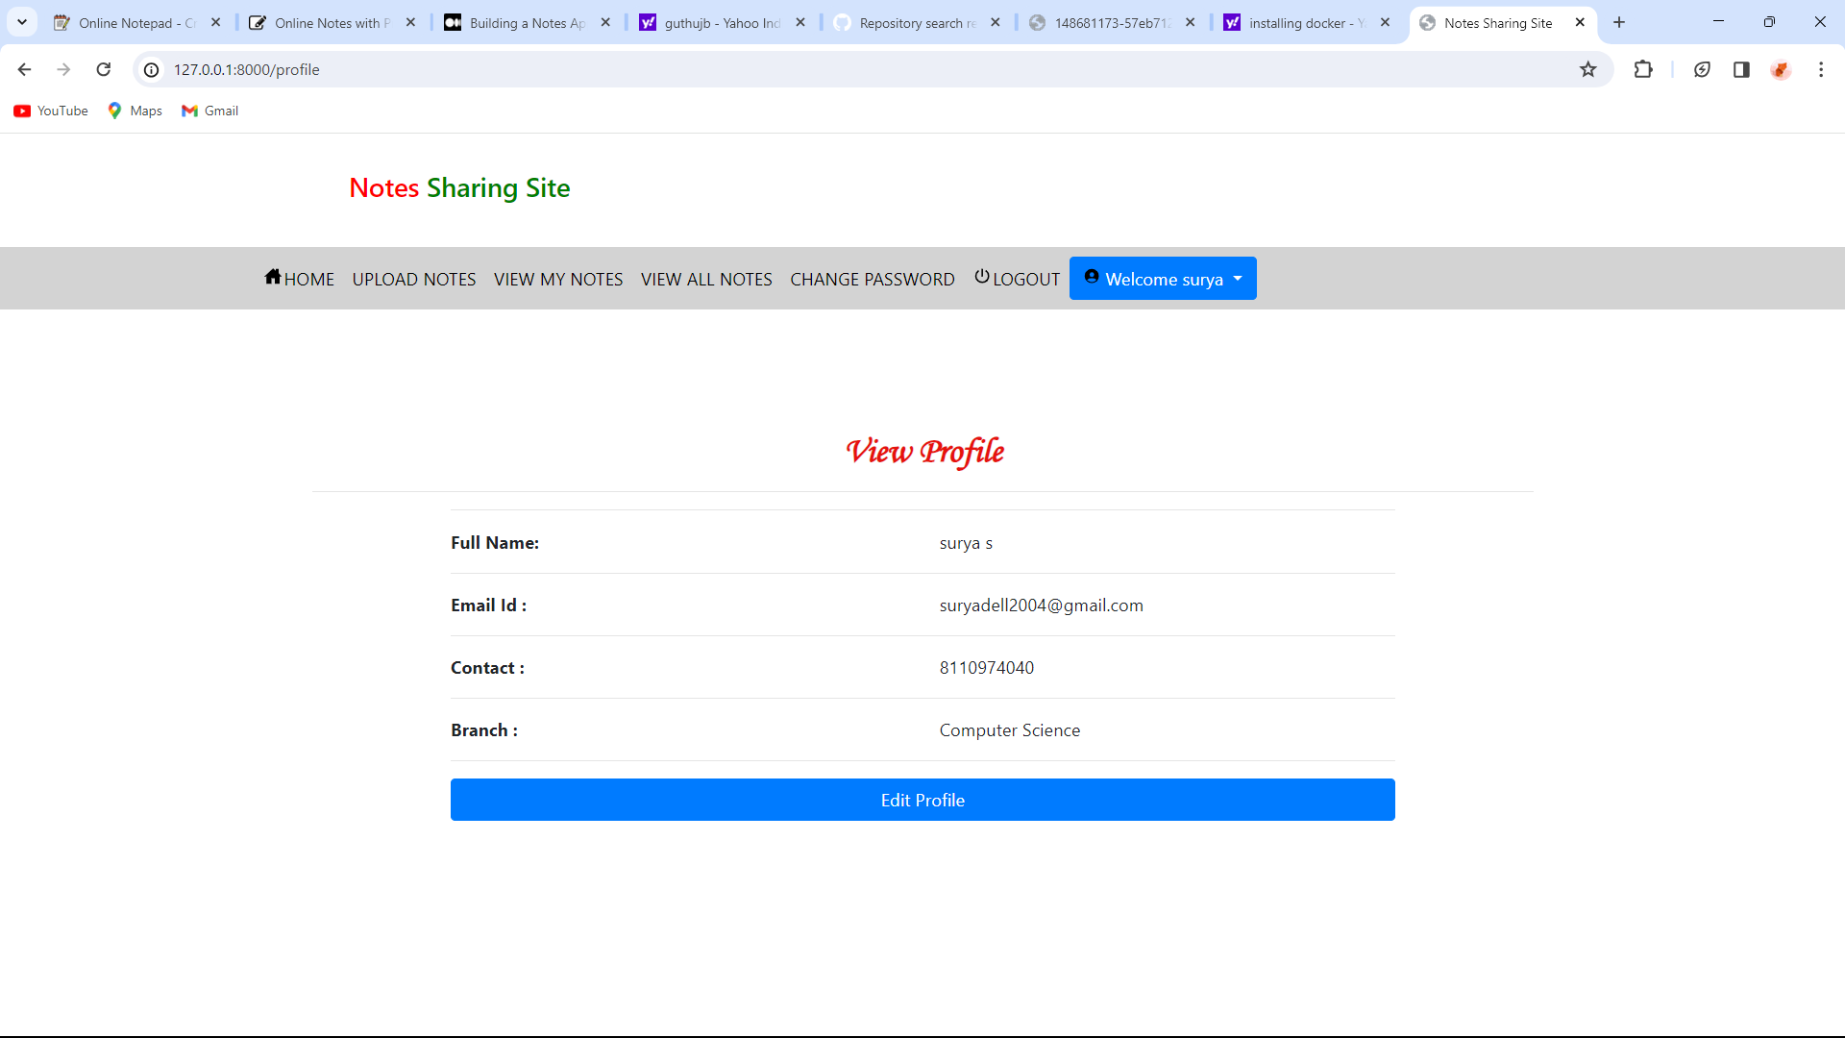
User-Profile

Slide 12
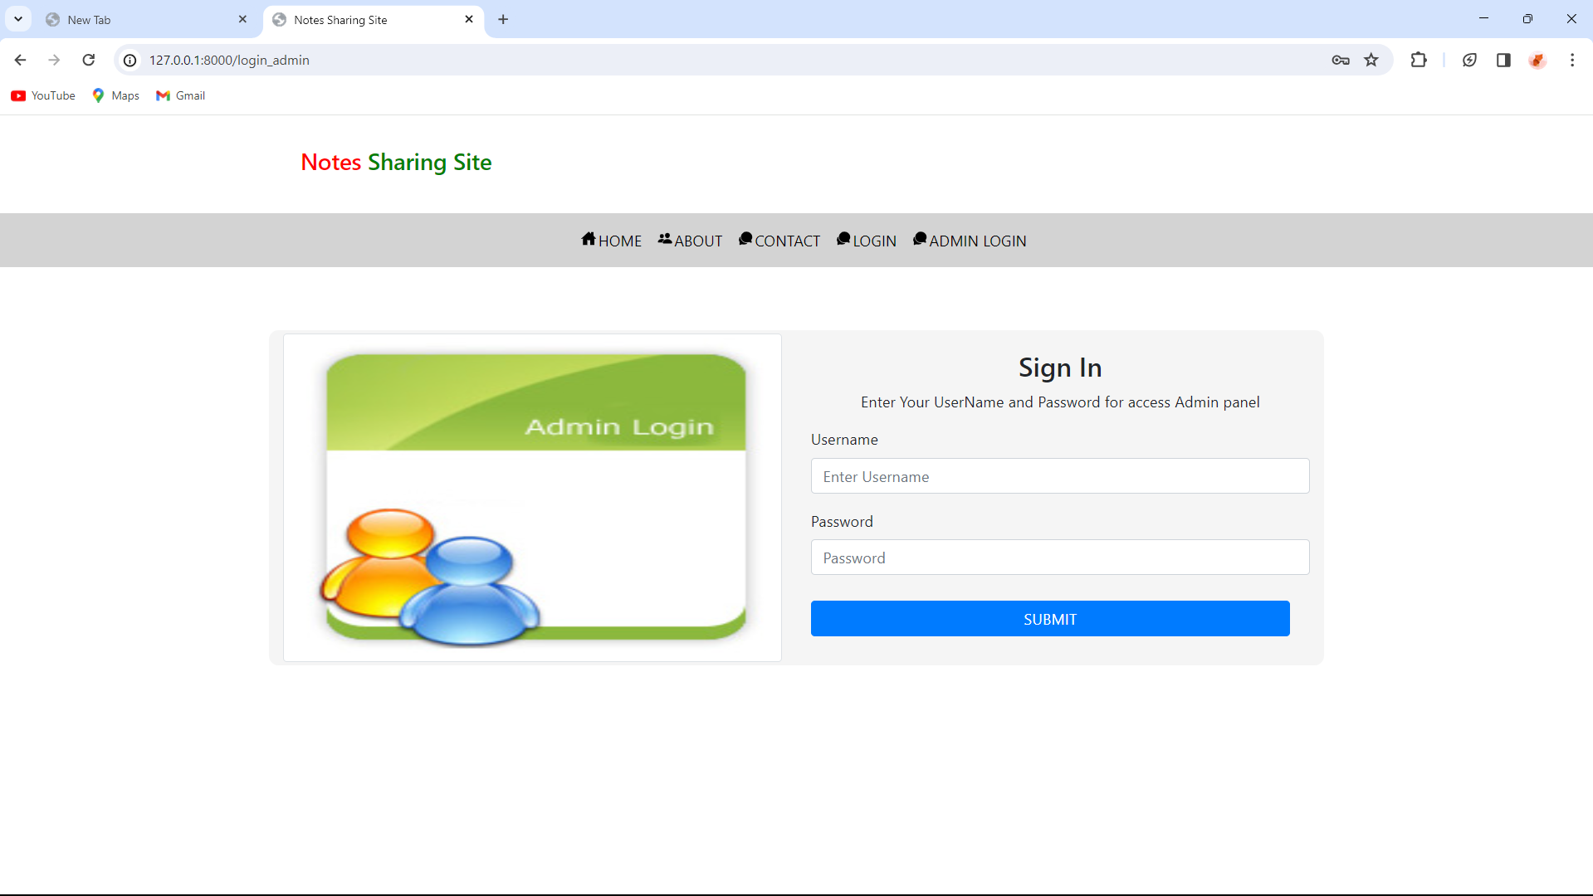
Admin-Page

Slide 13
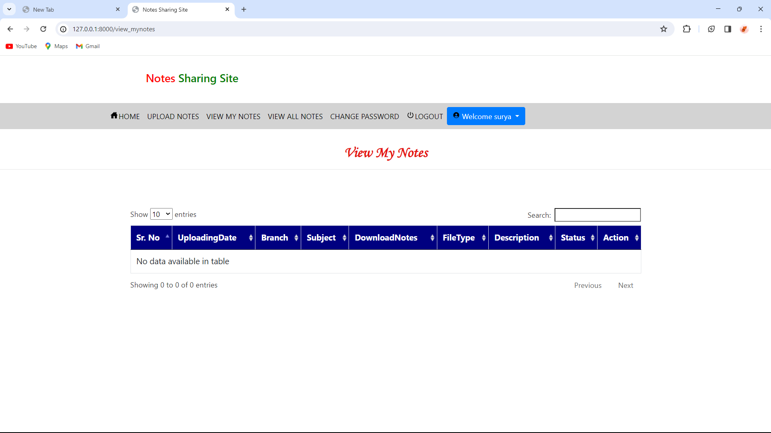
My-notes

Slide 14
Future Enhancements:
Potential improvements or additional features for future iterations.Integration with third-party services (e.g., Google Drive, Dropbox) for note storage.
Real-time collaboration features.
Mobile application development for note access on the go.

Slide 15
Conclusion
Summary of the project overview.
Importance and potential impact of the notes sharing web app.
Acknowledgment of contributors (if applicable).
Source :

Slide 16
Thank You!
Notes:
Thank You !!

