Slide 1
Object oriented software engineering ccs356
Unit-ii
Requirement Gathering and analysis
prepared by
j.Sridhar
Iii-cse

Slide 2

Requirements gathering
What is Requirements Gathering?
Requirements Gathering Is A Crucial Phase In The Software Development Life Cycle (SDLC) And Project Management. It Involves Collecting, Documenting, And Managing The Requirements That Define The Features And Functionalities Of A System Or Application. The Success Of A Project Often Depends On The Accuracy And Completeness Of The Gathered Requirements In Software.

Slide 3


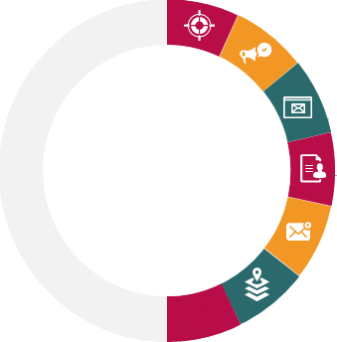


Processes of Requirements Gathering in Software
Development
Assigning Roles
01
02
Define Project Scope
Conduct Stakeholder
Interviews
03
04
Document Requirements
Requirements
Gathering
05
Verify & Validate
Requirements
06
Prioritize Requirements

Slide 4
Assigning roles:
The first step is to identify and engage with all relevant stakeholders. Stakeholders can include end-users, clients, project managers, subject matter experts, and anyone else who has a vested interest in the software project. Understanding their perspectives is essential for capturing diverse requirements.
Define Project Scope:
Clearly define the scope of the project by outlining its objectives, boundaries, and limitations. This step helps in establishing a common understanding of what the software is expected to achieve and what functionalities it should include.

Slide 5
CONDUCT STAKEHOLDER INTERVIEWS:
Schedule interviews with key stakeholders to gather information about their needs, preferences, and expectations. Through open-ended questions and discussions, aim to uncover both explicit and implicit requirements. These interviews provide valuable insights that contribute to a more holistic understanding of the project.
DOCUMENT REQUIREMENTS:
Systematically document the gathered requirements. This documentation can take various forms, such as user stories, use cases, or formal specifications. Clearly articulate functional requirements (what the system should do) and non-functional requirements (qualities the system should have, such as performance or security).

Slide 6
VERIFY AND VALIDATE REQUIREMENTS:
Once the requirements are documented, it’s crucial to verify and validate them. Verification ensures that the requirements align with the stakeholders’ intentions, while validation ensures that the documented requirements will meet the project’s goals. This step often involves feedback loops and discussions with stakeholders to refine and clarify requirements.
Prioritize Requirements:
Prioritize the requirements based on their importance to the project goals and constraints. This step helps in creating a roadmap for development, guiding the team on which features to prioritize. Prioritization is essential, especially when resources and time are limited.

Slide 7
Requirement Analysis
Requirements analysis (requirements engineering) is the process of determining user expectations for a new or modified product. It is usually a team effort and demands a variety of human soft skills, such as critical thinking, communication and judgment.

Slide 8
Requirement analysis process
Recognize the problem
Evaluation and synthesis
Modelling the requirements
Specification
Review

Slide 9
Recognize the Problem
The primary goal of requirement analysis is to thoroughly grasp the main objective of the requirement, which includes why it is needed, whether it adds value to the product, whether it will be beneficial, whether it will raise the quality of the project, and whether it will have any other effect. These factors are appropriately acknowledged in this step so that fundamental requirements for solving business problems can be met.

Slide 10
Evaluation and Synthesis
Evaluation is to decide whether something is valuable or not, and synthesis means to build or develop anything. The following tasks are critical in the evaluation and synthesis stage of requirements analysis (not an exhaustive list):
To define all software functions that are required
To define all data objects that are visible to the outside world

Slide 11
Modelling the Requirements
This step typically includes graphical representations of the functions, data entities, external entities, and their relationships. The visual perspective may aid in discovering inaccurate, inconsistent, missing, or excessive requirements. Data flow diagrams, entity-relationship diagrams, data dictionaries, state-transition diagrams, and other models fall under this category.

Slide 12
Specification
We have a better knowledge of the system behaviour after modelling the requirements. Inconsistencies and ambiguities have been recognized and resolved. The data flow between modules has been examined. The actions of elicitation and analysis have generated a greater understanding of the system. We have completed the needs analysis in the previous steps, and in this step, we document these requirements in the SRS (software requirements specification) document.
Review
After creating the SRS, it must be reviewed to see if it can be enhanced and polished to make it better and higher in quality.

Slide 13
Requirement Analysis Techniques
Business process model and notation (BPMN)
Flowcharts
Gantt charts

Slide 14
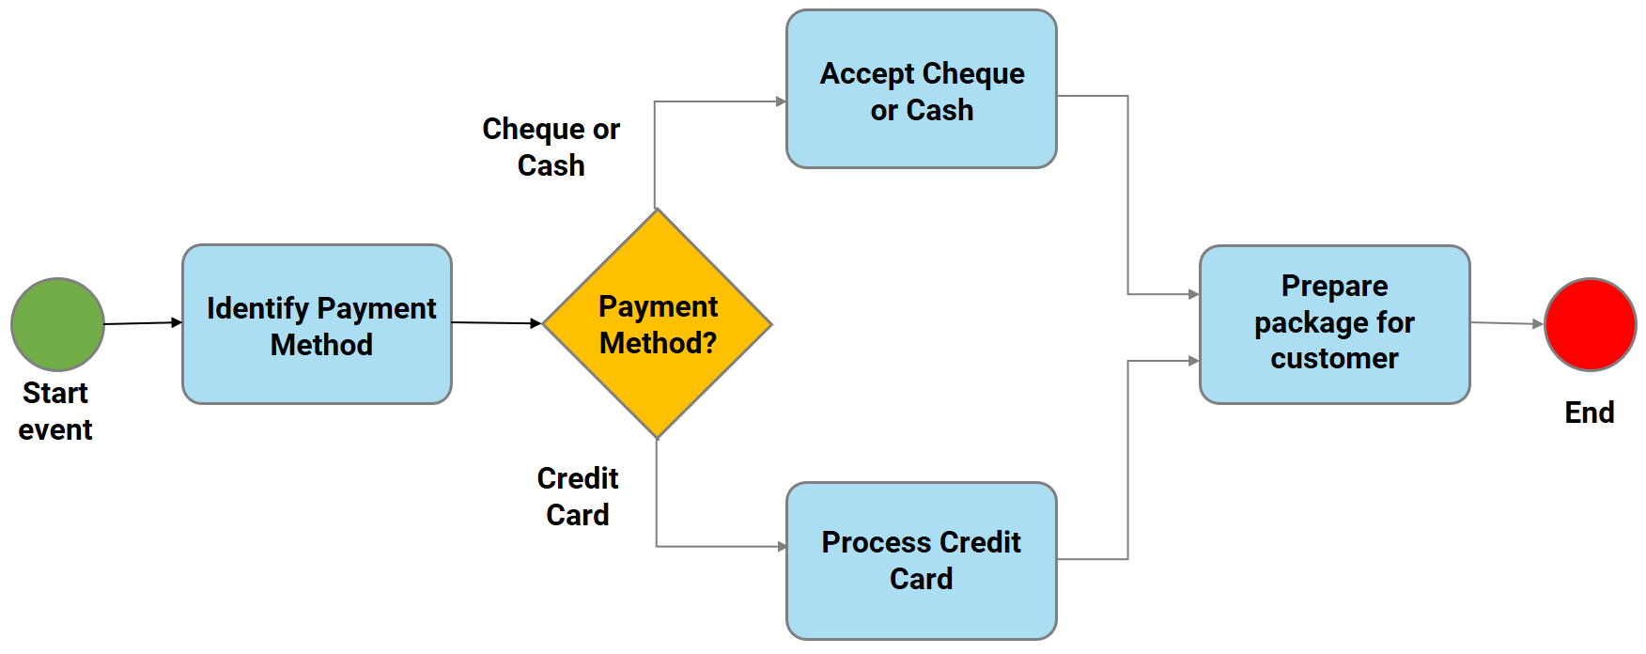
Business Process Model and Notation (BPMN)
The business process model and notation are used to generate graphs that aid in the understanding of business processes. It is a common strategy used by business analysts to coordinate the sequence of messages between various participants in a linked set of activities.

Slide 15
Flowcharts
A flowchart is a graphical representation of a process, system, or computer algorithm. It is widely used in various fields to document, examine, plan, enhance, and frequently convey complex processes in clear, simple diagrams. They use rectangles, ovals, diamonds, and possibly other shapes to indicate the type of step and linking arrows to define flow and sequence
Start
Input
Process
Decision
Output

Slide 16
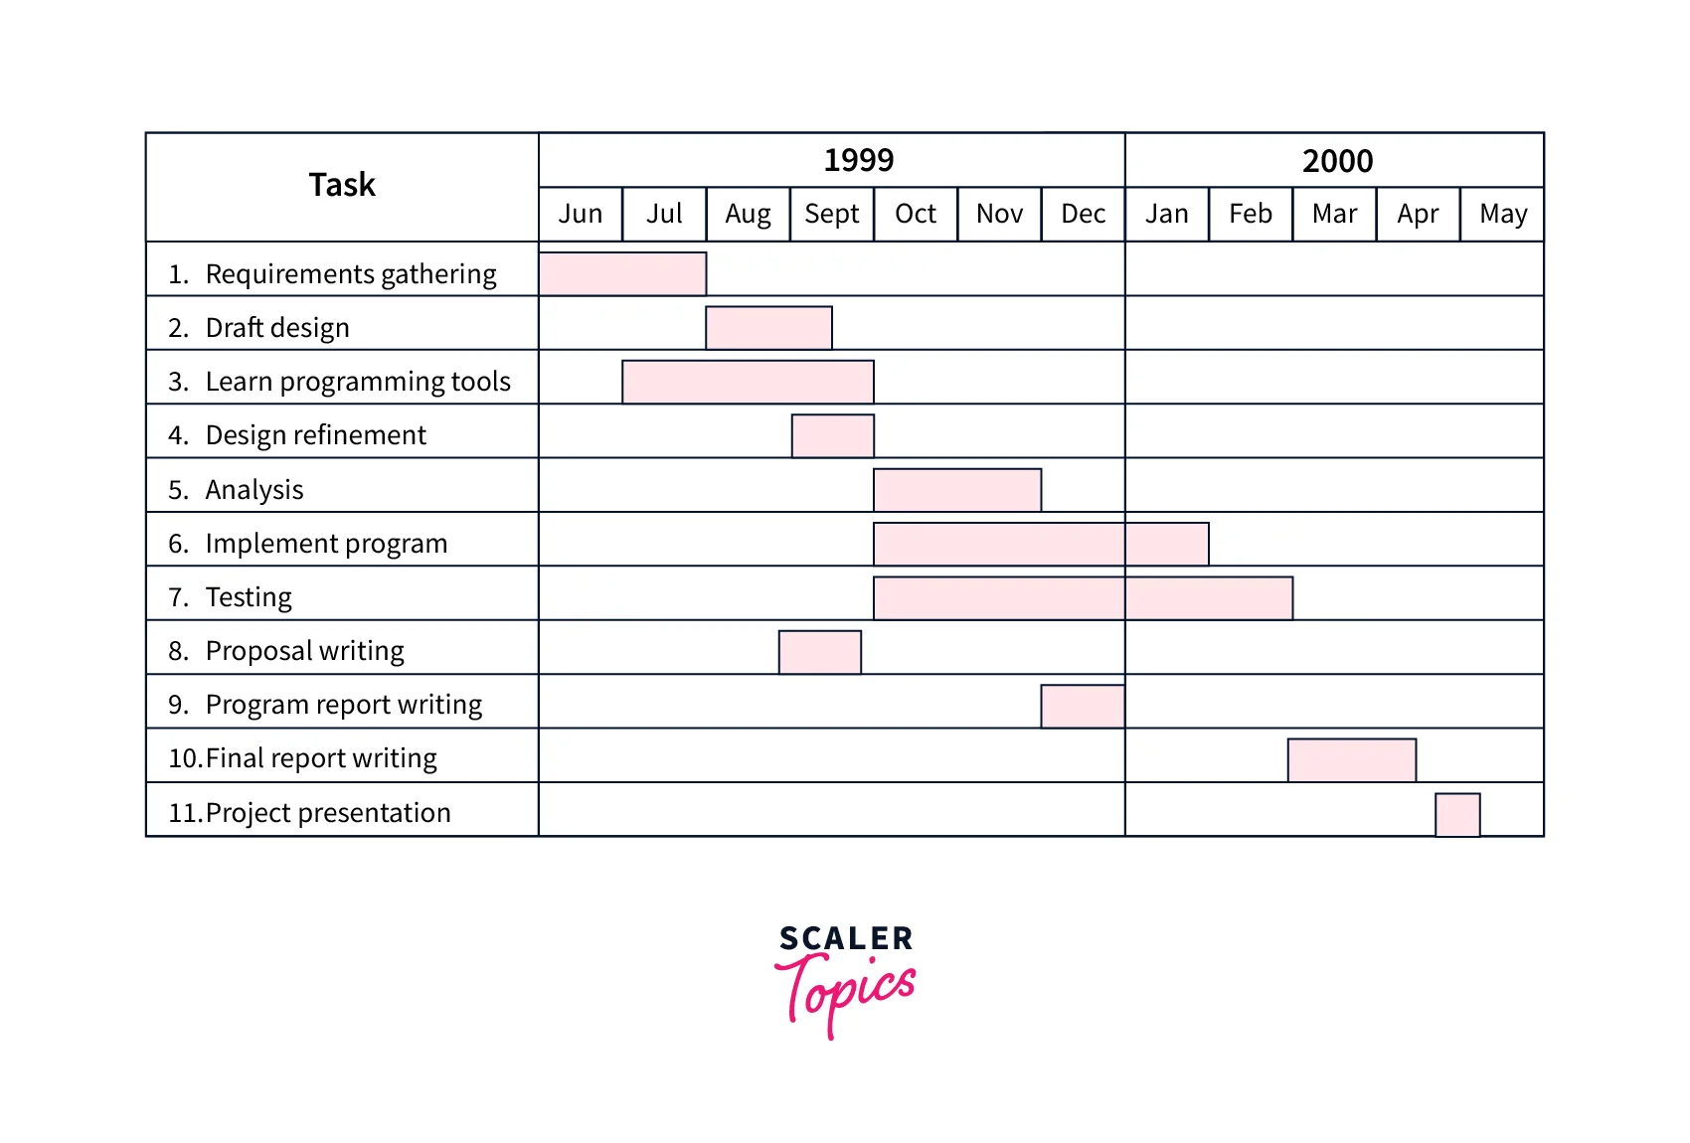
Gantt Charts
A gantt chart, widely used in project management, is one of the most popular and useful methods of displaying activities (tasks or events) against time. The chart lists activities on the left and a time scale along the top. Each action is represented as a bar, with the position and length of the bar reflecting the activity's start, duration, and end dates. Primarily, a gantt chart displays the following information:

Slide 17


