Slide 1
KLH Lost and Found App

Slide 2
About the App
The KLH Lost and Found App aims to connect people who have lost items with those who have found them.
It provides a platform for posting lost items with detailed descriptions and photos, and for sharing photos of found objects, making it easier for people to reunite with their belongings.

Slide 3
Key Features
1
1. Posting Lost Items
2
2. Sharing Photos of Found Objects
3
3. Auction
Users can post detailed descriptions of lost items, including location, date, and time of loss.
If the item is not found by the deadline, an auction begins.Users can place bids on the item.The highest bidder wins the auction.
Finders can upload photos of found items, allowing owners to easily identify their belongings.

Slide 4
Front-end Technology
HTML
CSS
JavaScript
The structural foundation of the app's user interface.
Responsible for the app's visual styling and presentation.
Enables interactive elements and dynamic functionality.

Slide 5



Back-end Framework
Java
MongoDB
Spring Boot
The core programming language for the server-side logic.
The database for storing and managing app data.
A powerful Java-based framework, providing a streamlined development experience for building web applications.

Slide 6
Roles and Responsibilities
Front End and Back End
Suryatej , Govind
Database
Shreya , Sunanda
Documentation
Harshitha
Testing
Harshitha, Sunanda

Slide 7


Slide 8
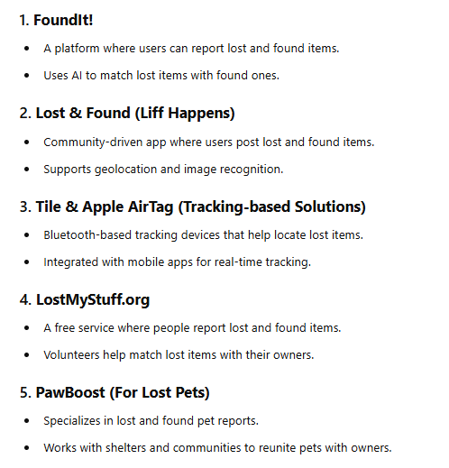

Slide 9
Conclusion
The KLH Lost and Found App offers a solution for reuniting people with their lost items.
With its user-friendly features, robust backend infrastructure, and a dedicated team, this app has the potential to become a valuable resource for the community.

