Slide 1

Research Question
Bibliometric analysis of SDG research using Elsevier Scopus data can be used to identify emerging trends, knowledge gaps, and inform the development of research agendas and policies to support the achievement of the SDGs. Scopus is a good choice for this as it covers a diverse range of disciplines and includes SDG-related research from around the world

Slide 2
Bibliometric Methods
This research question seeks to analyze the growth of SDG research over time. It will explore the number of publications on each SDG, the most influential authors and institutions, collaborations between researchers and institutions, and the keywords used in SDG research. The findings of this research can be used to inform the development of research agendas and policies to support the achievement of the SDGs

Slide 3
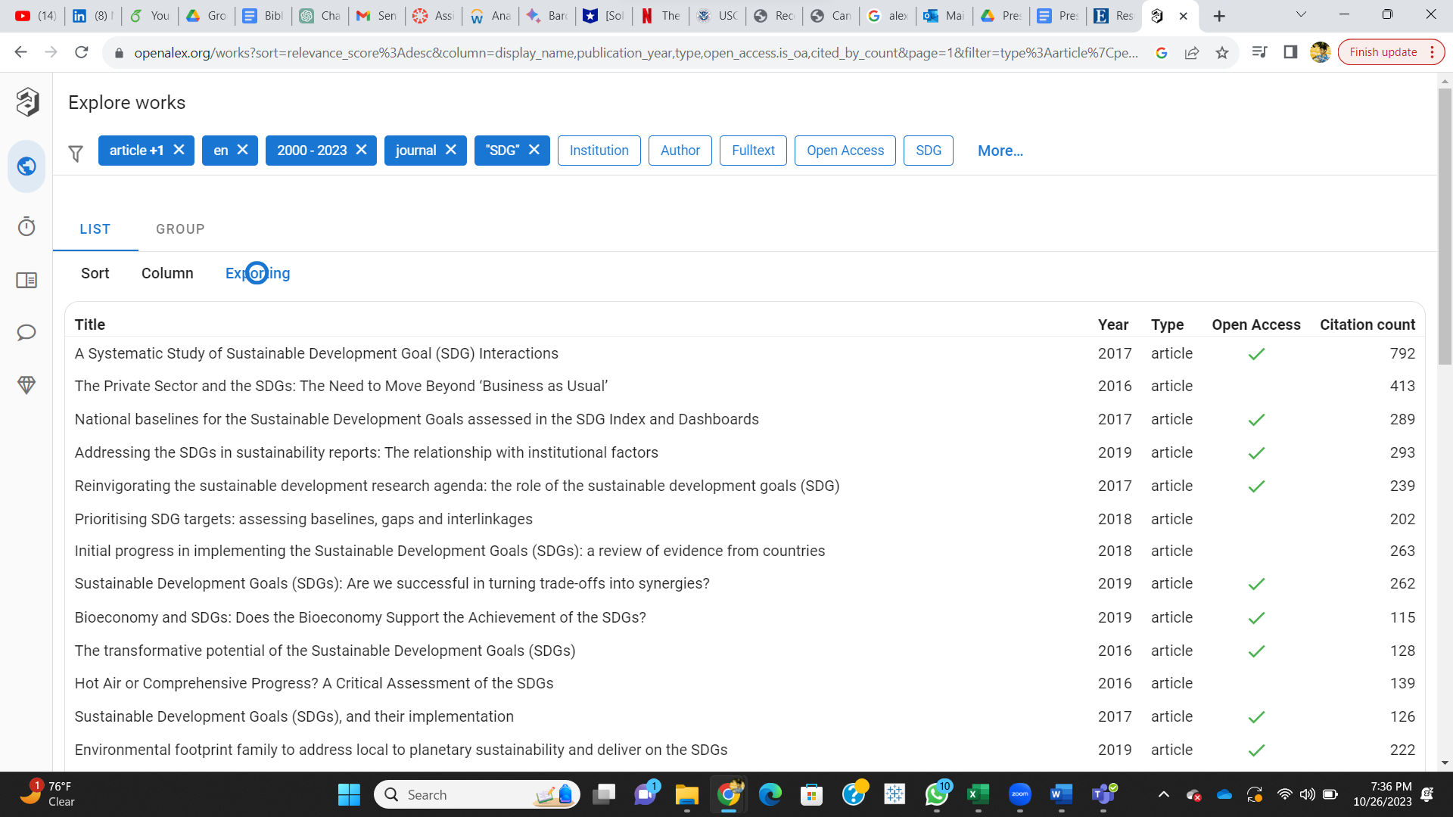

Slide 4
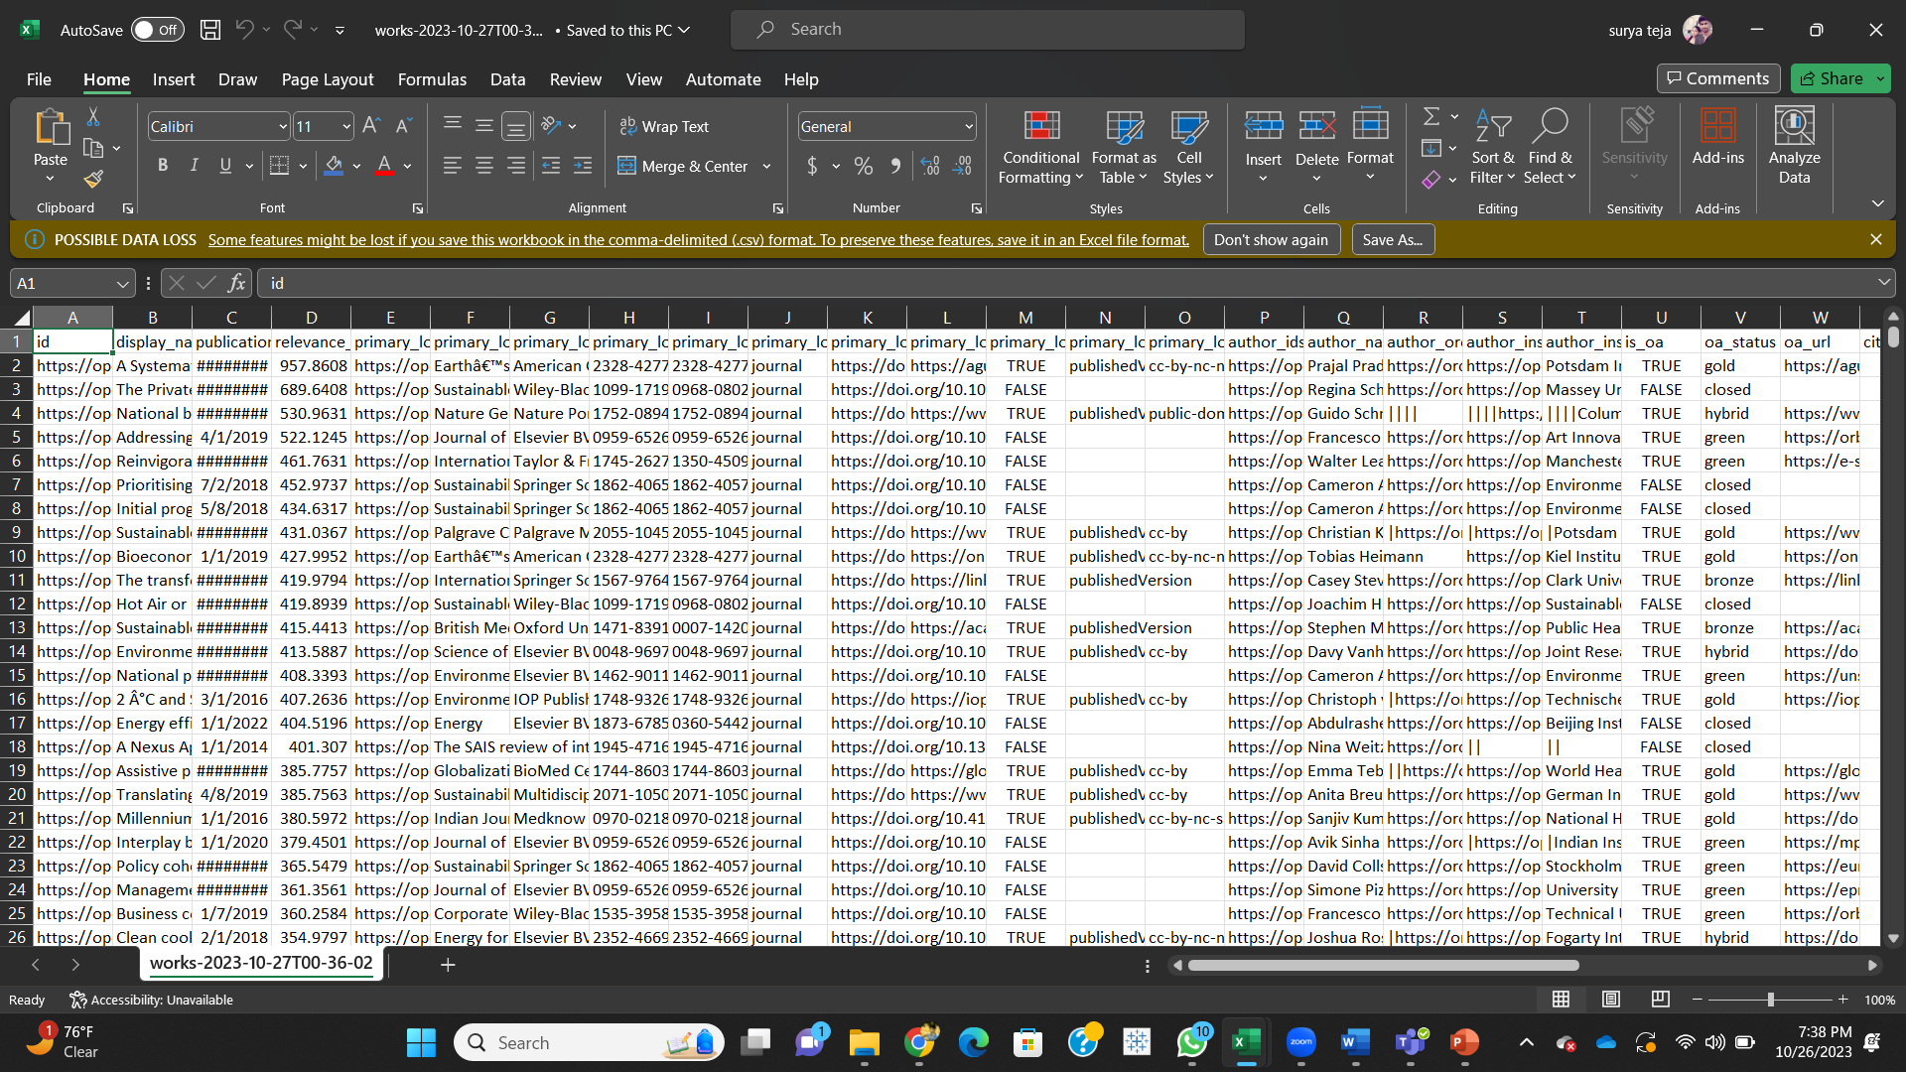

Slide 5

Other Tools for Connectivity
Node-link diagrams: Node-link diagrams are a type of graph visualization that uses nodes to represent entities and links to represent relationships between entities. Node-link diagrams can be used to visualize a variety of types of networks, including social networks, computer networks, and transportation networks.
1
Sankey diagrams: Sankey diagrams are a type of flow diagram that uses arrows to represent the flow of energy or materials between different entities. Sankey diagrams can be used to visualize the flow of data through a network, the flow of energy through an ecosystem, or the flow of goods through a supply chain.
2
Matrix visualizations: Matrix visualizations are a type of data visualization that uses a grid to represent the relationships between different entities. Matrix visualizations can be used to visualize a variety of types of networks, including social networks, correlation matrices, and adjacency matrices.
3
Force-directed layouts: Force-directed layouts are a type of graph layout algorithm that uses physical forces to arrange nodes and edges in a network. Force-directed layouts can be used to create dynamic and visually appealing visualizations of networks.
4
Geographic information systems (GIS): GIS software can be used to visualize networks on a map. This can be useful for understanding how networks are distributed geographically and how they interact with other features on the landscape.

Slide 6
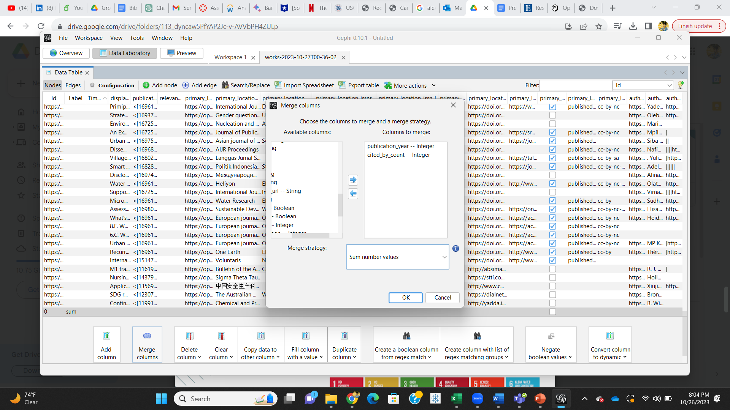

Slide 7
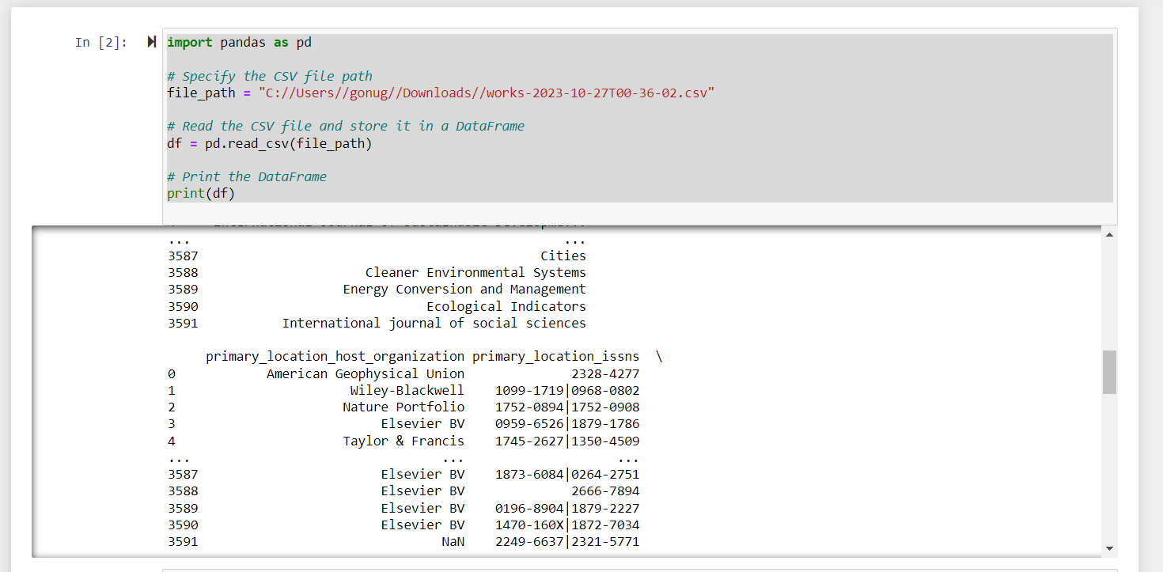

Slide 8
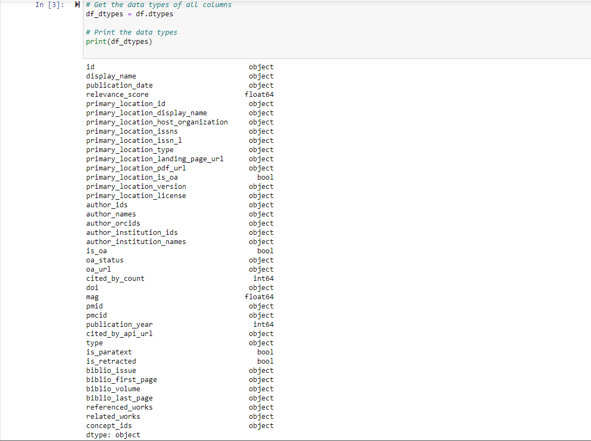

Slide 9
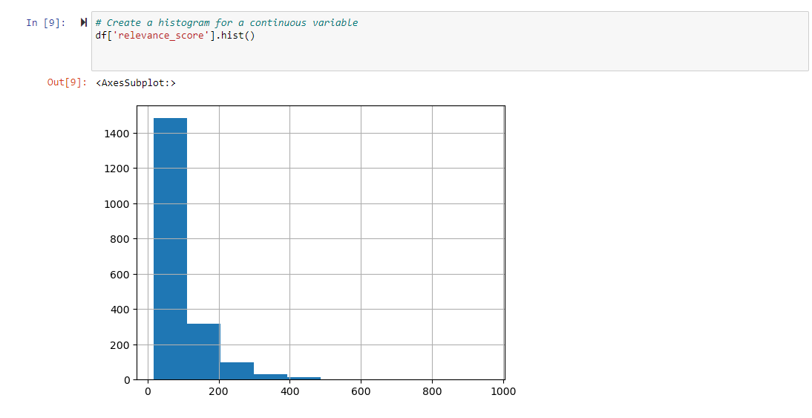

Slide 10
Netwrok Connections of SDG Researchers
A network analysis of SDG researchers can reveal important insights into their connections and collaborations.
This analysis can be used to identify key players in the SDG research community, understand the flow of information and ideas, and identify gaps in collaboration.
The network analysis can also be used to inform strategies for improving communication and collaboration among SDG researchers.

Slide 11
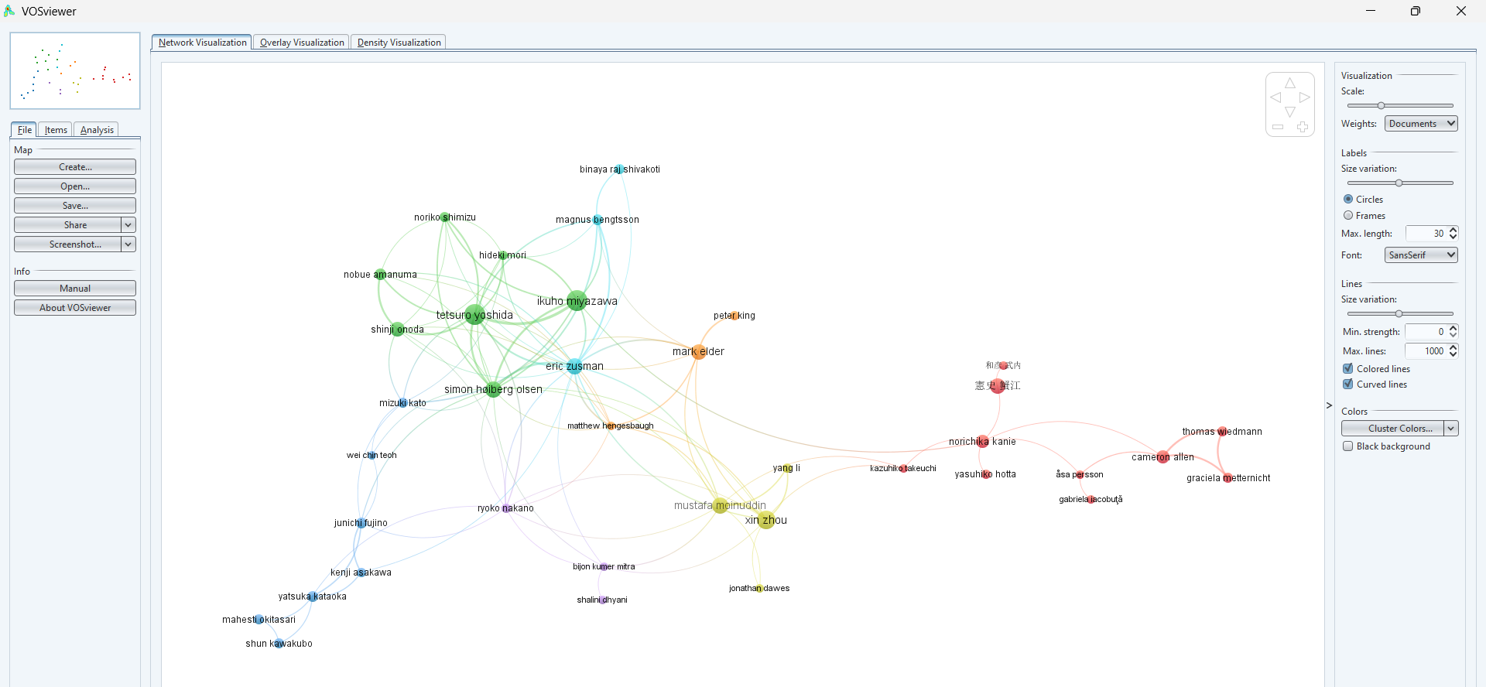

Slide 12
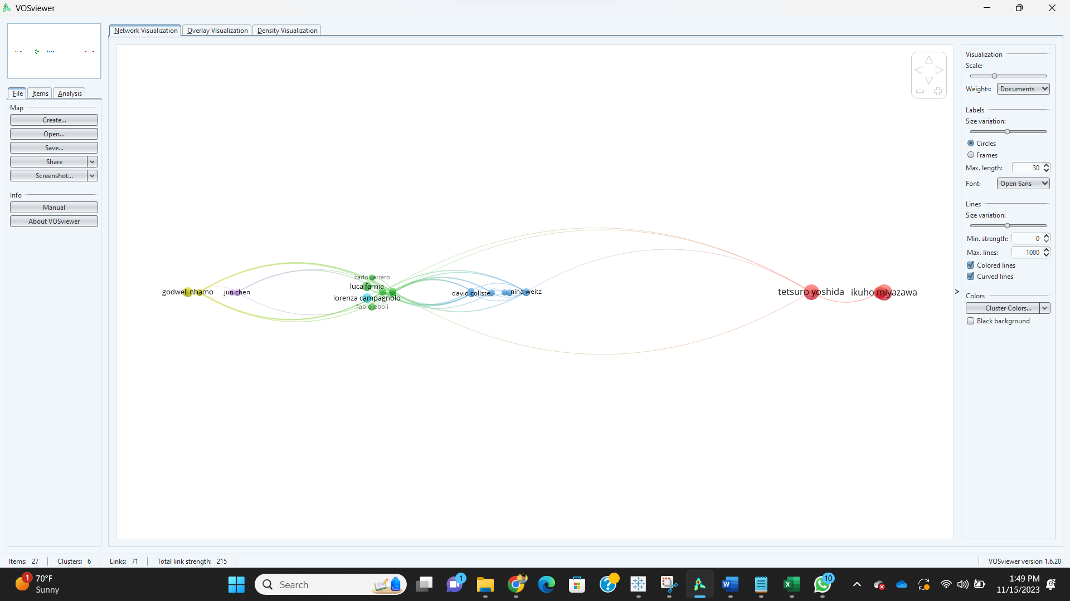

Slide 13
What is co-citation analysis?
Co-citation analysis is a technique for identifying relationships between scholarly works.
It is based on the idea that two works are more likely to be related if they are both cited by other works.
Co-citation analysis can be used to identify influential works, to map out the intellectual landscape of a field, and to track the evolution of ideas over time.

Slide 14
How to do co-citation analysis
Co-citation analysis is typically done using bibliometric software.
The software takes a list of works as input and then outputs a list of all the pairs of works that are co-cited.
The software can also output a network graph that shows the relationships between the works.

Slide 15
What can you learn from co-citation analysis?
Co-citation analysis can be used to identify influential works.
Works that are cited by many other works are more likely to be influential.
Co-citation analysis can also be used to map out the intellectual landscape of a field.
The network graph shows how the works are related to each other.
Co-citation analysis can also be used to track the evolution of ideas over time.
By looking at how the network graph changes over time, you can see how the ideas in a field have evolved.

Slide 16
