Slide 2
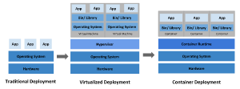
KUBERNETES
Kubernetes is a portable, extensible, open source platform for managing containerized workloads and services, that facilitates both declarative configuration and automation. It has a large, rapidly growing ecosystem. Kubernetes services, support, and tools are widely available.
The name Kubernetes originates from Greek, meaning helmsman or pilot. K8s as an abbreviation results from counting the eight letters between the "K" and the "s". Google open-sourced the Kubernetes project in 2014. Kubernetes combines over 15 years of Google's experience running production workloads at scale with best-of-breed ideas and practices from the community.

Slide 3
used resource allocation issues. For example, if multiple applications run on a physical server, there can be instances where one application would take up most of the resources, and as a result, the other applications would underperform. A solution for this would be to run each application on a different physical server. But this did not scale as resources were underutilized, and it was expensive for organizations to maintain many physical servers.
Virtualized deployment era:
As a solution, virtualization was introduced. It allows you to run multiple Virtual Machines (VMs) on a single physical server's CPU. Virtualization allows applications to be isolated between VMs and provides a level of security as the information of one application cannot be freely accessed by another application.
Virtualization allows better utilization of resources in a physical server and allows better scalability because an application can be added or updated easily, reduces hardware costs, and much more. With virtualization you can present a set of physical resources as a cluster of disposable virtual machines.
Each VM is a full machine running all the components, including its own operating system, on top of the virtualized hardware.
Container deployment era:
Containers are similar to VMs, but they have relaxed isolation properties to share the Operating System (OS) among the applications. Therefore, containers are considered lightweight. Similar to a VM, a container has its own filesystem, share of CPU, memory, process space, and more. As they are decoupled from the underlying infrastructure, they are portable across clouds and OS distributions.
Containers have become popular because they provide extra benefits, such as:
Agile application creation and deployment: increased ease and efficiency of container image creation compared to VM image use.
Continuous development, integration, and deployment: provides for reliable and frequent container image build and deployment with quick and efficient rollbacks (due to image immutability).
Dev and Ops separation of concerns: create application container images at build/release time rather than deployment time, thereby decoupling applications from infrastructure.

Slide 4
Observability: not only surfaces OS-level information and metrics, but also application health and other signals.
Environmental consistency across development, testing, and production: runs the same on a laptop as it does in the cloud.
Cloud and OS distribution portability: runs on Ubuntu, RHEL, CoreOS, on-premises, on major public clouds, and anywhere else.
Application-centric management: raises the level of abstraction from running an OS on virtual hardware to running an application on an OS using logical resources.
Loosely coupled, distributed, elastic, liberated micro-services: applications are broken into smaller, independent pieces and can be deployed and managed dynamically – not a monolithic stack running on one big single-purpose machine.
Resource isolation: predictable application performance.
Resource utilization: high efficiency and density.

Slide 5
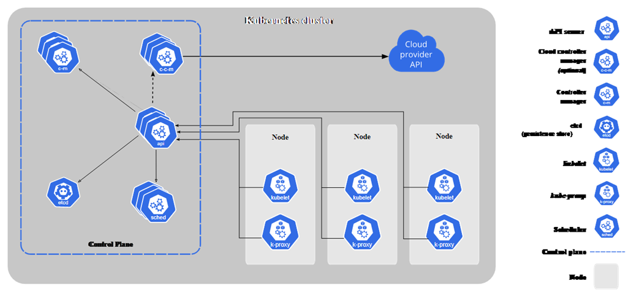
Kubernetes Components
When you deploy Kubernetes, you get a cluster.
A Kubernetes cluster consists of a set of worker machines, called nodes, that run containerized applications. Every cluster has at least one worker node.
The worker node(s) host the Pods that are the components of the application workload. The control plane manages the worker nodes and the Pods in the cluster. In production environments, the control plane usually runs across multiple computers and a cluster usually runs multiple nodes, providing fault-tolerance and high availability.
This document outlines the various components you need to have for a complete and working Kubernetes cluster.

Slide 6
Control Plane Components
The control plane's components make global decisions about the cluster (for example, scheduling), as well as detecting and responding to cluster events (for example, starting up a new pod when a deployment's replicas field is unsatisfied).
Control plane components can be run on any machine in the cluster. However, for simplicity, set up scripts typically start all control plane components on the same machine, and do not run user containers on this machine. See Creating Highly Available clusters with kubeadm for an example control plane setup that runs across multiple machines.
kube-apiserver
The API server is a component of the Kubernetes control plane that exposes the Kubernetes API. The API server is the front end for the Kubernetes control plane.
The main implementation of a Kubernetes API server is kube-apiserver. kube-apiserver is designed to scale horizontally—that is, it scales by deploying more instances. You can run several instances of kube-apiserver and balance traffic between those instances.
etcd
Consistent and highly-available key value store used as Kubernetes' backing store for all cluster data.
If your Kubernetes cluster uses etcd as its backing store, make sure you have a back up plan for those data.
You can find in-depth information about etcd in the official documentation.
kube-scheduler
Control plane component that watches for newly created Pods with no assigned node, and selects a node for them to run on.
Factors taken into account for scheduling decisions include: individual and collective resource requirements, hardware/software/policy constraints, affinity and anti-affinity specifications, data locality, inter-workload interference, and deadlines.
kube-controller-manager
Control plane component that runs controller processes.
Logically, each controller is a separate process, but to reduce complexity, they are all compiled into a single binary and run in a single process.
Some types of these controllers are:
Node controller: Responsible for noticing and responding when nodes go down.
Job controller: Watches for Job objects that represent one-off tasks, then creates Pods to run those tasks to completion.
EndpointSlice controller: Populates EndpointSlice objects (to provide a link between Services and Pods).
ServiceAccount controller: Create default ServiceAccounts for new namespaces.
cloud-controller-manager
A Kubernetes control plane component that embeds cloud-specific control logic. The cloud controller manager lets you link your cluster into your cloud provider's API, and separates out the components that interact with that cloud platform from components that only interact with your cluster.
The cloud-controller-manager only runs controllers that are specific to your cloud provider. If you are running Kubernetes on your own premises, or in a learning environment inside your own PC, the cluster does not have a cloud controller manager.

Slide 7
As with the kube-controller-manager, the cloud-controller-manager combines several logically independent control loops into a single binary that you run as a single process. You can scale horizontally (run more than one copy) to improve performance or to help tolerate failures.
The following controllers can have cloud provider dependencies:
Node controller: For checking the cloud provider to determine if a node has been deleted in the cloud after it stops responding
Route controller: For setting up routes in the underlying cloud infrastructure
Service controller: For creating, updating and deleting cloud provider load balancers
Node Components
Node components run on every node, maintaining running pods and providing the Kubernetes runtime environment.
kubelet
An agent that runs on each node in the cluster. It makes sure that containers are running in a Pod.
The kubelet takes a set of PodSpecs that are provided through various mechanisms and ensures that the containers described in those PodSpecs are running and healthy. The kubelet doesn't manage containers which were not created by Kubernetes.

Slide 8
kube-proxy
kube-proxy is a network proxy that runs on each node in your cluster, implementing part of the Kubernetes Service concept.
kube-proxy maintains network rules on nodes. These network rules allow network communication to your Pods from network sessions inside or outside of your cluster.
kube-proxy uses the operating system packet filtering layer if there is one and it's available. Otherwise, kube-proxy forwards the traffic itself.
Container runtime
The container runtime is the software that is responsible for running containers.
Kubernetes supports container runtimes such as containerd, CRI-O, and any other implementation of the Kubernetes CRI (Container Runtime Interface).

Slide 9
Addons
Addons use Kubernetes resources (DaemonSet, Deployment, etc) to implement cluster features. Because these are providing cluster-level features, namespaced resources for addons belong within the kube-system namespace.
Selected addons are described below; for an extended list of available addons, please see Addons.
DNS
While the other addons are not strictly required, all Kubernetes clusters should have cluster DNS, as many examples rely on it.
Cluster DNS is a DNS server, in addition to the other DNS server(s) in your environment, which serves DNS records for Kubernetes services.
Containers started by Kubernetes automatically include this DNS server in their DNS searches.
Web UI (Dashboard)
Dashboard is a general purpose, web-based UI for Kubernetes clusters. It allows users to manage and troubleshoot applications running in the cluster, as well as the cluster itself.
Container Resource Monitoring
Container Resource Monitoring records generic time-series metrics about containers in a central database, and provides a UI for browsing that data.
Cluster-level Logging
A cluster-level logging mechanism is responsible for saving container logs to a central log store with search/browsing interface.

Slide 10
The Kubernetes API
:
The core of Kubernetes' control plane is the API server. The API server exposes an HTTP API that lets end users, different parts of your cluster, and external components communicate with one another.
The Kubernetes API lets you query and manipulate the state of API objects in Kubernetes (for example: Pods, Namespaces, ConfigMaps, and Events).
Most operations can be performed through the kubectl command-line interface or other command-line tools, such as kubeadm, which in turn use the API. However, you can also access the API directly using REST calls.
Consider using one of the client libraries if you are writing an application using the Kubernetes API.
OpenAPI specification
Complete API details are documented using OpenAPI.
OpenAPI V2
The Kubernetes API server serves an aggregated OpenAPI v2 spec via the /openapi/v2 endpoint. You can request the response format using request headers as follows

Slide 11
Header | Possible values | Notes
Accept-Encoding | gzip | not supplying this header is also acceptable
Accept | application/com.github.proto-openapi.spec.v2@v1.0+protobuf | mainly for intra-cluster use
 | application/json | default
 | * | serves application/json
Kubernetes implements an alternative Protobuf based serialization format that is primarily intended for intra-cluster communication. For more information about this format, see the Kubernetes Protobuf serialization design proposal and the Interface Definition Language (IDL) files for each schema located in the Go packages that define the API objects.
OpenAPI V3
FEATURE STATE: Kubernetes v1.24 [beta]
Kubernetes v1.26 offers beta support for publishing its APIs as OpenAPI v3; this is a beta feature that is enabled by default. You can disable the beta feature by turning off the feature gate named OpenAPIV3 for the kube-apiserver component.
A discovery endpoint /openapi/v3 is provided to see a list of all group/versions available. This endpoint only returns JSON. These group/versions are provided in the following format:

Slide 12
"paths": { ..., "api/v1": { "serverRelativeURL": "/openapi/v3/api/v1?hash=CC0E9BFD992D8C59AEC98A1E2336F899E8318D3CF4C68944C3DEC640AF5AB52D864AC50DAA8D145B3494F75FA3CFF939FCBDDA431DAD3CA79738B297795818CF" }, "apis/admissionregistration.k8s.io/v1": { "serverRelativeURL": "/openapi/v3/apis/admissionregistration.k8s.io/v1?hash=E19CC93A116982CE5422FC42B590A8AFAD92CDE9AE4D59B5CAAD568F083AD07946E6CB5817531680BCE6E215C16973CD39003B0425F3477CFD854E89A9DB6597" }, .... }}
The relative URLs are pointing to immutable OpenAPI descriptions, in order to improve client-side caching. The proper HTTP caching headers are also set by the API server for that purpose (Expires to 1 year in the future, and Cache-Control to immutable). When an obsolete URL is used, the API server returns a redirect to the newest URL.
The Kubernetes API server publishes an OpenAPI v3 spec per Kubernetes group version at the /openapi/v3/apis/<group>/<version>?hash=<hash> endpoint.
Refer to the table below for accepted request headers.

Slide 13
Header | Possible values | Notes
Accept-Encoding | gzip | not supplying this header is also acceptable
Accept | application/com.github.proto-openapi.spec.v3@v1.0+protobuf | mainly for intra-cluster use
 | application/json | default
 | * | serves application/json
Persistence
Kubernetes stores the serialized state of objects by writing them into etcd.
API groups and versioning
To make it easier to eliminate fields or restructure resource representations, Kubernetes supports multiple API versions, each at a different API path, such as /api/v1 or /apis/rbac.authorization.k8s.io/v1alpha1.

Slide 14
Versioning is done at the API level rather than at the resource or field level to ensure that the API presents a clear, consistent view of system resources and behavior, and to enable controlling access to end-of-life and/or experimental APIs.
To make it easier to evolve and to extend its API, Kubernetes implements API groups that can be enabled or disabled.
API resources are distinguished by their API group, resource type, namespace (for namespaced resources), and name. The API server handles the conversion between API versions transparently: all the different versions are actually representations of the same persisted data. The API server may serve the same underlying data through multiple API versions.
For example, suppose there are two API versions, v1 and v1beta1, for the same resource. If you originally created an object using the v1beta1 version of its API, you can later read, update, or delete that object using either the v1beta1 or the v1 API version, until the v1beta1 version is deprecated and removed. At that point you can continue accessing and modifying the object using the v1 API.

Slide 15
API changes
Any system that is successful needs to grow and change as new use cases emerge or existing ones change. Therefore, Kubernetes has designed the Kubernetes API to continuously change and grow. The Kubernetes project aims to not break compatibility with existing clients, and to maintain that compatibility for a length of time so that other projects have an opportunity to adapt.
In general, new API resources and new resource fields can be added often and frequently. Elimination of resources or fields requires following the API deprecation policy.
Kubernetes makes a strong commitment to maintain compatibility for official Kubernetes APIs once they reach general availability (GA), typically at API version v1. Additionally, Kubernetes maintains compatibility with data persisted via beta API versions of official Kubernetes APIs, and ensures that data can be converted and accessed via GA API versions when the feature goes stable.

Slide 16
If you adopt a beta API version, you will need to transition to a subsequent beta or stable API version once the API graduates. The best time to do this is while the beta API is in its deprecation period, since objects are simultaneously accessible via both API versions. Once the beta API completes its deprecation period and is no longer served, the replacement API version must be used.
API Extension
The Kubernetes API can be extended in one of two ways:
Custom resources let you declaratively define how the API server should provide your chosen resource API.
You can also extend the Kubernetes API by implementing an aggregation layer.

